Slide 1
Agenda
6.00 – 6.30pm – Networking & Drinks
6.30– 6.50pm – BAM intro &
Presentation – Sarah Harding
Networking activities
6.50 – 7.10 pm – Edward Zia’s 7 Key High Growth Marketing Strategies to Boost sales’
7.10-7.30 – Q & A/ Lucky Door/Feedback
7.30 – 8pm onwards – Further Networking

Slide 2
Business Abundance Masters
2018 Event Series

Slide 3
Business Abundance Masters
Series of Monthly Events Run
Educate, Inspire & Support growth both personally and professionally for Business Owners and those who want to get ahead within their careers
Connect with us on
Meetup & Eventbrite, Facebook
Developed and Presented by:
Sarah Harding – BAM - Business & Finance Mentor

Slide 4
Lucky Door Prizes
Complete our survey to go in the
Draw to win :
Book – Business Building
Bottle of Wine

Slide 5
Thank you to We Work
We Work has sponsored tonight's event and has allowed the venue

Slide 6
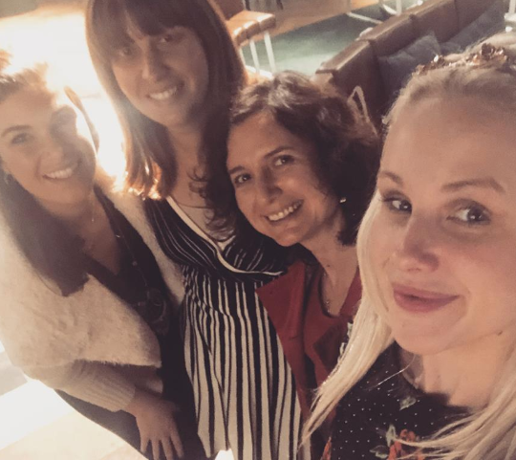
What to expect from tonight …
4 Key Financial areas to control for Business Success
Tonight’s topic … “Edward Zia’s 7 Key High Growth Marketing Strategies to Boost your Sales"
3. BAM membership & Upcoming and future events …

Slide 7
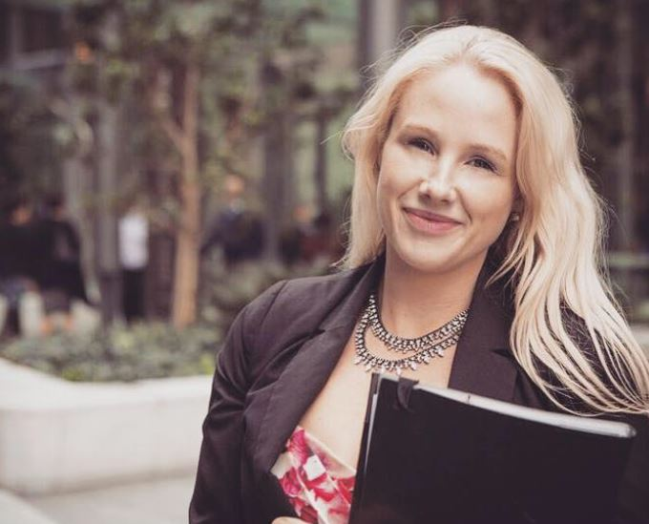
Thank you from Sarah Harding
BAM Business & Finance Mentor
I’ve helped lots of people create and protect wealth within their lives
and I’ve loved it – particularly enjoy working with business owners, families and
motivated individuals who really want to expand their wealth and knowledge and want to work with an expert
My qualifications –
Diploma of FP/ Bachelor of Business (Finance)/Masters of Applied Finance (Financial Planning)/SMSF Accredited/Margin Lending Accredited - Completing the Entourage Business Development program at the moment
When I’m not working I am also involved in volunteering for the wider
Community within politics and giving back.
I love to network & complete professional development
Add me on Facebook/LinkedIn In – Would love to connect (Sarah Virginia Harding)

Slide 8
We help clients to grow & protect their wealth in a tax effective manner giving them more time to do the things they love
Particularly enjoy working with :
Entrepreneurs & Business Owners
Executives
Family Businesses
This presentation contains information that is general in nature.
It does not take into account the objectives, financial situation or needs of any particular person.
You need to consider your financial situation and needs before making any decisions based on this information. If you decide to purchase or vary a financial product, your financial adviser, AMP Financial Planning Pty Limited and other companies within the AMP Group may receive fees and other benefits.
The fees will be a dollar amount and/or a percentage of either the premium you pay or the value of your investment. Please contact us if you want more information.

Slide 9
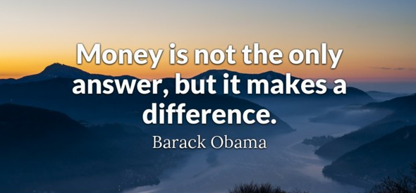
Cash Flow
Wealth Accumulation
Protecting your family
Funding your retirement
Our Value –
“We help you implement & stay on track to help build passive income & ensure you don’t loose everything”

Slide 10
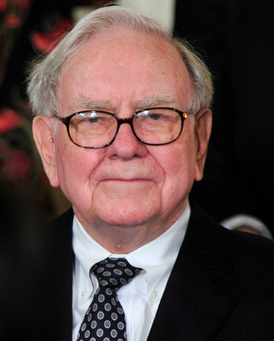
What do these business leaders have in common?
Richard Branson
Mark Zuckerberg
Warren Buffett
Key Themes
Clear “Why”
Giving back
Investing outside of their businesses

Slide 11
1. What is your Business Vision … What is your WHY?
Can you clearly articulate what your purpose is and what your really
wanting to achieve by being in Business?

Slide 12
2. What is the difference between Active Versus Passive Income?
Time & Effort Required …
Active – Income from Business - Generating new sales, subscriptions, speaking opportunities, Contracts, 1 on 1 consultations
Passive – Income from Property, shares, Managed Funds, Bonds, Cash, Other Business Investment ect
Different goals require different strategies….

Slide 13
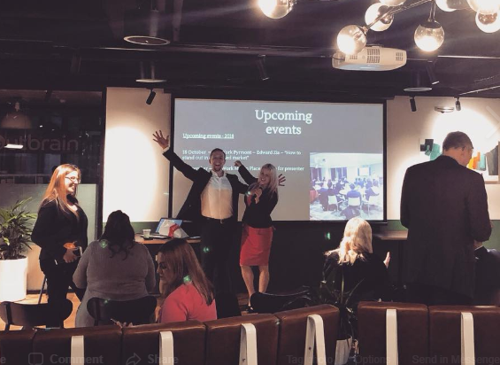
Networking Activity – 2 activities you can do for active income and 2 activities for passive

Slide 14
3. Understanding different structures available
Personal
Company
Trust
Superannuation/SMSF
“best place to buy and invest to minimise tax and hold onto more profit”
Key considerations
Tax
Asset Protection

Slide 15
4. Active Versus Passive Investing
In general,
Active management aims to outperform the market compared to a specific benchmark, while Passive management mirrors the investment holdings of an index and its performance

Slide 16
Some of the key benefits of passive investing are:
Ultra-low fees – There's nobody picking stocks, so oversight is much less expensive. Passive funds simply follow the index they use as their benchmark.
Transparency – It's always clear which assets are in an index fund.
Tax efficiency – Their buy-and-hold strategy doesn't typically result in a massive capital gains tax for the year.
Some of the key benefits of active investing are:
Flexibility – Active managers aren't required to follow a specific index. They can buy those "diamond in the rough" stocks they believe they've found
Hedging – Active managers can also hedge their bets using various techniques such as short sales or put options, and they're able to exit specific stocks or sectors when the risks become too big.
Passive managers are stuck with the stocks the index they track holds, regardless of how they are doing.
Tax management – Even though this strategy could trigger a capital gains tax, advisers can tailor tax management strategies to individual investors, such as by selling investments that are losing money to offset the taxes on the big winners.

Slide 17
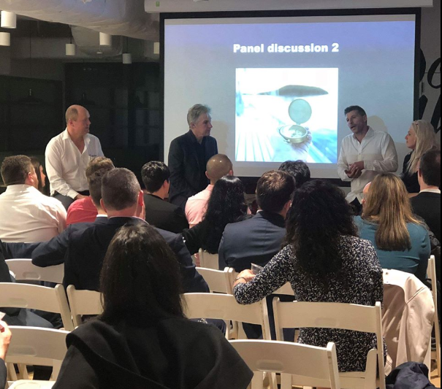
What are 2 books/resources/podcasts you consume to learn about business/wealth creation???

Slide 18
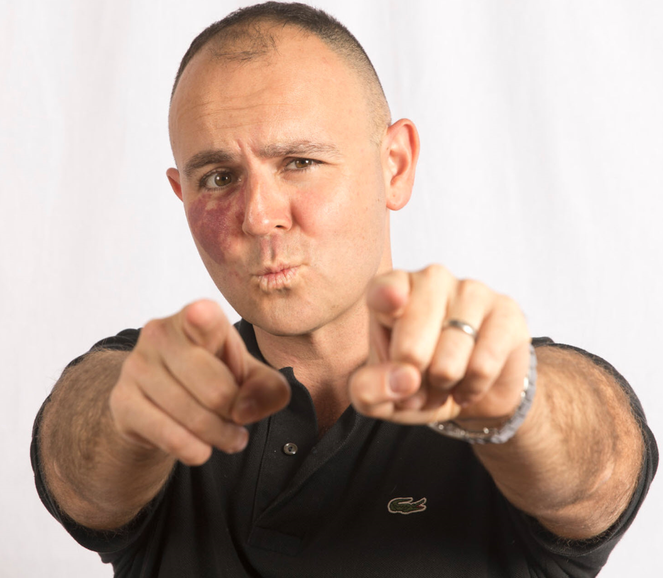
Gust Presenter … “Edward Zias 7 Key High Growth Marketing Strategies"
Marketing Mentor, Coach & Speaker.
He’s helped lots of people make lots of money and here to help you WIN BIG.
Ex-Military Fed, Post Graduate in Marketing, Host at NSW Business Chamber, Meetup City Organiser, Love Christian Outreach, Liberal Party Member, Founder of EA.

Slide 19
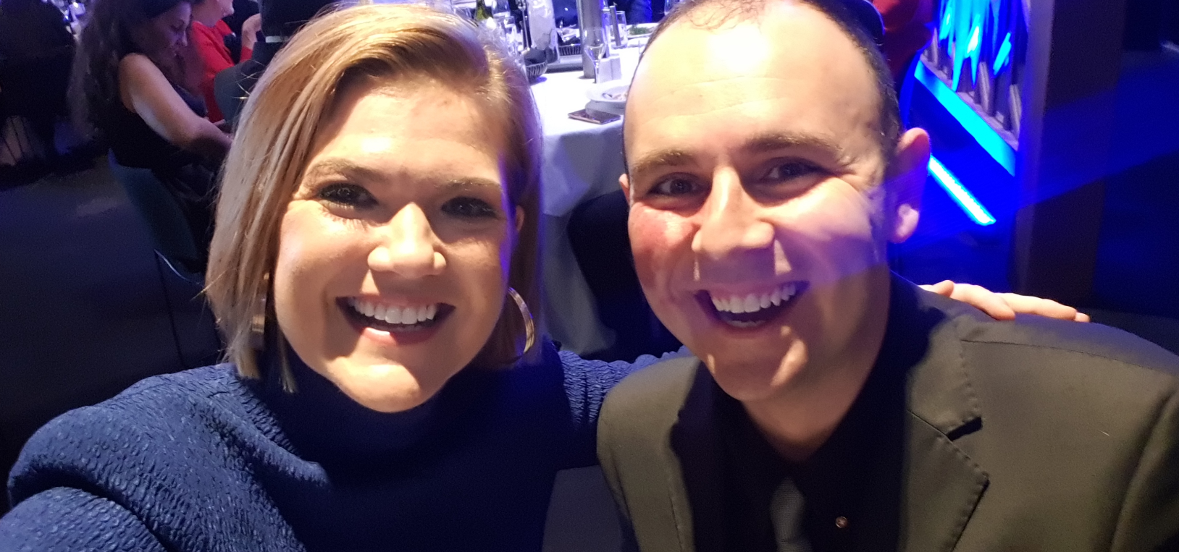
PROFITABLE Situation #1
You’re ready to hit it hard with your best knowledge of what works.
Taking your first step and your next step is everything. The best place to start is with your Business Chamber. Perfect for entrepreneurs!
What are you going to do ASAP to win big?

Slide 20
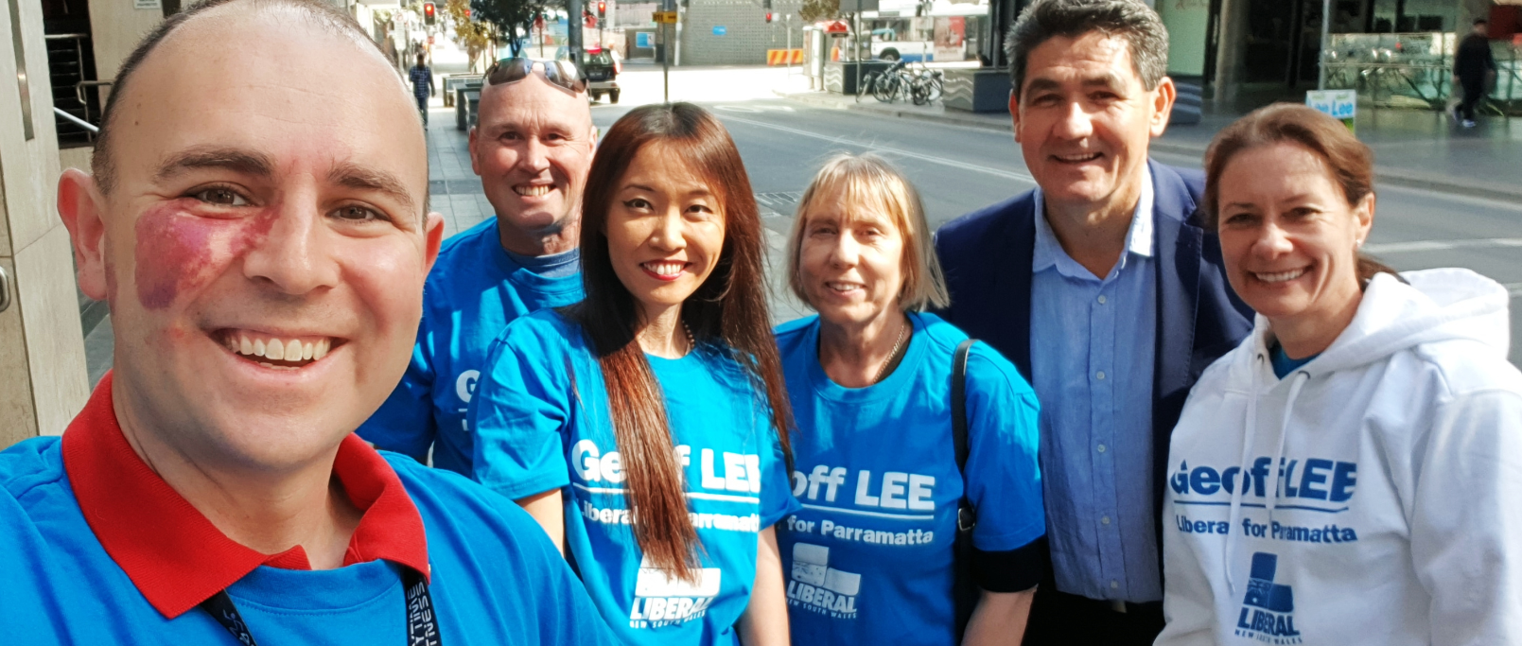
PROFITABLE Situation #2
Your Niche and who you are after with what is critical.
You must refine and build your tight message and gets lots of exposure to them. All the time every day.
What are you going to do ASAP to win big?

Slide 21
PROFITABLE Situation #3
You must ATTRACT the right people to you (Marketing).
“Thought Leadership” is a powerhouse strategy that even Bunnings Warehouse are right into. The value you gives, ‘allows you to sell’. LinkedIn, FB, Instagram, Your Website, Groups, Email Blasts and More.
What are you going to do ASAP to win big?

Slide 22
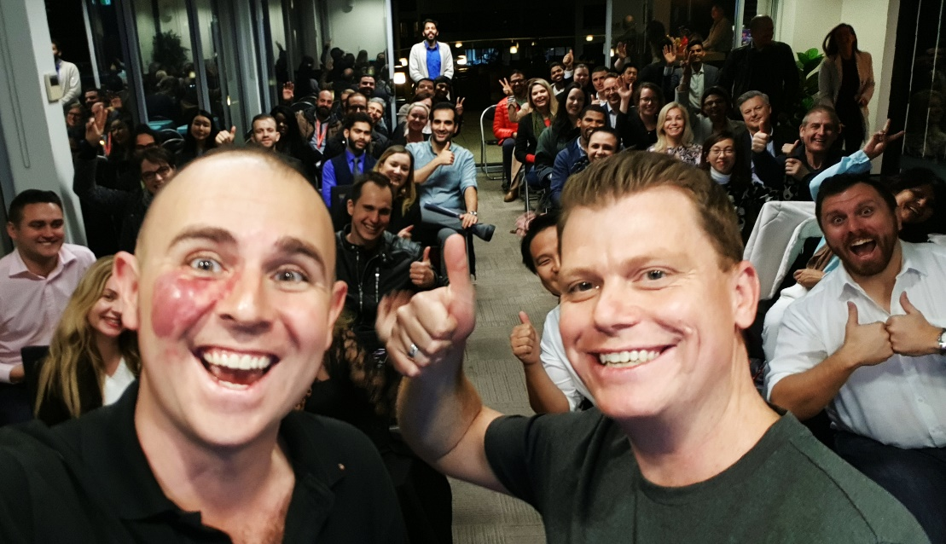
PROFITABLE Situation #4
You must GO TO the right people (Sales).
The ones who embrace this, get over their own fears and do it, go great! Direct approaches, LinkedIn Messaging, Business Networking, asking for Coffee Meetings, Literal Elevator Chats and more!
What are you going to do ASAP to win big?

Slide 23
PROFITABLE Situation #5
You must keep improving everything to make it convert better, sell more and become more influential.
Improving your website to drive conversion, improving social media content, practising your pitch and becoming a natural and more; you can never stay still.
What are you going to do ASAP to win big?

Slide 24
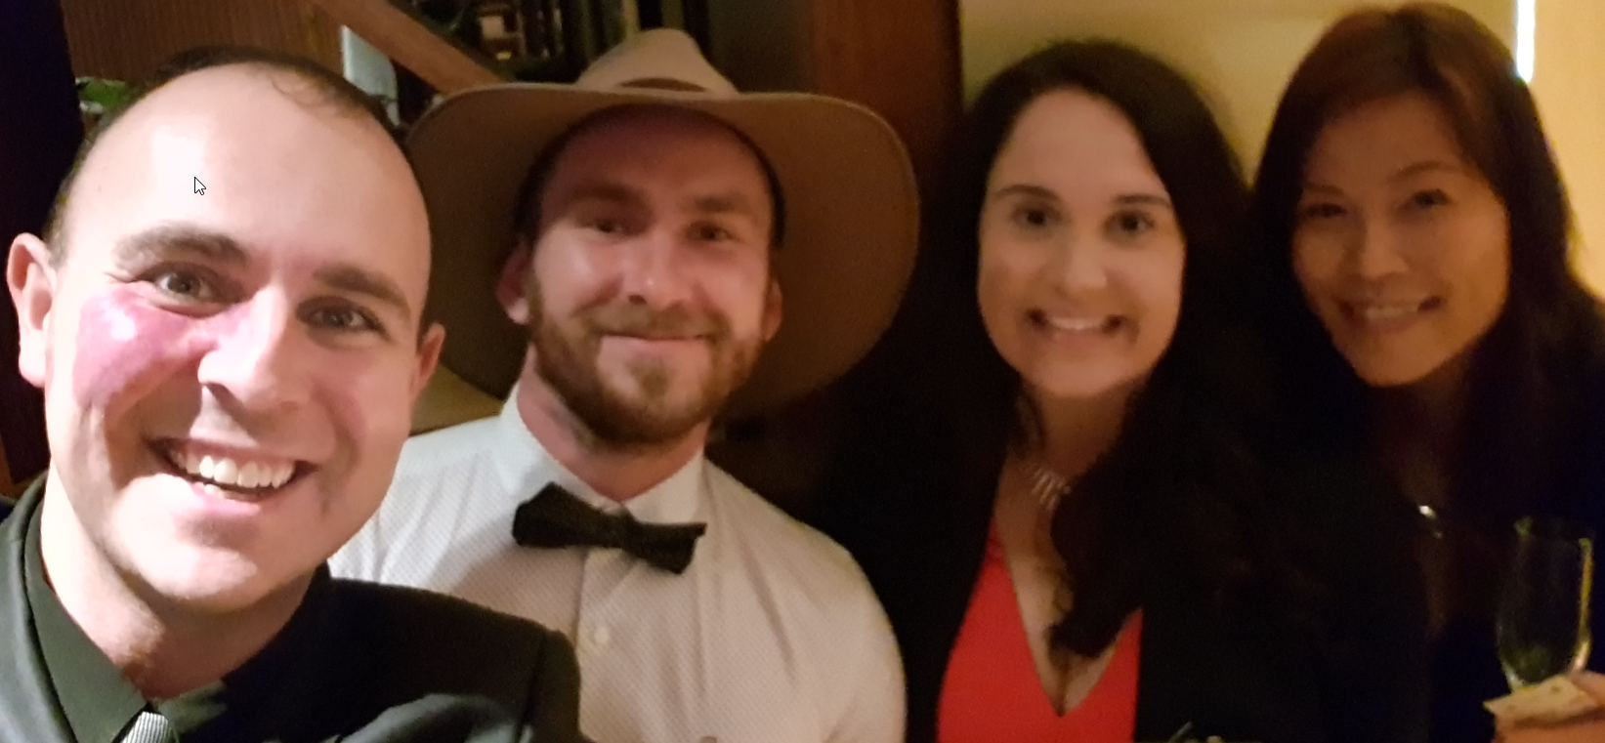
PROFITABLE Situation #6
Publicity and Leveraged Exposure for you and your company is critical.
You must get speaking opportunities, create them, get up before groups, gain media attention and have people see you as the ‘Thought Leader / Commander’ in what you do.
What are you going to do ASAP to win big?

Slide 25
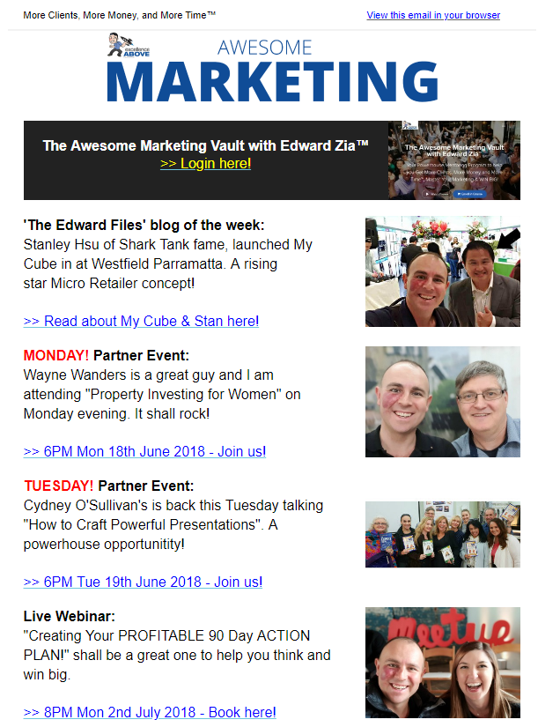
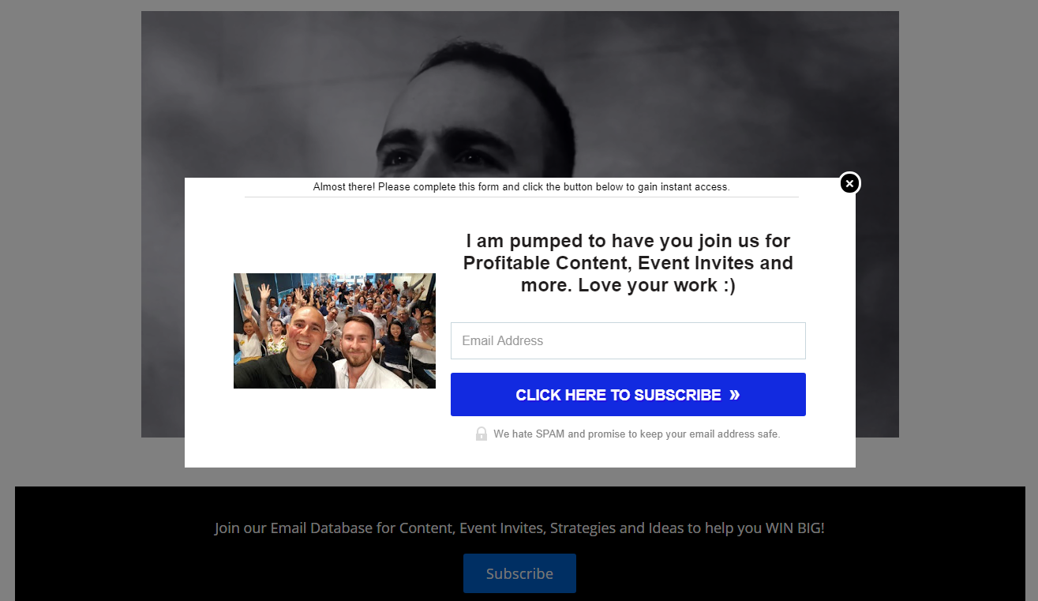
PROFITABLE Situation #7
You need Automated & Leveraged Strategies that promote your cause whilst you rest and smile.
Opt-in forms, Email Marketing, Recording Webinars, Live Events, Facebook Advertising, Working your LinkedIn + more!
What are you going to do ASAP to win big?

Slide 26
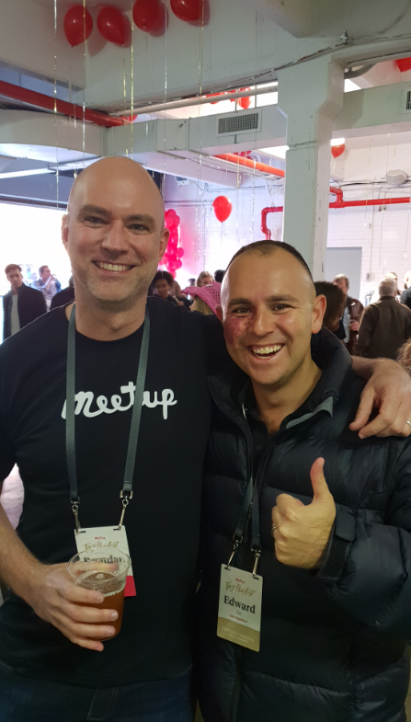
BONUS INVITE: Discovery Session
If you have loved this session and want to WIN BIG in your business, it’s time for us to have a REAL CONVERSATION.
One Time Only:
45 Minutes, Valued at $500 + GST and perfect for ambitious wonderful people.

Slide 27
Feedback and Lucky Door Prizes
Feel free to connect with us online we are here to help –
0408 759 682
Sarah Virginia Harding
Sarah@wyadvice.com

Slide 28
Special Invite 1
BAM your Business Vault
The BAM your Business Vault Program to help you BAM your business, get more clients & time and Masters your money & take your business to the next level
Personal Mentoring by me, access to the online vault with all up to date content to help accelerate and grow your business, access to speaking opportunities at future BAM events
Access to the closed Facebook group where all events & activities are going to be shared with BAM members and invitation to all future events – also events will be live streamed if you are unable to make them
$97 per month – register at https://business-abundance-masters.teachable.com/p/bam-your-business-vault

Slide 29
Special Invite 2
Personal Discovery Session Its easy to start this journey!
To help get you going 1-1 hour discovery session to talk through where you may be stuck financially to give you clarity and direction around how to map out your next steps…
Leave your details on the feedback form at the end and we will contact you to book

Slide 30
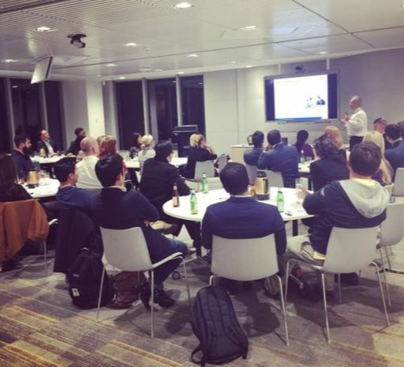
Upcoming events
Upcoming events - 2018
LAST EVENT FOR 2018
5 December – We Work Martin Place – TBA

