Slide 1
Virtual Extensible LAN

Slide 2
VXLAN
Spine and Leaf Topology
In the field of telecommunications, a Clos network is a kind of multistage circuit-switching network which represents a theoretical idealization of practical, multistage switching systems. It was invented by Edson Erwin in 1938 and first formalized by Charles Clos in 1952.

Slide 3
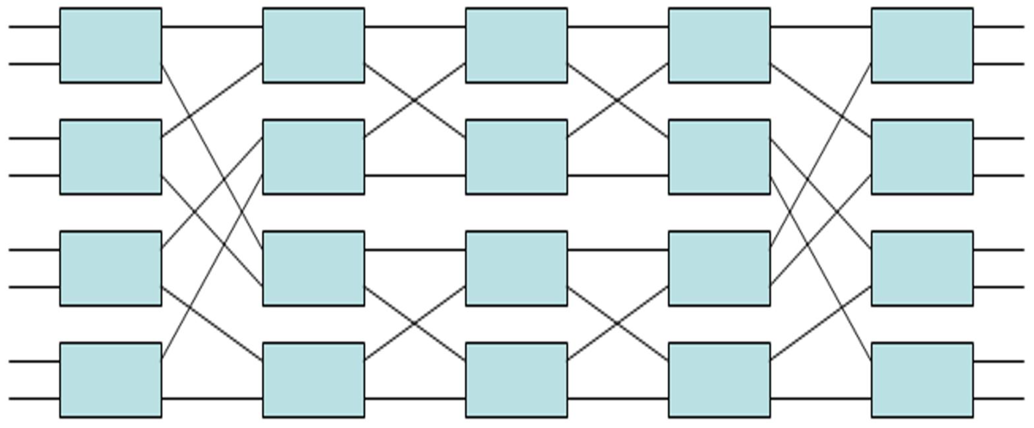
Spine and Leaf Back in the 1950's

Slide 4
VXLAN
VXLAN is an overlay data plane encapsulation scheme that was developed to address the various issues seen in traditional Layer 2 networks. (North to South Traffic)
Increases Mobility and reduces broadcast and L2 Failure Domains
Extends Layer 2 and 3 overlay networks seen in traditional network, using MAC-in-IP/UDP tunneling. (East to West Traffic)
Each overlay is termed a VXLAN associated with a VNI
IANA assigned to VXLAN the UDP destination port 4789

Slide 5
VXLAN
Unlike the VLAN ID, has only 12 bits which allows for 4000 VLANs
VXLAN hasa 24-bit VXLAN network identifier (VNI), allows 16 million VLANs.
VNI is located in the VXLAN shim header that encapsulates the original inner MAC frame originated by an endpoint.
To ensure discovery of VNIs over the underlay layer3 network, virtual tunnel endpoints (VTEP) are used.
VTEP entities, originate or terminate VXLAN tunnels
They map L2 and L3 packets to the VNI to be used in the overlay network.

Slide 6
VXLAN
VTEP has two interfaces:
Local LAN interfaces: Provide bridging between local hosts
IP interface: Core facing network interface for VXLAN.
IP address helps identify the VTEP in the network
Also used for VXLAN traffic encapsulation and de-encapsulation
VXLAN standards defines VXLAN as a data-plane protocol, but it does not define a VXLAN control plane.
Four VXLAN control and data plane are supported by Cisco Devices
Multicast underlay
Static unicast VXLAN tunnels
MP-BGP EVPN control plane
LISP control plane

Slide 7
VXLAN
Cisco SDA is an example of an implementation of VXLAN with the LISP control plane.
You will have 50 bytes off over head, increase MTU to Jumbo Frames

Slide 8
VXLAN
VXLAN Header
Reserved 8-bit: 0 ignored by the receiving VTEP
VNI 24-bits: What allows VXLAN to create 16 million VLANs
Reserved 24-bit: 0 ignored by the receiving VTEP
Flag 8-bits: Only the first 3 Bits are used, shows VNI is valid
VXLAN Basic Configuration
(CONFIG)#INT VXLAN 1
(CONFIG-IF-VX1}#VXLAN SOURCE-INTER LO1
(CONFIG-IF-VX1)#VXLAN VLAN 10 VNI 10
(CONFIG-IF-VX1)#VXLAN VLAN 11 VNI 11
CONFIG-IF-VX1)#VXLAN FLOOD VTEP 20.20.20.20 21.21.21.21 (VTEP)DESTINATION
ABOVE CONFIGURATION IS TO TALK TO SAME VLANS LOCATED ON OTHER SITES
NO GATEWAY NEEDED

