Slide 1
What Lenders Look at to Approve you for Financing

Slide 2
Business Financing
It can be a challenge …
… particularly for startup companies
Lenders tend to be cautious
They want to be sure you’ll pay them back

Slide 3
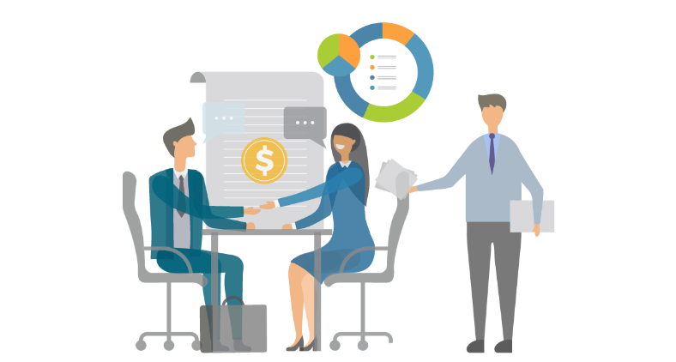
Business Lending
There are several options
These include:
Traditional lenders (usually banks)
Online lenders
Microlenders
The SBA

Slide 4
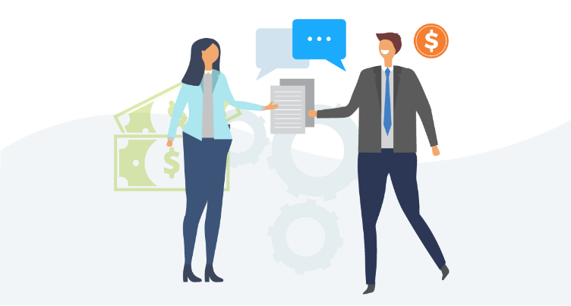
What do Loan Applicants Need to Supply?
Lenders generally want to see that you have:
Enough assets
Sufficient financial reserves and
Enough personal collateral …
… to ride out business fluctuations

Slide 5
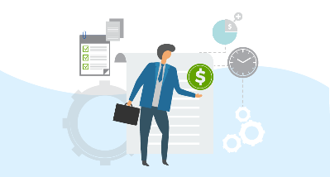
How do Loan Applicants Demonstrate These Things?
Borrowers need to show a solid cash flow, sufficient to repay the loan
They need to show a track record of profitability and
They have to demonstrate success in a similar business endeavor
Essentially, they have to prove their creditworthiness
This isn’t easy when you’re just starting out

Slide 6
How do Borrowers Prove their Creditworthiness?
For startup entrepreneurs in particular …
… they will need to demonstrate …
… by using other means …
… that they are creditworthy business owners

Slide 7
How do Borrowers Prove their Creditworthiness?
One way is to prove they owned or managed a profitable business in a different industry
This means bringing in a resume and maybe financials from an earlier venture
They may be able to show this if they can supplement their own experience with that of someone who also has success in the field
This means bringing in a partner or maybe an angel investor as a mentor

Slide 8
Preparing to Meet with a Lender
The borrower should have the following items:
A sound business plan
Any financial information they can provide on their business
Information on their personal credit
Often, also, some means of securing the loan

Slide 9
What goes into a Sound Traditional Business Plan?
Industries vary, but traditional business plans all have similar components
These are:
An executive summary
Description of the company
Market analysis

Slide 10
What goes into a Sound Traditional Business Plan?
Business plans also include:
Data on the company’s organization and management
A description of the service or product line
Marketing and sales data (startups won’t have much in the way of sales data, but they should have a handle on how they’re going to market their wares

Slide 11
What goes into a Sound Traditional Business Plan?
Business plans also include:
The company’s actual funding request
Financial projections
An appendix which includes all supporting documentation

Slide 12
Startup Business Plans
These are usually shorter than traditional plans
They include information on key partnerships, activities, and resources
The value proposition
Customer relationships and segments

Slide 13
Startup Business Plans
They also include:
Communications channels
Cost structure and
Revenue streams

Slide 14
Parts of a Traditional Business Plan
Executive summary – a brief overview of your company, product, executive team, and future plans for growth
Company description – get into detail about your company’s niche and the problems it solves
Market analysis – how can you do better than your competition?

Slide 15
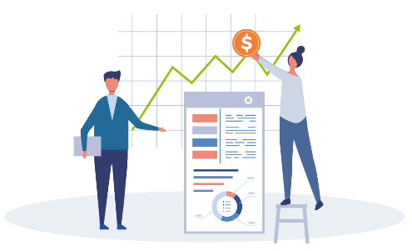
Parts of a Traditional Business Plan
Company organization and management – what’s your business entity and who does what?
Service or Product Line – not only what you sell, but also future plans or even patents
Marketing and sales data – what are your strategies to attract and retain customers?

Slide 16
Parts of a Traditional Business Plan
The company’s actual funding request – itemize and clearly show how you are looking to spend the funds
Financial projections – include income statements and the like if the company is already established. If not, this is a place to list potential collateral
An appendix – here’s where to add licenses, permits, and patents and the like

Slide 17
Parts of a Startup Business Plan
Key partnerships – which suppliers and manufacturers will you work with?
Key activities – how will your company gain a competitive advantage?
Key resources – which resources will you leverage to give your customers value? These can include:
Personnel
Intellectual property
Capital

Slide 18
Parts of a Startup Business Plan
Value proposition – which unique value will your product or service bring to the market?
Customer relationships – what will the customer experience be like? In person? Online? Something else?
Customer segments – who will your business serve? Do you have a good handle on what your ideal customer (AKA buyer persona) is really like?

Slide 19
Parts of a Startup Business Plan
Communications channels – how will you speak with your customers? How will you optimize communications in the future?
Cost structure – will you be trying to maximize value or reduce cost? Regardless of strategy, how much is that going to cost?
Revenue streams – how will your venture actually make money? Direct sales? Memberships or subscriptions? Selling ad space? Something else?

Slide 20
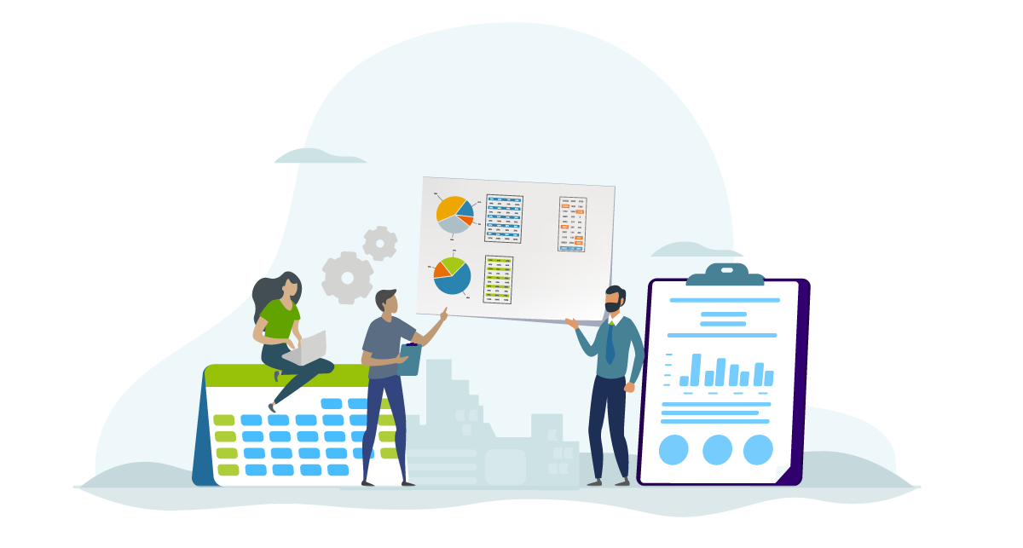
Financial Information on a Business
Apart from the business plan and its contents …
You will need a P & L
That’s a profit and loss statement

Slide 21
Profit and Loss Statement
A P&L is, according to Investopedia:
“… [A] financial statement that summarizes the revenues, costs and expenses incurred during a specific period of time, usually a fiscal quarter or year. These records provide information about a company's ability – or lack thereof – to generate profit by increasing revenue, reducing costs, or both. The P&L statement is also referred to as 'statement of profit and loss', 'income statement,' 'statement of operations,' 'statement of financial results,' and 'income and expense statement.'”
See: https://www.investopedia.com/terms/p/plstatement.asp

Slide 22
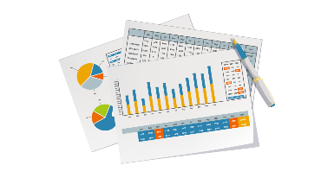
Profit and Loss Statement
The P&L (AKA the income statement), one of three quarterly and annual statements a company makes as to its financial health. The other two are:
The cash flow statement
The balance sheet
There are numerous blank P&L forms are online to help you

Slide 23
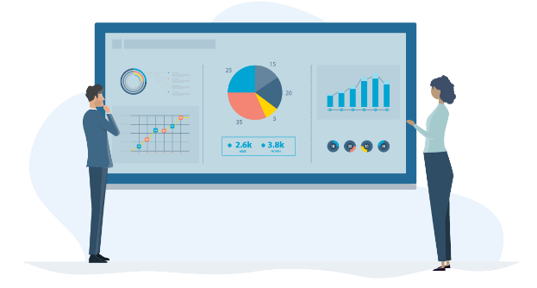
What does a P&L show?
The idea is to show changes in accounts
This is over a specific time frame
In that way, it’s similar to your cash flow statement
This is not like a balance sheet, which is more of a snapshot

Slide 24
What does a P&L show?
A P & L will give you a handle on the money your business has
You know how much capital is coming in …
… and going out
It’s good for more than just yet another piece of paper to give to a lender

Slide 25
Monthly and Annual Revenues
Online lenders in particular want this data
It shows not only what your company makes …
… but also any trends …
… or even seasonality

Slide 26
Bank Balances
Online and offline lenders want this data
It helps to show not only trends …
… but also responsible money management
It’s also another way of showing seasonality

Slide 27
The Power of Knowing Your Numbers
The power of knowing your numbers is vital to running any profitable business
You can make any necessary adjustments to show a profit
Numbers do not lie to you!
They tell everything about the health of a business

Slide 28
The Power of Knowing Your Numbers
Knowing your numbers means you have a huge advantage over business owners who do not
Your profit and loss statement tells a story of your unique business
Understanding the story behind your numbers can be an extremely important factor for achieving success

Slide 29
Personal Credit Information
Lenders will often want to see your FICO score
This is particularly the case for:
Sole proprietorships and/or
Startup companies
They want to know if you’re experienced in paying back loans …
… or if you default on your obligations

Slide 30
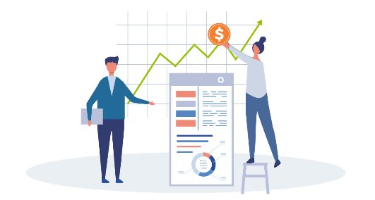
Time in Business Information
For online lenders in particular, time in business matters
Of course a startup has no time in business
But other ventures do
Because so many businesses fail in their first year …
… creditors want to know this

Slide 31
Means of Securing the Loan
Lenders are often looking for a means of securing the loan
This protects them in case you default on your obligations
Fortunately, collateral and other means of securing loans can be done creatively

Slide 32
Collateral-based loans
Use your assets as collateral
Rates are often 5% or less
Your personal credit rating will not matter

Slide 33
Some of the Types of Collateral You Can Use
Your 401(k)
Stocks
Existing inventory
Accounts receivable

Slide 34
Or Ask a Friend or Family Member with These Kinds of Assets
They may let you leverage their asset in exchange for a % of your business
They usually want less of a % of your company than a VC would
Essentially, they would be acting like an angel investor
It’s a bonus if they can mentor you in business

Slide 35
401(k) Financing
Use existing 401(k) or IRA as collateral for business financing
Pay no tax penalties
You still earn interest on your 401(k)
Low rates, often less than 5%
Close and fund in less than 3 weeks
Can usually get up to 100% of what’s “rollable” within your 401(k)

Slide 36
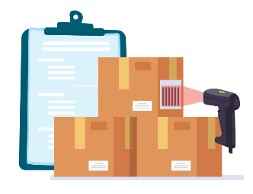
Securities-Based Financing
Use your existing stocks as leverage to get business financing
Borrow as much as 90% of the value of your stocks
You keep earning interest on the stocks pledged as collateral
Closing and funding takes less than 3 weeks

Slide 37
Securities-Based Financing
70 – 90% loan to value
Rates are like mortgage rates
5% is common…
… but you only pay interest on what you borrow
This is a working capital line of credit
Challenged personal credit

Slide 38
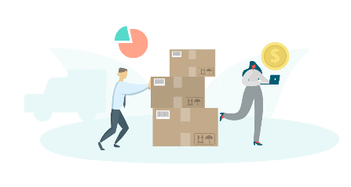
Inventory Financing
Use your existing inventory as collateral for business financing
You will need inventory valued at $500,000 or more
You can get approved for a line of credit for 50% of inventory value
Rates are usually 5 – 15% depending on type of inventory
Funding within 3 weeks or less

Slide 39
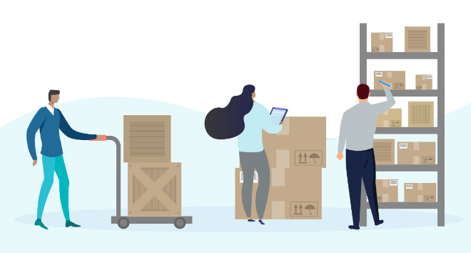
Inventory Financing
Minimum inventory loan amount: $150,000
General loan to value (cost) is 50%
So inventory value needs to be $300,000 or more
It can’t be lumped together inventory, like office equipment

Slide 40
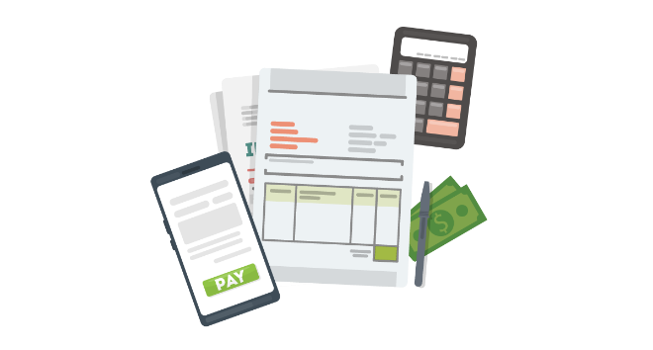
Accounts Receivable Financing
Use your outstanding account receivables for financing
Get as much as 80% of your receivables advanced ongoing in less than 24 hours
Remainder of the accounts receivable is released once the invoice is paid in full
Closing takes 2 weeks or less

Slide 41
Accounts Receivable Financing
Factor rates as low as 1.33%
It is a credit line with rates of less than 1% with no consumer credit requirement
Receivables should be with the government or another business
If you also have purchase orders, you can get financing to have those filled
You won’t need to use your cash flow to do so

Slide 42
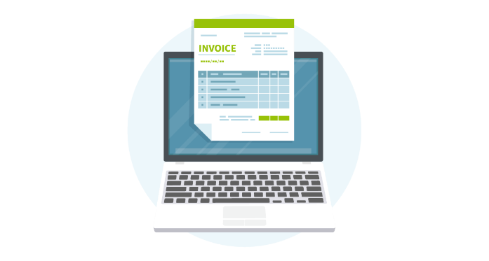
Accounts Receivable Financing
Get forwarded up to 80% of receivables
You have to be in business for one year
These must be receivables from another business
Rates of 1.25-5%

Slide 43
Other Collateral Options
Other collateral options include your company’s equipment
You can also use invoice factoring
Invoice factoring is not quite a loan
Instead, you essentially ‘sell’ your outstanding invoices to a factoring company …
… and they collect directly from your customers

Slide 44
Personal Guarantees
Another option is the personal guarantee
It’s exactly what it sounds like
Your personal assets are at stake
But sometimes, particularly for startups, you’ll have to give one

Slide 45
Microloans
Microloans are another option
You can’t get a microloan from a regular lender
Instead, you get a microloan from a microlender
Try the Association for Enterprise Opportunity to find a local microlender
http://www.microenterpriseworks.org/

Slide 46
SBA
SBA loans are another option
You usually need to show some time in business for SBA loans
The most popular SBA loan for working capital is the 7(a)
Approvals for up to $750,000
Rates are usually 2-4% above prime rate
All owners with more than 20% ownership must provide a personal guarantee
Good consumer credit is required

Slide 47
Recap for What Lenders Look at to Approve You For Financing
Lenders want to be sure a company can pay back its obligations
They want to know your business is a going concern
They want to see if it is succeeding, or if it should be
Borrowers need to prove their creditworthiness

Slide 48
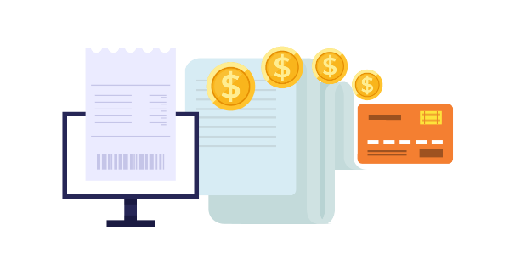
Recap for What Lenders Look at to Approve You For Financing
Documentation is crucial
Virtually every lender wants to see a business plan
Business plans can be traditional or for startups – and these have different sections
Lenders also want a P & L
They usually also want some sort of collateral or personal guarantee

