Slide 1
Computer Networks Categories
Dr. Mohammad Adly

Slide 2

Categorizing Computer Networks
Transmission Mode
Geographical Area
Administration Type

Slide 3
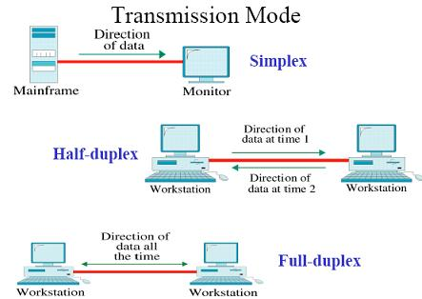
Transmission Mode
Simplex
Half-Duplex
Full-Duplex

Slide 4
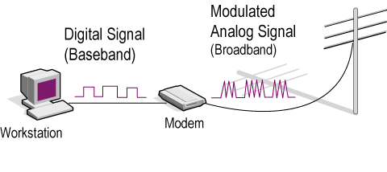
Signaling Mode
Baseband
  One signal at a time on network media
  Digital local signal
Broadband
  Divides network media into multiple channels
  Allows several signals
  Analog modulated signal

Slide 5
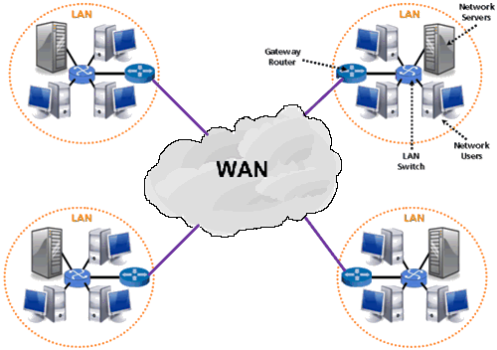
Geographical Area
Local Area Network (LAN)
Wide Area Network (WAN)

Slide 6
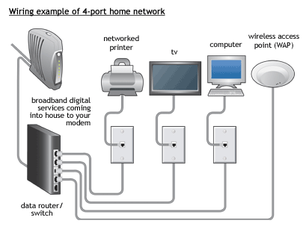
Local Area Network (LAN)
Group of computers connected in small geographical area
Area less than 3 Km (One building)
Used to share files and services
High speed of communications
Under user administrative control
Technology used
  Ethernet
  Wi-Fi

Slide 7
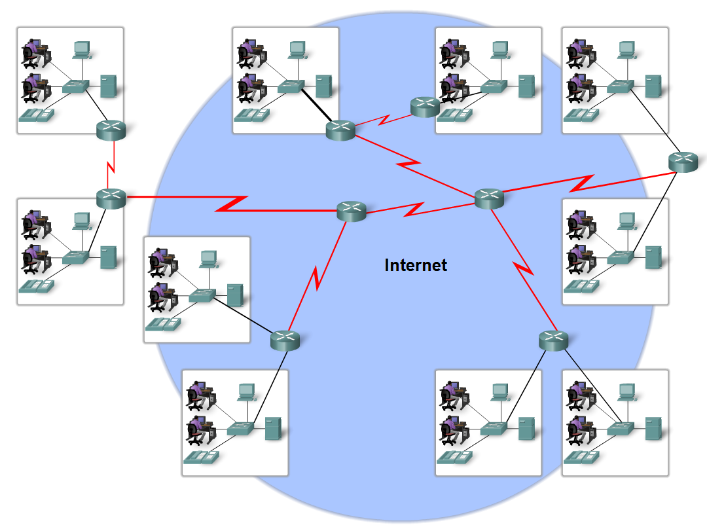
Wide Area Network (WAN)
Group of computers connected in large geographical area
Low speed
Under ISP administrative control
Technology used
  Dial-up
  ISDN
  DSL
  X.25
  Frame Relay
  ATM

Slide 8
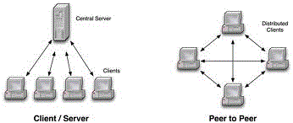
Administration Type
Peer-to-Peer Network
Client/Server Network

Slide 9
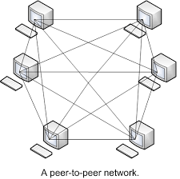
Peer-to-Peer Network
Host provides and consumes network services
Each host has the same administrative privileges

Slide 10
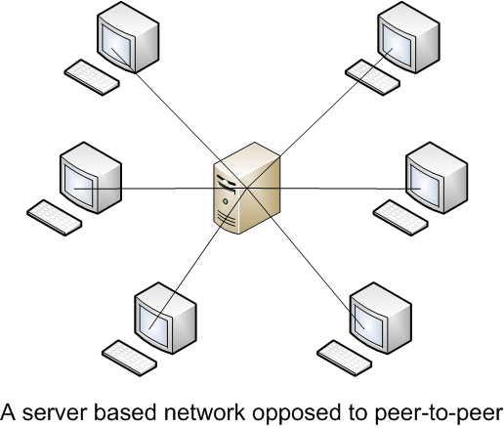
Client/Server Network
Some hosts are assigned server roles
Server is superior in hardware and software
Servers provide network resources to hosts
Other hosts are assigned client roles
Clients consume network resources

Slide 11
Administration Type
 | Peer-to-Peer | Client/Server
Centralization | No central server | All client machines connect to central server
Storage | Each machine share files equally with others | All files/folders are on dedicated storage on server Client access such files
Cost | Inexpensive | Expensive because of server cost
Scalability | Home or small office | Medium/large enterprises
Operating System | Client operating system | Server operating system to handle multiple requests

Slide 12
Thank you

