Slide 1
Nuchal Hands
Kristen Hosaka, D.C., SpBAP
Well Adjusted Birth

Slide 2
Disclaimer
This class is based on Clinical Observations from a Chiropractic perspective and birth assistance perspective, years of observing patterns, trial and error, and tears of joy and heartbreak to come up with repeatable outcomes. Outcomes may vary with practitioners and skill levels.
These are not “researched based” statements.

Slide 3
Nuchal Hands - objectives
Scope of Practice
Definitions of Nuchal Hand and Compound Presentation
Effects of Nuchal Hands and/or Compound Presentations
What indications might suggest NH or CP?
What tools do we have to help during pregnancy?
What tools do we have to help during labor?

Slide 4
Scope of Practice
Not all information in this presentation is within YOUR scope.
Know what IS and is NOT in YOUR SCOPE and stick to it
Differential Diagnosis is important to know to maintain your scope.
Stay in Your Lane

Slide 5
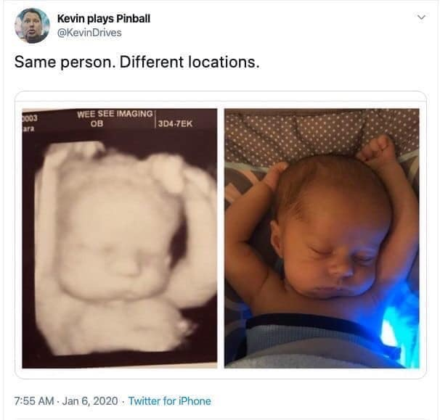
Definitions
Nuchal Hand - One or both hands are by the baby’s face when born
Nuchal Arm - the baby’s arm is by the face when born
Compound Presentation - when any other body part presents with the head (or buttocks with breech presentation)

Slide 6
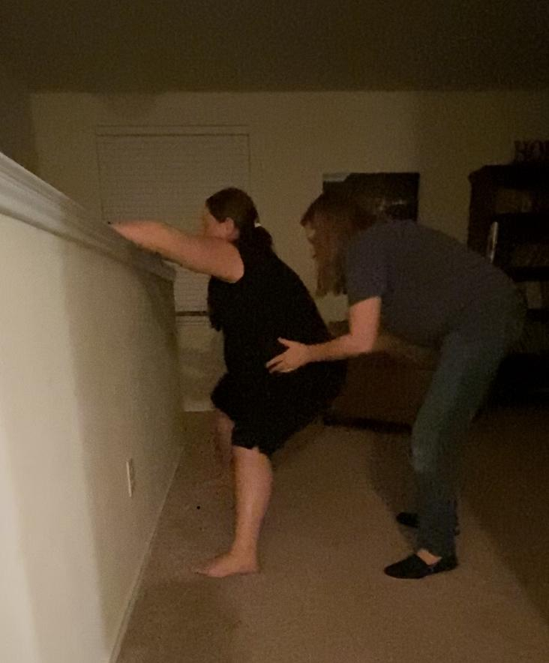
Effects in Labor
Longer labor
Difficulty with fetal engagement into the inlet of the pelvis
Increased pain
Increased interventions in labor
Increased chance of perineal tears
Increased chance of injury to mother and baby

Slide 7
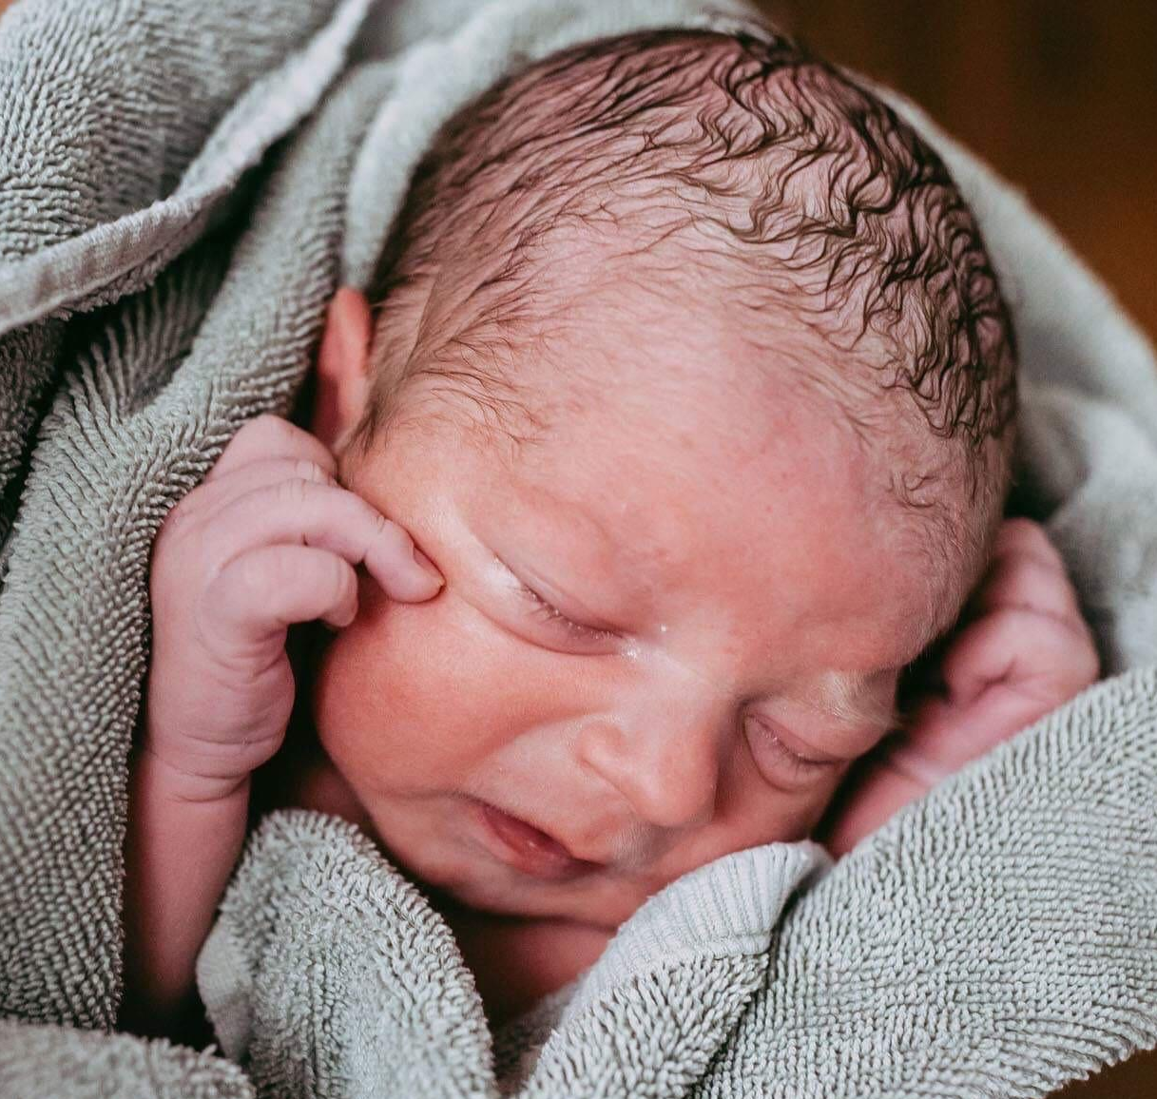
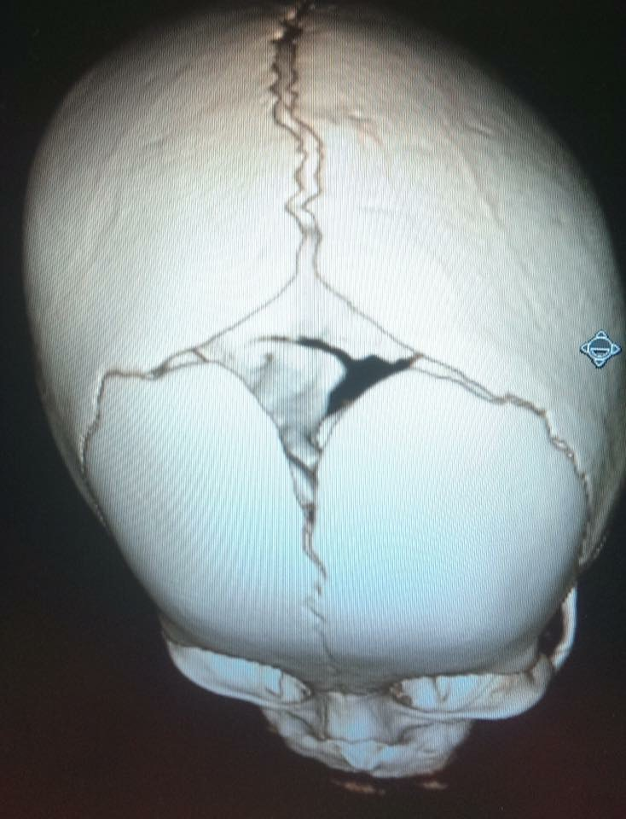
Effects to baby
Increased chance of injury to baby
Subluxation
Baby may be born with greater tension in arms due to position of growth
Cranial plates may have asymmetrical compression leading to cranial asymmetries
Torticollis may occur from contractions in asynclitic position
Difficulties nursing due to tension patterns
Intervention cascade

Slide 8
Indications
Body awarenesses
Asymmetrical lie of fetal head
Asymmetry of uterus
Uterine and pelvic tension patterns asymmetrical
Focused awareness during contractions
Asymmetrical movement of sacrum during contractions
Vaginal exam - palpation may reveal additional presenting parts

Slide 9
Body awarenesses
Tension or pain points not resolved with bodywork
Heaviness to one side of pelvis
Awareness in “hip pocket”
Pain points over baby “parts”
Notes:
Demo with baby

Slide 10
Asymmetry of uterus, pelvis, or fetal lie
Head shifted to one side of the pelvis
Sacral asymmetry not resolved with bodywork
Uterus shifted to one side
Torsional rotation of pelvis leading to uterine rotation
Kick patterns on opposite sides of uterus
Asynclitic head position may be indicated by pelvic floor tension (leg check) or (may be observed during vaginal exam)
Notes:
Show tensegrity model

Slide 11
Pelvic Floor Tension Leg Check
Perform leg check and determine difference in leg lengths.
Have client perform a Kegel and recheck legs.
Leg that got shorter is the side of a tighter pelvic floor.
External Coccygeus muscle release may be indicated on side of short leg.

Slide 12
Pelvic Floor Tension Leg Check
Kegel

Slide 13
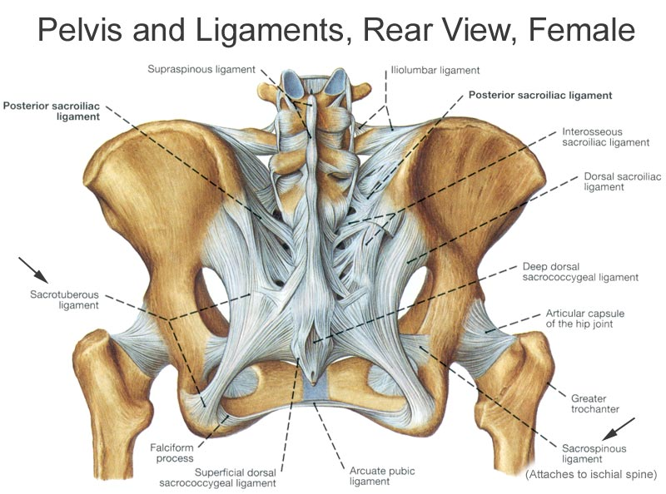
Pelvic Floor Tension Leg Check
To find the Coccygeus muscle, contact just lateral to the sacrum below the Pirifomis. Move fingers towards the feet about ½” into a “hole” between the Piriformis and the STL.
Hold gentle pressure until the tissue “melts” under your fingers.
Coccygeus Correction

Slide 14
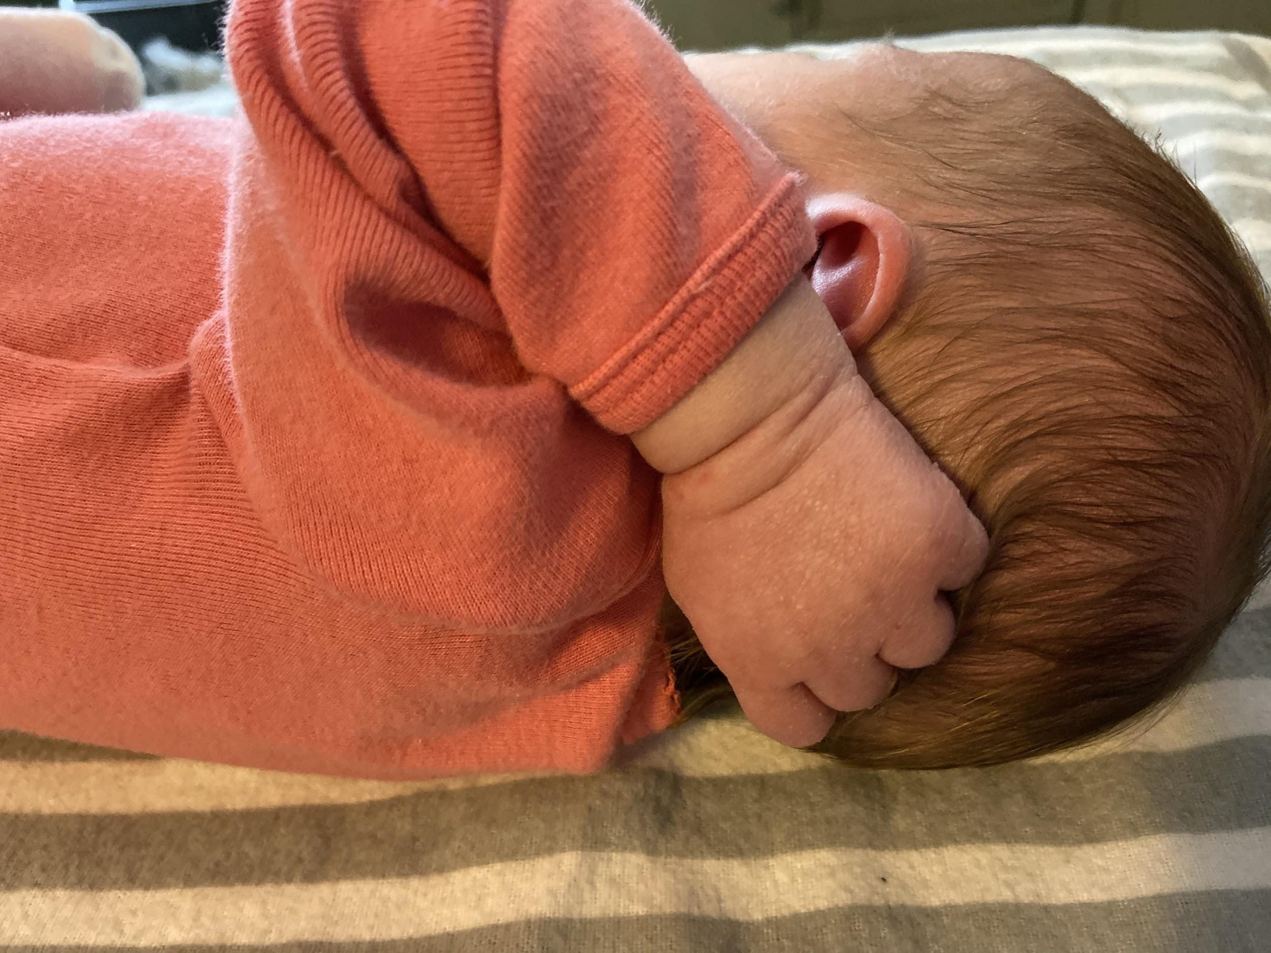
Focused awareness during contractions
Asymmetrical feel to contractions
Pain in back and/or lower abdomen that can be pointed out
“It hurts right here!!”
Notes:
Demo lego squeeze with baby

Slide 15
Vaginal Exam - (stay in scope)
Possible indicators of NH/CP
Asynclitic head position
Cervix to one side
Sutures indicate less than optimal head position
Palpation of additional parts in addition to head
Fetal head has limited motion with palpation either internally or externally and feels “stuck”

Slide 16
Inviting Baby to Move
Talk to Baby
Visualize Change in Position
Create Space for Movement
Use Motion
Use Gravity
***Thank you Gail Tully and Spinning Babies® for changing the paradigm to “Balance, Movement, and Gravity”

Slide 17
During Pregnancy
Create space for baby to move through Chiropractic, CST, Spinning Babies® exercises, or other body work
Uterine Ligaments, Diaphragm, Inguinal Ligament Releases
Hip Opening Stretches (SpB Daily Essentials for example)
Side Lying Release
Forward Leaning Inversion (may add Manteada or round ligament release)
Open Knee Chest with Manteada
Rebozo Manteada
Mirror neurons - imagery and visualization
Notes:
Mirroring hands up (cell phones) etc
https://www.inuterofilm.com/#:~:text=IN%20UTERO%20is%20a%20cinematic%20rumination%20on%20what,human%20behavior%2C%20and%20the%20state%20of%20the%20world.

Slide 18
During Labor
Adjust Subluxations
Fascial Release or Unwinding
Forward Leaning Inversions through 3 contractions (if needed)
Forward Leaning Inversions with round ligament release or Manteada (w/ or w/o ctx)
Open Knee Chest with Manteada
Visualization by birthing person
Monitor baby’s reactions throughout

Slide 19
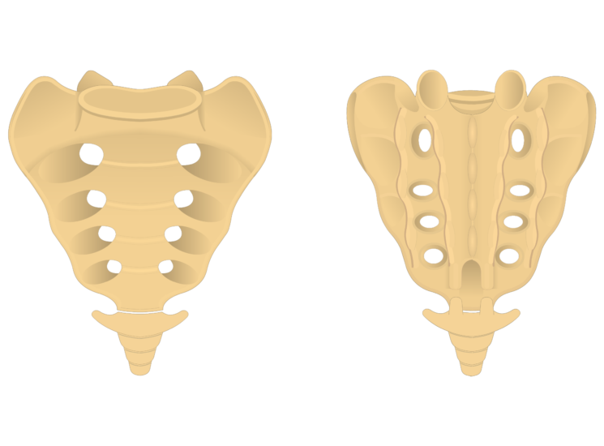
Sacrum Motion
Nutation & Counter-Nutation
Video One - https://www.serola.net/research-entry/reciprocating-unilateral-motion/
Video Two - https://www.serola.net/research-category/structure/normal-movement/bilateral-nutation/
Video Two
SI Joint Pain Relief
Serola Biomechanics Inc.
Video One
Reciprocating Unilateral Nutation

Slide 20
Analyzing Sacral Motion during contractions
Even Motion
Normal labor progression
No movement
Early labor or weak contractions
Inexperience of observer
Compound Presentation or Nuchal Hand
Sacrotuberous Ligament restriction (more likely to observe near transition)
Subluxation
Significant change in upward movement
Get ready for pushing
Notes:
tunnel analogy

Slide 21
Analyzing Sacral Motion
during contractions
Asymmetrical Motion Possibilities
Asymmetrical segmental motion - bulging on one side
One side moving and the other “stuck”
Subluxation
Standing Sacral Release (SSR) can be performed in any position
Adjust at point of restriction - if restriction returns with next ctx, think nuchal hand or asynclitic position and collaborate with midwife or OB
Nuchal Hand (MAY also have back or “butt” pain not from OP position) - midwife may initiate the following to correct:
Standing Sacral Release (SSR) or Buckled Sacrum technique
Forward Leaning Inversions (FLI) through contractions (with manteada if necessary)
Open Knee Chest with manteada
Notes:
tunnel analogy

Slide 22
Asymmetrical segmental motion

Slide 23
Newborn Care
If baby was stuck in a Nuchal Hand or Compound Presentation during pregnancy, baby may present with positional patterns associated with their original pattern of growth. They may sleep with hands by face or head. These patterns can cause a fascial pull or restriction that warrants Chiropractic or Cranio-Sacral Therapy to release these fascial patterns. Baby may also have cranial restrictions from fascial pulls or from direct pressure on the cranium in an asymmetrical manner from the compound presentation. Please encourage birthing person to get care for baby after the birth.

Slide 24
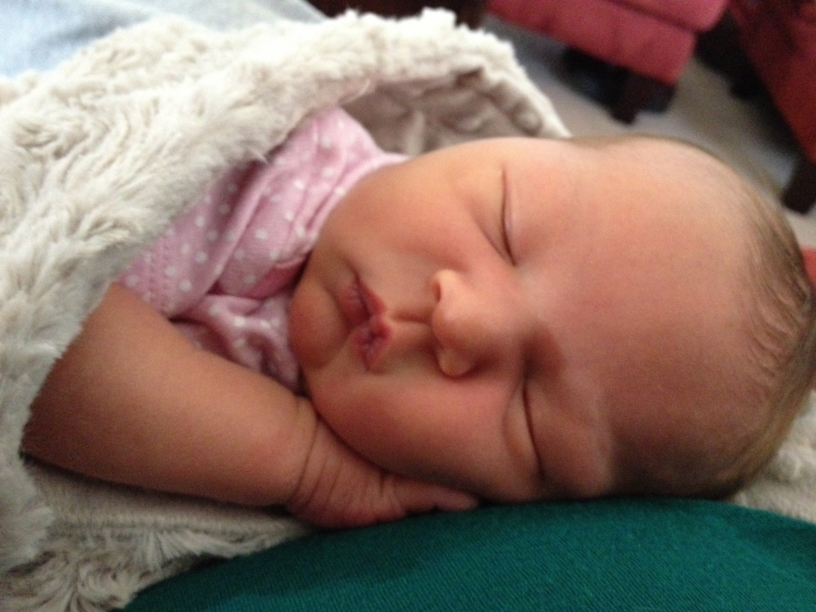
Hand on opposite shoulder in labor with elbow wedged on Pubic Bone
Forward Leaning Inversions through 3 contractions allowed baby to shift.

Slide 25
Hand behind head in labor.
Open Knee Chest with round ligament release allowed hand to come forward. Nuchal hand at birth.
Difficulty engaging in pelvis
Long labor
Pain in 2 places with contractions

Slide 26
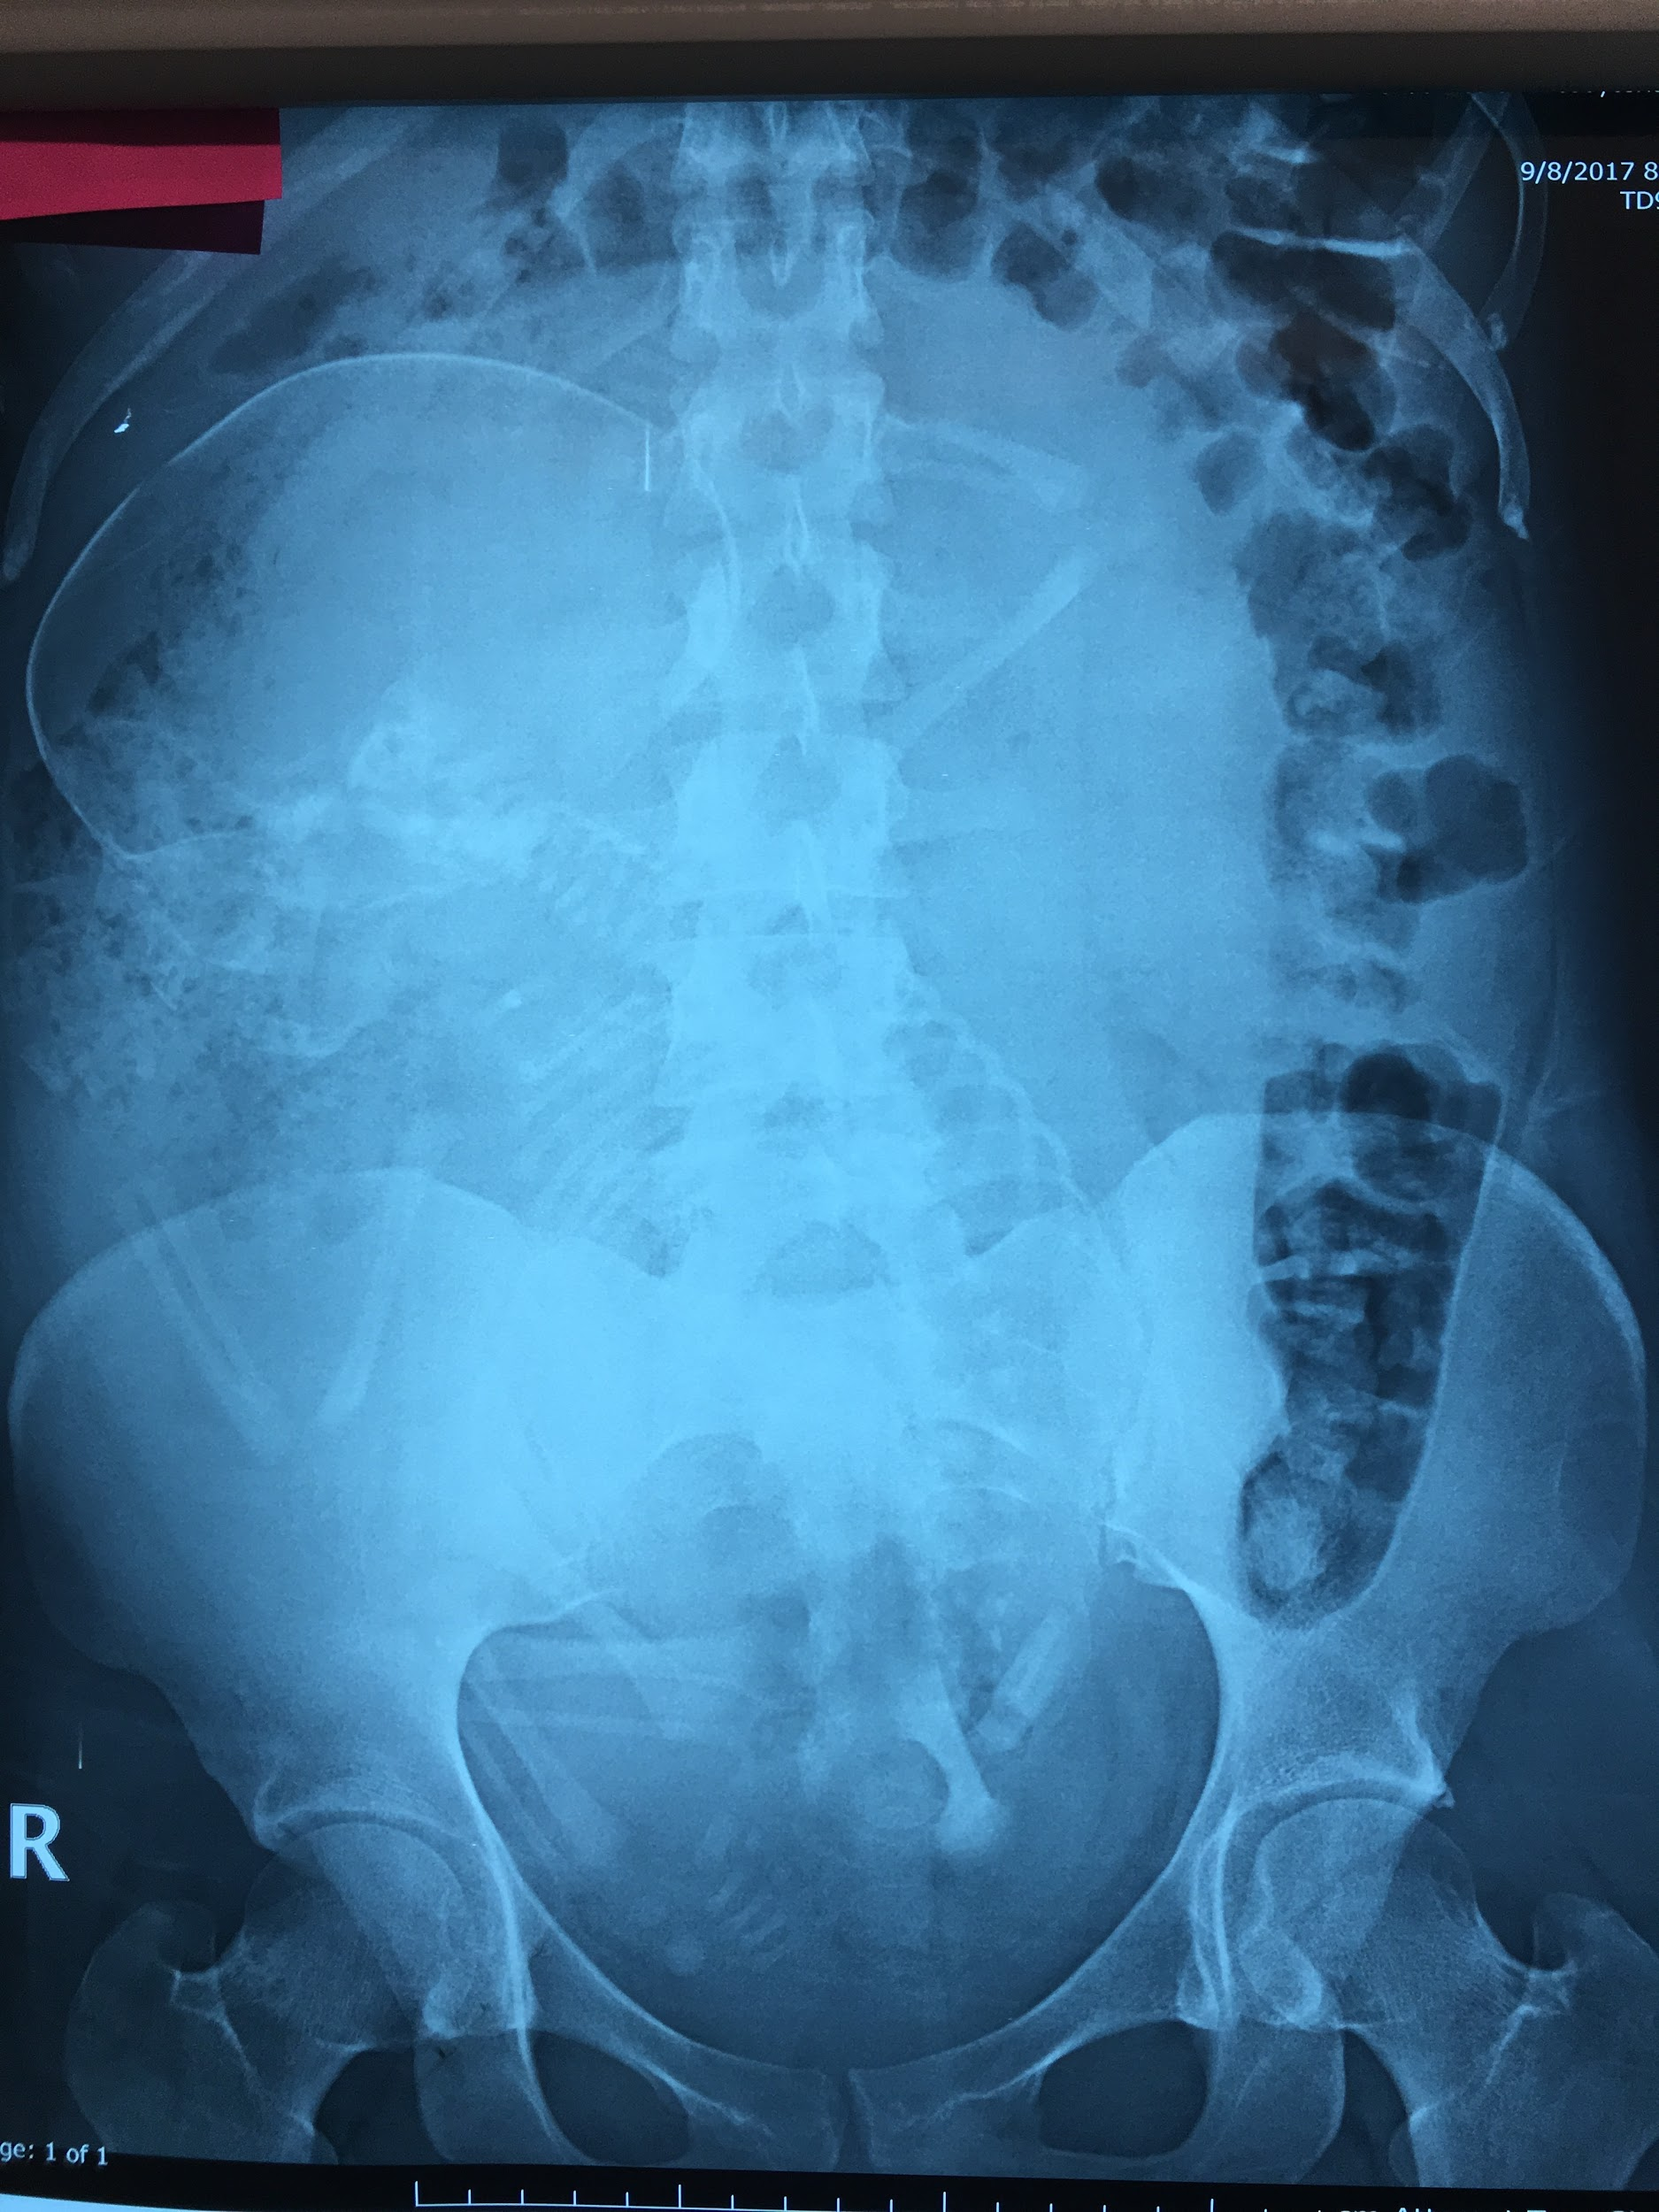
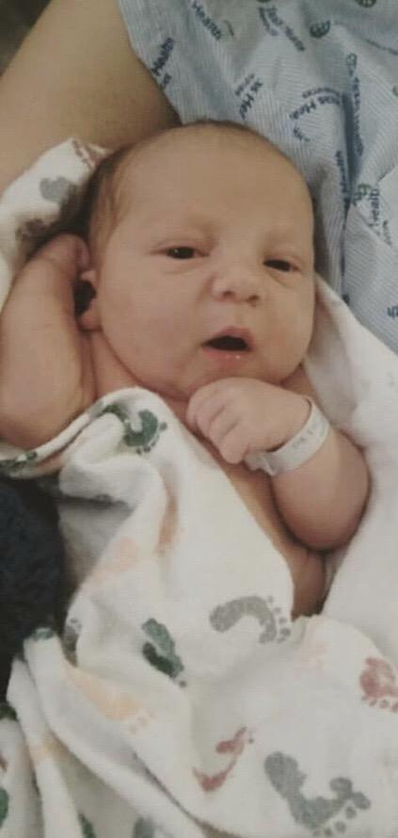
Compound Presentation causing consistent breech position.
Collaboration with Midwife using FLIs, OKC, and Rebozo Manteada helped bring arm back in front of head at 36wks.
Baby remained breech. Cord found wrapped around legs during Cesarean Birth.

Slide 27
Grace
Our job isn’t to ensure a perfect birth.
Our job is to offer the best possible outcomes for the situations presented to us.
We do the best we can with what is in front of us.
Those outcomes aren’t always what we would consider easy or ideal.
Sometimes the best we can achieve is a surgical birth.
And that is beautiful too.

Slide 28
Hands Down
Babies Come out With
Greater Ease

Slide 29
Change the Birth
Change the Life
Well Adjusted Birth

