Slide 1
Soft Skills Training

Slide 2
Module Three Emotional Intelligence
By the end of the course, you will be able to:
Discover what emotional intelligence is and why it is so important for your career
Understand the different components of Emotional Intelligence
Learn the ways to manage conflicts

Slide 3
module outline
01
02
03
04
Lesson
Lesson
Lesson
Lesson
What is Emotional Intelligence and its components
Self Awareness, Self Regulation & Motivation
Social Skills
Conflict Resolution

Slide 4
“
"The greatest ability in business is to get along with others and influence their actions. A person's emotional intelligence quotient (EQ) trumps their intelligence quotient (IQ) every time." - Warren Buffett
"Emotional intelligence is not the absence of emotions, but the ability to control, express, and channel them effectively." - John Mayer

Slide 5
The emotions people have while working, directly reflect the true quality of their work life.
Notes:
Recent surveys reveal that there is a positive link between the emotional climate of a business unit and its performance.
Surveys suggest that the climate – how people feel about working in an organisation - can account for 20 to 30 percent of business performance.
The emotions people have while working, directly reflect the true quality of their work life.
Having positive emotions at work is one of the strongest predictors of employee satisfaction - and how likely they are to quit. Dealing with the soft issue of bringing out the best in people pays off in hard results

Slide 6
What is Emotional Intelligence?
Refers to the ability to recognise, interpret and process emotions in yourself and others.
this means being aware that emotions can drive our behaviour and impact people (positively or negatively), and learning how to manage those emotions- both our own and others- especially when we are under pressure”
Notes:
Emotional Intelligence is essential when it comes to building a well-balanced life.
According to the World Economic Forum, emotional intelligence was ranked as one of the top 10 most important workplace skills, when it comes to what workers will need in order to be successful in 2020 and beyond.
Emotional intelligence consists of two dimensions, intrapersonal intelligence and interpersonal intelligence.

Slide 7
Why emotional intelligence
EQ impacts various areas of life, including relationships, career growth, and overall well-being.
It equips individuals with the ability to manage conflicts constructively.
It enables individuals to make informed decisions, manage stress, and maintain positive connections.
Stronger relationships and effective communication
We work with and for people
Human beings = emotional and social beings
Notes:
Here are several reasons why emotional intelligence is important:
Self-awareness: Emotional intelligence helps individuals become more aware of their own emotions, strengths, weaknesses, values, and goals. This self-awareness enables them to make more informed decisions, effectively manage stress, and align their actions with their values.
Emotional self-regulation: People with high emotional intelligence can effectively regulate and control their emotions, avoiding impulsive reactions and making more thoughtful choices. They are better equipped to manage conflicts, handle pressure, and maintain positive relationships.
Empathy and understanding others: Emotional intelligence fosters the ability to understand and empathize with the emotions of others. This skill enhances interpersonal relationships, encourages effective communication, and promotes teamwork and collaboration.
Leadership: Effective leaders possess strong emotional intelligence. They can understand and respond to the needs and concerns of their team members, build trust and rapport, inspire and motivate others, and make fair and unbiased decisions.
Conflict resolution: Emotional intelligence equips individuals with the ability to manage conflicts constructively. By understanding others' perspectives and emotions, individuals can find mutually beneficial solutions, mediate disagreements, and maintain harmonious relationships.
Adaptability and resilience: Emotionally intelligent individuals are more adaptable to change and resilient in the face of adversity. They can navigate challenging situations with greater ease, maintain a positive outlook, and bounce back from setbacks more effectively.
Improved communication: Emotional intelligence enhances communication skills, including active listening, nonverbal cues interpretation, and effective expression of emotions. This promotes clearer and more

Slide 8
Your EQ Could Matter More Than Your IQ, Especially at Work
Notes:
Recent surveys reveal that there is a positive link between the emotional climate of a business unit and its performance.
Surveys suggest that the climate – how people feel about working in an organisation - can account for 20 to 30 percent of business performance.
The emotions people have while working, directly reflect the true quality of their work life.
Having positive emotions at work is one of the strongest predictors of employee satisfaction - and how likely they are to quit. Dealing with the soft issue of bringing out the best in people pays off in hard results

Slide 9
Components of Emotional Intelligence
Intrapersonal intelligence
Self-Awareness
Self-Regulation
Motivation
Daniel Goleman’s model (1998) focuses on Emotional Intelligence (EI) as a wide array of competencies and skills that drive leadership performance, and consists of five areas:
Empathy
Social Skills
Interpersonal intelligence
Notes:
Emotional intelligence consists of two dimensions, intrapersonal intelligence and interpersonal intelligence.
Interpersonal intelligence refers to the ability to understand social situations and the behavior of other people, whereas intrapersonal intelligence refers to the ability to understand one's own behavior, thoughts, and feelings.

Slide 10
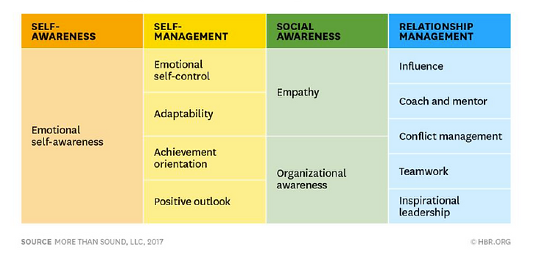
Domains & Competencies
Notes:
Self-awareness: To start, be more aware of your own emotions and thoughts. Why are you feeling those emotions? How might you be expressing them, or how might they be impacting your behavior? How do they affect those around you?
Self-management: Once you’re aware of those emotions and thoughts, you can manage your behavior. There’s no shame in feeling emotions — in fact, it’s healthy. But it’s important to be careful with how those emotions affect others. Self-management involves taking responsibility for your thoughts, feelings, and behaviors. It also means setting goals for managing yourself.
Social awareness: It’s not enough to be aware of your own thoughts and feelings. It’s also important to be in tune with the thoughts and feelings of others. Social awareness is all about considering the feelings of others and trying to look at the world from their perspective. Other people might come from vastly different backgrounds than you. How does that impact their thoughts and feelings? Try to treat their actions with empathy and understanding, mindful of what they might be feeling.
Relationship skills: With self-management and empathy, you can start to build and maintain healthy relationships with people from a diverse range of backgrounds. Relationship skills include learning how to communicate your feelings and needs, as well as listening to others. For a positive relationship to thrive, you have to know how to resolve conflict peacefully and understand when to ask for or offer help.

Slide 11
02
lesson
Self Awareness & Self Regulation

Slide 12
Self Awareness
This component involves recognizing and understanding one's own emotions, strengths, weaknesses, values, and goals. It includes being aware of how emotions influence thoughts, behaviors, and decision-making.
This is the ability to recognize and understand your moods and emotions and how they affect others.

Slide 13
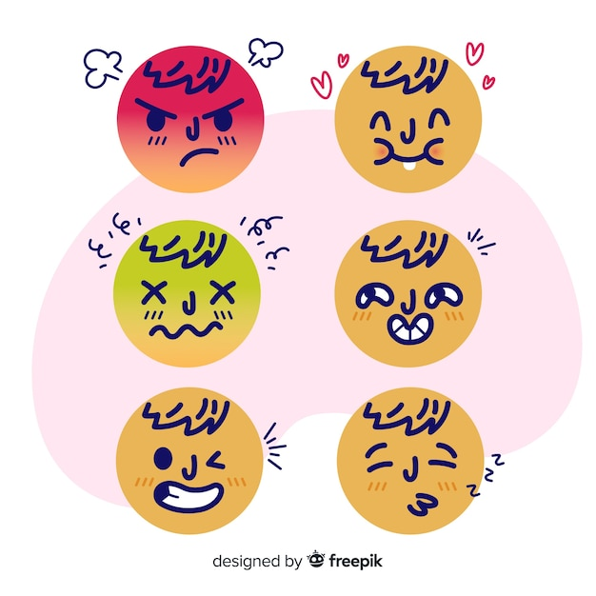
Understanding & Recognizing Emotions
Emotions influence our thoughts, behaviors, and interactions.
Recognizing and understanding emotions is the first step toward emotional intelligence..
Example: joy, anger, fear, sadness, surprise
Developing self-awareness by identifying and acknowledging one's own emotions.
Paying attention to physical sensations, thoughts, and behaviors associated with different emotions.
Example: Recognizing when you feel anxious or excited before giving a presentation.

Slide 14
Improving your self awareness in EI
Reflect on your emotions
Understand your emotional strengths
Develop strategies for managing emotions
Reflect on areas of challenge or struggle
Engage in self-assessment exercises
Seek feedback:
Leverage your strengths and work on weaknesses
Journaling
Embrace a growth mindset
Notes:
Reflect on your emotions: Take time to reflect on your emotions throughout the day. Notice what triggers certain emotions and how they affect your thoughts and behaviors. Consider keeping a journal to track and analyze your emotional experiences.
Seek feedback: Ask trusted friends, family members, or colleagues for feedback on your strengths and weaknesses. Their perspectives can provide valuable insights into your blind spots and areas for improvement.
Leveraging strengths and working on weaknesses to improve emotional intelligence
Develop strategies for managing emotions: Find techniques that help you regulate and manage your emotions effectively, such as deep breathing, meditation, or engaging in self-soothing activities.
Journaling
Reflect on areas of challenge or struggle: Be honest with yourself about the areas where you face difficulties or need improvement.
Embrace a growth mindset: View weaknesses as opportunities for development and adopt a mindset focused on continuous improvement.
Engage in self-assessment exercises: Utilize self-assessment tools, such as personality assessments or emotional intelligence assessments, to gain a deeper understanding of your tendencies, preferences, and areas of growth.

Slide 15
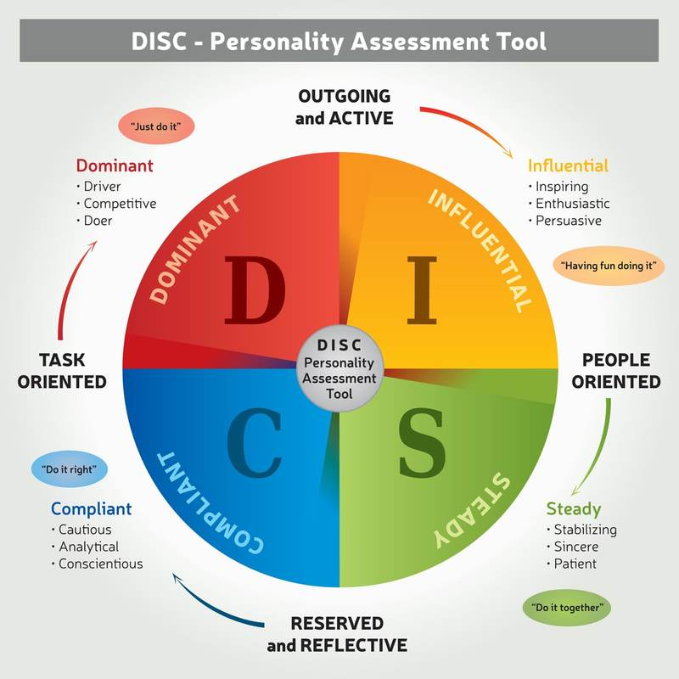
Understanding your behaviour
The DISC model is a behavioral assessment tool that categorizes individuals into four primary behavioral styles: Dominance (D), Influence (I), Steadiness (S), and Conscientiousness (C).
Notes:
It helps individuals understand their preferred communication and behavioral styles and provides insights into how they interact with others.

Slide 16
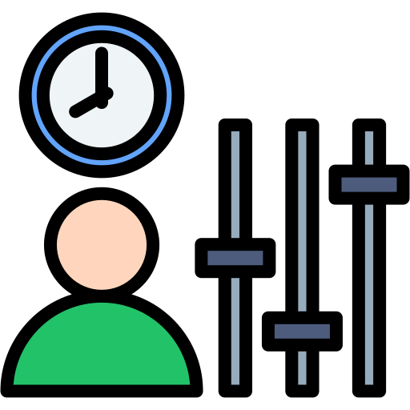
Self Regulation
Self-regulation refers to the ability to manage and control one's emotions effectively. It involves keeping disruptive emotions and impulses in check, maintaining composure in challenging situations, and avoiding impulsive reactions.
Self-regulation also includes the capacity to adapt to change and demonstrate flexibility.
This involves being able to control your impulses and moods and to think before acting.
It helps avoid impulsive reactions, make thoughtful choices, and maintain composure.
Example: Taking a deep breath and counting to ten before responding to a provoking situation.

Slide 17
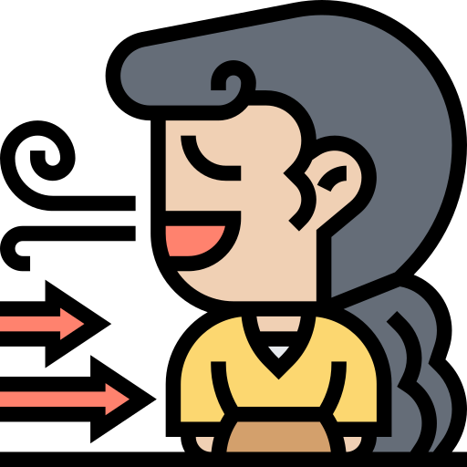
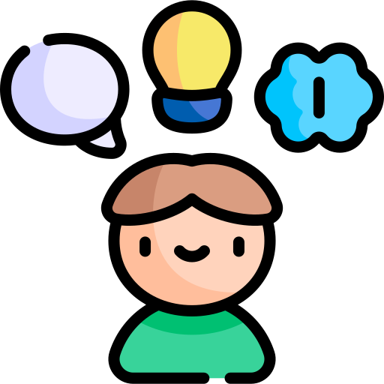
Techniques for Managing Emotions Effectively
Self-soothing techniques, such as deep breathing and mindfulness exercises.
Engaging in activities that promote relaxation, such as exercise or hobbies.
Seeking support from trusted friends, family, or professionals when needed.
Reflect and learn from experiences
Challenge negative thoughts
Notes:
Self-soothing techniques, such as deep breathing and mindfulness exercises.
Engaging in activities that promote relaxation, such as exercise or hobbies.
Seeking support from trusted friends, family, or professionals when needed.
Reflect and learn from experiences: After an emotional episode, take time to reflect on your reactions and their impact. Identify lessons learned and develop strategies for handling similar situations more effectively in the future.
Challenge negative thoughts: Notice and challenge negative or distorted thoughts that contribute to intense emotional reactions. Replace them with more balanced and realistic thoughts that promote emotional stability and self-control.

Slide 18
Coping with Stress and Anxiety
Prioritize self-care activities.
Positive self-talk
Recognize and acknowledge your stress and anxiety triggers.
Notes:
Prioritize self-care activities that nurture your well-being and help you recharge. This can include getting enough sleep, exercising regularly, and engaging in activities that bring you joy and relaxation.
Positive self-talk: Use positive affirmations and self-talk to counter negative thoughts and self-doubt. Replace self-critical thoughts with supportive and encouraging statements that promote resilience and self-confidence.
Recognize and acknowledge your stress and anxiety triggers. Understand how stress and anxiety manifest in your thoughts, emotions, and physical sensations. By being aware of your reactions, you can take proactive steps to manage them effectively.

Slide 19
Motivation
Motivation is another essential component of emotional intelligence. It refers to the ability to harness and sustain the drive to achieve goals, pursue personal growth, and maintain a positive outlook.
In the face of difficulties, your motivation helps you stay focused and resilient. You maintain a positive attitude, viewing challenges as opportunities for growth rather than insurmountable obstacles.
You might remind yourself of the meaningful impact your work can have or envision the sense of accomplishment you will experience upon completion.
Notes:
Here's an example that illustrates motivation as a component of emotional intelligence:
Let's say you're working on a challenging project that requires a lot of time and effort. As you encounter obstacles and setbacks along the way, your motivation plays a crucial role in how you respond.
With high motivation as part of your emotional intelligence, you are driven by a sense of purpose and a clear understanding of your values and goals. You have identified the importance of the project and how it aligns with your personal aspirations.
Moreover, motivation in emotional intelligence enables you to set realistic and achievable goals. You break down the project into manageable tasks and establish a clear plan of action. By doing so, you maintain a sense of progress and keep yourself engaged and committed.
Additionally, motivation extends beyond personal goals. It also involves motivating and inspiring others. As a leader or team member, you recognize the importance of motivating and supporting your colleagues. You encourage their growth, celebrate their achievements, and provide guidance and assistance when needed.
Overall, motivation as a component of emotional intelligence fuels your drive to succeed, pushes you through challenges, and inspires others around you. It keeps you focused on your goals, encourages perseverance, and contributes to personal and professional growth.

Slide 20
Staying Motivated
Motivation is the driving force behind goal achievement and personal growth.
Identifying personal values and goals provides direction and purpose.
Example: Setting career goals aligned with your passion for making a positive impact.
Maintaining a positive mindset
Reflecting on what matters most to you in life and work.
Setting SMART goals (Specific, Measurable, Achievable, Relevant, Time-bound).
Aligning actions with values

Slide 21
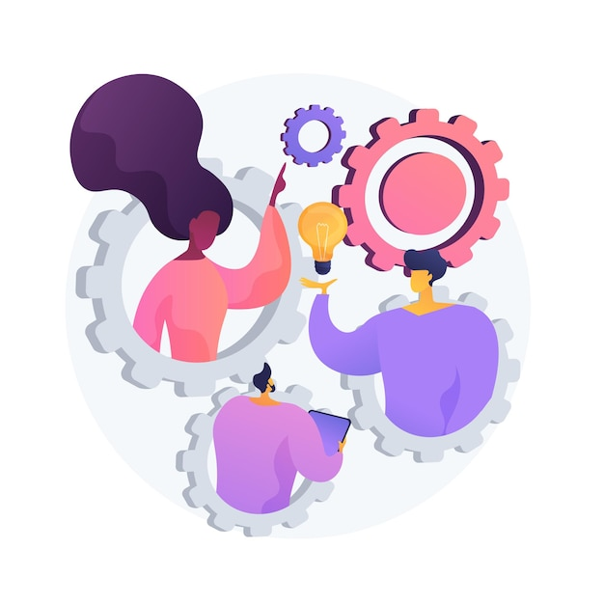
03
Empathy and Social Skills

Slide 22
Empathy
Empathy is the ability to recognize and understand others’ motivations and to put yourself in their shoes.
Empathy is the ability to understand and share the feelings of others.
It promotes effective communication, strengthens relationships, and resolves conflicts.
Empathy in emotional intelligence involves considering the impact of your words and actions on others. By being aware of how your behavior affects those around you, you can adapt your communication style, show respect, and tailor your approach to meet others' emotional needs.
Notes:
Empathy is a significant component of emotional intelligence, encompassing the ability to understand and share the emotions of others. It involves recognizing and appreciating others' perspectives, feelings, and experiences. Here's an example illustrating empathy as a component of emotional intelligence:
Imagine you have a co-worker who appears visibly upset and withdrawn. With empathy, you would be attuned to their emotions and demonstrate understanding. Instead of making assumptions or dismissing their feelings, you would approach them with compassion and a genuine desire to help.
You might initiate a conversation by saying, "I noticed that you seem upset today. Is everything okay?" By actively listening and paying attention to their response, you would create a safe space for them to express their feelings.
As they share their concerns, you would practice empathy by putting yourself in their shoes and attempting to understand their perspective. Rather than dismissing their emotions or offering unsolicited advice, you would respond with statements like, "I can understand why you might be feeling frustrated. It sounds like this situation has been challenging for you."

Slide 23
Developing Empathy Skills
Active listening and paying attention to verbal and nonverbal cues.
Practice non-judgment: Suspend judgment and avoid making assumptions about others
Practicing empathy by responding with understanding and compassion.
Validate emotions: Show empathy by expressing understanding and acceptance of their feelings, even if you don't necessarily agree with their perspective.

Slide 24
Asking open-ended questions to encourage sharing.
Providing support and reassurance when someone is going through a difficult time.
Being non-judgmental and showing genuine interest in others' experiences.
Asking open-ended questions to encourage sharing.
Providing support and reassurance when someone is going through a difficult time.
Being non-judgmental and showing genuine interest in others' experiences.
Strategies for Demonstrating Empathy Towards Others

Slide 25
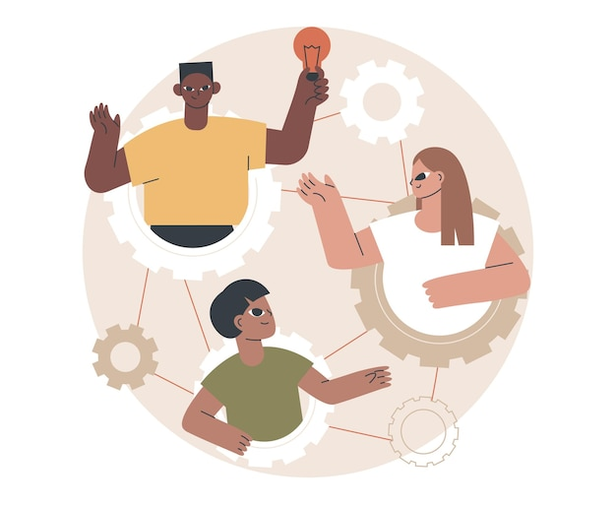
Social Skills
This is the ability to manage relationships, build networks, and connect with people.
Social skills are a significant component of emotional intelligence, focusing on the ability to effectively interact and communicate with others.
They involve understanding social dynamics, adapting behavior in different social situations, and building positive relationships.
If someone appears stressed or anxious, you might offer words of encouragement or support. If they share exciting news, you will celebrate their achievements and show genuine enthusiasm.
Notes:
Here's an example that illustrates social skills as a component of emotional intelligence:
Imagine you are attending a networking event where you have the opportunity to meet new people and establish professional connections. Social skills in emotional intelligence would come into play as you navigate the event.
With well-developed social skills, you would be able to approach others with confidence and make a positive first impression. You would demonstrate active listening by showing genuine interest in their stories and asking thoughtful questions. Through your nonverbal cues, such as maintaining eye contact and using appropriate body language, you would convey attentiveness and openness.
Furthermore, your social skills would enable you to adapt your communication style to different individuals and situations. For instance, you might recognize that some individuals prefer a more direct and concise communication style, while others appreciate a more friendly and engaging approach. By being attuned to their preferences, you can tailor your communication to establish rapport and build a connection.
Overall, social skills as a component of emotional intelligence allow you to connect with others, build relationships, and navigate social interactions effectively. They involve active listening, adaptability, empathy, and fostering positive connections. By developing these skills, you can enhance your personal and professional relationships, and create a harmonious and collaborative environment.

Slide 26
Building your social skills
Importance of effective communication in relationships
Active listening and attentiveness
Nonverbal communication cues
Clear and concise expression of thoughts and emotions
Building trust and rapport
Showing appreciation and gratitude
Respecting diverse perspectives and opinions
Resolving conflicts constructively

Slide 27
04
lesson
Conflict Resolution

Slide 28
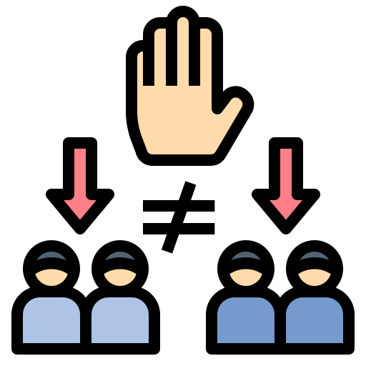
Conflict resolution
Conflict resolution is a way for two or more parties to find a peaceful solution to a disagreement among them. The disagreement may be personal, financial, political, or emotional.
It is to resolve an issue or problem between two or more people. Disagreements in the workplace are inevitable, as employees have different personalities, goals, and opinions.
Notes:
Human interaction may sometimes lead to conflict, so response—and resolution—require conflict resolution strategies. Conflict resolution or negotiation is a way for the opposing parties to find a solution to their disagreement that leaves everyone reasonably satisfied.
Sometimes, the person who resolves a conflict may be a neutral party or mediator while at other times, they may be someone involved in the conflict who takes an outside perspective to find a solution.
The ability to resolve conflicts is often seen as a leadership trait. People who can identify conflicts, acknowledge different opinions and build a consensus are valuable to many organizations. They make it more likely for personal differences to be set aside so work can continue.

Slide 29
How people handle conflicts
Different people use different methods to resolve conflict, depending on their personalities and preferences. Dr. Kenneth Thomas and Dr. Ralph Kilmann, calls out the five common ways people tend to respond to conflict. Knowing what allows individuals to identify with their reaction and aides in resolving the conflict.
Thomas-Kilmann Model
Notes:
According to Thomas and Kilmann, there are five modes/conflict responses that can be assessed based on scales of assertiveness (how much we focus on our own needs during the conflict) and cooperativeness (how much we focus on other people's needs over our own during the conflict). They are:
Competing is assertive and uncooperative - an individual pursues their concerns at the expense of others. This is a power-oriented mode in which you use whatever power seems appropriate to win your own position—your ability to argue, your rank, or economic sanctions. Competing means "standing up for your rights," defending a position that you believe is correct, or simply trying to win.
benefits: asserting your position, possibility of quick victory, protecting your interests
costs: strained relationships, suboptimal decisions, decreased initiative and motivation, possible escalation and deadlock
Accommodating is unassertive and cooperative - the complete opposite of competing. When accommodating, the individual neglects their own concerns to satisfy the concerns of others; there is an element of self-sacrifice in this mode. Accommodating might take the form of selfless generosity or charity, obeying another person's order when you would prefer not to, or yielding to another's point of view.
benefits: helping someone out, restoring harmony, building relationships, choosing quick ending
costs: sacrificed concerns, loss of respect, loss of motivation
Avoiding is unassertive and uncooperative - the person neither pursues their concerns nor those of the other individual. Thus they do not deal with the conflict. Avoiding might take the form of diplomatically sidestepping an issue, postponing an issue until a better time, or simply withdrawing from a threatening situation.
benefits: reducing stress, saving time, steering clear of danger, setting up more favourable conditions
costs: declining relationships, resentment, delays, degrading communication and decision making
Collaborating is both assertive and cooperative - the complete opposite of avoiding. Collaborating involves an attempt to work with others to find some solution that fully satisfies their concerns. It means digging into an issue to pinpoint the underlying needs and wants of the individuals. Collaborating between two or more persons might take the form of exploring a disagreement to learn from each other's insights or trying to find a creative solution to an interpersonal problem.
benefits: high-quality decisions, learning and communications, resolution and commitment, strengthening relationships
costs: time and energy required, psychological demands, possibility of offending, vulnerability risk
Compromising is moderate in both assertiveness and cooperativeness. The objective is to find some expedient, mutually acceptable solution that partially satisfies all parties. It falls intermediate between competing and accommodating. Compromising gives up more than competing but less than accommodating. Likewise, it addresses an issue more directly than avoiding it but does not explore it in as much depth as collaborating. In some situations, compromising might mean splitting the difference between the two positions, exchanging concessions, or seeking a quick middle-ground solution.
benefits: pragmatism, speed and expediency, fairness, maintaining relationships
costs: partially sacrificed concerns, suboptimal solutions, superficial understanding

Slide 30
Techniques for resolving conflicts peacefully
Active listening
Empathy
Calm communication
Use "I" statements
Seek common ground
Win-win approach
Compromise
Mediation
Take breaks if needed
Focus on the issue, not personal attacks
Practice forgiveness
Notes:
Active listening: Give full attention to the other person's perspective and seek to understand their point of view without interrupting or judging.
Empathy: Try to put yourself in the other person's shoes and understand their emotions and concerns.
Calm communication: Use a calm and respectful tone while expressing your thoughts and feelings. Avoid aggressive or confrontational language.
Use "I" statements: Share your thoughts and emotions using "I" statements to take responsibility for your own feelings and avoid blaming or accusing the other person.
Seek common ground: Identify shared interests or goals that can serve as a foundation for finding a mutually agreeable solution.
Collaborative problem-solving: Engage in open dialogue, brainstorm ideas, and work together to find creative solutions that meet both parties' needs.
Win-win approach: Aim for outcomes that benefit both parties rather than seeking to "win" the conflict at the expense of the other person.
Compromise: Be willing to make concessions and find a middle ground that satisfies both parties' important needs and concerns.
Mediation: Consider involving a neutral third party who can facilitate communication and help find a resolution that is acceptable to both parties.
Take breaks if needed: If emotions are escalating, take a break from the discussion to cool down and regain composure before continuing the conversation.
Focus on the issue, not personal attacks: Stay focused on the problem at hand and avoid personal attacks or bringing up unrelated past grievances.
Practice forgiveness: Let go of resentment and work towards forgiveness to rebuild trust and move forward positively.

Slide 31
Becoming More Emotionally Intelligent
Practice observing and reflecting on your feelings
Look for coping mechanisms
Pay attention to your behaviour
Challenge thoughts that trigger negative emotions or perceptions
Take responsibility for your feelings and behavior
Know your stressors
Practice empathizing; seek first to understand

Slide 32
Summary & Reflections
Emotional intelligence is crucial for personal and professional success.
Strategies for staying motivated, developing social skills, and improving emotional intelligence.
The importance of practice, resources for growth, and constructive conflict resolution.
Applying these skills leads to stronger relationships, effective communication, and better conflict management.

Slide 33
Thank You!

