Slide 1

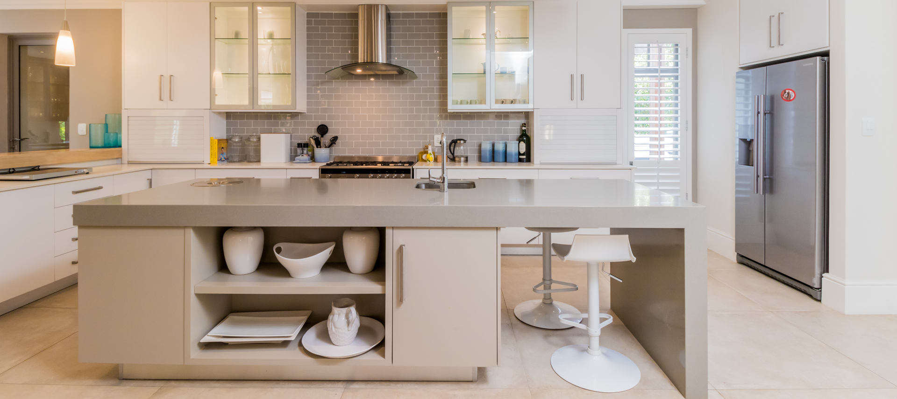
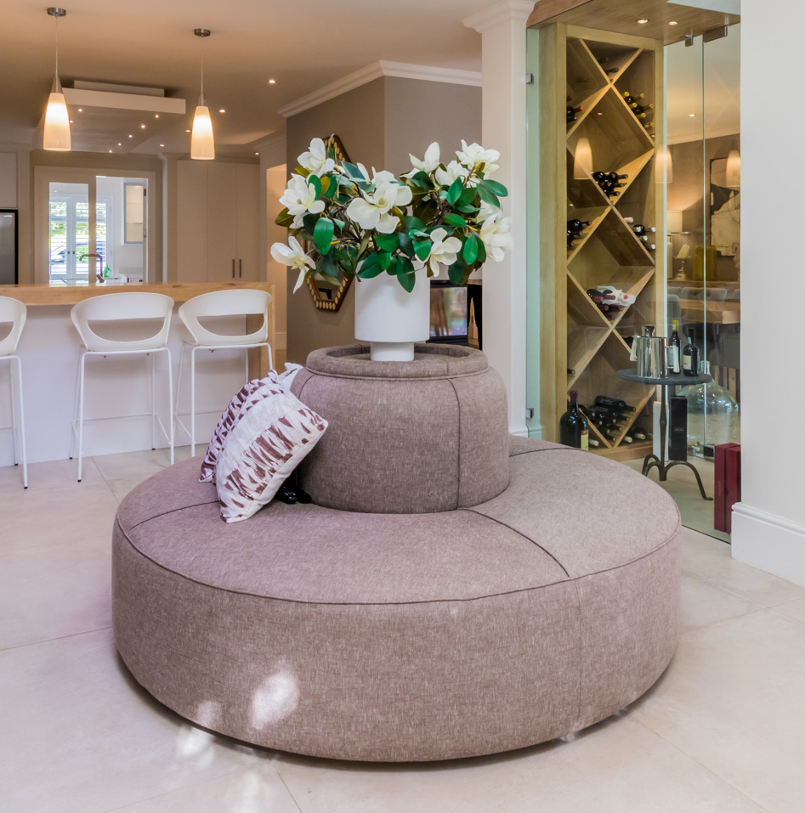
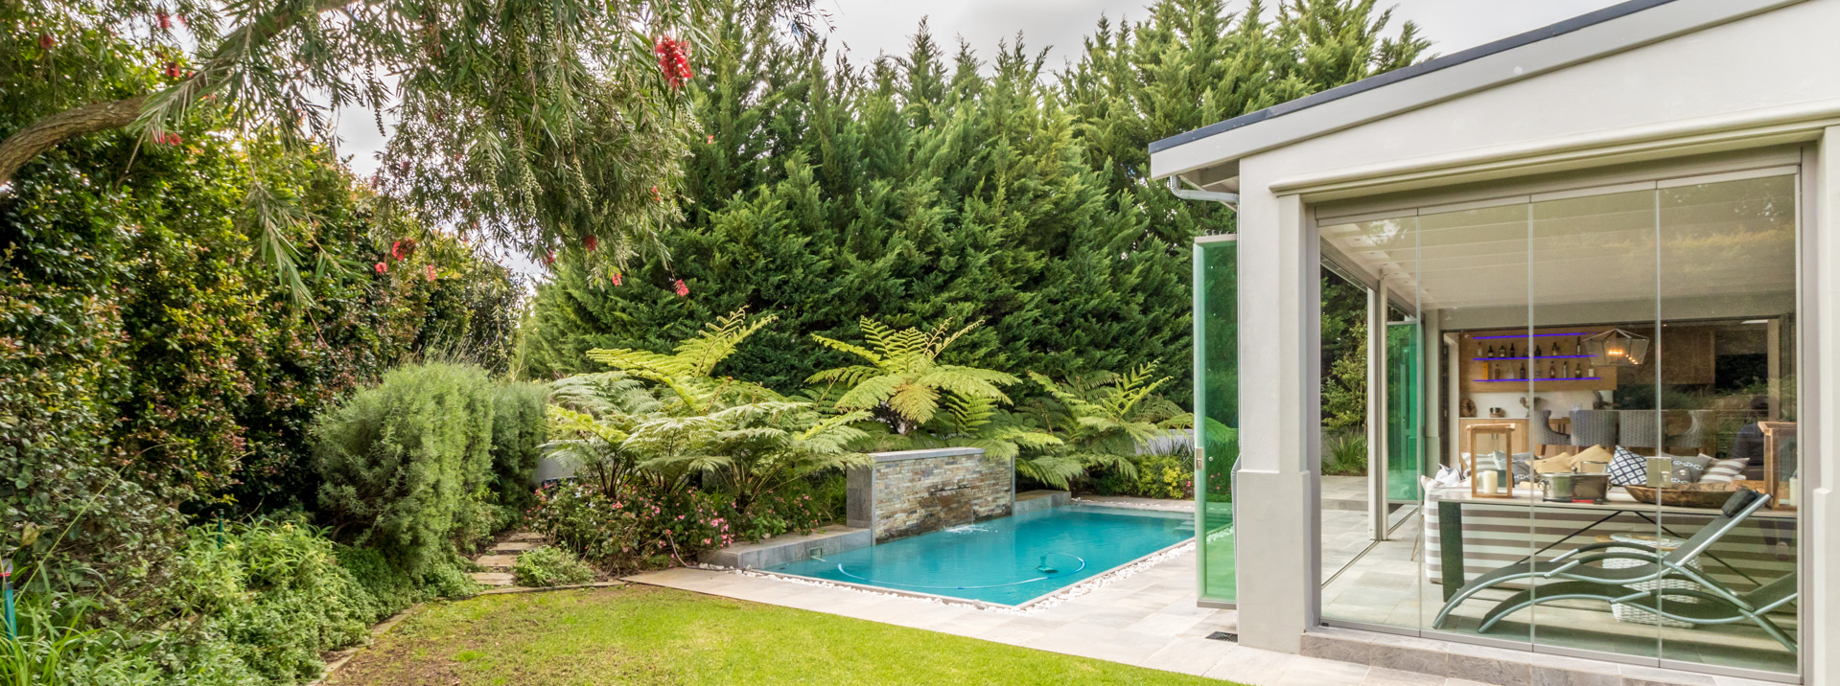
New Listing
JOHANNESBURG
10 Main Street

Slide 2
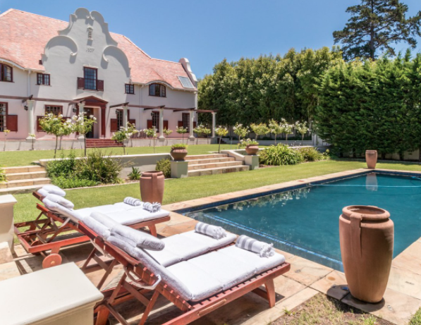
New Listing
JOHANNESBURG
Main Street
NOTHING COMPARES.

