Slide 1
Australian ExpressRoute
Overview of Technical connection

Slide 2

Connectivity choices: Internet or Private
Branch Office 2
Branch office 2
Microsoft
Microsoft
WAN
WAN
Branch office 1
Branch office 1
Public
internet
Public
internet
Corp HQ
Corp HQ
IPsec VPN over Internet
  Encrypted data traverses Internet to reach Azure
  Limited bandwidth and higher availability
Cloud on your WAN
  Traffic flows directly from customer WAN to Microsoft
  Reduces complexity
  Lower latency, higher bandwidth and higher availability

Slide 3
ExpressRoute
Branch office 2
Microsoft
Predictable performance
WAN
Branch office 1
Security
Public
internet
High throughput
Corp HQ
ExpressRoute provides a private,
dedicated, high-throughput network connection to Microsoft
Lower cost

Slide 4


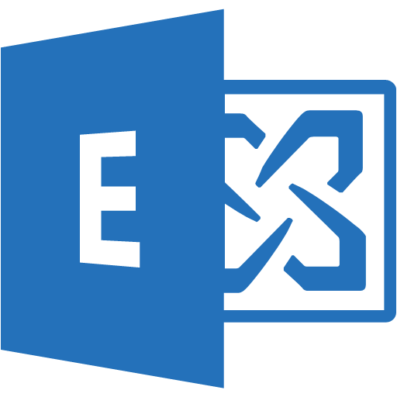
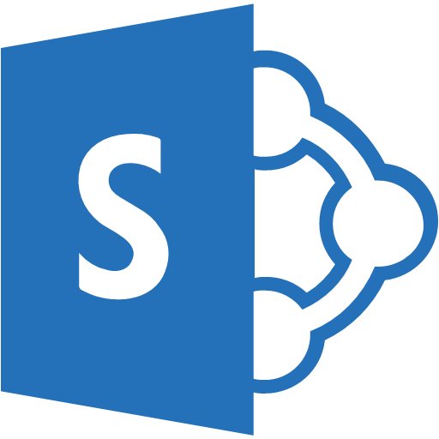


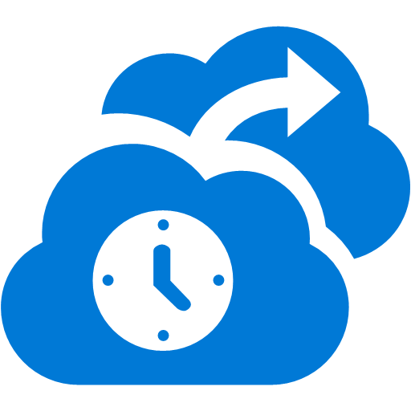




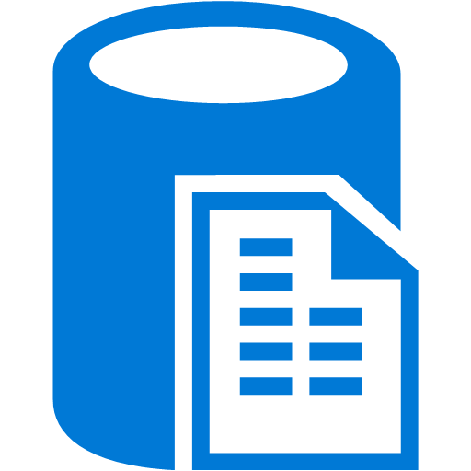
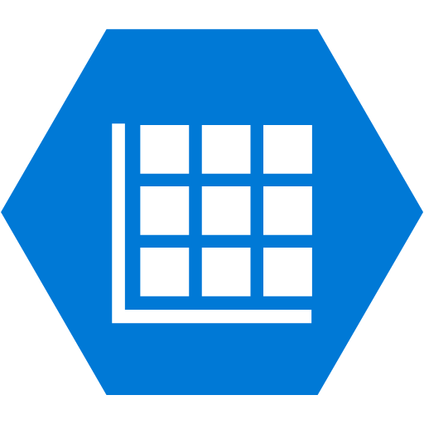


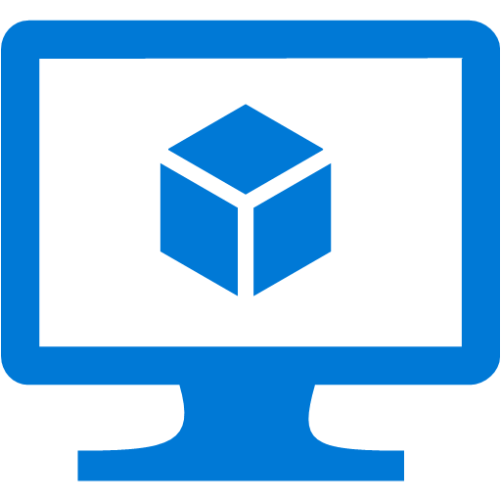


ExpressRoute Connectivity
Partner Edge
Microsoft Edge
Customer’s
network
Customer’s
connection
Traffic to Office 365 Services
Traffic to public IP addresses in Azure
Traffic to Virtual Networks

Slide 5

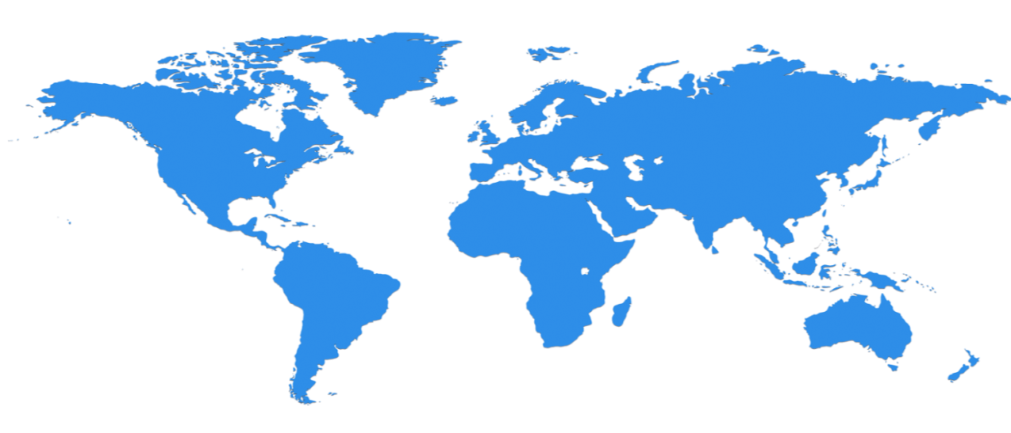

Huge infrastructure scale is the enabler
24 Regions Worldwide, 19 ONLINE…huge capacity around the world…growing every year
North Central US
Illinois
North Europe
Ireland
West Europe
Netherlands
Central US
Iowa
Canada Central
Toronto
Canada East
Quebec City
US Gov
Iowa
China North *
Beijing
China South *
Shanghai
Japan East
Saitama
West US
California
East US
Virginia
India Central
Pune
Japan West
Osaka
South Central US
Texas
East US 2
Virginia
US Gov
Virginia
India South
Chennai
India West
Mumbai
East Asia
Hong Kong
SE Asia
Singapore
Operational
Announced/Not Operational
Australia East
New South Wales
  * Operated by a regional partner
Brazil South
Sao Paulo
Australia South East
Victoria
  100+ datacenters
  Top 3 networks in the world

Slide 6


Billing options and bandwidths
New billing options
Connectivity Provider
‘Unlimited Data’ – Fixed Monthly Price
‘Metered Data’ –
Variable Monthly Price
50 Mbps
100 Mbps
200 Mbps 500 Mbps
1 Gbps
2 Gbps
5 Gbps
10 Gbps
Bandwidth | Billing Model
 | Unlimited Data | Metered Data
10 Mbps | ✗ | ✗
50 Mbps | ✓ | ✓
100 Mbps | ✓ | ✓
200 Mbps | ✓ | ✓
500 Mbps | ✓ | ✓
1 Gbps | ✓ | ✓
2 Gbps | ✓ | ✓
5 Gbps | ✓ | ✓
10 Gbps | ✓ | ✓
You pick the billing model that works
for you.
No more EXPs and NSPs!

Slide 7


ExpressRoute connectivity models
ExpressRoute
ExpressRoute
ExpressRoute
WAN
Cloud Exchange
Co-location
Point-to-point Ethernet Connection
Any-to-any (IPVPN) Connection

Slide 8
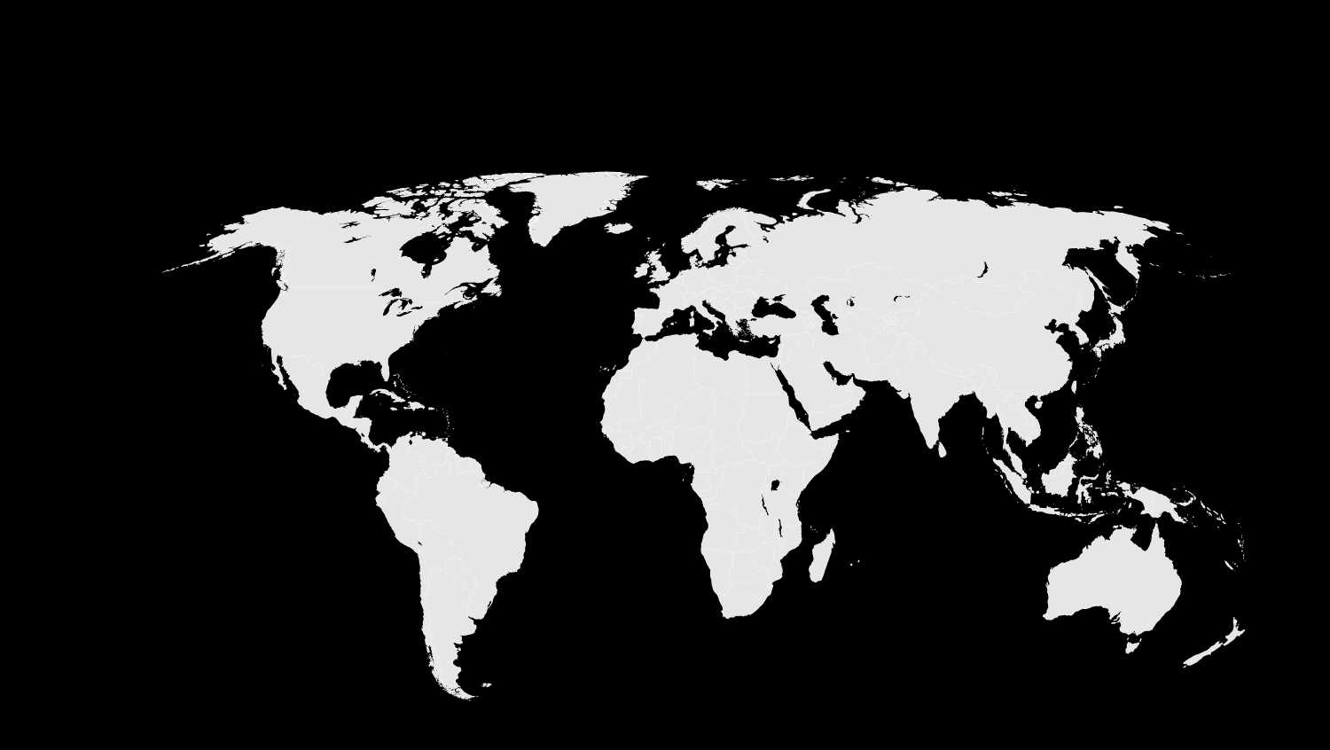





















ExpressRoute Sites and Partners
Atlanta
Chicago Chicago (Gov Cloud)*
Dallas
LA
NY
Seattle
Silicon Valley
Washington DC
Washington DC (Gov Cloud)*
Amsterdam
Dublin*
London
Chennai*
Hong Kong
Mumbai*
Melbourne*
Osaka*
Singapore
Sydney
Tokyo
Sao Paulo

Slide 9

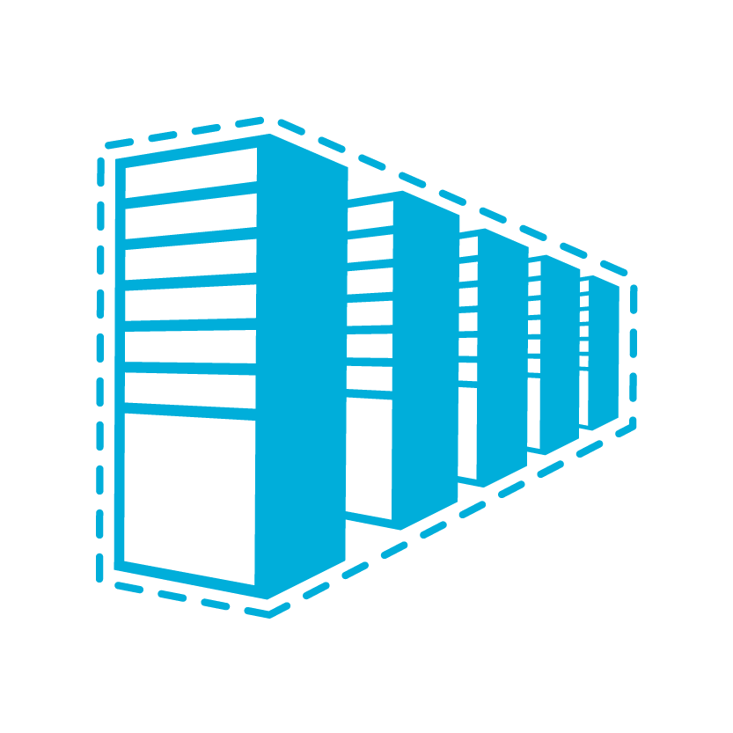

ExpressRoute and S2S VPN Coexistence
S2S VPN as a backup for ExpressRoute
S2S connectivity to branch offices
Connecting Virtual Networks in other Azure regions
Internet
Contoso HQ
VPN Gateway
(Internet Edge)
SQL Farm
IIS Servers
Services on public IPs
ExpressRoute
AD/DNS
Monitoring
Exchange
Contoso virtual networks/VMs

Slide 10
ExpressRoute Premium Add On
NEW
Global connectivity
  Link a Virtual Network from any Azure Region to your ExpressRoute circuit
More routes (IP prefixes)
  Supports up to 10,000 routes, increase from 4,000 routes
Connect more Virtual Networks
  Up to 100 virtual networks depending on bandwidth option

Slide 11
VPN Gateways for Virtual Network
NEW
ExpressRoute gateway or VPN gateway needed to access a virtual network
Introducing a new Standard Gateway
  Supports ExpressRoute and VPN coexistence
  Improved throughput for ExpressRoute
Virtual Network Gateway SKU | ExpressRoute GW Throughput | VPN GW ExpressRoute Coexistence | VPN GW Throughput | VPN GW Max IPsec Tunnels | Cost (USD) / Hour
Basic | 500 Mbps | No | 100 Mbps | 10 | $0.04
Standard | 1000 Mbps | Yes | 100 Mbps | 10 | $0.19
Performance | 2000 Mbps | Yes | 200 Mbps | 30 | $0.49
Note that ExpressRoute traffic for Azure public services, O365, and
Skype for Business does NOT go through a Virtual Network gateway

Slide 12

Office 365 Timelines and Partners
Supported Workloads
  Exchange Online & Exchange Online Protection
  SharePoint Online, OneDrive for Business, Office 365 Video, Delve
  Skype for Business Online (formerly Lync Online)
  Office Online
  Power BI and Project Online
Australian ER Partners with O365
  Other providers soon. (Telstra Q1 2016)

Slide 13
ExpressRoute Traffic Paths within Australia
Overview of Technical connection
http://azure.microsoft.com/en-us/services/expressroute/
https://azure.microsoft.com/en-us/documentation/articles/expressroute-faqs/

Slide 14
4 ExpressRoute partners in Australia:
ER Partner | Type of Connection | Connection Advantages
Telstra | Via Telstra Cloud Direct Connect (metered & unmetered) | Great for existing Telstra MPLS customers that want to connect multiple sites directly to Azure
Equinix | metered & unmetered | Great for Equinix customers (or that have connectivity to Equinix) that want to connect to multiple clouds with the same link(s)
NextDC | metered & unmetered | Great for NextDC customers (or that have connectivity to NextDC) that want to connect to multiple clouds with the same link(s)
MegaPort | metered & unmetered | Focuses on rapid (dynamic) provisioning of connectivity & bandwidth between major DCs, fully automated within minutes
Many connection paths (NOs & VNOs)
(Network Operators / Virtual Network Operators)
Most customers have telco connectivity to/from their head office & branch office(s) via a telco that is not directly connected to an ExpressRoute partner. As such, these telcos can include the ER service from one of the above providers into their end-to-end service and provide a complete capability to customers.

Slide 15
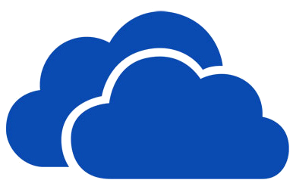



Customer network components
Optional / required customer / partner network equipment (routers, etc…) for BGP peering, firewalls, etc…
ER Provider
MS Enterprise Edge
Datacentre
ER Partners provide multi-tenancy, security for MS Connectivity
Microsoft’s high speed / enterprise cloud connection point
Physical Network Provider
Customer internal LAN
Network Operators / Virtual Network Operators provide IP circuits to customers offices / datacentres
ER provider secures connectivity for MS cloud connectivity
Microsoft carries all traffic from this point to Azure (an other MS cloud services) and return. This is included in the cost of the ER service.
MS SLA’s apply (based on redundant connections)

Slide 16




Azure Australia East (Sydney) Express Route Connectivity (existing)
ER connectivity available now
Telstra MPLS
Azure Infrastructure
Existing ER infrastructure
Customer ER traffic
S1 – Macquarie Park
Sydney, Mascot
MSEE
(Microsoft Enterprise Edge)
Customer Racks
Customer Racks
Customer ER traffic
Customer ER traffic
Customer ER traffic
Optus MPLS

Slide 17
Azure Australia South East (Melbourne) Express Route Connectivity
Azure Infrastructure
Optus MPLS
M1 – Port Melbourne
Melbourne
Customer Racks
MSEE
(Microsoft Enterprise Edge)
Customer Racks
Telstra MPLS
Short 1.8 Km dedicated fibre (=direct cross connect)

Slide 18
ExpressRoute Provider Partners in Australia
(with direct connection to MS Enterprise Edge)
Name | Type | Connection Locations
Equinix | ER connection provider ECX – Equinix Cloud Exchange | Sydney - 47 Bourke Road, Alexandria, Sydney, NSW 2015 Melbourne - 600 Lorimer Street, Port Melbourne, Victoria 3207 http://www.equinix.com/services/interconnection-connectivity/cloud-exchange/
Telstra | Telstra Cloud Direct Connect | MPLS network connected via Sydney (Alexandria) & Melbourne (Port Melbourne)
NextDC | ER connection provider AXONVX | Melbourne - 826 Lorimer Street, Port Melbourne, Victoria 3207 http://www.nextdc.com/data-centres/services/microsoft-azure-expressroute-connections http://www.nextdc.com/axonvx-virtual-connectivity-demand
MegaPort | ER connection provider | https://www.megaport.com/ https://megaport.com/about/megaport_enabled_locations

Slide 19
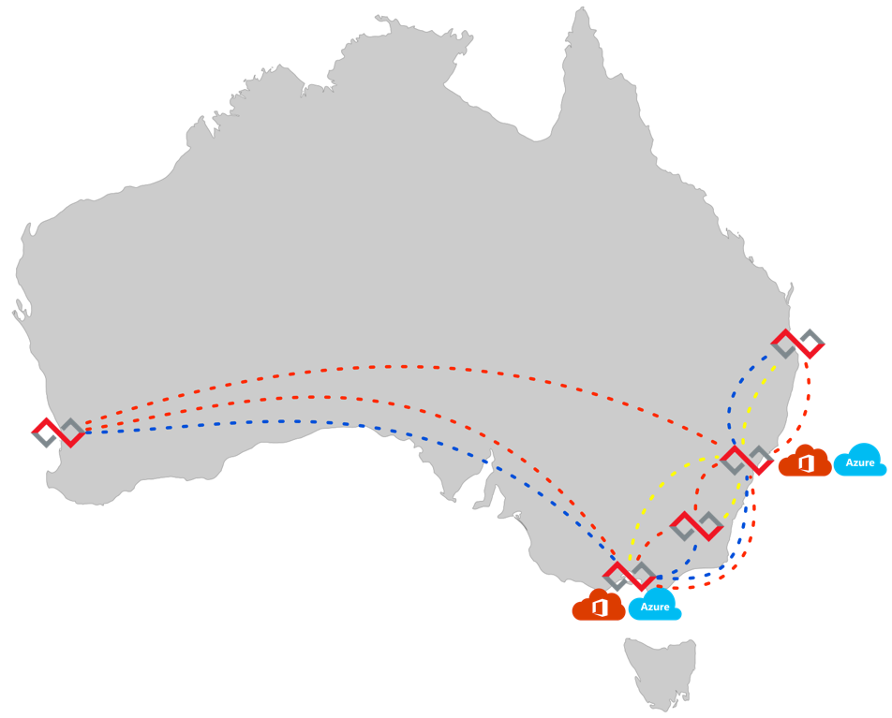
NATIONAL COVERAGE

Slide 20




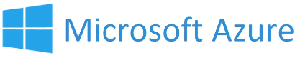
Connecting to Microsoft Azure
Microsoft Azure requires dual paths for redundancy
2 x Port Setup
2 x Port Rental
2 x Elastic Cross Connects
Plus connectivity from customer colocation rack (via cross connect) or from customer premises (via carrier service)
Data centre
cross connects or
carrier service
Customer
Top of Rack Switch
Elastic
Cross Connects
(EXC)
AXONVX Ports
AXONVX Switching Fabric

Slide 21
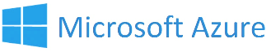

Supporting multiple customers
Shared ports, individual elastic cross connects (EXC’s)
Data Centre 1
One interconnect, multiple customer connections
Rapidly provision circuits
Orchestrate your solutions with AXONVX APIs
Multiple Customers
Systems
Integrator
Customer
Equipment

Slide 22
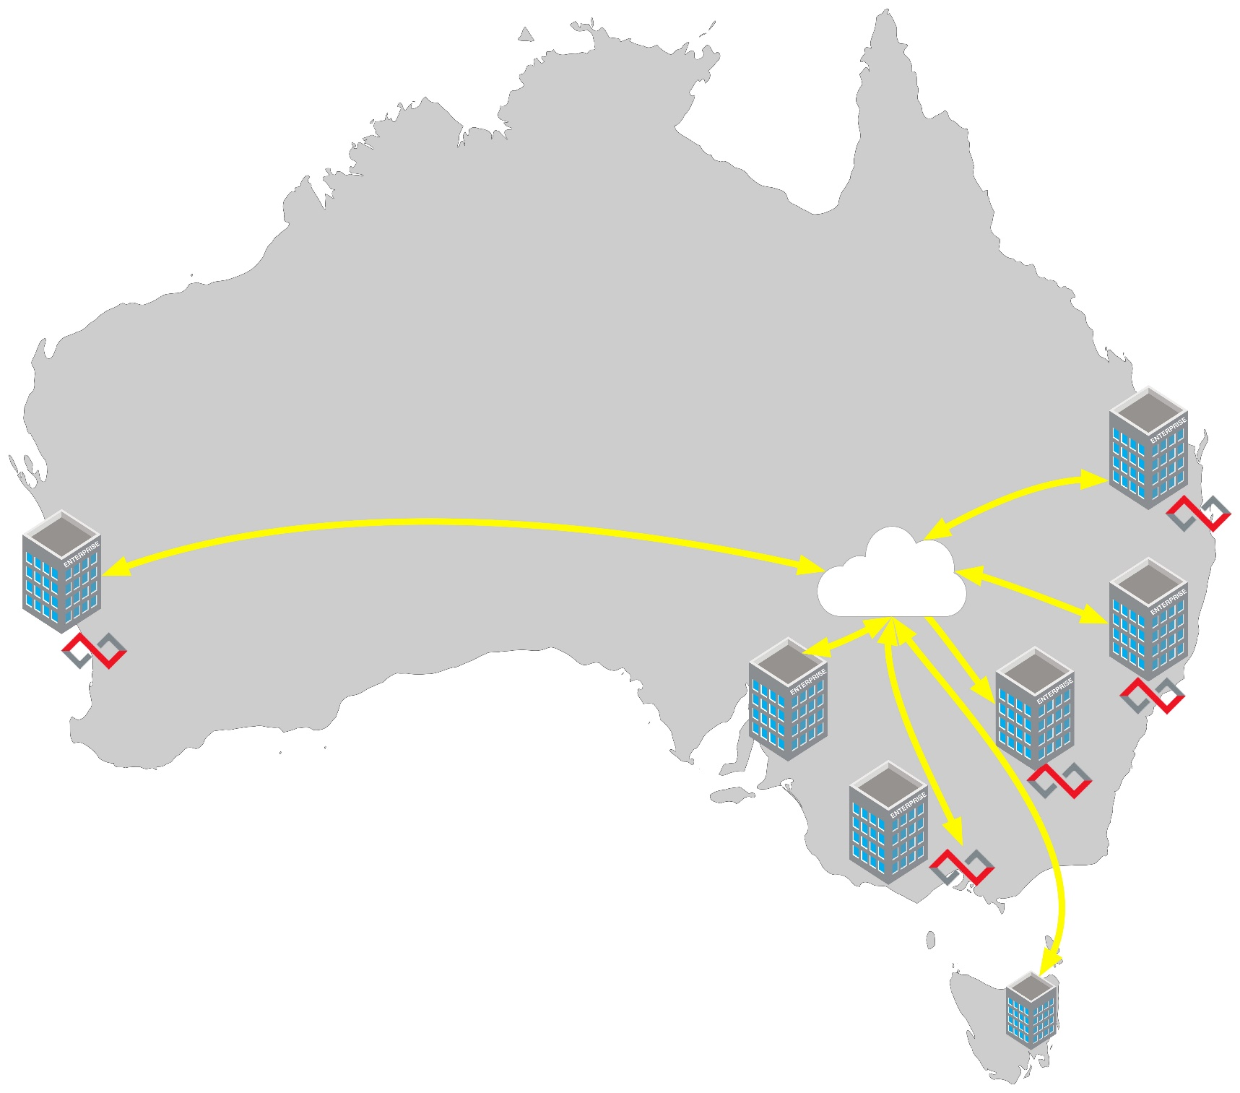
MPLS WAN

Slide 23
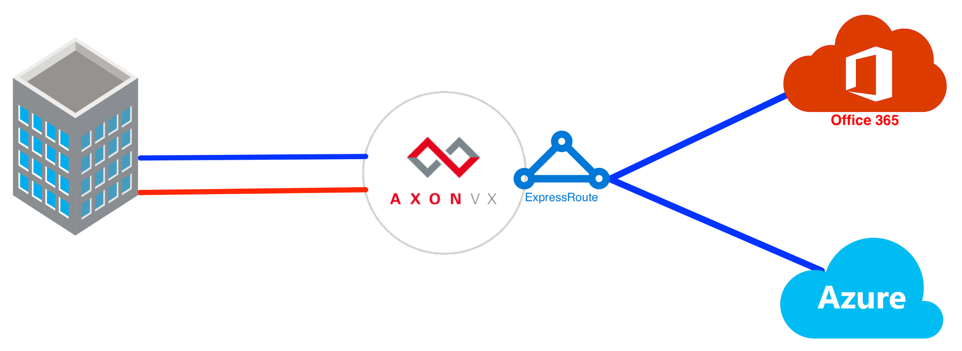
DARK FIBRE / ETHERNET

Slide 24

References
Great web links for more information
  ExpressRoute Technical Documentation: https://azure.microsoft.com/en-us/documentation/services/expressroute/
  ExpressRoute for Office 365: https://support.office.com/en-us/article/Azure-ExpressRoute-for-Office-365-6d2534a2-c19c-4a99-be5e-33a0cee5d3bd
  Other related services
  Microsoft Cloud Services and Network Security:
  https://azure.microsoft.com/en-us/documentation/articles/best-practices-network-security.html
  Azure Virtual Networks: https://azure.microsoft.com/en-us/documentation/services/virtual-network/
  Network Security Groups: https://azure.microsoft.com/en-us/documentation/articles/virtual-networks-nsg/
  User Defined Routing: https://azure.microsoft.com/en-us/documentation/articles/virtual-networks-udr-overview/
  Azure Virtual Gateways: https://azure.microsoft.com/en-us/documentation/services/vpn-gateway/
  Site-to-Site VPNs: https://azure.microsoft.com/en-us/documentation/articles/vpn-gateway-site-to-site-create/
Notes:
Most of these links are on the Azure.com website under the documentation heading covering many of the topics I've discussed today. There are links to Getting Started and How To’s that are very informative. Most of the examples we’ve seen today are from the bottom link, Microsoft Cloud Services and Network Security, a Best Practices white paper the link takes you to high level overviews, some of what we’ve covered today, and links to detailed instructions on how to build the each of the examples I’ve discussed today and more. The detailed examples use both the classic PowerShell scripting and the new ARM template methods.

