Slide 1
Module 1: Popular Social Media Live Streaming Formats
How to Use Live Streaming in
Social Media Marketing
Notes:
Title Slide

Slide 2
About Your Instructor: Kelsey Jones
10 years experience in SEO, content, and social media
Spoken at Pubcon, State of Search, SMX East
Wrote 2 courses for Digital Marketing Institute
kelsey@sixstories.com
@wonderwall7 on most social media
https://www.sixstories.com
Notes:
Title & Content

Slide 3
In This Module, We Are Going To Cover:
An overview of the current most popular social media live streaming platforms
Examples of each
Which platform would work best for your business
Notes:
Title & Content

Slide 4
Facebook Live
Best For
Exclusive Features
Brands or thought leaders with large followings
Businesses who want a blend of business and personal
Any industry
Can stream from app or desktop
Instantly saved as video
Live stream URL to share
Has third-party API tools available to schedule broadcasts
Users can receive notification when page they follow is live
Largest active user base
Notes:
Title & Content

Slide 5
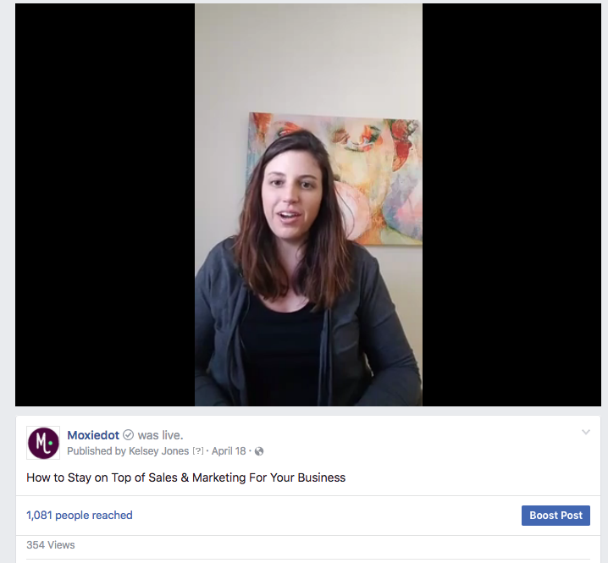
Facebook Live
Notes:
Title & Content

Slide 6
Instagram Live
Best For
Exclusive Features
Brands targeting millennials or anyone 18-45
Creative or visual brands, like beauty store, fitness experts, or artists
Several broadcasts daily or weekly
Live stream notification area on top of app
Extremely active daily user base
Video saved on profile when done
Notes:
Title & Content

Slide 7
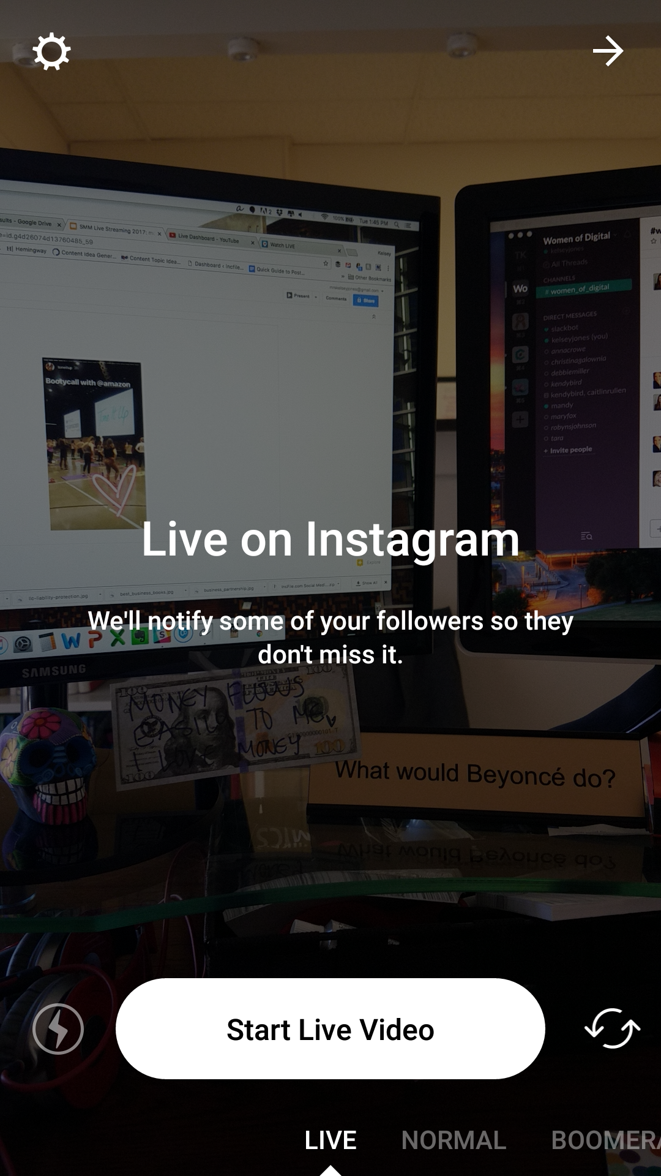
Instagram Live
Notes:
Title & Content

Slide 8
Youtube Live
Best For
Exclusive Features
Brands that have a large video or specifically YouTube user base
Organizations targeting anyone 18+
Businesses who have video studios and multiple hosts
Owned and integrated into Google products
Can be used in a webinar format (Webinar Jam)
Video saved on YouTube automatically when done
Supports multiple user format (e.g. many people in seperate locations live streaming into one video)
Automatic lighting fix
Notes:
Title & Content

Slide 9
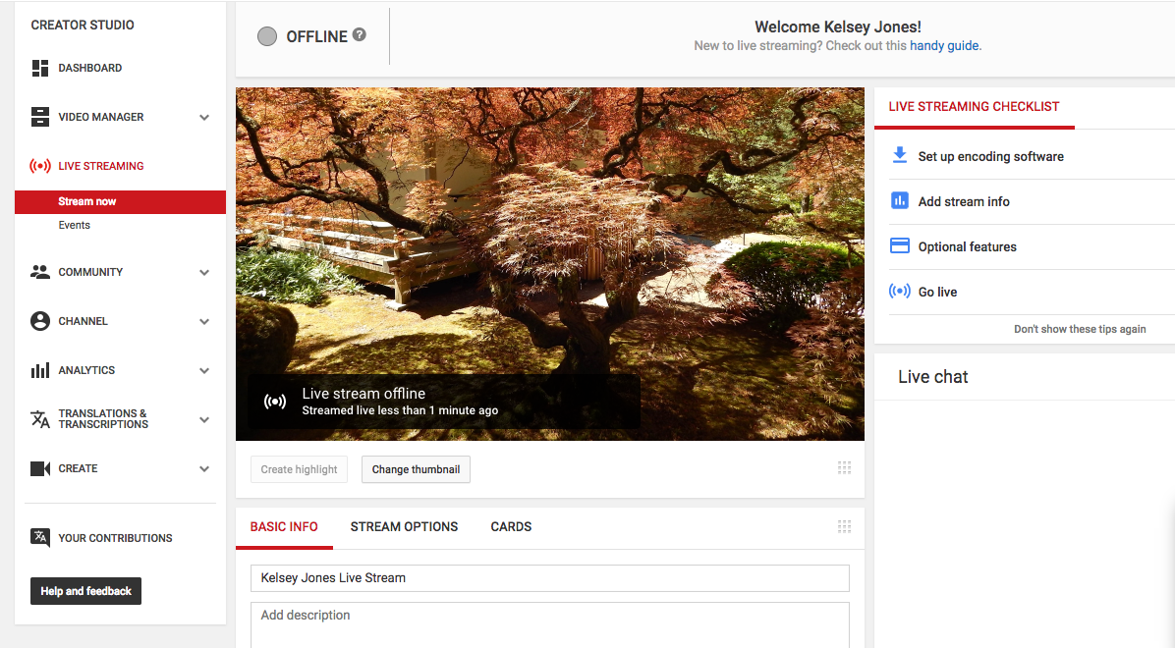
Youtube Live
Notes:
Title & Content

Slide 10
Periscope Live
Best For
Exclusive Features
Brands or thought leaders with large following on Twitter
Any industry that skews 35+
Live Events with active hashtags
Owned by Twitter
Promoted on Twitter profile
Notes:
Title & Content

Slide 11
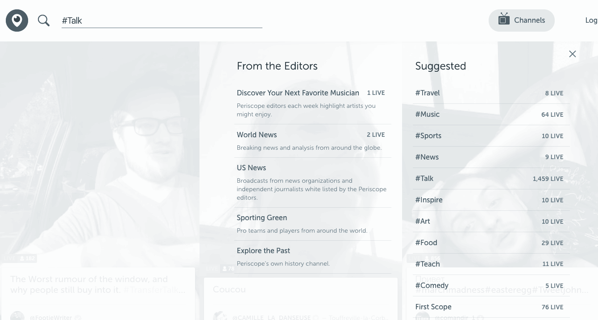
Periscope Live
Notes:
Title & Content

Slide 12
What’s Next In Social Media Live Streaming?
Virtual Reality
Snapchat
Wearable streaming
360-Degree streaming
Notes:
Title & Content

Slide 13
In This Module, We Covered:
An overview and examples of the current most popular social media live streaming platforms
Which platform would work best for your business
The future of live streaming
Notes:
Title & Content

Slide 14
In The Next Module, We Are Going To Cover:
Which technology you need to live stream on social media
What’s the bare minimum technology needed?
Notes:
Title & Content

Slide 15
Thanks for watching! See you in the next module!
Notes:
Title Slide

Slide 16
Notes:
Section Header

