Slide 1
What is a Social Filter?

Slide 2
Having a social filter means not saying something just because you think it.

Slide 3
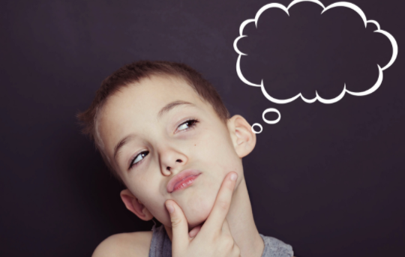
Sometimes we think things but don’t say them because they could be rude or hurt people’s feelings. This is called filtering your thoughts or having a filter.

Slide 4
When someone has no filter, it means they just say what they are thinking without thinking of other people or how they may feel.

Slide 5
If what you’re thinking may hurt someone else’s feelings, you should probably think it and not say it.

Slide 6
This is a skill that comes easily to some people, but some of us need more practice, and that’s okay.
Let’s watch this video first of kids deciding if they should say it or think it. Next, we’ll go through some examples together.
“Social Skills Video: Think it or Say it” by Everyday Speech
https://www.youtube.com/watch?v=NLm2BuW73m4

Slide 7
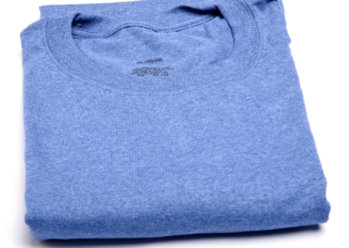
Think it or say it?
You get to school and your friend is wearing a new shirt. She is so excited and loves the new shirt she just bought. She asks you what you think of it. You don’t like it at all. Do you think it or say it?
How can you respond without hurting her feelings?

Slide 8
Think it or say it?
John had just won 2 tickets to see the new zombie movie. He was so excited and yelled, “This is the best prize ever!!!!” You think the movie looks bad and the tickets are not the best prize ever.
How can you respond without hurting his feelings?

Slide 9
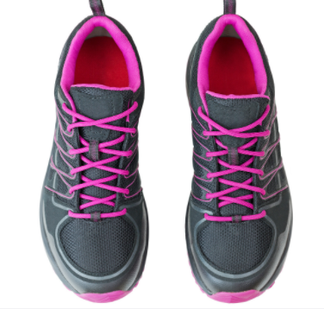
Think it or say it?
Your friend Marie just got some new shoes. You LOVE them! They are so cute and look so good on her. She asks you want you think?
How can you respond?

Slide 10
Think it or say it?
Your friend Sara is having a birthday party at her favorite place, the Reptile Center. She can’t wait to have her friends there to see the animals and touch them. You HATE reptile and think they are gross. She asks, “This is going to be awesome, aren’t you excited?”
How can you respond without hurting her feelings?

Slide 11
Think it or say it?
Your friend Jack asks you to come over after school to hang out. He is going to invite his other friend, Fred. You don’t get along with Fred and don’t like him very much. You definitely don’t want to go.
How can you respond without hurting his feelings?

Slide 12
Review: What is a filter?

