Slide 1
End of Day Two
6 min. Pitch / Team
1. One Written Caselet on the Project (Submit)
One Audio Visual Caselet (3 min.) on the Project (Show)
Pitch by the Team (Show) : Prototype

Slide 2
Final Presentation Coverage
Each Group create a thematic display
A. Pitch : 5 min. Verbal
- Business Idea- Concept Pitch : Quality of Pitch & Presentation, Uniqueness & Wow factor in Solution i.e. Problem Solved!!
- Show by Canvases & Prototype
B. Project Process Presentation Video : 3 min. (Photos, Videos)
- Process : Complete Coverage of all Stages of Project, Learning from Each Stage of Project, Tools-Techniques used & their advantages, Overall Learning of the Project.
C. Written Caselet (2 A4 size pages) : Submit

Slide 3
Reference for Pitch
1. Journey
Share top 3 observations with photographs
Share top empathy video
Share top 3 insights
Share the Problem Statement
Present the top 2 ideas & how did you get them!!
Pitch : 5 Min. : Story & Share the 1 prototypes
Business Plan
Experience

Slide 4
Assessment
Specific Assessment method Class participation during Project | Weight 10%
Minor Project after day 2 (10% Prototype & Pitch 10%) | 20%
Major Project: Prototype & Pitch + Quiz & Reflective Note | 30%
Final Project Presentation (Prototype & Pitch) | 40%
*Creation of Audio Visual material for different screens will be greatly appreciated

Slide 5
Final Learning Outcome
1. Learn design thinking as an approach for human- centred innovation.
2. Practice interviewing and observation skills to develop an empathetic worldview.
Framing actionable problem statements.
Ideate & create a storyboard.
Understanding of prototyping as a strategy to develop & test ideas.
Develop problem solving approach.

Slide 6
FINAL PRESENTATION COVERAGE 3RD DAY

Slide 7
Projects
2. Major Project : Self Guided Team - till we meet on Day 3
Kind of Organizations where you may get placed
Day Three
Session 1 & 2
Session 3 & 4
Session 4 & 5
Presentation - Pitch
Design Clinic
Preparation for refinement / redoing things
Live Cases

Slide 8
Assessment
Specific Assessment method Class participation during Project | Weight 10%
Minor Project after day 2 (10% Prototype & Pitch 10%) | 20%
Major Project: Prototype & Pitch + Quiz & Reflective Note | 30%
Final Project Presentation (Prototype & Pitch) | 40%
*Creation of Audio Visual material for different screens will be greatly appreciated

Slide 9
Final Presentation Coverage
Project Process Presentation : Show by Canvases /ipad & 5 Slides Max.
Process : Completeness of Coverage of all Stages of Project, Learning from Each Stage of Project, Tools-Techniques used & their advantages, Overall Learning of the Project.
Pitch : 5 min. Verbal using max. PowerPoint : 5 Slides Max.
Business Idea- Concept Pitch : Quality of Pitch & Presentation, Uniqueness & WoW factor in Solution i.e. Problem Solved!!
Business Plan : PowerPoint : 5 slides max. AND Poster, Banner, Brochure, Ad etc.
Use Business Canvas
Vote : Top Problem, Top Solution, Top Pitch, Top Business Plan: Based on this : Refine, Redo parts, Redo complete

Slide 10
Innovation & Research Foundation Team
Faculty :
Prof. Rohit Swarup, Chairman IRF
Prof. Vijai Katiyar, Academic Chairperson, NID Prof. Subhash Tendle, Head Crafting Creative Communication, MICA
Prof. Amar Gargesh, Sr. Faculty NID & MICA Prof. Ninad Shastri, Trustee & Mentor IRF
Support team :
Prof. Romita Swarup, Sr. Trainer & Mentor, IRF
Prof. Karmjit Bihola, Coordinator Design Engineering, Gujarat Tech. Uni.
Prof. Ishteyaq Quadri, NID Alumnus (1992 batch)

Slide 11
03
Express
© All rights reserved. 2019. Innovation & Research Foundation (IRF)

Slide 13
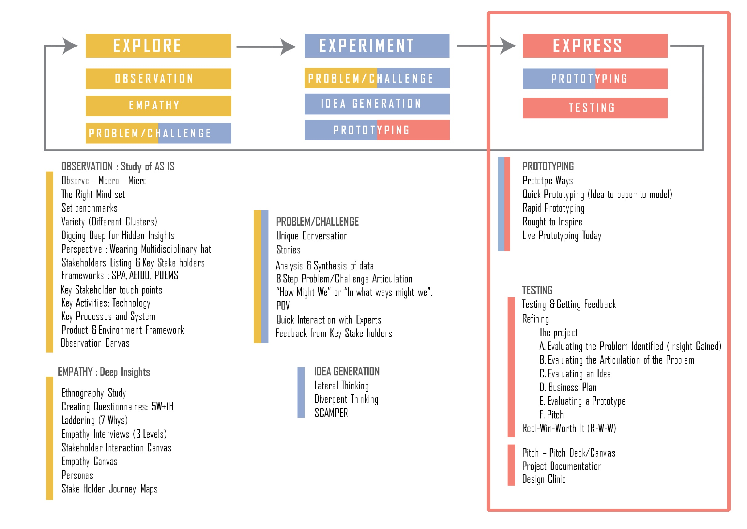

Slide 14
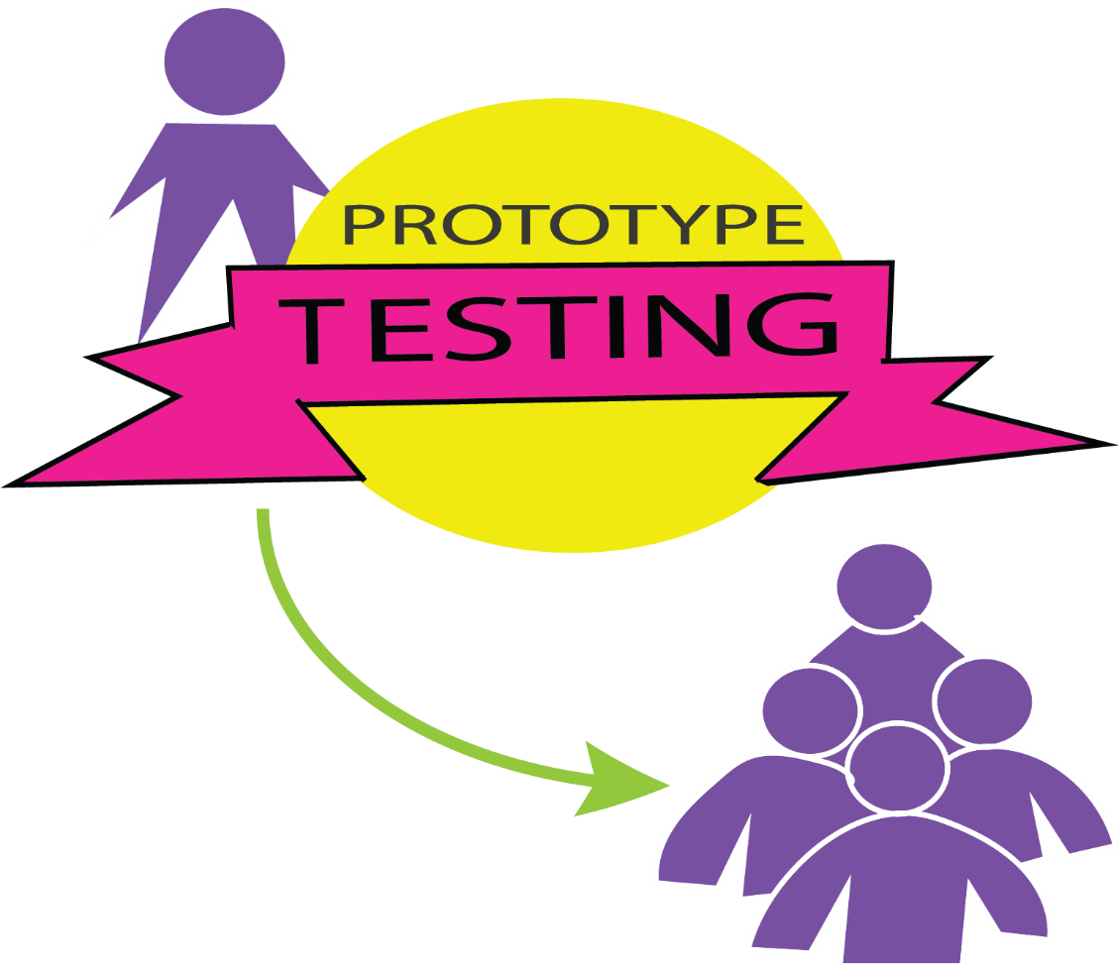
f. Testing

Slide 15
REFINING

Slide 16
The Project
- Each Team : 6 members (Sub Teams 3 members)
Work Experience Member : At least 2 / group & 1 / sub group
Finding a ‘WOW’ Problem to solve
Getting a ‘WOW’ Solution
Creating a ‘WOW’ Prototype
Creating a ‘WOW’ Pitch
Creating a ‘WOW’ Business plan

Slide 17
Though no problem is a trifle one YET Lets solve a problem worth befitting an MBA
Product/Service or System : it could be anything
The strength will be in excellence at each stage-step & exhibiting it by exquisite documentation (photos, videos, plan)
Take as much help of experts i.e. faculty & professionals (After Problem Articulation, Problem Solution & Prototyping)
Video Record
Observation, Empathy, Problem Solution & Prototype

Slide 18
A.
Evaluating the Problem Identified (Insight Gained)
- Impact on Society (will it ease a social problem)
- Business Impact (will it ease individual / market problem)
- Scale of Impact i.e. number of people it will impact
- Does the problem fall in the WOW category

Slide 19
B.
Evaluating the Articulation of the Problem
STAKEHOLDER needs a way to (PROBLEM/NEED)
Because (INSIGHT)
STAKEHOLDER =
needs a way to
PROBLEM/NEED=
because
INSIGHT =

Slide 20
C.
Evaluating an Idea
Guiding Criteria | Idea 1 | Idea 2 | Idea 3
Context
Scalability
Sustainability
Mystry to Heuristics
Heuristics to Algorithm
Algorithm to Code
Innovation in: Product/Service Process/System Business Model One Area Business Model More than 3 years
Innovation is : Radical/Incremental

Slide 21
D.
Business Plan

Slide 22
E.
Evaluating a Prototype
- Is the prototype self explanatory
- Is the prototype close to the final product (1 Least, 5 Max.)
Is the prototype impressive - refined or rough
Are their accompanying explanation / models e.g. orthographic drawings, business canvas presentation done on chart paper, business plan, flow diagrams/ process maps etc.

Slide 23
F.
Pitch
- Optimism & enthusiasm of team
- Enthusing the listener
Precise
Use of all medium i.e. charts, prototypes, speech etc.
Adherence to time
Everyone contributes
Leaves a WoW effect for the effort & solution

Slide 24
Real - Win -
Worth It (R-W-W)
The Real-Win-Worth It (R-W-W) screen is a simple but powerful tool to use in the early stages of the innovation process to test the viability of ideas for new products or services.
It’s also useful at stage gates throughout the development process to confirm the value of the innovation project or to support its termination.
At its highest level, the R-W-W screen consists of six fundamental questions:
Is the market real?
Is the product real?
Can the product be competitive?
Can our company be competitive?
Will the product be profitable at an acceptable risk level?
Does launching the product make strategic sense?

Slide 25
3M has used R-W-W on over 1500 projects
It played a central role in the ultimate success of the company’s computer privacy light-control film, which, although it promised unique privacy benefits, almost didn’t go to market.
Using the R-W-W screen, they revealed a complete lack of market knowledge regarding market size and target customer segments, and whether the film would satisfy the most attractive segments.
Subsequent test marketing showed a large market potential, so a full line of films for laptops and PCs was launched.
It quickly became one of 3M’s largest and fastest-growing businesses.

Slide 26
Action Steps
Although project screening teams vary by company, type of initiative, and stage of development, effective teams typically involve members from across functions,
including R&D, marketing, and manufacturing. Service business teams would also include members from systems and IT.
They should work with senior managers who are familiar with the screen and who can dispassionately push for accurate answers.
The development team then answers the six fundamental questions by exploring an even deeper set of supporting questions.
The team determines where the answer to each question falls on a continuum ranging from definitely yes to definitely no.
A definite no to any of the fundamental questions typically leads to termination of the project, for obvious reasons.

Slide 27
1. Real
The first set of questions focuses on the market.
- Is there a need or desire for the product?
- Could it be created with available technology and materials, or would it require a breakthrough of some sort?
- Can the customer buy it?
- Is the size of the potential market adequate?
- If it can be created, can it be produced and delivered cost-effectively, or would it be so expensive that potential customers would shun it?
- Will the customer buy the product?
- Are there subjective barriers to purchasing it?
- Will the final product or service satisfy the market?
- Is there a clear concept?
- Can the product be made or the service designed?

Slide 28
2. Win
Assuming that there are no definite “No’s” in the first step, move on to exploring the competitive environment.
Can the product or service be competitive?
Does it have a competitive advantage?
Can someone else’s offering provide customers with the same results or benefits?
Can the advantage be sustained?
How will competitors respond?
If we were going to attack our own product or service, what vulnerabilities would we find?
How can we reduce them?
Would the product or service survive a sustained price war?

Slide 29
- Can our company be competitive?
Do we have superior resources?
Do we have appropriate management?
Does the organization have direct or related experience with the market, are its development-process skills appropriate for the scale and complexity of the project, and does the project both fit company culture and have a suitable champion?
Can we understand and respond to the market?

Slide 30
3. Worth It
Finally, if the R-W-W Screen shows promise in the first two steps, it’s time to explore the risks vs. payoffs.
Will the product or service be profitable at an acceptable risk?
Are forecasted returns greater than costs?
Are risks acceptable?
How will small changes in price, market share, and launch timing affect cash flows and break-even points?
Does launching the product make strategic sense?
Does the product or service fit our overall growth strategy?
Will it enhance the company’s capabilities by, for example, driving the expansion of manufacturing, human capital, logistics, or other functions?

