Slide 1
Building a Dispatching Service Module 2
Freight Dispatching

Slide 2
Module 2: Getting Set Up
Lesson 1.
Carrier Packets
Lesson 2.
Load Boards
Lesson 3.
Understanding Freight Rates & Lanes
Lesson 4.
Understanding CPM & Carrier Profits
Lesson 5.
How to Book a Load

Slide 3
Module 2 Lesson 1: Carrier Packets
You will need a carrier packet before you start acquiring carriers. I will send your custom carrier packet to your email. A carrier packet is your personal agreement forms.
It is a legal document and not a contract only agreement form. This makes the owner operator responsible for paying you.If a carrier does not pay you then you can report them for non-payment; you would report them to the department of transportation (DOT).
When an owner operator is reported and there is proof (in some cases no proof may be needed),the owner operator's authority will be under investigation. While under investigation the owner operator will not be able to operate, investigations can last up to 21 days.
You must be compliant with DOT and the FMCSA to operate. Now, I have not heard of someone not paying before. I have only had a problem once an owner operator paid me 30 days late.

Slide 4
Module 2
Lesson 1: Carrier Packets
Be mindful that if you choose to report an owner operator for non-payment their income would be affected. We truly never known what someone is going through, and people do have families. Also, in business sometimes things happen out of our control.
Owner operators are good with paying their dispatcher. Every owner-operator you sign up will need to completely fill out your carrier packet before you send them loads.
The agreement forms are your legal documents so your carriers can pay you. You may also want to print important pages out for example: the carriers address, factoring information, insurance information, how much they want to make per load, and where they want to drive to will be on the paper. You will use a lot of the information on the packet often.

Slide 5
Module 2 Lesson 1: Carrier Packets cont.
The carrier packet includes a limited power of attorney section. This will give you or your company the right to do certain tasks.
Such as, you will be calling the shipper as you where the carrier's company for each carrier you have. You will contact their insurance each time you need to add the shipper to the COI (Certificated of Insurance). You will also call their factoring. There are many things you will do with this. I cover all of this through out the course. Along with the carrier packets you need them to send their mc authority, W-9, NOA if they factor, and COI (Certificate of Insurance). Every time you call a broker or shipper, and the owner operators is not set up you will have to set them up. This is apart of back office. This is covered in detail in Module 3.
When you fill a broker carrier agreement out for the carriers, often times you will email the paperwork given to you when they sign up to the broker or shipper.
When you want to sign a carrier up with a load and they ask you to send paperwork and fill out packet you want to do this fast. This is very important. Email them paperwork immediately if they ask. Do not send the agreement forms you have with owner operators, those are for your records and used to book loads only.

Slide 6
Module 2
Lesson 1 : Carrier Packets cont.
In some broker agreements (they could be called the carrier packets),you will upload the forms while filling out the packet.
You want to put all your owner operators into their own file, it makes it easier to use while booking the loads. The faster you book your carriers, the less work you will have to do.
You want to book your carriers at least a day or two in advance. This way you do not have a lot of work to do. You will make more calls if your carrier needs a load that day in the beginning.
NOA is a notice of assignment, from factoring companies. Some shippers and brokers want this paper when getting carriers set up and all shippers require a W-9 form to get set up. It must be dated for the current year, for tax purposes. All shippers require the mc authority certification, note the authority must be active with FMCSA. I will show you how to check this.

Slide 7
Module 2 Lesson 2: Load Boards
Load boards are used to find loads.
Some shippers have their own load boards like TQL..
Shippers open at 7am-9pm.
Keep your time zone in mind. If you are in central standard time you want to start booking loads at 6am.
Not all load board rates are the same, you will have to call each one.
To quickly decide which load to call you need to determine the CPM rate (cents per mile). You take the rate and divide it by the miles. If a load is $2000 and going 500 miles, it is $4 per mile (CPM) 2000/ 500 = 4
Most trucks looking for loads are on load boards.
Dat Truckers edge and 123 load board are the best. You will need to purchase load board to move your trucks. Dat has free trail, and so does 123.
https://truckersedge.dat.com/
Freight Brokers, Freight Load Boards, Truck Load Boards | Direct Freight
Load Board To Find Available Truck Loads and Post Freight | 123Loadboard
Truckloads Carriers (truckerpath.com)
FREE Load Board, Free Freight Search, Best Load Boards
Best Free Load Board | Find available truck loads, backhauls | Doft

Slide 8
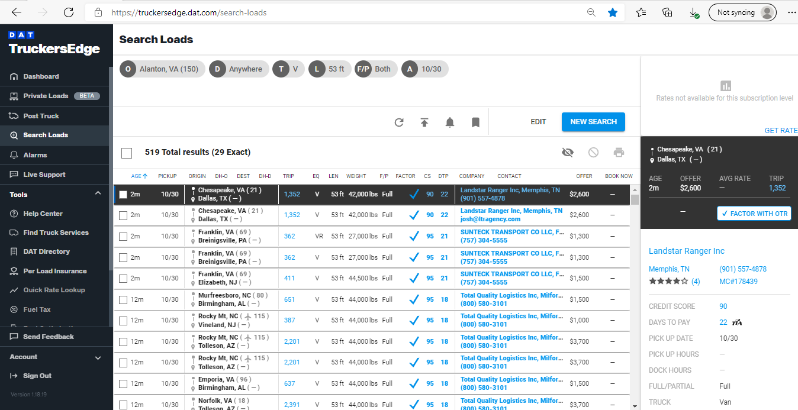
DAT Truckers Edge load board example

Slide 9
Module 2 Lesson 3: Understanding Freight rate & Lanes
The country is broken up into lanes. You do not need to know the exact CPM for each lane, but you want to know and idea of the average rate for each equipment type.
Not all lanes pay each equipment time the same.
When calling about a load be sure to ask for more, but you want to make sure you know what the rates are for that lane. Then you want to think about the rate for the area the driver will drop off in.
If a driver picks up a load in Chicago, IL for a dry van, they can easily get a load for $4 CPM. If they have two options paying the same, you want to take them to the place that will pay more leaving.
If the choices where Florida and Pennsylvania they will make more going to Pennsylvania. It may appear that they are making more going to Florida, but the freight will pay more leaving Pennsylvania than Florida.
To help with this when looking for loads check the loads out in the city he will be dropping at. This will also help ensure your driver doesn’t get stuck somewhere.
In your carrier packet, the Owner-Operators will fill out their min CPM, where they want to run, and truck type.
You will use this information to book the loads they will accept.
When signing drivers up don’t worry about the owner operators wanting way too much CPM. There are owner operators that have unrealistic expectations. Remember only 10% of owner operators make it in their first year of business. Sometimes there is nothing you can do.

Slide 10
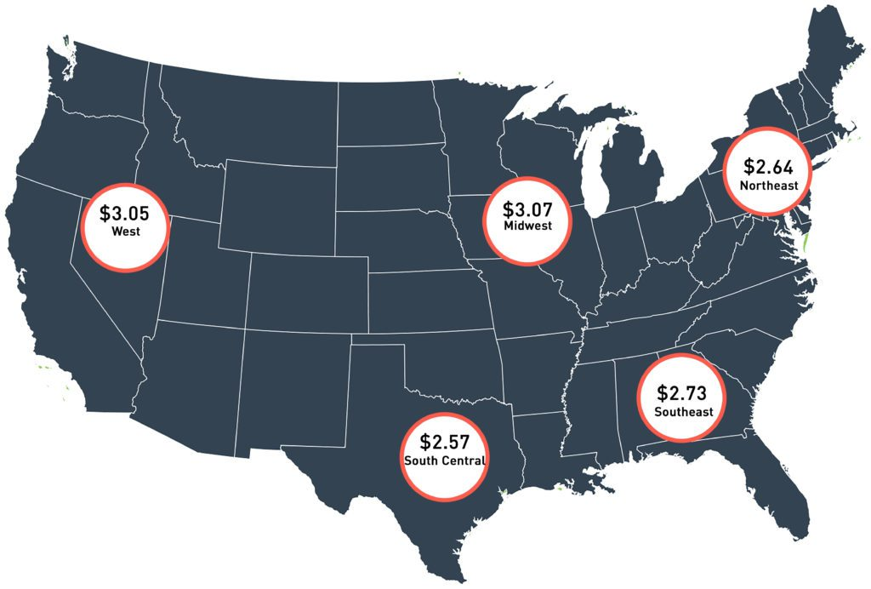

Slide 11
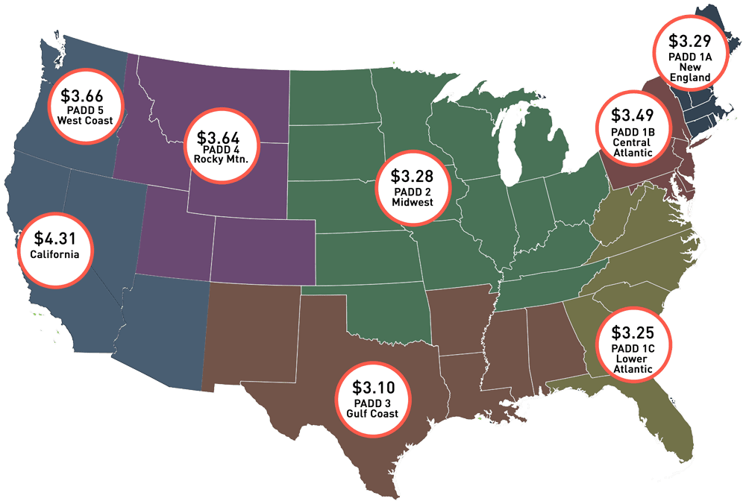

Slide 12
Module 2 Lesson 4: Understanding CPM & Carrier Profits
CPM, the cents per mile the truck is making. It does not include DH (dead head miles).
If a load is $1000.00 going 500 miles, the CPM is $2 per mile. 1000 / 500 = 2. (CPM = $2)
You want to make sure your driver is not DH too many miles. DH means no freight is being carried. It is the miles it takes to pick up a load.
Shippers do not pay for DH miles. They may be willing to pay more if the driver has a far DH. In your packets the owner operator will tell you how many miles they are willing to DH.
When searching for loads you can enter the maximum amount of DH miles. This will show you all the loads available within the DH mile radius.
Every trucks profits will be different because some owner operator's drive their trucks and some hire drivers. Everyone pays insurances, but all rates are different. Some have truck notes from dealerships, some lease trucks, and some own.
This makes every owner operators profits different. Every owner operator should know how much CPM they need to make to be profitable.
It is not your job to make sure their business is profitable. The CPM they tell you is the number they should need to make a profit.
They should be counting their insurance, truck payment, fuel, maintenance, licensees, taxes, permits, tolls, driver pay, ELD (log to track driver's hours), and anything else that goes to the truck. This is every owner's responsibility or their accountant.

Slide 13
Module 2 Lesson 5: How to Book a Load
When booking a load, you will need your carrier agreement papers, COI (certificate of insurance), MC authority certificate, and NOA if they factor.
You may want to print the carrier agreement forms or write the information down. You can also have it pulled up and will be asked questions, it is wise to have this information available.
You do not need to print out COI, NOA, or authority certificate. You will need to have these papers readily available to send to shipper and brokers.
When you get on the load boards enter the city your driver is in, the equipment type, what states they are willing to go to, and dh miles to and from.
This will give you the proper range of loads your carrier is willing to take.
Then you want to call the shipper make sure the MC number is right in front of you.
The load boards will have the details to the load posted although sometimes they leave out a lot of information.
When you call introduce yourself, state your name and where you're from and your carrier's company name.
Next, inform them that you are calling to see if the load is available.
Ex: Hey, my name is Kala from Truck Loads. I’m calling to see if your dry van load from Austin, TX to Denver, CO is available. If they ask for post ID number or reference number look on the load details and give them the number.
Never call introducing yourself as your company. This is why the carrier signs the limited power of attorney part in your carrier packet.
I use sticky notes to write down loads. You want to write down the loads pick/ drop location, dh mi, trip mi, pay, number, and any details provided.
If they say the load is available, ask them to check your MC. This will save you time, not all shippers and broker take new authorities. If you know the shipper or broker will take your carrier or they are already signed up skip this part.
Now you want to get all the details. Verify the pickup and drop location. Then you want to verify or ask how many “total miles is the load.” Then you want to ask how many drops or picks if they do not tell you. Ask what are the pickup and drop times if they do not tell you.
Some loads have more than one pick meaning they would go to more than one place to get loaded. Same with drop they can have more than one drop location.
Some loads have 24/7 pick up and drop. Some have live unload or appointment time. This means your driver will have to be there at that time.
So now you have all the details you need. If your driver is eligible for the load and set up, your job is to accept the load and they will send you a rate con. Rate cons are the only way to confirm the load is yours.
If you're not set up, they will send you a packet to fill out.

Slide 14
Module 2 Lesson 5:How to Book a Load cont.
Every time you call a shipper or broker ask them if they can email you their load list. DO THIS EVERYTIME!
This is how you will build your load list and get away from using the boards. Every shipper or broker you talk to is a potential new friendship, be mindful of your response because you do not know who has what. Also, someone may rub you wrong but can still send you great load list and keep your drivers happy. Peoples attitude in the logistics world do not always reflect their work ethic so beware.
When you are looking at the load board you want to have your calculator out. When scanning through loads you want divide the rate to miles quickly to see who you should call first.
If you are booking a load for the carrier same day you want to add the CPM quickly and make calls fast. Great loads do not always last long.
You want to start looking for loads at 6am CT. Most shippers will be opened.
Once you have 3-4 loads that fit your carriers' criteria you want to send them your options. Do not fill out packets before asking if they want the load. You may fill out packets for shippers and brokers that do not want the load after you have booked the loads you want for the day. Any extra task will lessen the chance of you getting the load.
If the carrier is not set up, they must be compliant with the shipper before they can take the load. Compliant means you have filled out packets, send in papers, and given whatever you needed to send in. Then their compliance team approves your carrier for loads. This process can take 5-45 mins for one shipper on your end. Then 15 minutes to 3 hours on there end you never know. Until you carrier is complaint in the shippers or brokers system, they cannot take the load and you will not receive rate con. Remember no rate con no load doesn’t matter what the shipper or broker says.
If the carrier is not set up, they must be compliant before they can take the load. Compliant means you have filled out packets, send in papers, and given whatever you needed to send in. Then their compliance team approves your carrier for loads. This process can take 5-45 mins for one shipper on your end. Then 15 minutes to 3 hours on there end you never know. Until you carrier is complaint in the shippers or brokers system, they cannot take the load and you will not receive rate con. Remember no rate con no load doesn’t matter what the shipper or broker says.
When you call to book a load always ask for more. At first you won’t know how much to ask for until you understand freight lanes and rates. What you can do is ask for what better paying similar loads on the boards have been posted. You can also ask for $200-300 more every time. You will not always get what you ask, but you will get more on every load you book if you ask for more each time. You do not need to explain why you asking for more just confidently ask for more. If your driver has a far DH then you may explain that, but just ask like it is already yours..

Slide 15
Module 2 Lesson 5: How to Book a Load pt. 3
When you are getting carriers set-up the shipper or broker may ask for additional details. You want to ask your carriers what company provides the ELD (Electronic Log Device). Sometimes this is asked in the packet.
Often times, you will be asked for the drivers name and phone number.
As well as, you may be asked for a picture of the truck with DOT & MC number. All trucks are required to have their DOT and MC number on their truck. This is not very common, but some may ask.
Some shippers will be added to COI (certificate of insurance). Forward the request email your carriers insurance agent. When you are done filling out the packet, give the insurance company a call to see if they have received your request and if they have sent it.
Before you accept the load, if your driver has a factoring company check to see if the shipper or broker can be factored first. If not, let your driver know the payment options. Every shipper and broker has different pay options. Be mindful , if they do not factor the load to check the shipper or brokers credit score. It is posted on DAT. If you don’t know, tell your carrier you do not know their credit score, the credit score determines how well they pay the carriers.I would not take a payment from anyone with less than an 80-credit score rating.
If loads are being factored, credit does not matter because they will be paid from the factoring company; and the factoring company already has a line of credit with the shipper. You will need their banks routing number and account number so they can get paid. In the shippers and brokers packet you will put owner operators banking information in.
When everything is all set up, the shipper will send you rate con. Remember you do not have a load if you do not have rate con, be sure to you read it throughly. Everything discussed with the shipper/broker will be inside the packets. Sign it and send it to the owner operator and do not send to the driver unless you have permission to do so from owner operator. Do not forward rate con, they don’t need to know who you got the load from. Send in separate email.
If the owner operator has a driver, ask him if wants to send load details to his/her drivers. If he does, only send the pickup and drop information. It’s best if the owner operator send this information this their employees. This information is in your carrier agreement as well.
Be sure to always check with the owner operator on what load they want before signing rate con. Loads booked and not picked up will affect the owner operator's ability to book with some companies.
You want to book loads paying $2000+ per day. You want your driver to be able to complete the load within 24 hrs. Drivers can only work 14 hours and drive 11 hours. Therefore, loads that can be done within 24 hrs paying $2000+ 5 days a week will get owner operator 10k+ each week.

Slide 16
Homework
Review your carrier packet to make sure you understand it.
Get on YouTube for at least 30 mins and look at trucking ElD’s.
Get on YouTube for at least 30 mins and look at videos on CDL driving requirements. Make sure they are talking about the hours they can legally run. You can also read two articles about this.
Get on YouTube and watch 20 mins about a truck driver’s lifestyle in the truck.
Spend 10-15 min each day imagining that you are calling owner operators, and they are delighted to sign up with you. Imagine they are sending you your carrier packet too. Set your timer.
Write 3 things each day that you are grateful for that truckers do. If you don’t know google! They supply our whole country with goods every day! Gratitude is a multiplier.
*Next Class we will be filling out packets and booking loads*

