Slide 1
What is A Computer Network?
Dr. Mohammad Adly

Slide 2
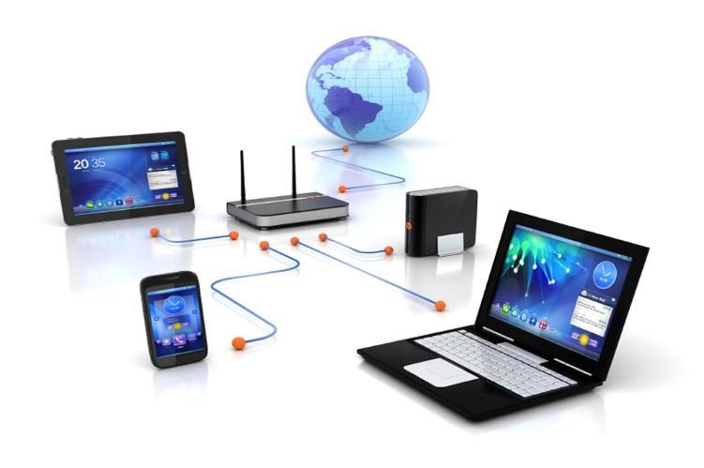
Definition of a Computer Network
A group of computers (hosts/nodes) and computer peripherals connected via a transmission media and connecting devices

Slide 3
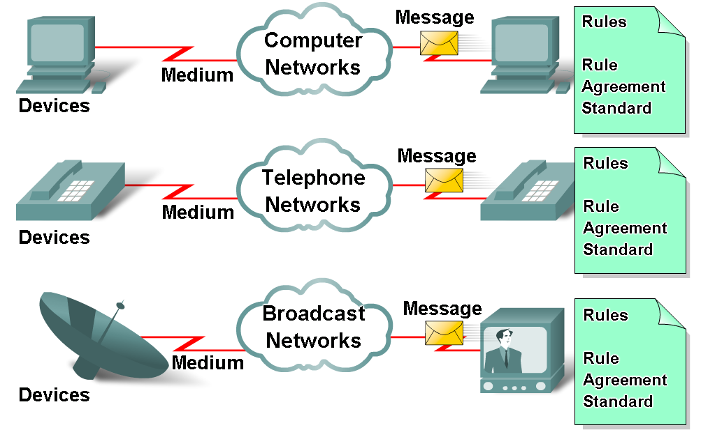
Basic Network Elements
End Devices
Communicating with each other (Send/Receive)
Connecting Devices
Switches, Routers, and Access Points
Medium
How devices connected?
Messages
Information travelling through network
Protocols
Rules governing information transfer

Slide 4
Computer Types
Personal Computers (PCs)
Desktop Computer
Laptops
Tablets
Smart Mobile Phones
Embedded Systems in Machines
Internet of Things (IoT)

Slide 5
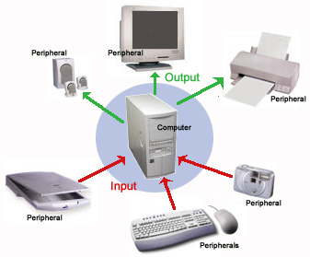
Computer Peripherals
Hardware connected to computer
Printers
Scanners
Storage Media
Cloud Computing and Data Center
Servers
Storage Devices
Managing Terminals
Offers several types of services

Slide 6
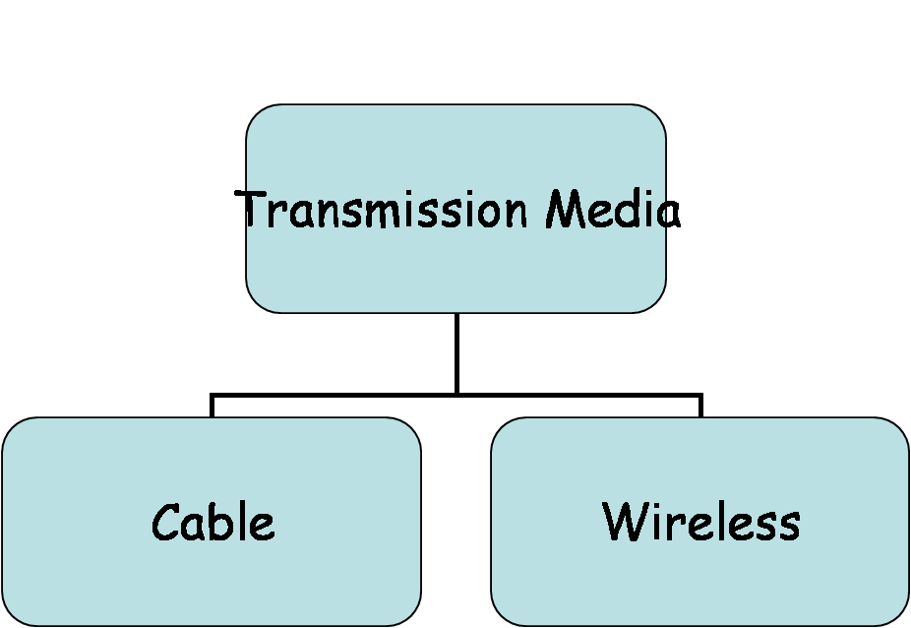
Transmission Media
Wired (Cables)
Copper
Coaxial Cables
Twisted Pair Cables (Shielded/Unshielded)
Fiber Optic
Single Mode
Multi-Mode
Wireless
Air as Transmission Media
Frequency Band
Area of Coverage

Slide 7
Network Benefits and Services
Resources Sharing
Hardware Resources
Computer Peripherals
Storage Media
Processors
Software Resources
File Sharing
Databases
Applications
Services
Browsing and E-mail
Voice Calls and Video Conferences

Slide 8
Thank you

