Slide 1
DBH VIRTUAL PROVIDER TRAINING​
Technology, Implementation, and Workflow
Presenter: Andrea Piazza, Director of Virtual Programming​

Slide 2
Content Synopsis
OVERVIEW OF KEY IDEAS
General Overview
DBH Technology Overview
Zoom
Microsoft Suite
Teams
Sharepoint
Ring
Email
KIPU
IT Support
Whats Next

Slide 3
Overview
OVERVIEW OF KEY IDEAS
Welcome to Discovery Behavioral Health’s training on technology, implementation, and workflow. We will review general information related to the use and implementation of technology in the telehealth program. Next we will take a deeper dive into some of the technology you will be using specific to virtual programming at DBH including Zoom Health, Microsoft teams and more. We will conclude by addressing how to troubleshoot IT issues via IT support and take a brief peak at some technology innovations you may see in the future.

Slide 4
Learning Objectives
GENERAL TECHNOLOGY FOR TELEHEALTH OVERVIEW
DBH TECHNOLOGY OVERVIEW
HOW TO USE DBH TECHNOLOGY PLATFORMS
IT SUPPORT
FUTURE DBH TECHNOLOGY INNOVATIONS

Slide 5
What is important to know when it comes to technology for telehealth?
5 Questions You Will be Able to Answer
What technology does DBH use for telehealth?
How do I use Zoom Health and other DBH approved technology?
Where do I go when I have issues with my technology?
What technology might I expect to see DBH use in the future?

Slide 6
General Overview
Telehealth technology should be selected based on need
Synchronous and asynchronous tools
Use only approved tools
Recognize privacy and security requirements

Slide 7
DBH TECHNOLOGY OVERVIEW
Zoom Health: video conferencing
Microsoft Suite: collection of multi-use software
Microsoft Teams: business communication
Sharepoint: long-term content management software
Ringcentral: phone and fax
Email: digital asynchronous communication
KIPU: electronic health record

Slide 8
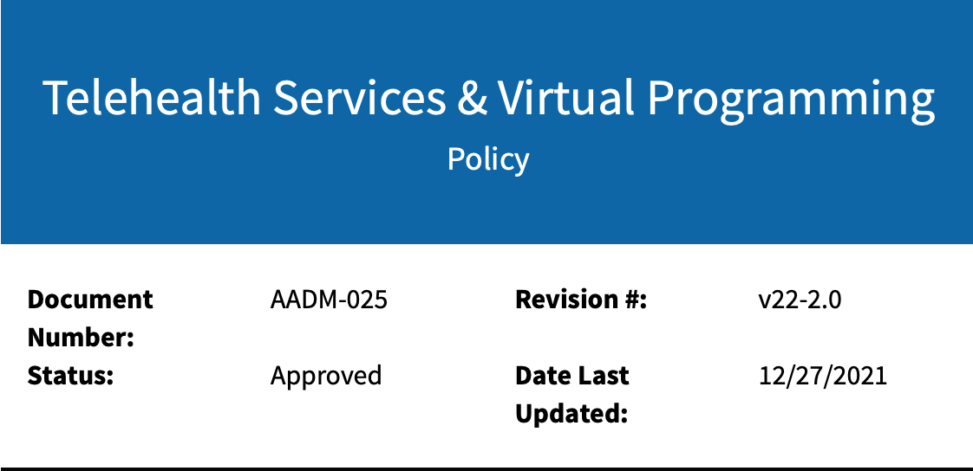
Telehealth Services Policy
Located in Zavanta
Let's take a look
Notes:
https://discoverybehavioralhealth.sharepoint.com/teams/CSQMTeam/Shared%20Documents/Forms/AllItems.aspx?id=%2Fteams%2FCSQMTeam%2FShared%20Documents%2F5%2E%20Clinical%20Quality%20%28%26%20Documentation%29%2F5%2E%20Clinical%20Supervision%2F1%2E%20Clinicians%20Desk%20Reference%202021%2Epdf&parent=%2Fteams%2FCSQMTeam%2FShared%20Documents%2F5%2E%20Clinical%20Quality%20%28%26%20Documentation%29%2F5%2E%20Clinical%20Supervision&p=trueps%3A%2F%2Fdiscoverybehavioralhealth.sharepoint.com%2Fteams%2FCSQMTeam%2FShared%2520Documents%2FForms%2FAllItems.aspx%3Fid%3D%252Fteams%252FCSQMTeam%252FShared%2520Documents%252F5%252E%2520Clinical%2520Quality%2520%2528%2526%2520Documentation%2529%252F5%252E%2520Clinical%2520Supervision%252F1%252E%2520Clinicians%2520Desk%2520Reference%25202021%252Epdf%26parent%3D%252Fteams%252FCSQMTeam%252FShared%2520Documents%252F5%252E%2520Clinical%2520Quality%2520%2528%2526%2520Documentation%2529%252F5%252E%2520Clinical%2520Supervision%26p%3Dtrue&client=safari&rls=en&sxsrf=APq-WBuEkL-BLoHkUa5kTubFt96LOluLDA%3A1645483081310&ei=SRQUYsDIEpPNkPIP__uL8AQ&ved=0ahUKEwiAka6U7pH2AhWTJkQIHf_9Ak4Q4dUDCA0&uact=5&oq=https%3A%2F%2Fdiscoverybehavioralhealth.sharepoint.com%2Fteams%2FCSQMTeam%2FShared%2520Documents%2FForms%2FAllItems.aspx%3Fid%3D%252Fteams%252FCSQMTeam%252FShared%2520Documents%252F5%252E%2520Clinical%2520Quality%2520%2528%2526%2520Documentation%2529%252F5%252E%2520Clinical%2520Supervision%252F1%252E%2520Clinicians%2520Desk%2520Reference%25202021%252Epdf%26parent%3D%252Fteams%252FCSQMTeam%252FShared%2520Documents%252F5%252E%2520Clinical%2520Quality%2520%2528%2526%2520Documentation%2529%252F5%252E%2520Clinical%2520Supervision%26p%3Dtrue&gs_lcp=Cgdnd3Mtd2l6EAMyBwgAEEcQsAMyBwgAEEcQsAMyBwgAEEcQsAMyBwgAEEcQsAMyBwgAEEcQsAMyBwgAEEcQsAMyBwgAEEcQsAMyBwgAEEcQsANKBAhBGABKBAhGGABQsgdY5gxghBFoAXABeACAAQCIAQCSAQCYAQCgAQHIAQjAAQE&sclient=gws-wiz

Slide 9
Zoom Health
Notes:
https://discoverybehavioralhealth.sharepoint.com/teams/CSQMTeam/Shared%20Documents/Forms/AllItems.aspx?id=%2Fteams%2FCSQMTeam%2FShared%20Documents%2F5%2E%20Clinical%20Quality%20%28%26%20Documentation%29%2F5%2E%20Clinical%20Supervision%2F1%2E%20Clinicians%20Desk%20Reference%202021%2Epdf&parent=%2Fteams%2FCSQMTeam%2FShared%20Documents%2F5%2E%20Clinical%20Quality%20%28%26%20Documentation%29%2F5%2E%20Clinical%20Supervision&p=trueps%3A%2F%2Fdiscoverybehavioralhealth.sharepoint.com%2Fteams%2FCSQMTeam%2FShared%2520Documents%2FForms%2FAllItems.aspx%3Fid%3D%252Fteams%252FCSQMTeam%252FShared%2520Documents%252F5%252E%2520Clinical%2520Quality%2520%2528%2526%2520Documentation%2529%252F5%252E%2520Clinical%2520Supervision%252F1%252E%2520Clinicians%2520Desk%2520Reference%25202021%252Epdf%26parent%3D%252Fteams%252FCSQMTeam%252FShared%2520Documents%252F5%252E%2520Clinical%2520Quality%2520%2528%2526%2520Documentation%2529%252F5%252E%2520Clinical%2520Supervision%26p%3Dtrue&client=safari&rls=en&sxsrf=APq-WBuEkL-BLoHkUa5kTubFt96LOluLDA%3A1645483081310&ei=SRQUYsDIEpPNkPIP__uL8AQ&ved=0ahUKEwiAka6U7pH2AhWTJkQIHf_9Ak4Q4dUDCA0&uact=5&oq=https%3A%2F%2Fdiscoverybehavioralhealth.sharepoint.com%2Fteams%2FCSQMTeam%2FShared%2520Documents%2FForms%2FAllItems.aspx%3Fid%3D%252Fteams%252FCSQMTeam%252FShared%2520Documents%252F5%252E%2520Clinical%2520Quality%2520%2528%2526%2520Documentation%2529%252F5%252E%2520Clinical%2520Supervision%252F1%252E%2520Clinicians%2520Desk%2520Reference%25202021%252Epdf%26parent%3D%252Fteams%252FCSQMTeam%252FShared%2520Documents%252F5%252E%2520Clinical%2520Quality%2520%2528%2526%2520Documentation%2529%252F5%252E%2520Clinical%2520Supervision%26p%3Dtrue&gs_lcp=Cgdnd3Mtd2l6EAMyBwgAEEcQsAMyBwgAEEcQsAMyBwgAEEcQsAMyBwgAEEcQsAMyBwgAEEcQsAMyBwgAEEcQsAMyBwgAEEcQsAMyBwgAEEcQsANKBAhBGABKBAhGGABQsgdY5gxghBFoAXABeACAAQCIAQCSAQCYAQCgAQHIAQjAAQE&sclient=gws-wiz

Slide 10
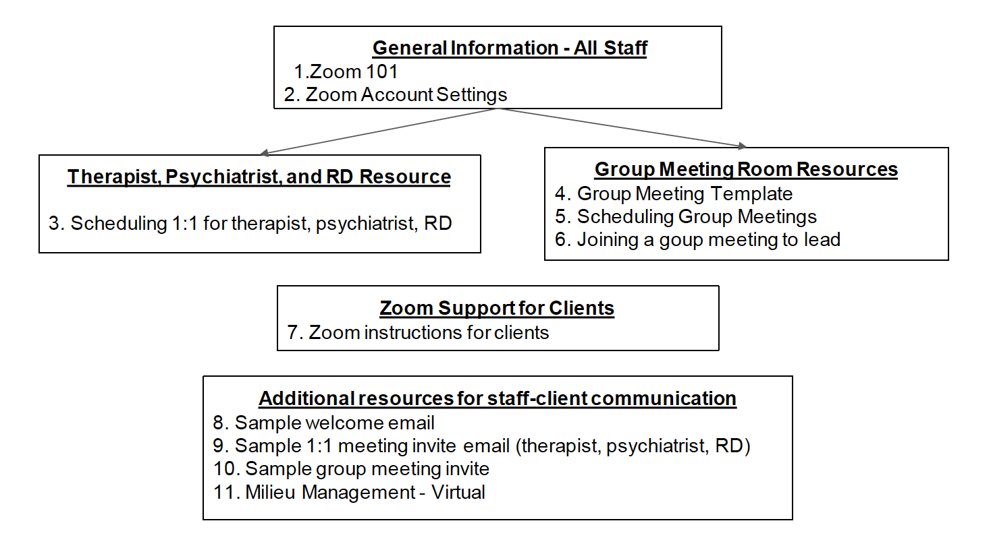
ZOOM Resources Packet
Notes:
https://discoverybehavioralhealth.sharepoint.com/teams/CSQMTeam/Shared%20Documents/Forms/AllItems.aspx?id=%2Fteams%2FCSQMTeam%2FShared%20Documents%2F5%2E%20Clinical%20Quality%20%28%26%20Documentation%29%2F5%2E%20Clinical%20Supervision%2F1%2E%20Clinicians%20Desk%20Reference%202021%2Epdf&parent=%2Fteams%2FCSQMTeam%2FShared%20Documents%2F5%2E%20Clinical%20Quality%20%28%26%20Documentation%29%2F5%2E%20Clinical%20Supervision&p=trueps%3A%2F%2Fdiscoverybehavioralhealth.sharepoint.com%2Fteams%2FCSQMTeam%2FShared%2520Documents%2FForms%2FAllItems.aspx%3Fid%3D%252Fteams%252FCSQMTeam%252FShared%2520Documents%252F5%252E%2520Clinical%2520Quality%2520%2528%2526%2520Documentation%2529%252F5%252E%2520Clinical%2520Supervision%252F1%252E%2520Clinicians%2520Desk%2520Reference%25202021%252Epdf%26parent%3D%252Fteams%252FCSQMTeam%252FShared%2520Documents%252F5%252E%2520Clinical%2520Quality%2520%2528%2526%2520Documentation%2529%252F5%252E%2520Clinical%2520Supervision%26p%3Dtrue&client=safari&rls=en&sxsrf=APq-WBuEkL-BLoHkUa5kTubFt96LOluLDA%3A1645483081310&ei=SRQUYsDIEpPNkPIP__uL8AQ&ved=0ahUKEwiAka6U7pH2AhWTJkQIHf_9Ak4Q4dUDCA0&uact=5&oq=https%3A%2F%2Fdiscoverybehavioralhealth.sharepoint.com%2Fteams%2FCSQMTeam%2FShared%2520Documents%2FForms%2FAllItems.aspx%3Fid%3D%252Fteams%252FCSQMTeam%252FShared%2520Documents%252F5%252E%2520Clinical%2520Quality%2520%2528%2526%2520Documentation%2529%252F5%252E%2520Clinical%2520Supervision%252F1%252E%2520Clinicians%2520Desk%2520Reference%25202021%252Epdf%26parent%3D%252Fteams%252FCSQMTeam%252FShared%2520Documents%252F5%252E%2520Clinical%2520Quality%2520%2528%2526%2520Documentation%2529%252F5%252E%2520Clinical%2520Supervision%26p%3Dtrue&gs_lcp=Cgdnd3Mtd2l6EAMyBwgAEEcQsAMyBwgAEEcQsAMyBwgAEEcQsAMyBwgAEEcQsAMyBwgAEEcQsAMyBwgAEEcQsAMyBwgAEEcQsAMyBwgAEEcQsANKBAhBGABKBAhGGABQsgdY5gxghBFoAXABeACAAQCIAQCSAQCYAQCgAQHIAQjAAQE&sclient=gws-wiz

Slide 11
ZOOM Tips from Jacqui
Notes:
https://discoverybehavioralhealth.sharepoint.com/teams/CSQMTeam/Shared%20Documents/Forms/AllItems.aspx?id=%2Fteams%2FCSQMTeam%2FShared%20Documents%2F5%2E%20Clinical%20Quality%20%28%26%20Documentation%29%2F5%2E%20Clinical%20Supervision%2F1%2E%20Clinicians%20Desk%20Reference%202021%2Epdf&parent=%2Fteams%2FCSQMTeam%2FShared%20Documents%2F5%2E%20Clinical%20Quality%20%28%26%20Documentation%29%2F5%2E%20Clinical%20Supervision&p=trueps%3A%2F%2Fdiscoverybehavioralhealth.sharepoint.com%2Fteams%2FCSQMTeam%2FShared%2520Documents%2FForms%2FAllItems.aspx%3Fid%3D%252Fteams%252FCSQMTeam%252FShared%2520Documents%252F5%252E%2520Clinical%2520Quality%2520%2528%2526%2520Documentation%2529%252F5%252E%2520Clinical%2520Supervision%252F1%252E%2520Clinicians%2520Desk%2520Reference%25202021%252Epdf%26parent%3D%252Fteams%252FCSQMTeam%252FShared%2520Documents%252F5%252E%2520Clinical%2520Quality%2520%2528%2526%2520Documentation%2529%252F5%252E%2520Clinical%2520Supervision%26p%3Dtrue&client=safari&rls=en&sxsrf=APq-WBuEkL-BLoHkUa5kTubFt96LOluLDA%3A1645483081310&ei=SRQUYsDIEpPNkPIP__uL8AQ&ved=0ahUKEwiAka6U7pH2AhWTJkQIHf_9Ak4Q4dUDCA0&uact=5&oq=https%3A%2F%2Fdiscoverybehavioralhealth.sharepoint.com%2Fteams%2FCSQMTeam%2FShared%2520Documents%2FForms%2FAllItems.aspx%3Fid%3D%252Fteams%252FCSQMTeam%252FShared%2520Documents%252F5%252E%2520Clinical%2520Quality%2520%2528%2526%2520Documentation%2529%252F5%252E%2520Clinical%2520Supervision%252F1%252E%2520Clinicians%2520Desk%2520Reference%25202021%252Epdf%26parent%3D%252Fteams%252FCSQMTeam%252FShared%2520Documents%252F5%252E%2520Clinical%2520Quality%2520%2528%2526%2520Documentation%2529%252F5%252E%2520Clinical%2520Supervision%26p%3Dtrue&gs_lcp=Cgdnd3Mtd2l6EAMyBwgAEEcQsAMyBwgAEEcQsAMyBwgAEEcQsAMyBwgAEEcQsAMyBwgAEEcQsAMyBwgAEEcQsAMyBwgAEEcQsAMyBwgAEEcQsANKBAhBGABKBAhGGABQsgdY5gxghBFoAXABeACAAQCIAQCSAQCYAQCgAQHIAQjAAQE&sclient=gws-wiz

Slide 12
My ZOOM Tips
Sharing Sound
Different Types of Screen Sharing
Zoom Support
Example:
Zoom Support for Captions: https://support.zoom.us/hc/en-us/articles/4409683389709-Enabling-or-disabling-closed-captioning-and-live-transcription-services
Notes:
https://discoverybehavioralhealth.sharepoint.com/teams/CSQMTeam/Shared%20Documents/Forms/AllItems.aspx?id=%2Fteams%2FCSQMTeam%2FShared%20Documents%2F5%2E%20Clinical%20Quality%20%28%26%20Documentation%29%2F5%2E%20Clinical%20Supervision%2F1%2E%20Clinicians%20Desk%20Reference%202021%2Epdf&parent=%2Fteams%2FCSQMTeam%2FShared%20Documents%2F5%2E%20Clinical%20Quality%20%28%26%20Documentation%29%2F5%2E%20Clinical%20Supervision&p=trueps%3A%2F%2Fdiscoverybehavioralhealth.sharepoint.com%2Fteams%2FCSQMTeam%2FShared%2520Documents%2FForms%2FAllItems.aspx%3Fid%3D%252Fteams%252FCSQMTeam%252FShared%2520Documents%252F5%252E%2520Clinical%2520Quality%2520%2528%2526%2520Documentation%2529%252F5%252E%2520Clinical%2520Supervision%252F1%252E%2520Clinicians%2520Desk%2520Reference%25202021%252Epdf%26parent%3D%252Fteams%252FCSQMTeam%252FShared%2520Documents%252F5%252E%2520Clinical%2520Quality%2520%2528%2526%2520Documentation%2529%252F5%252E%2520Clinical%2520Supervision%26p%3Dtrue&client=safari&rls=en&sxsrf=APq-WBuEkL-BLoHkUa5kTubFt96LOluLDA%3A1645483081310&ei=SRQUYsDIEpPNkPIP__uL8AQ&ved=0ahUKEwiAka6U7pH2AhWTJkQIHf_9Ak4Q4dUDCA0&uact=5&oq=https%3A%2F%2Fdiscoverybehavioralhealth.sharepoint.com%2Fteams%2FCSQMTeam%2FShared%2520Documents%2FForms%2FAllItems.aspx%3Fid%3D%252Fteams%252FCSQMTeam%252FShared%2520Documents%252F5%252E%2520Clinical%2520Quality%2520%2528%2526%2520Documentation%2529%252F5%252E%2520Clinical%2520Supervision%252F1%252E%2520Clinicians%2520Desk%2520Reference%25202021%252Epdf%26parent%3D%252Fteams%252FCSQMTeam%252FShared%2520Documents%252F5%252E%2520Clinical%2520Quality%2520%2528%2526%2520Documentation%2529%252F5%252E%2520Clinical%2520Supervision%26p%3Dtrue&gs_lcp=Cgdnd3Mtd2l6EAMyBwgAEEcQsAMyBwgAEEcQsAMyBwgAEEcQsAMyBwgAEEcQsAMyBwgAEEcQsAMyBwgAEEcQsAMyBwgAEEcQsAMyBwgAEEcQsANKBAhBGABKBAhGGABQsgdY5gxghBFoAXABeACAAQCIAQCSAQCYAQCgAQHIAQjAAQE&sclient=gws-wiz

Slide 13
MICROSOFT SUITE
https://www.microsoft.com/en-us/microsoft-365/products-apps-services

Slide 14
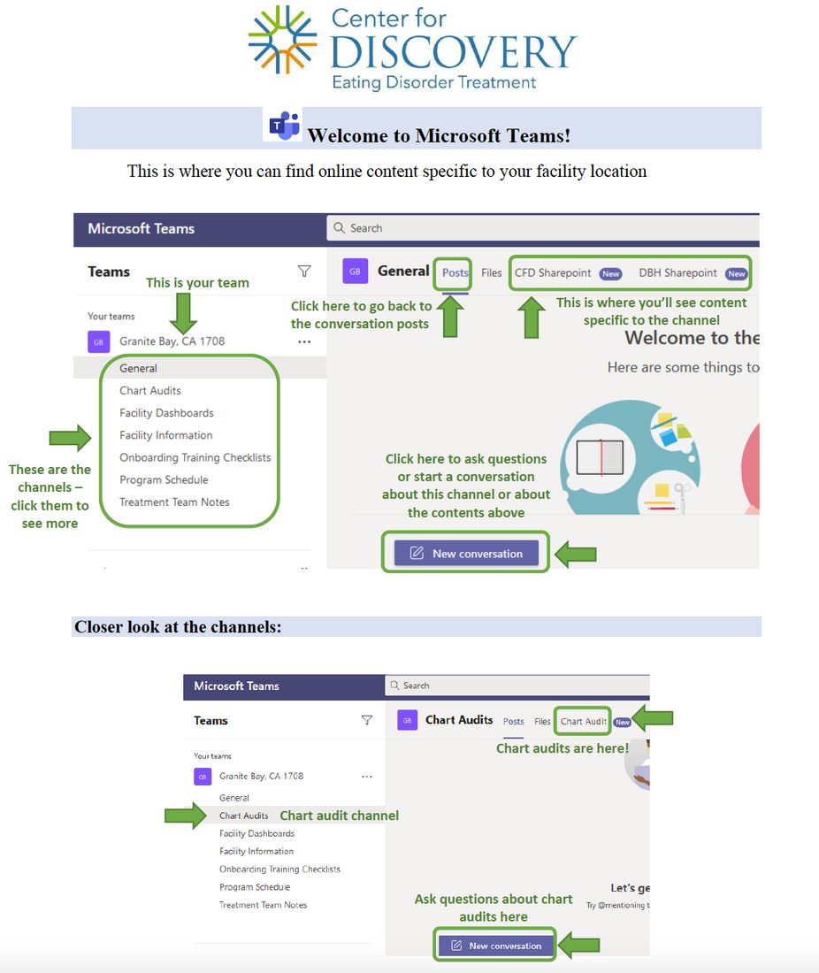
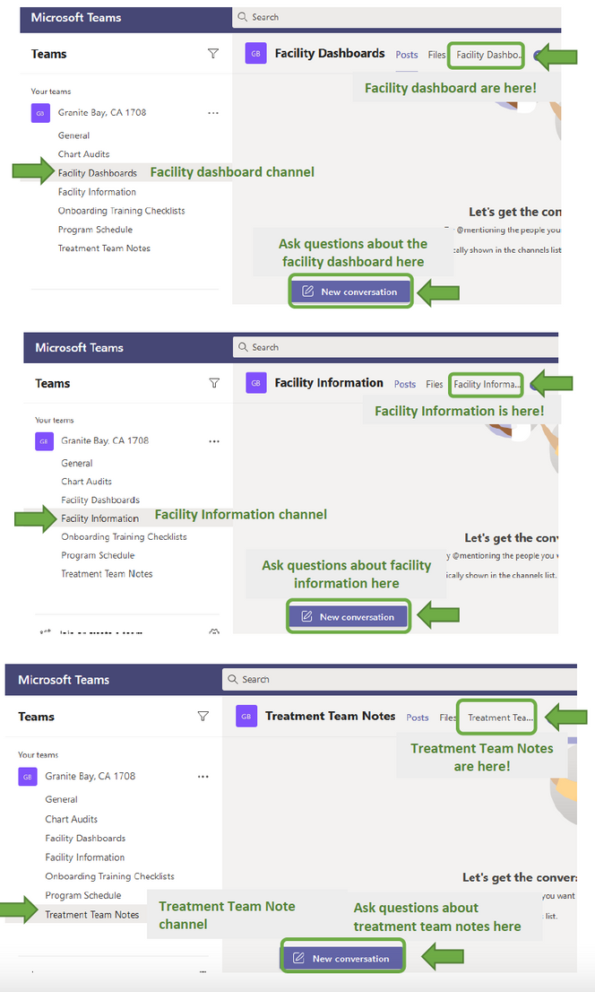
MIRCOSOFT TEAMS

Slide 15
MICROSOFT SHAREPOINT
CFD
DMA
OTHER

Slide 16
RingCentral
Work Phone
Fax
Desktop App

Slide 17
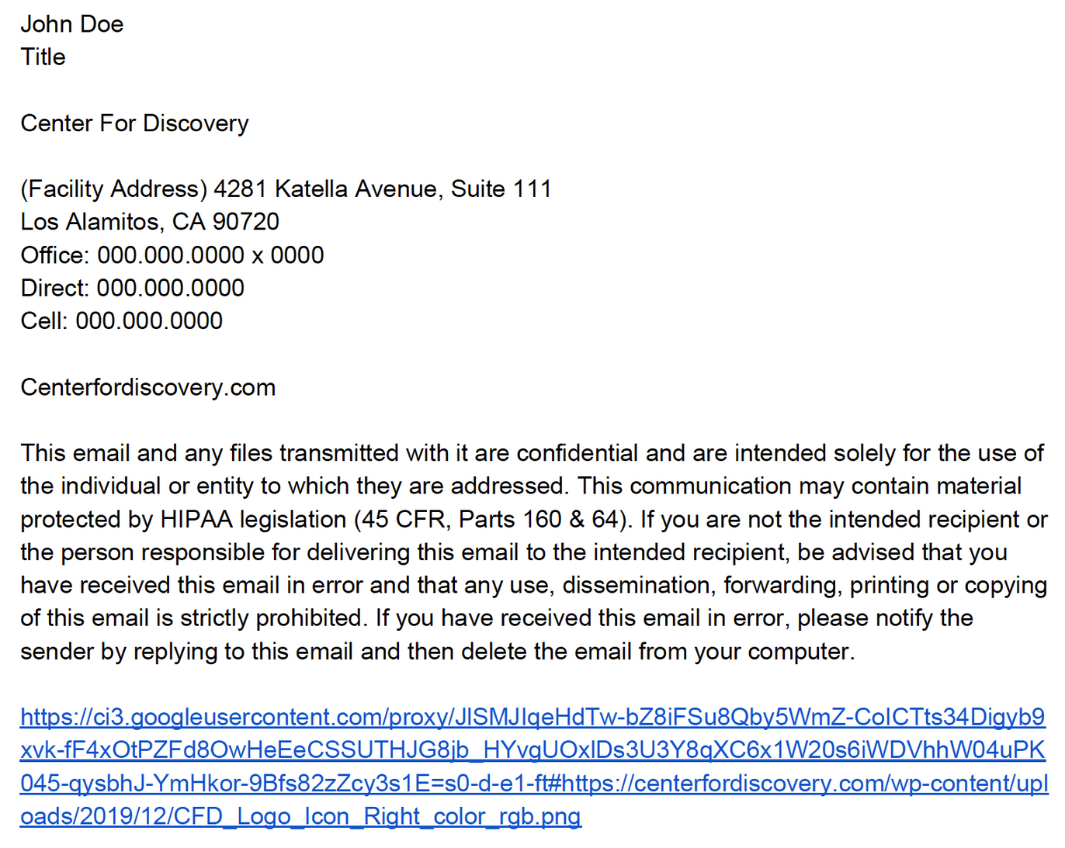
Email
Document in coordination of care
Email signature guidelines

Slide 18
Kipu
Our primary EMR
Let's walk through how to use it from a technology stand point

Slide 19
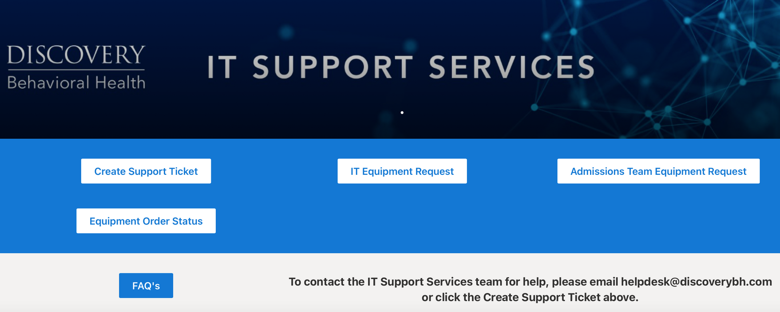
IT Support
Let's practice.

Slide 20
Whats Next?

Slide 21
SUMMARY
Technology, the implementation of it and the ongoing workflow is a crucial piece of telehealth to master. The technology we use as telehealth providers often defines our work and has significant impacts on our efficiency and effectiveness. We reviewed the general overview of technology based on what the leading telehealth training organizations provide and what Discovery Behavioral Health provides. We also addressed how to troubleshoot certain challenges with technology and some future technology implementations to look out for.

Slide 22
Thank You!
For Questions:
Apiazza@discoverybh.com

Slide 23
Resources
“Key Substance Use and Mental Health Indicators in the ...” The National Survey on Drug Use and Health, Substance Abuse and Mental Health Services Administration, Oct. 2021, https://www.samhsa.gov/data/sites/default/files/reports/rpt35319/2020NSDUHFFR1PDFW102121.pdf.
HPSA and MUA/P: HPSA scoring criteria: Guidance portal. HPSA and MUA/P: HPSA Scoring Criteria | Guidance Portal. (n.d.). Retrieved January 28, 2022, from https://www.hhs.gov/guidance/document/hpsa-and-muap-hpsa-scoring-criteria
Two-thirds of primary care physicians can't get mental health services for patients. Commonwealth Fund. (2009, April 14). Retrieved January 28, 2022, from https://www.commonwealthfund.org/press-release/2009/two-thirds-primary-care-physicians-cant-get-mental-health-services-patients?redirect_source=%2Fpublications%2Fpress-releases%2F2009%2Fapr%2Ftwo-thirds-of-primary-care-physicians-cant-get-mental-health-services-for-patients
Behavioral Health Workforce Projections. (2020, December). Retrieved from Health Resources & Services Administration (HRSA).
Hilty DM, Yellowlees PM, Parish MB, et al. Telepsychiatry: Effective, evidence-based and at a tipping point in healthcare delivery. Psych Clin N Amer 2015;38(3):559-592.
Shore, J. H., & Yellowlees, P. (2018). Telepsychiatry and Health Technologies: A Guide for Mental Health Professionals. Arlington, VA: American Psychiatric Association Publishing.
https://www.healthdata.org/infographic/covid-19-pandemic-has-had-large-and-uneven-impact-global-mental-health
Ostrowski, J., & Collins, T.P. (2016). A Comparison of Telemental Health Terminology Used across Mental Health State Licensure Boards).
National Consortium of Telehealth Resource Centers. How patients can engage in telehealth. https://www.telehealthresourcecenter.org/wp-content/uploads/2020/03/How-Patients-Can-EngageTelehealth-FINAL.pdf
Hilty, D. M., Gentry, M. T., McKean, A. J., Cowan, K. E., Lim, R. F., & Lu, F. G. (2020). Telehealth for rural diverse populations: telebehavioral and cultural competencies, clinical outcomes and administrative approaches. mHealth, 6, 20. https://doi.org/10.21037/mhealth.2019.10.04
https://www.amazon.com/Burnout-Secret-Unlocking-Stress-Cycle/dp/198481706X

