Slide 1
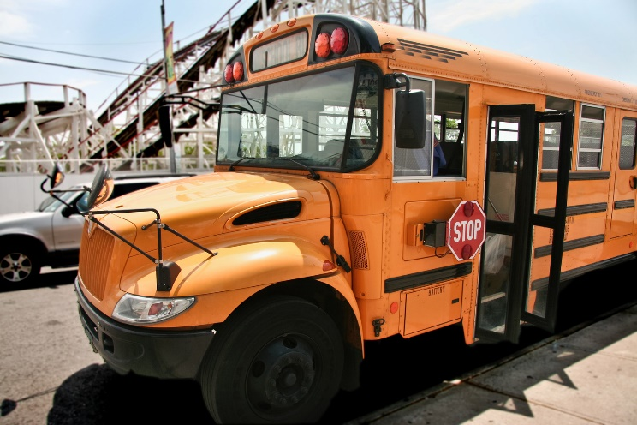
Riding the School Bus

Slide 2
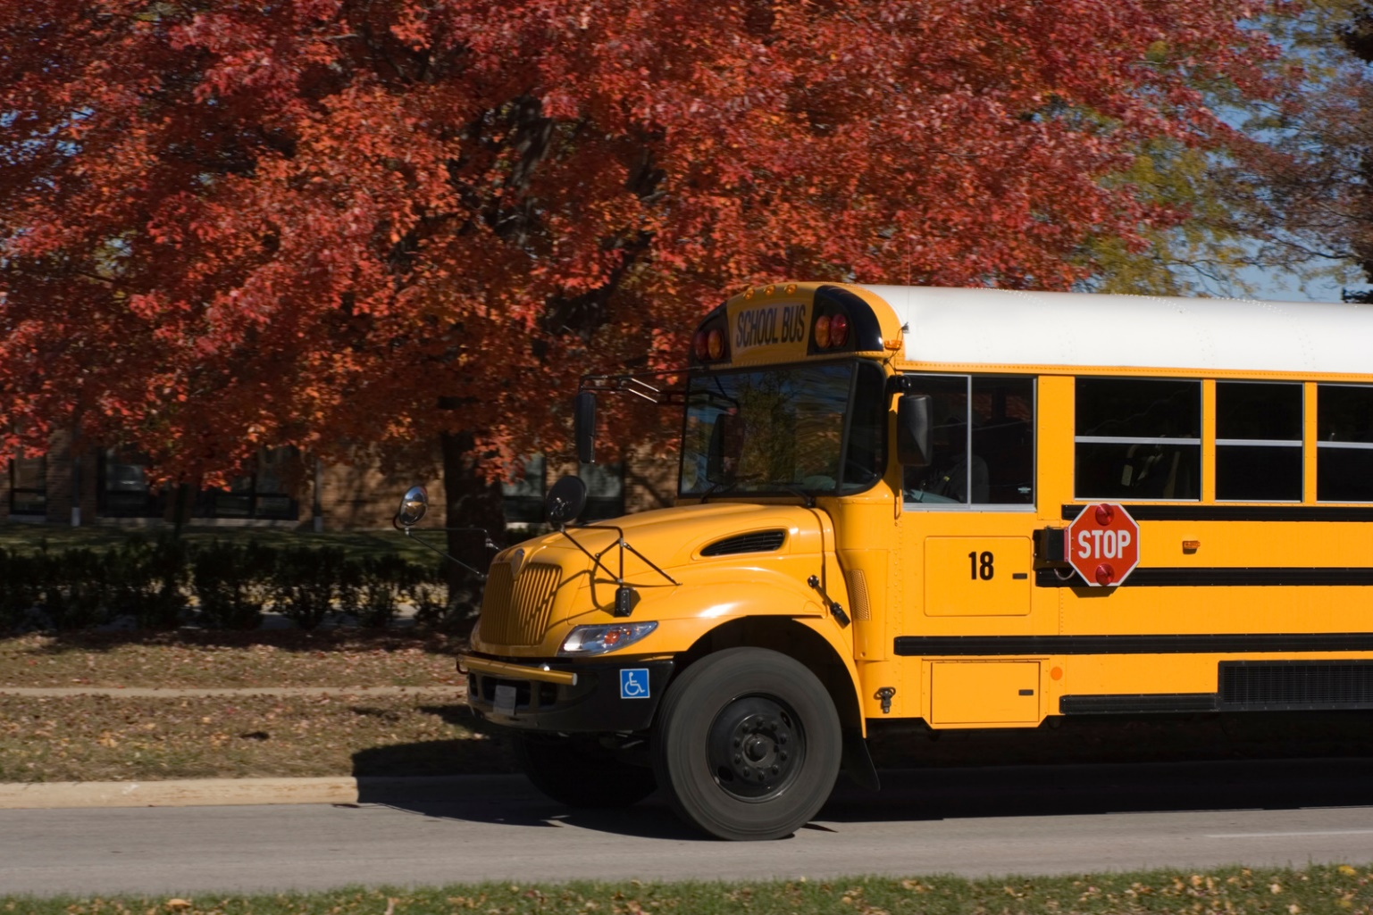
How do you get to school? Many students ride a school bus.

Slide 3
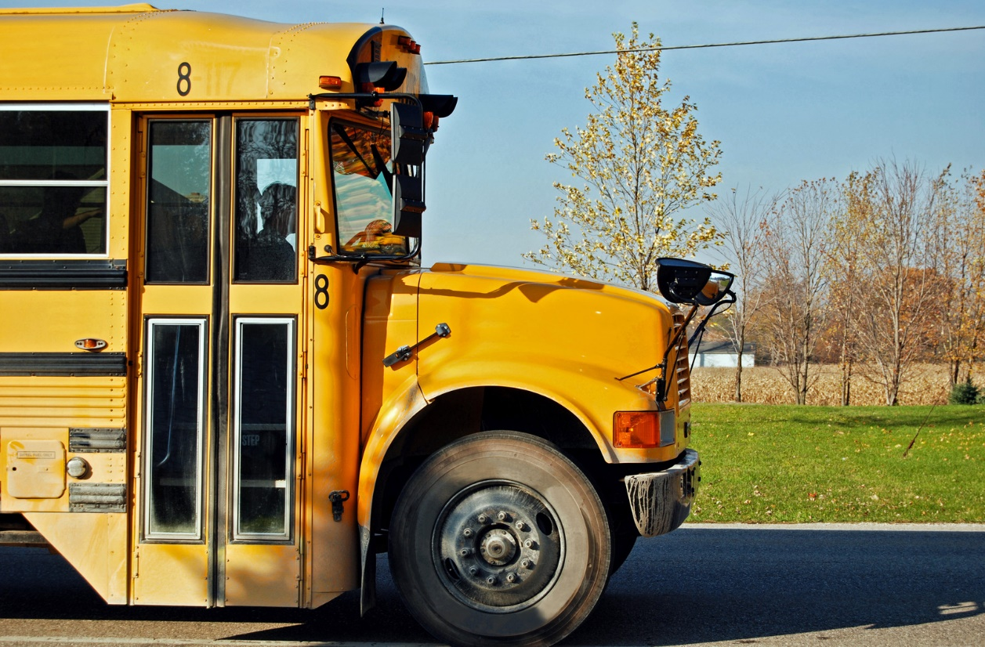
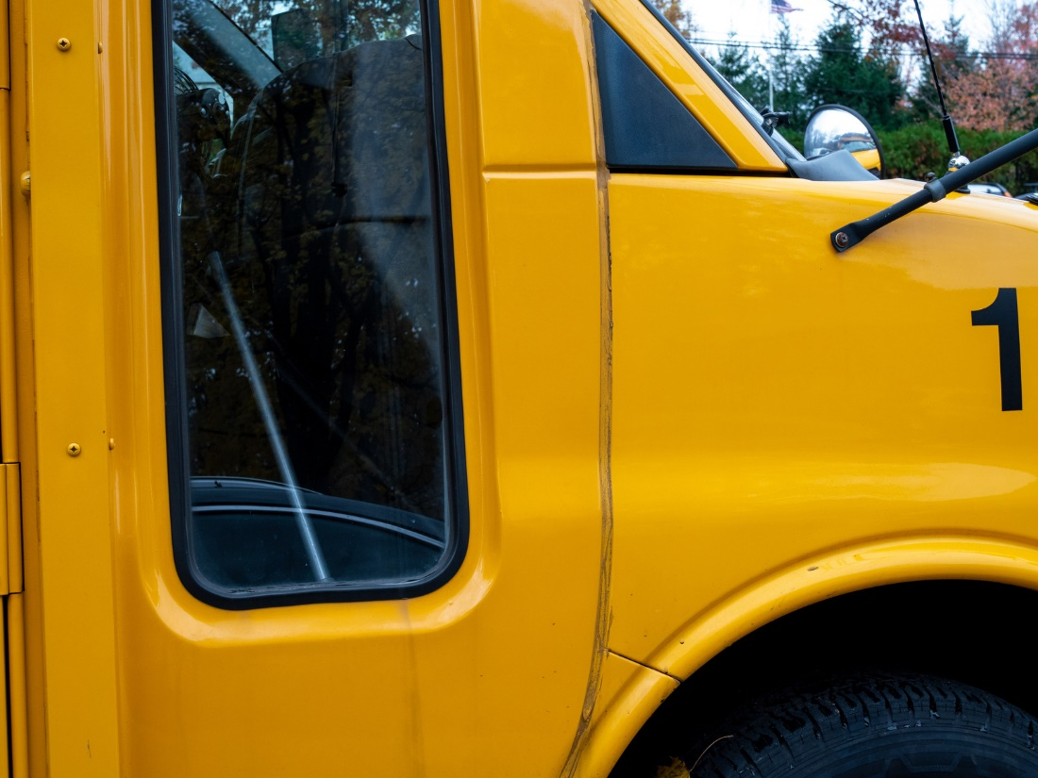
Make sure you know what bus number you ride.

Slide 4
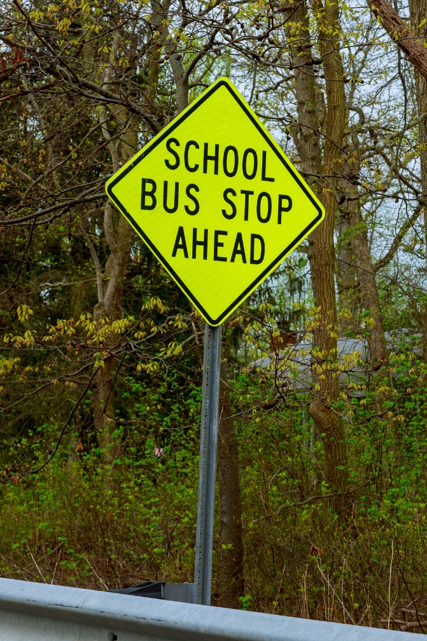
1. Wait at your bus stop.

Slide 5
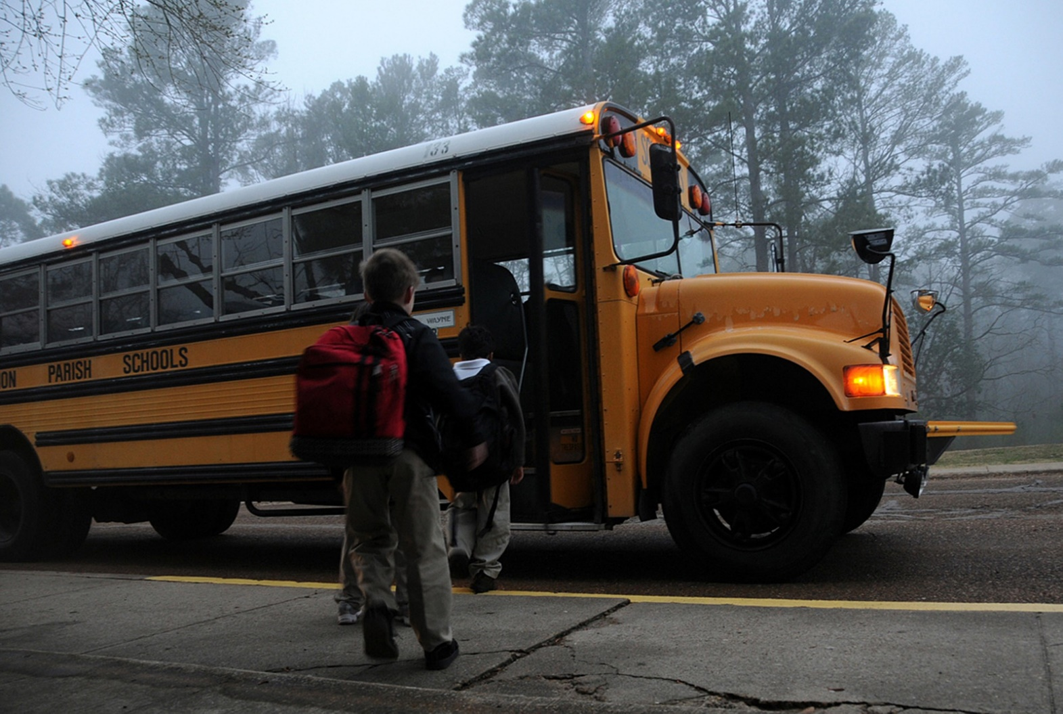
2. When the bus arrives, wait for the stop sign to come out and doors to open.

Slide 6
3. Get on the bus.

Slide 7
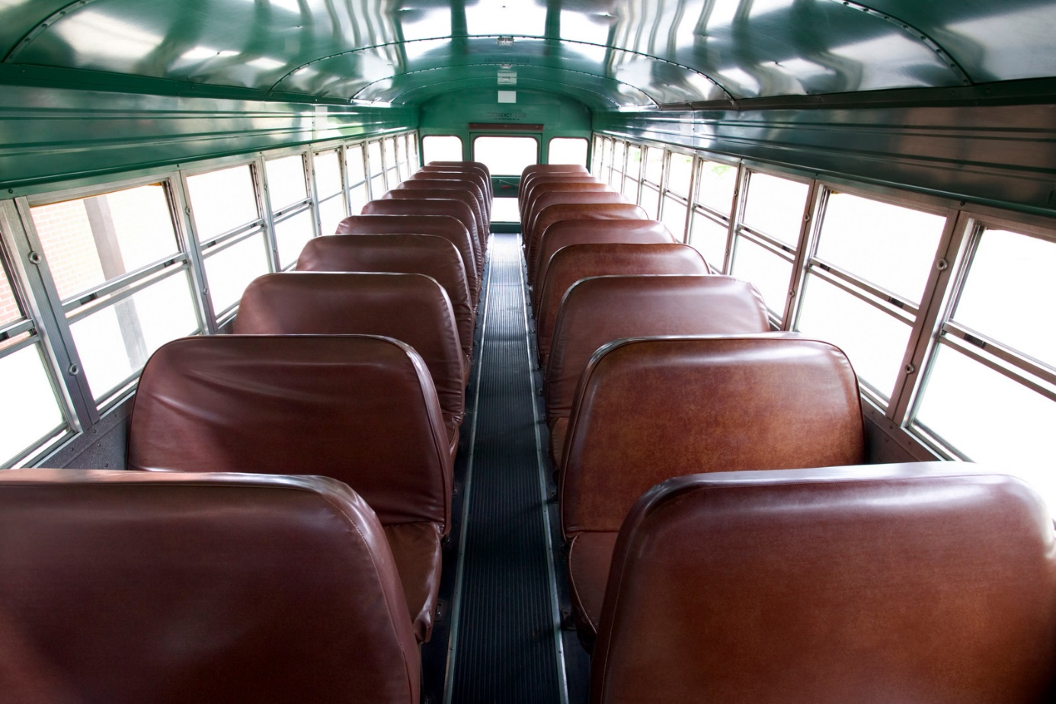
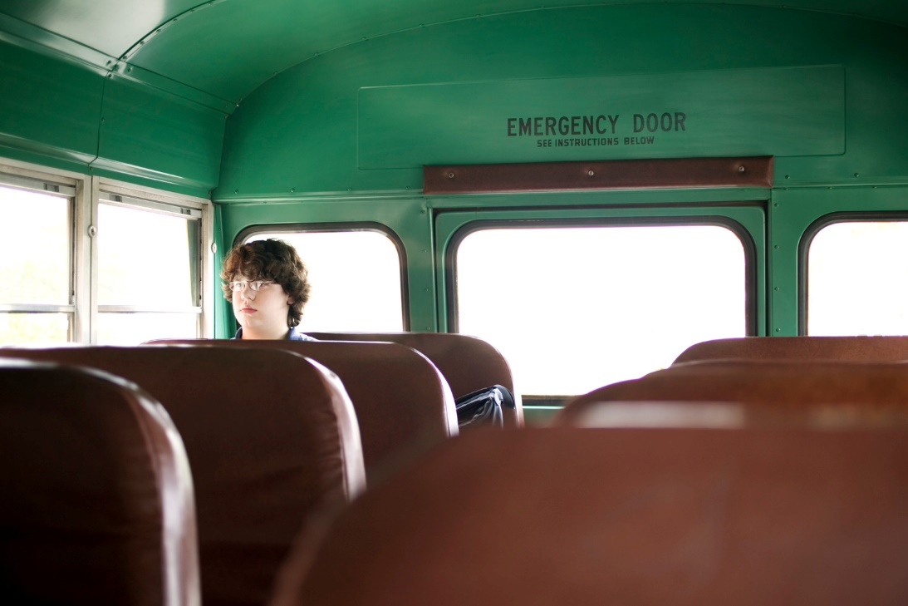
4. Find an open seat.

Slide 8
5. Put on your seatbelt (if your bus has them).

Slide 9
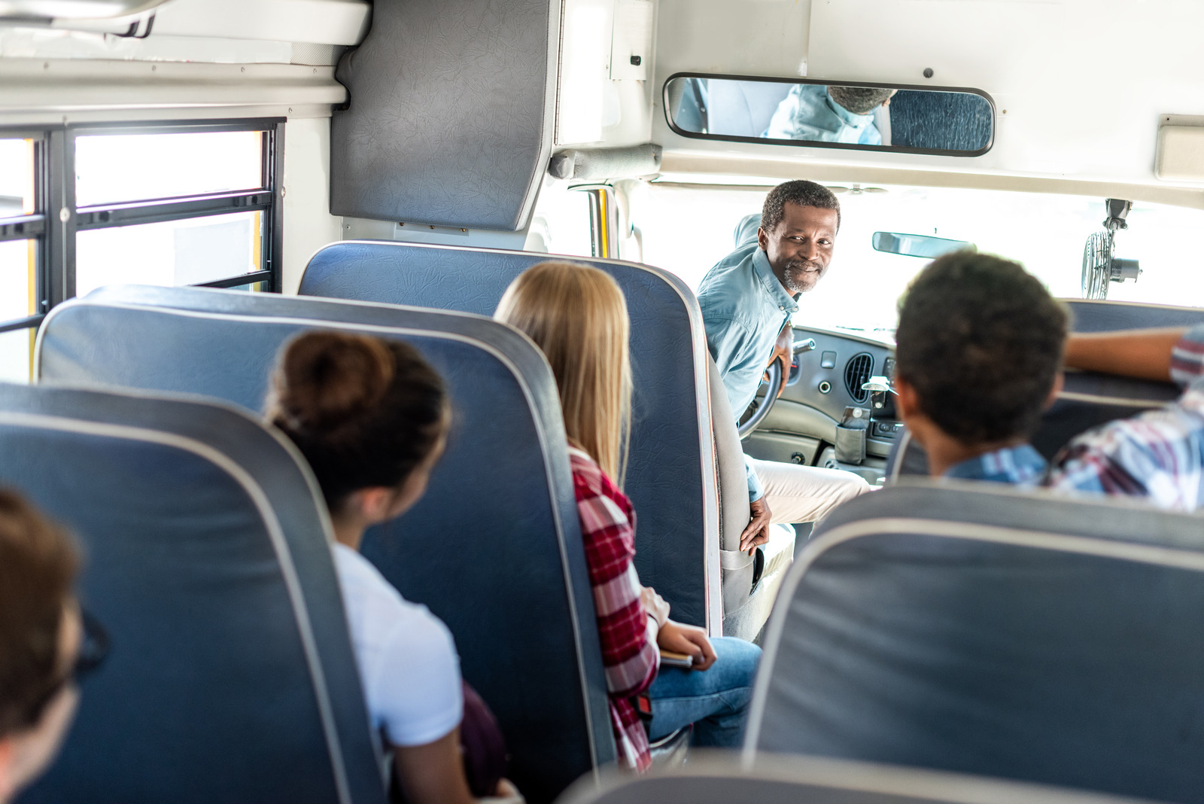
6. Enjoy the ride to school!

Slide 10
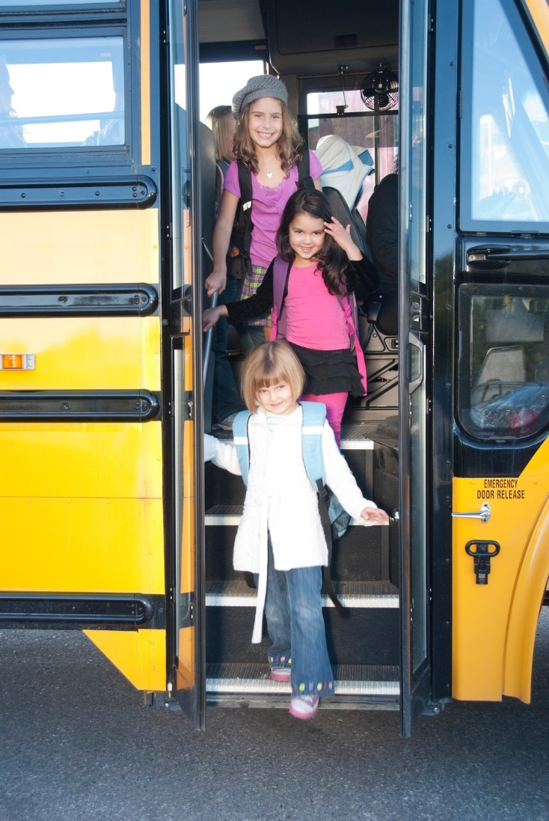
7. Wait for the bus to come to a complete stop. Walk off the bus and into the school.

Slide 11
On the way home, make sure you look at the bus number and get on the correct bus. If you don’t know, ask for help.

Slide 12
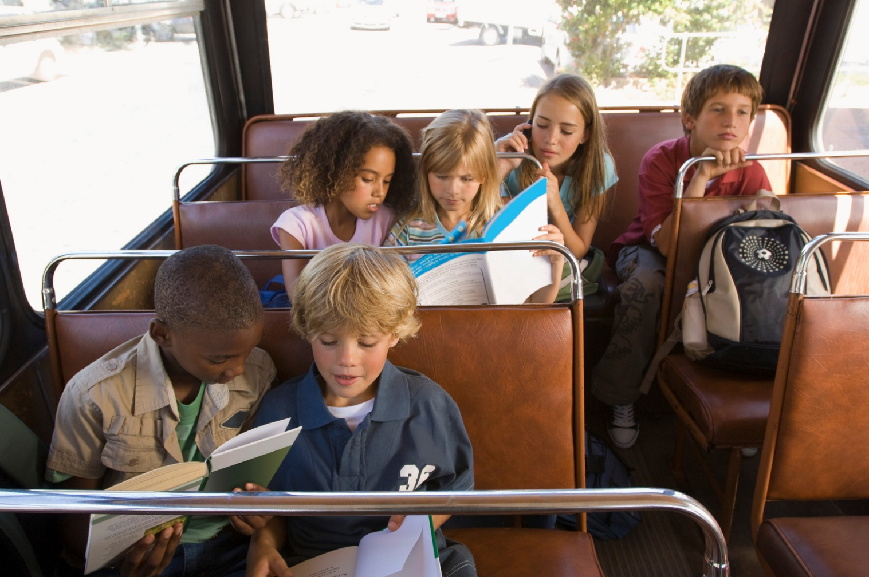
Remember! On the bus, stay in your seat.

Slide 13
Listen to the bus driver and attendant.

Slide 14
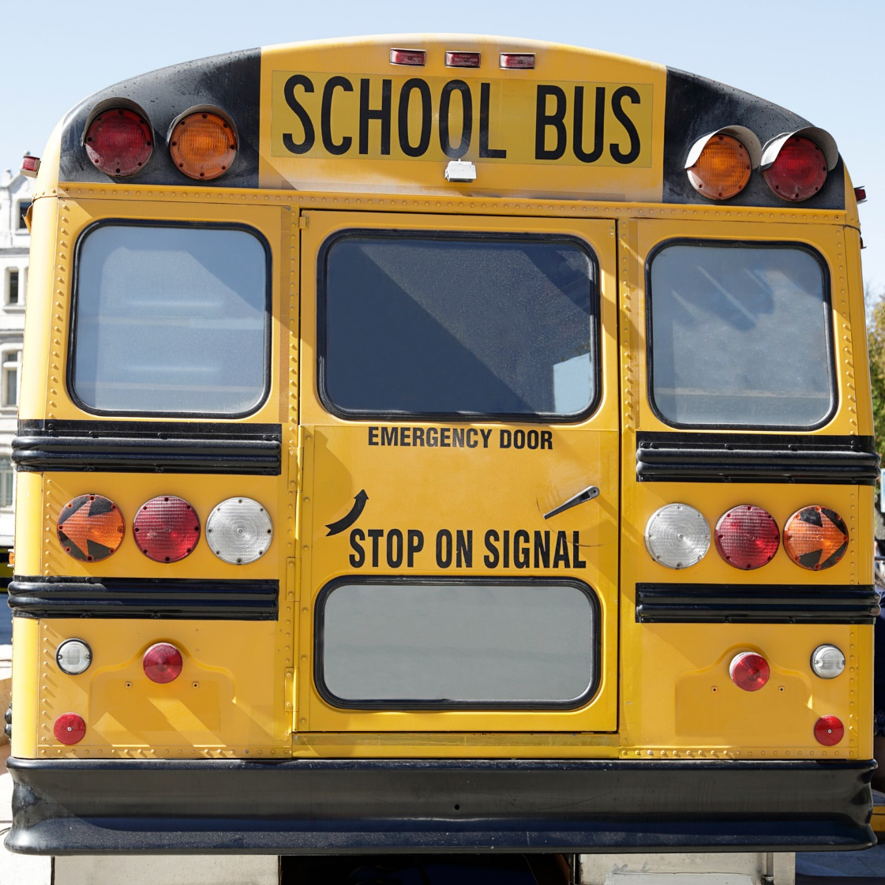
If there is an emergency, exit the back of the bus or emergency door.

Slide 15
Follow the rules to stay safe.

Slide 16
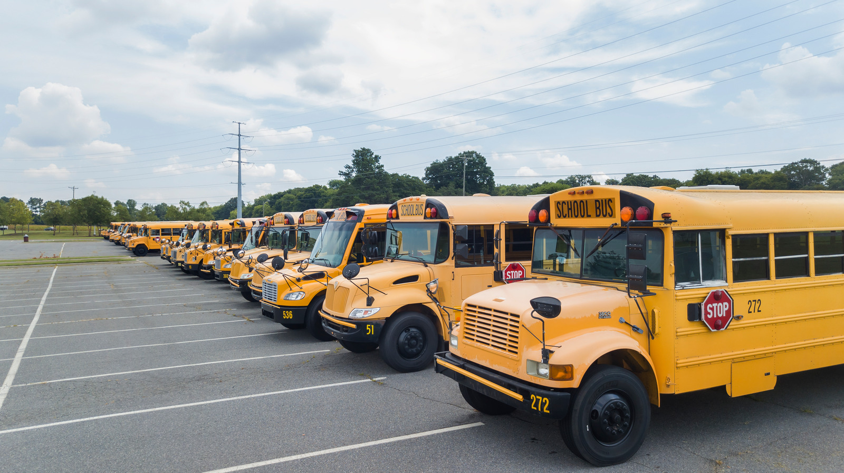
Review: How do you ride the school bus?

