Slide 1
SBA | Office of International Trade
Theo Samuels-Hunte
Export Finance Manager: PA & DE
One Penn Center
C: 215 370 5203
theo.hunte@sba.gov
Copies of this presentation are available
Export Loan Fact Sheets are available e-mail request to theo.hunte@sba.gov

Slide 2
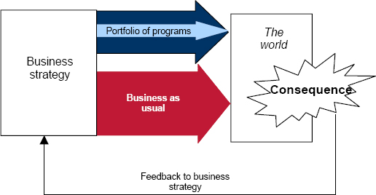
Opportunity
How do we identify opportunity?
As finance managers we want to improve our relationship with clients by adding value.
What is adding value?
Identifying opportunities that will produce a benefit or growth.
Example: PPP| EIDL|
Deliver business change to become ever more customer focused.
Create improved financial products/solutions.
https://www.pmi.org/

Slide 3
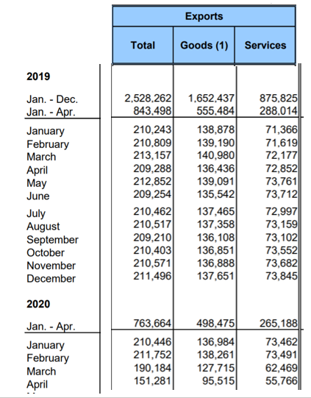
COVID 19 Pandemic Impact
As US Small businesses adapt to new market trends, growth will continue as the market picks up.
Retail increased 17.7%
New York Times 6/15/20
***Source: https://www.census.gov/foreign-trade/PressRelease/current_press_release/exh1.pdf
Notes:
2019 vs 2020 March was (11%) and April was (28%)

Slide 4
Lower Cost of Finding Overseas Buyers
SBA Office of International Trade: STEP Grants to the State provides funds to assist with export development programs.
Business travel and trade missions| Gold Key Service (USFCS or State )
Due diligence on buyers: reduces lenders risk (USFCS or States)
Regulatory standards marking for import i.e EU, CA etc.
ExporTech : Intl’l business plan. | Lender participation opportunity
https://export.delaware.gov/step-grant/
https://dced.pa.gov/programs/global-access-program-gap/
The US Commercial Service has cut fees by up to 100 % until September 30, 2020.
https://www.trade.gov/find-buyers-and-partners

Slide 5
SBA Export Loans 90% Guarantee Programs
Loan guaranties, just like the 7(a) and SBA Express loans
Same eligibility as other SBA loans
Highest guaranty available to protect the lender
Diversifying the portfolio
Competitive tools for borrowers/your clients
Indirect Exports:
Manufacturers using an Export Trading Company
Suppliers to other domestic manufacturers that export directly: supply chain financing solution

Slide 6
COVID 19 Pandemic SBA Export Loan Changes
Debt Relief for Export Loan Products
SBA will pay 6 months of principal, interest, and any extraordinary monthly servicing fees.
Existing (approved before March 27, 2020)
Export Express, EWCP and ITLs in regular servicing status
New (approved March 27, 2020 or later)
Export Express, EWCP and ITLs approved and disbursed prior to September 27, 2020.
Borrowers do not need to apply for this assistance. It will be automatically provided.

Slide 7
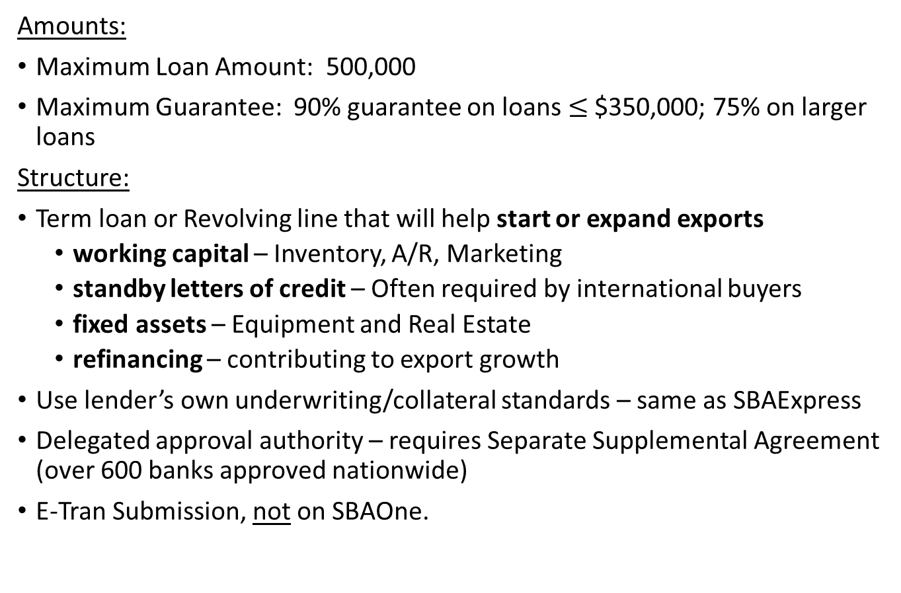
Solution: Export Express
Amounts:
Maximum Loan Amount: 500,000
Maximum Guarantee: 90% guarantee on loans $≤$ $350,000; 75% on larger loans
Structure:
Term loan or Revolving line that will help start or expand exports
working capital – Inventory, A/R, Marketing
standby letters of credit – Often required by international buyers
fixed assets – Equipment and Real Estate
refinancing – contributing to export growth
Use lender’s own underwriting/collateral standards – same as SBAExpress
Delegated approval authority – requires Separate Supplemental Agreement (over 600 banks approved nationwide)
E-Tran Submission, not on SBAOne.

Slide 8
Example: Export Express
Company:
Manufacturer of automotive components
Transaction:
Several contracts with Ford Motor (Indirect Export)
$200,000 line of credit with a 90% SBA Guaranty
No borrowing base requirements
Collateral- 2nd lien on all assets, priority lien on Ford A/R
Use of Proceeds
Used for production costs and to carry A/R
Notes:
*Golden Rule of Express Lending: As you would do with your similarly sized non-SBA loans

Slide 9
Solution: International Trade Loans (ITL)
Amounts:
Maximum Loan Amount: $5.0 million
Maximum Guarantee: 90%
Maximum SBA guaranteed portion: $4.5 Million ($4 Million for working capital)
Structure:
Term loan credit facility
Use of proceeds: permanent working capital, debt refinance, machinery
Standard 7(a) eligibility requirements, plus
The loan proceeds will significantly expand an existing export market or develop new export markets OR The applicant business has been adversely affected by import competition
AND
will improve the applicant’s competitive position
An Export Business Plan is required

Slide 10
Example: International Trade Loan (ITL)
Company: $2.4 million in annual sales. A machine shop facility
Order : Expanding international demand requiring additional equipment
Transaction:
10 year term, $750K term note to purchase new equipment, refi existing debt, and working capital with a 90% SBA guaranty * $5 million max, term note financing only (no lines of credit)
Collateral- 1st UCC on all business assets, 1st UCC lien on all new business equipment purchased with loan proceeds
Use of Proceeds:
$450K to purchase new manufacturing equipment
$169K Working Capital
$111K Debt refi
$19K Other

Slide 11
Solution: Export Working Capital Program (EWCP)
Amounts:
Maximum Loan Amount: $5.0 million
Maximum Guarantee: 90%
Maximum SBA guaranteed portion: $4.5 million
Structure:
Asset-based or transaction-based (purchase order or contract) financing
Single Project or Revolver for multiple transactions
For those Non-PLP: Export Finance Managers underwrite deals with quick turnaround time- 10-day brand promise
SBA Fee: .25 % per 12 months

Slide 12
Value Proposition: Maximize the Borrowing Base
 | Amount | % Advance | Collateral | % Advance | Collateral
Exportable Inventory |  | W/O Government Guaranty |  | With Government Guaranty
Raw Materials | $200,000 | 40% | $80,000 | 75% | $150,000
Work-in-Progress | $200,000 | 0% | $0 | 75% | $150,000
Finished Goods | $600,000 | 50% | $300,000 | 75% | $450,000
Subtotal | $1,000,000 |  | $380,000 |  | $750,000
Foreign A/R
Open Account | $400,000 | 0% | $0 | 90% | $360,000
L/C backed A/R | $600,000 | 70% | $420,000 | 90% | $540,000
Subtotal | $1,000,000 |  | $420,000 |  | $900,000
Total Borrowing Base | $2,000,000 |  | $800,000 |  | $1.650,000
Line Increases from $800,000 to $1,650,000 (+106%)

Slide 13
Example: EWCP Asset Based Line of Credit
Company:
Tool manufacturer $3.5 million/year, supplying auto assembly plants in Mexico, Asia
Employees – 30
Order:
Open account invoices to assembly plants . Supported by Export Credit Insurance
Transaction: ABL borrowing base monitored line of credit
Seller provides- 90-day terms
Working Capital Need:
Loan Amount: $800,000 *$5 million maximum SBA Fee: $1,800
Use of Proceeds: asset-based line of credit, 90% SBA guaranty
Collateral: Foreign accounts receivable- 75%* advance rate, Export Inventory- 0%* Advance Rate (90% max-75% max*)
Working Capital Provided: $800K revolving line used to finance open account terms on sales. *SBA policy additionally allows for 75% WIP

Slide 14
Example: EWCP Transaction Based
Company:
Automation firm
Transaction: Single Transaction
$3.5 Million equipment to South Africa
Working Capital Need:
$2MM facility 90% SBA guaranty
Use of Proceeds: Pre-shipment working capital
SBA Fee: $4,500 (.25 of guaranteed amount)
Collateral: 1st UCC lien on inventory and A/R, control account established with bank.

Slide 15
Example: EWCP Standby Letter of Credit
Company:
Tool Manufacturer
Transaction:
Provide $6.1M of tooling to Japan
Buyers required Standby letter of credit to secure advance payment
Working Capital Need
Loan Amount: $950K, 90% SBA guaranty
Use of Proceeds: Support Standby L/C for performance bond
Collateral: 25% of L/C cash required

Slide 16
Opportunity
Deliver business change to become ever more customer focused.
Create improved financial products
Solution
SBA Export Loans 90% Guarantee Programs

Slide 17
Thank You!
Theo Samuels-Hunte
Export Finance Manager ; PA & DE
One Penn Center
1617 JKF Blvd| Suite 1580
Philadelphia, PA 19103
Copies of this presentation are available
Export Loan Fact Sheets are available
e-mail request to theo.hunte@sba.gov

Slide 18
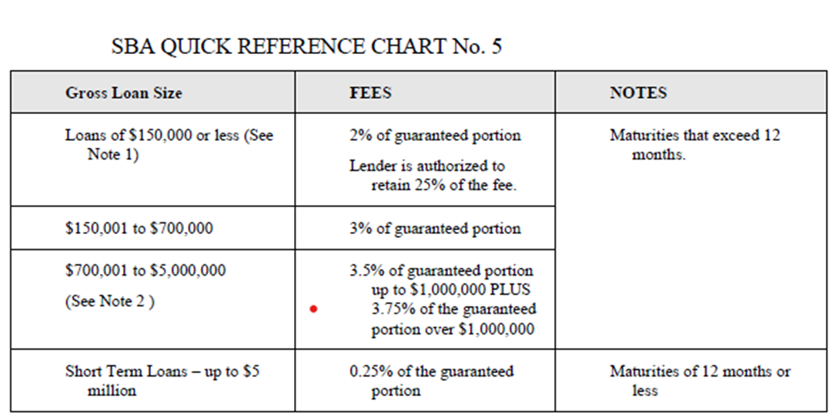
Example : $5 million 7(a) loan with a two-year term. The SBA guarantee fee on loans over $700,000 is 3.5% for the first $1 million of the guaranteed portion and 3.75% for the rest of the guaranteed portion. The SBA guarantees 75% of a $5 million loan, or $3.75 million.
The SBA guarantee fee is 3.5% of $1 million plus 3.75% of $2.75 million, or $138,125.

