Slide 1
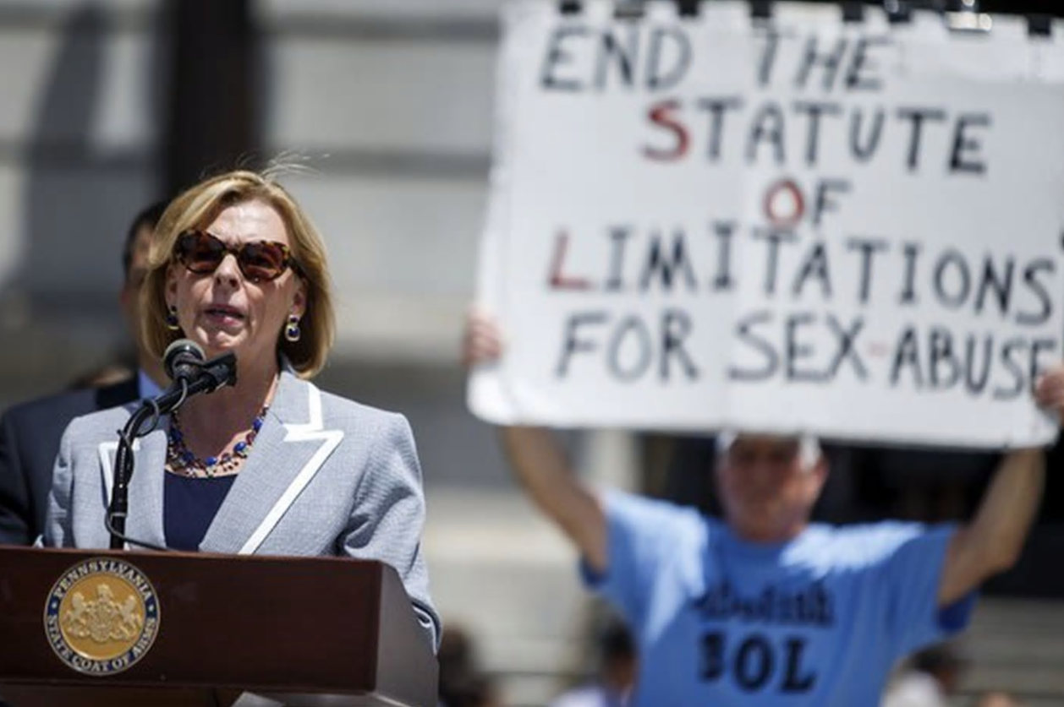
Religious Liberty Statutes and Religious Exemptions
PROF. MARCI A. HAMILTON
Founder, CEO, CHILD USA
CLE on Child Sex Abuse, Religious Institutions, and the First Amendment
November 17, 2020
CHILD USA Copyright © 2020
childusa.org

Slide 2
The Road to RFRA
CHILD USA Copyright © 2020
childusa.org

Slide 3
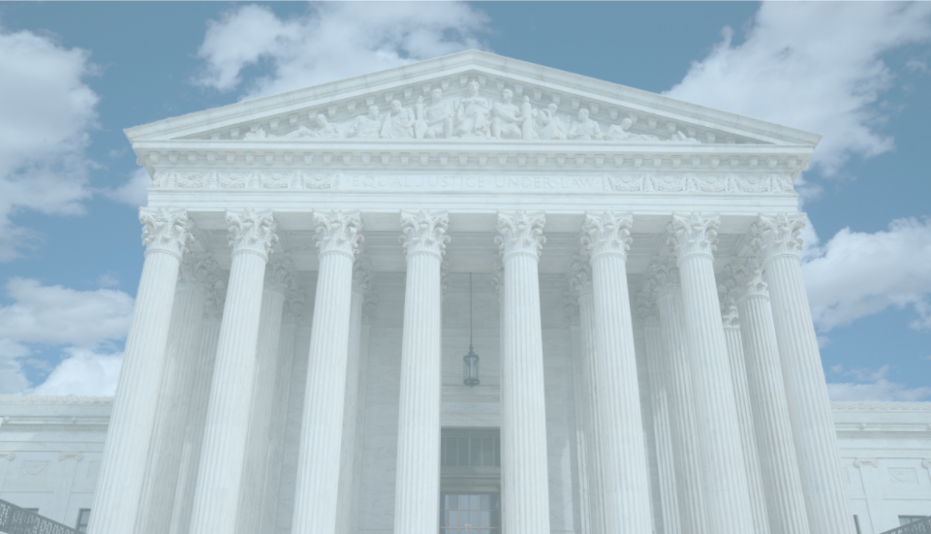
Employment Division v. Smith
Emp't Div., Dep't of Human Res. v. Smith, 494 U.S. 872 (1990).
CHILD USA Copyright © 2020
childusa.org
Notes:
https://billofrightsinstitute.org/founding-documents/primary-source-documents/memorial-and-remonstrance/

Slide 4
Religious Freedom Restoration Act of 1993
Prohibits any agency, department, or official of the United States or any State (the government) from substantially burdening a person's exercise of religion even if the burden results from a rule of general applicability, except that the government may burden a person's exercise of religion only if it demonstrates that application of the burden to the person: (1) furthers a compelling governmental interest; and (2) is the least restrictive means of furthering that compelling governmental interest.
Sets forth provisions pertaining to judicial relief, attorney's fees, and applicability.
Declares that: (1) nothing in this Act shall be construed to interpret the clause of the First Amendment to the Constitution prohibiting the establishment of religion; (2) the granting of government funding, benefits, or exemptions, to the extent permissible under that clause, shall not constitute a violation of this Act; and (3) as used in this Act, "granting" does not include the denial of government funding, benefits, or exemptions.
CHILD USA Copyright © 2020
childusa.org

Slide 5
RFRA Preface:
Neutral Generally Applicable Laws Should be Subject to Strict Scrutiny
CHILD USA Copyright © 2020
childusa.org
Notes:
https://billofrightsinstitute.org/founding-documents/primary-source-documents/memorial-and-remonstrance/

Slide 6
RFRA Substantial Burden Provision:
Shifting Burdens of Proofs
Believer proves the law imposes a “substantial burden”
Burden shifts to the government to prove the law
a. serves a compelling interest
b. in the least restrictive means
CHILD USA Copyright © 2020
childusa.org
Notes:
https://billofrightsinstitute.org/founding-documents/primary-source-documents/memorial-and-remonstrance/

Slide 7
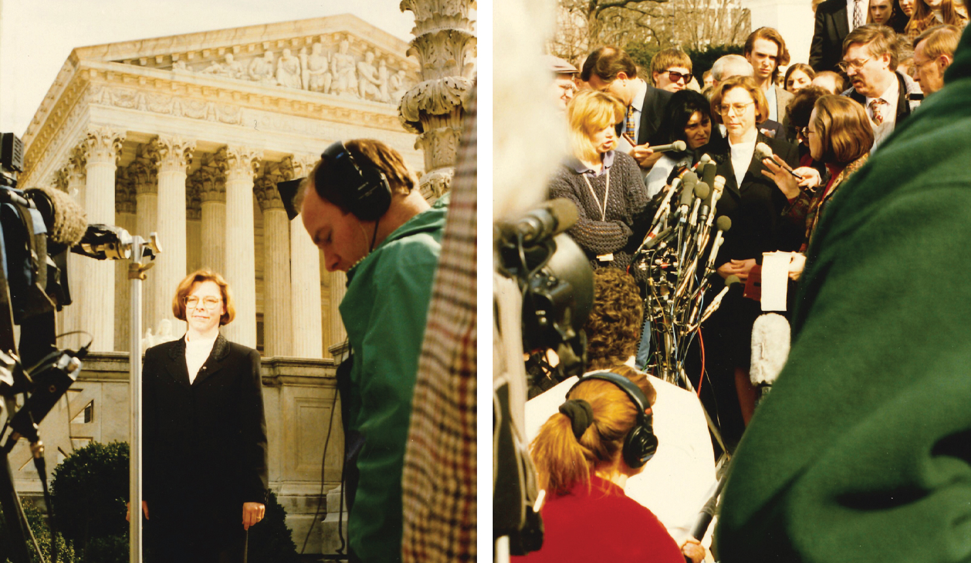
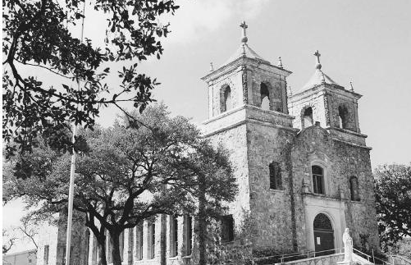
childusa.org
RFRA is Unconstitutional:
Boerne v. Flores
City of Boerne v. Flores, 521 U.S. 507 (1997).
CHILD USA Copyright © 2020
Notes:
https://billofrightsinstitute.org/founding-documents/primary-source-documents/memorial-and-remonstrance/

Slide 8
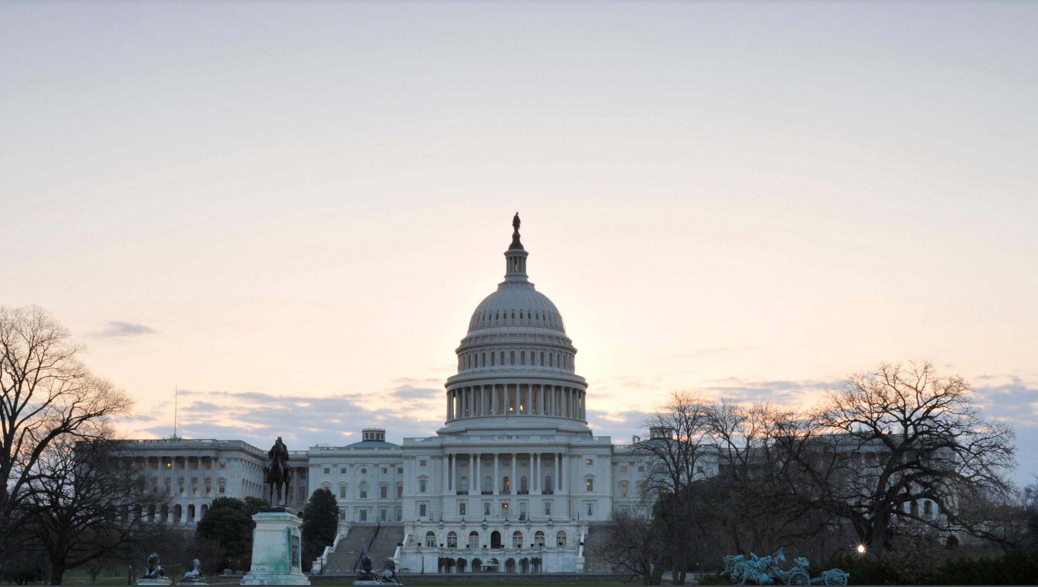
RFRA is Re-Enacted to Apply to Federal Law in 2000
CHILD USA Copyright © 2020
childusa.org
Notes:
https://billofrightsinstitute.org/founding-documents/primary-source-documents/memorial-and-remonstrance/

Slide 9
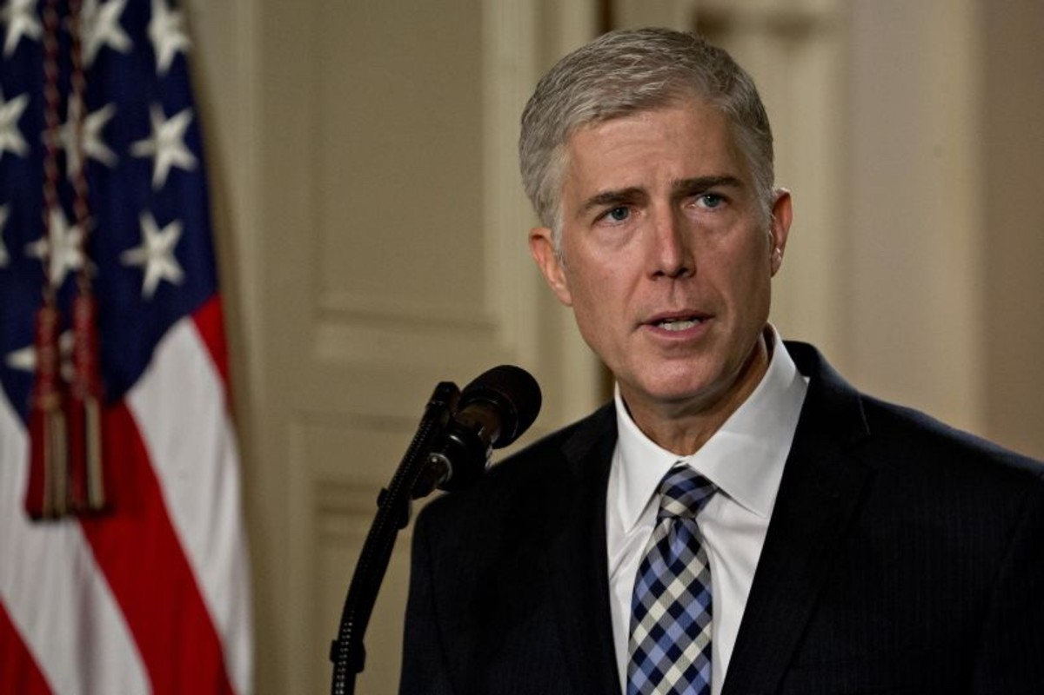
RFRA Applies to Every Federal Law
Justice Gorsuch says RFRA is a “super statute”
Bostock v. Clayton Cty., 140 S.Ct. 1731, 1754 (2020).
childusa.org
CHILD USA Copyright © 2020
childusa.org
CHILD USA Copyright © 2020
Notes:
https://billofrightsinstitute.org/founding-documents/primary-source-documents/memorial-and-remonstrance/

Slide 10
Federal laws involving child sex abuse:
18 U.S.C.A. § 1470 – Transfer of obscene material to minors
18 U.S.C.A. § 1591 – Sex trafficking of children by force, fraud, or coercion
18 U.S.C.A. § 1595 – Civil Remedy (for sex trafficking crimes)
18 U.S.C.A. § 2243 – Sexual abuse of a minor or ward
18 U.S.C.A. § 2244 – Abusive sexual contact
18 U.S.C.A. § 2251 – Sexual exploitation of children
18 U.S.C.A. § 2251a – Selling or buying of children
18 U.S.C.A. § 2252 – Certain activities relating to material involving the sexual exploitation of minors
18 U.S.C.A. § 2252a – Certain activities relating to material constituting or containing child pornography
18 U.S.C.A. § 2255 – Civil remedy for personal injuries
18 U.S.C.A. § 2258 – Failure to report child abuse
18 U.S.C.A. § 2260 – Production of sexually explicit depictions of a minor for importation into the United States
18 U.S.C.A. § 2421a – Promotion or facilitation of prostitution and reckless disregard of sex trafficking
18 U.S.C.A. § 2423 – Transportation of minors
18 U.S.C.A. § 2425 – Use of interstate facilities to transmit information about a minor
CHILD USA Copyright © 2020
childusa.org

Slide 11
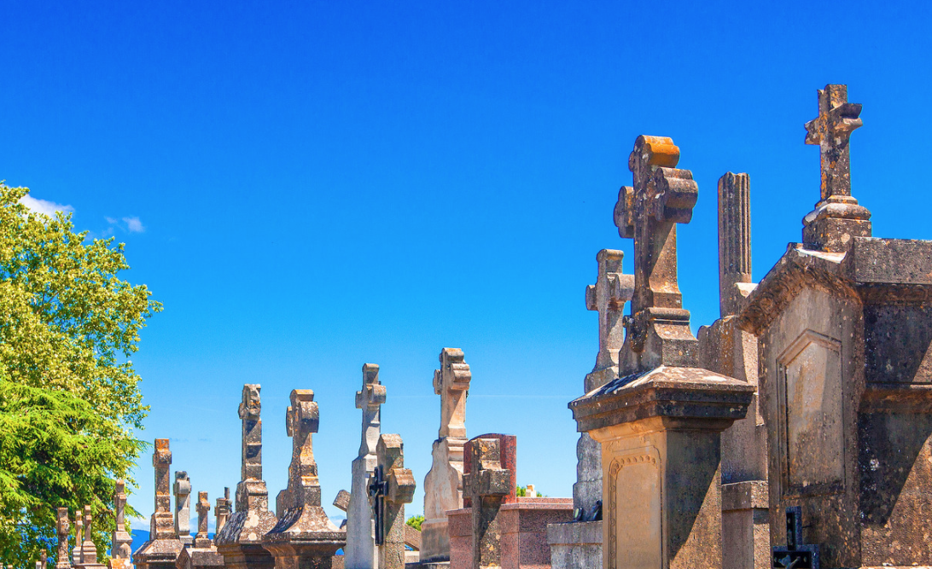
RFRA as a Shield of the Diocese’s Assets
Listecki v. Official Comm. of Unsecured Creditors, 780 F.3d 731 (7th Cir. Mar. 9, 2015).
childusa.org
CHILD USA Copyright © 2020
Notes:
https://billofrightsinstitute.org/founding-documents/primary-source-documents/memorial-and-remonstrance/

Slide 12
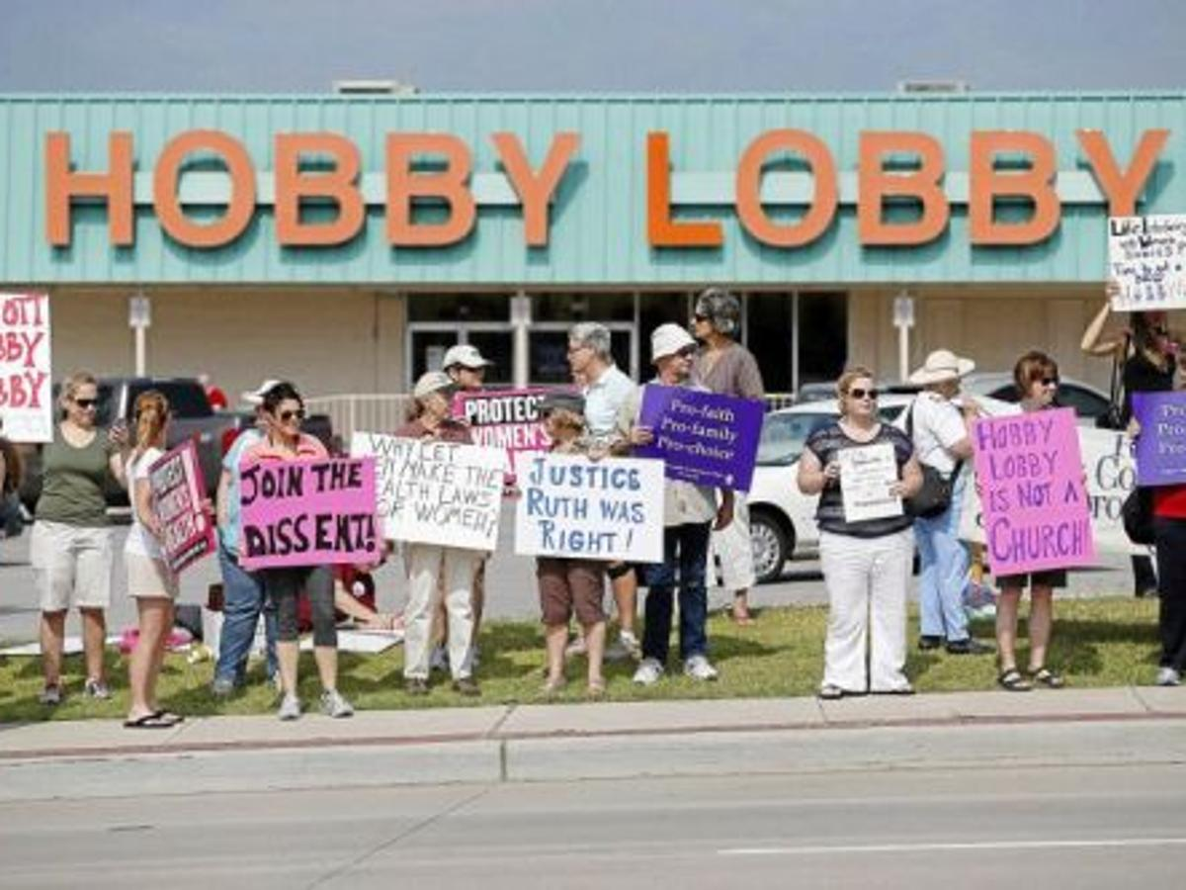
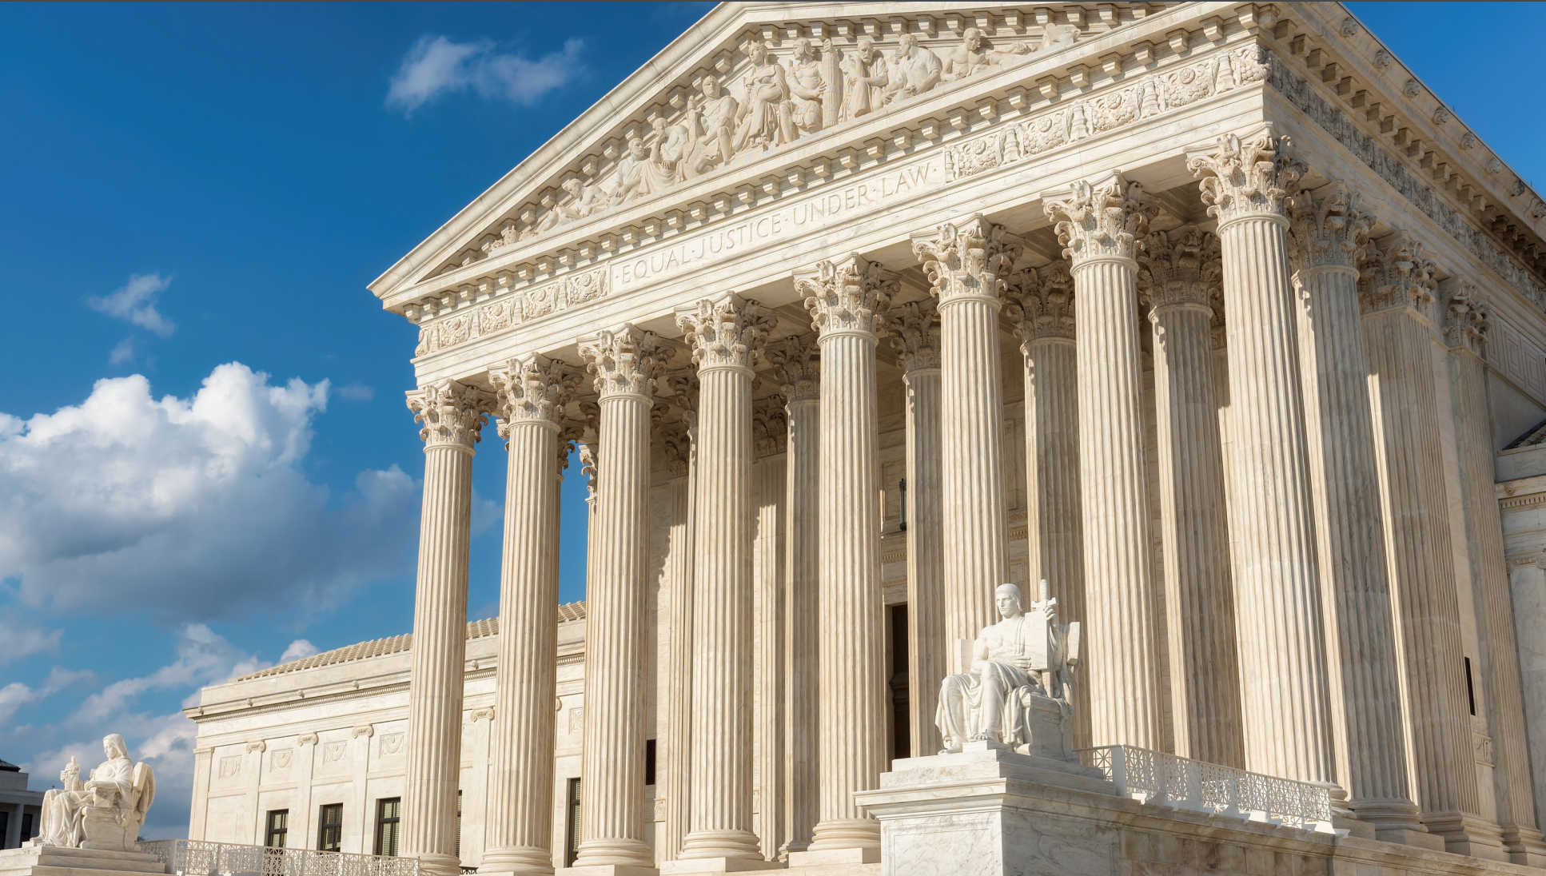
childusa.org
RFRA’s Extreme Interpretation:
Hobby Lobby
Burwell v. Hobby Lobby Stores, Inc., et al., 573 U.S. 682 (2014).
CHILD USA Copyright © 2020
Notes:
https://billofrightsinstitute.org/founding-documents/primary-source-documents/memorial-and-remonstrance/

Slide 13
The Most Potent Element of RFRA: Least Restrictive Means
CHILD USA Copyright © 2020
childusa.org
Notes:
https://billofrightsinstitute.org/founding-documents/primary-source-documents/memorial-and-remonstrance/

Slide 14
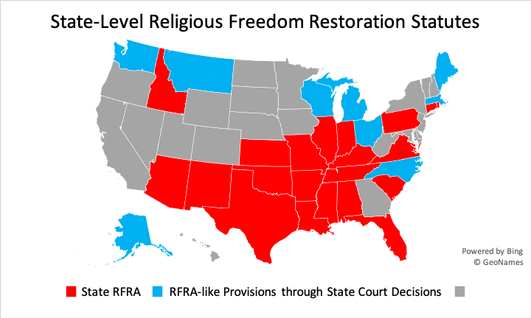
Full statute list available for download in written materials
CHILD USA Copyright © 2020
childusa.org

Slide 15
Child Sex Abuse Cases in which RFRA Defenses have been Asserted
In Florida, a Catholic priest who was called as a witness to child sexual abuse was protected by RFRA from testifying about a confession. The court determined that the State’s interest was not compelling enough to override the priest’s religious freedom rights.
Ronchi v. State, 248 So. 3d 1265, 1269 (Fla. Dist. Ct. App. 2018).
CHILD USA Copyright © 2020
childusa.org

Slide 16
Child Sex Abuse Cases in which RFRA Defenses have been Asserted
The Catholic Church attempted to use RFRA to shield itself from producing documents even though the court ruled that complying with discovery did not interfere with the practice of the Catholic faith.
Thopsey v. Bridgeport Roman Catholic Diocesan Corp., No. NNHCV106009360S, 2012 WL 695624 (Conn. Super. Ct. Feb. 15, 2012).
CHILD USA Copyright © 2020
childusa.org

Slide 17
Child Sex Abuse Cases in which RFRA Defenses have been Asserted
Warren Jeffs, the notorious polygamist, felon and president of the Fundamentalist Church of Jesus Christ of Latter-Day Saints argued, albeit unsuccessfully, that RFRA protected him against a search of his home that was related to the criminal investigation of his sexual assaults of children.”
Jeffs v. State, No. 03-10-00272-CR, 2012 WL 601846 (Tex. App. Feb. 24, 2012).
CHILD USA Copyright © 2020
childusa.org

Slide 18
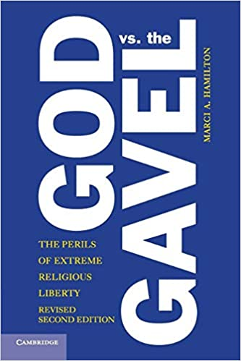
God vs. the Gavel: The Perils of Extreme Religious Liberty
CHILD USA Copyright © 2020
childusa.org
Notes:
https://billofrightsinstitute.org/founding-documents/primary-source-documents/memorial-and-remonstrance/

Slide 19
Lawyers’ Self-Care and Trauma
CHILD USA Copyright © 2020
childusa.org

Slide 20
Understanding Trauma:
Trauma is exposure to any situation or event that overwhelms a person's ability to cope.
Trauma is highly individual
Brains adapt in order to deal with traumatic experiences. If someone lives under severe stress/abuse, we see changes in the way their brain reacts to the world around them
The Effects of Trauma on Victims
Common impacts of trauma:
Changes in memory and concentration
Withdrawal, aggression, and/or anxiousness
Flashbacks and nightmares
Trouble sleeping and/or fatigue
Inability to trust others
Decreased sense of safety and intense fear
Potential long-term effects:
PTSD
Dissociative disorders
Substance abuse
Mood disorders
CHILD USA Copyright © 2020
childusa.org

Slide 21
Challenges of the CSA Cases for Attorneys
Vicarious Trauma:
As a professional working with victims of abuse, you are working with people who have experienced horrific violence or profound loss. When you witness the suffering of people you work with and feel a responsibility to help, over time this can change the way that you see yourself and what matters to you.
Secondary Traumatic Stress:
The exposure to a victim’s trauma can cause an alteration in the way a person thinks about the world, their feelings (about life, work, clients) and their relationships. Symptoms include:
Increased fatigue, reduced productivity
Illness
Social Withdrawal
Unwanted thoughts or images of traumatic events
Persistent anger and sadness
CHILD USA Copyright © 2020
childusa.org

Slide 22
Relevant Statistics
Attorneys and alcohol abuse
A recent study conducted by the ABA Commission on Lawyer Assistance Programs and the Hazelden Betty Ford Foundation showed that nearly 21% of lawyers and others in legal professions were considered problem drinkers.
Nearly half of the lawyers in the study stated that the drinking issues began within their first 15 years in the industry.
Attorneys and substance abuse
9% of attorneys have been found to struggle with prescription drug abuse. The biggest problems arise as individuals mix alcohol with prescriptions, leading to additional risks of dependence and even overdose.
Attorneys and mental health
More than 45% of attorneys experience depression during their career in the legal field. Of those individuals, nearly 12% of them reported having suicidal thoughts at least once.
CHILD USA Copyright © 2020
childusa.org
Notes:
https://americanaddictioncenters.org/rehab-guide/workforce/white-collar/lawyers

Slide 23
Options for Effective Self-Care
Emotional Self-Care
Know your vulnerabilities
Get help early on
Set limits
Establish a routine
Practice gratitude
Physical Self-Care
Get enough sleep
Get regular medical care
Get regular physical activity
Eat regular well-balanced meals
Limit exposure to media
Try out meditation, yoga, and creative outlets
Social Self-Care
Be aware of withdrawal and isolation
Establish a work support system
Find social activities that you enjoy
Take time to laugh and have fun
childusa.org
CHILD USA Copyright © 2020

Slide 24
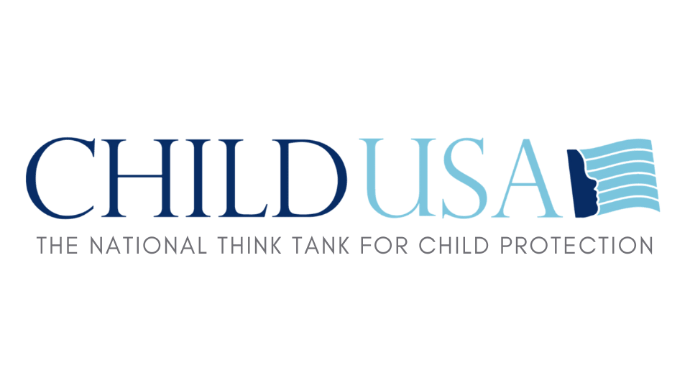
Visit our website for the most up-to-date information on SOL reform and CSA legal changes.
www.childusa.org
CHILD USA Copyright © 2020

