Slide 1
Packing Smart: Intelligence Inventory
Supplemental course materials,
Beginning Big Intelligence,
M.K. McGee (2018)

Slide 2
Intelligence Concepts
Emotional
Social
Cognitive
Collective

Slide 3
Intelligence Basics
“Clarify and organize” intelligence phenomena
“Concepts of ‘intelligence’ are attempts to clarify and organize the complex set of phenomena [that allow one to adapt to the environment, learn from experience, reason, and overcome obstacles]. … no such conceptualization has yet answered all the important questions, and none commands universal assent.”
From "Intelligence: Knowns and Unknowns" (1995), a report published by the Board of Scientific Affairs of the American Psychological Association
Expect complexity, nuance, and ambiguity
Consider cultural influences when generalizing
Adapt to modern information paradigms

Slide 4
Preparing for Big Intelligence
Treat intelligence as knowing about knowing
meta-knowing

Slide 5
Preparing for Big Intelligence
Original
Belief-based
Knowing
Meaning-based
Feedback-dependent
Understanding
Observable and assessable as thoughts
or other mental constructs

Slide 6
Intelligence Inventory
Social
Relationship-centric
Relatable, shareable
Collective
Crowd-centric
Networkable
Emotional
Body-centric, flowing
Abstract, intuitive
Cognitive
Brain-centric, rational
Concrete, testable

Slide 7
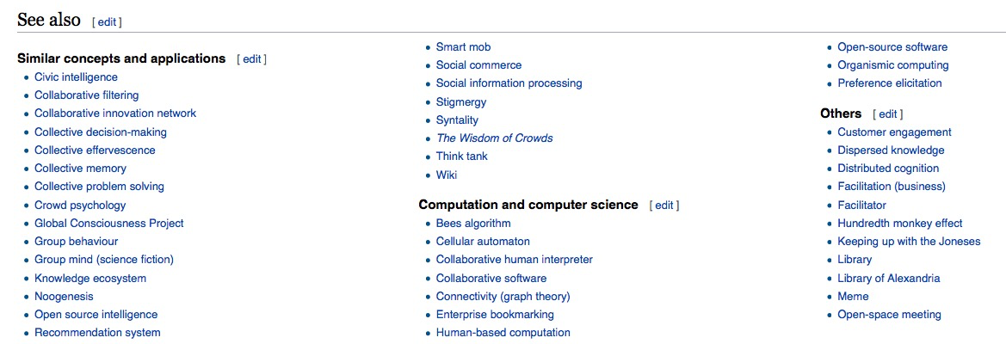
Collective Catch-all at the cusp of Big Intelligence
Excerpt from Wikipedia entry (accessed Mar 2018)

Slide 8
Intelligence: In the shadows
Social
Historicism; breakdown of the imagination
Collective
“Matrix” nihilism; hidden wish to be brainwashed to avoid paranoia
Emotional
Manipulation absent concern for the well being of self and others
Cognitive
Justification of bias and favoritism (explicit or implicit)

Slide 9
Why Pack Smart?
Big Intelligence
Collective Catch-all
Semantic despair
Existential dissonance

