Slide 1
VEX EDR V5
VEXcode Pro Robotics Course
(C++)

Slide 2
Getting Started with VEX V5
This course provides a structured sequence of project-based lessons and activities.
The lessons and activities are designed to help you grow as a Computational Thinker and a Roboticist.
We’ll install the software, learn about the hardware and configure the robot.
During the course we’ll go through all the fundamental programming concepts of C++ (Of course these concepts are not exclusive to C++)
We’ll end this course with a final project where you will have to apply everything you learned in order to successfully complete the project.

Slide 3
System Overview
The VEX EDR V5 is a robotics kit that is ideal for robotics education and competitions. The system contains several key electrical components, such as the Robot Brain, Smart Motors, Wireless Controller, Robot Radio, and Robot Battery. Familiarity with these components, as well as how they fit into the overall system, will help you to be successful with many of the lessons in this course. Learn more about them in these VEX Robotics Knowledge Base articles:
https://kb.vex.com/hc/en-us/categories/360002333191-V5
You may have to copy and paste the links into a browser
Robot Brain Overview https://kb.vex.com/hc/en-us/articles/360035953631-Overview-Robot-Brain-for-VEX-V5
Smart Port Overview https://kb.vex.com/hc/en-us/articles/360035590612-Smart-Ports-Robot-Brain-for-VEX-V5
Smart Motor Overview https://kb.vex.com/hc/en-us/articles/360035591332-Overview-Motor-for-VEX-V5
Wireless Controller Overview https://kb.vex.com/hc/en-us/articles/360035589632-Overview-Controller-for-VEX-V5
Robot Radio Overview https://kb.vex.com/hc/en-us/articles/360035590872-Overview-Radio-for-VEX-V5
Robot Battery Overview https://kb.vex.com/hc/en-us/articles/360035589732-Overview-Battery-for-VEX-V5

Slide 4
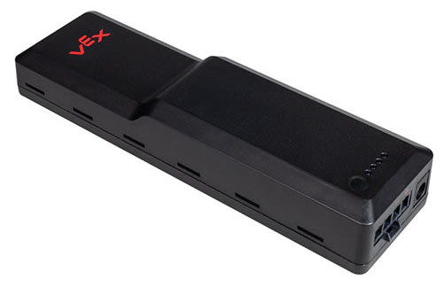
System Power
As you can imagine, one thing that a robot needs is power. The VEX EDR V5 robotics system includes a cutting-edge battery that provides consistent power output for its entire charge cycle. Before you update the robot system software or download programs to the Robot Brain, you should charge the Robot Battery.

Slide 5
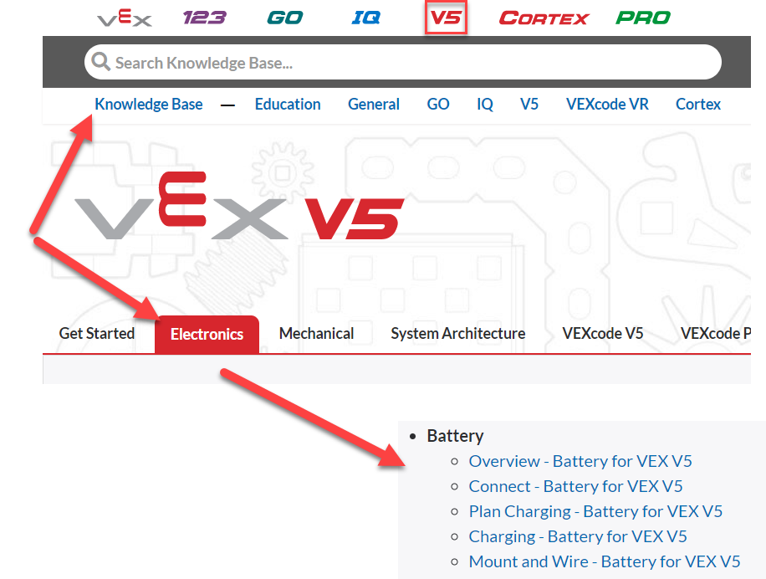
Attention:
Charge the Robot Battery and connect it to the Robot Brain.
It may take up to 60 minutes for the battery to fully charge.
Pressing the physical button on the battery will indicate its charge level. You can follow along with the guides from the VEX Knowledge Base if you would like additional support for charging and connecting the Robot Battery – Find them here:

Slide 6
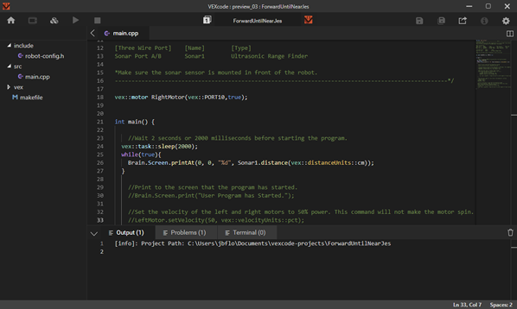
VEXcode Text (Now called “Pro”)
The VEX EDR V5 robotics system may be programmed through a variety of programming languages and environments.
The lessons in this course use the VEX C++ programming language in the VEXcode V5 Pro programming environment.

Slide 7
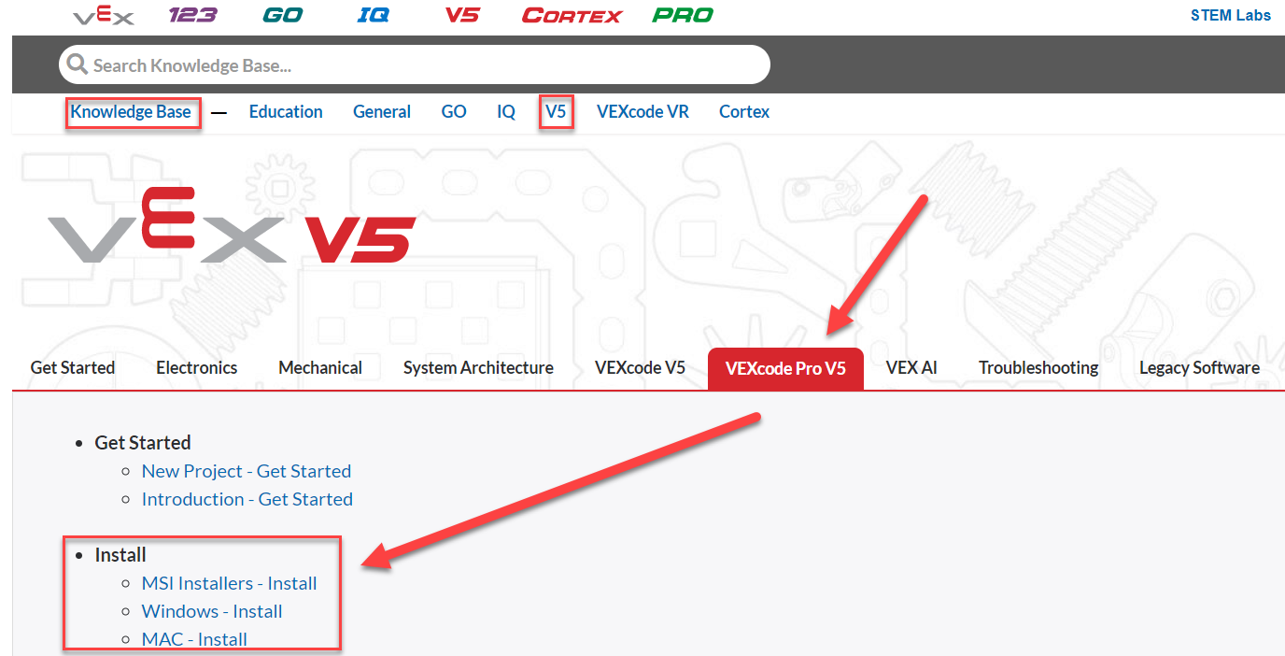
Installing VEXcode Pro V5
If you do not already have VEXcode V5 Pro installed, download and install it now.
You will need administrative privileges on your computer to complete this process.
The latest version of the software may be downloaded here. You can follow along with these guides from the VEX Knowledge Base if you would like additional support installing VEXcode V5 Pro:

Slide 8
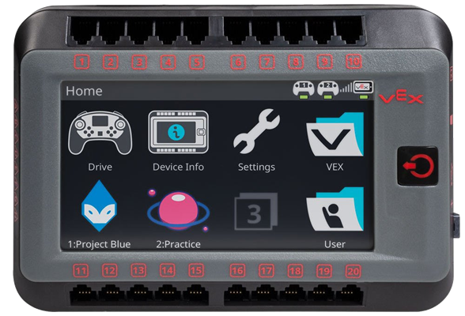
System Updates
The VEX EDR V5 Robot Brain is a fully programmable device that enables you to incorporate and control the motors, sensors, screen, and wireless controller.
In other words, the Robot Brain controls the flow of power and information for the entire robot system.

Slide 9
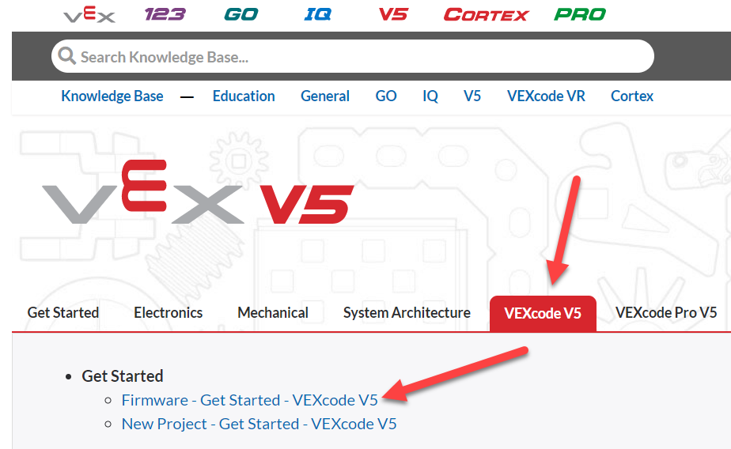
Many of the electrical components of the VEX EDR V5 robotics system (Robot Brain, Smart Motors, Robot Battery, Wireless Controller, Robot Radio, Smart Sensors) contain their own processors and software in order to complete their specific roles. This component-specific software is often called firmware. The name for the firmware for the VEX EDR V5 robotics system is VEXos. VEX has greatly simplified the process of keeping the VEXos firmware across these components up-to-date. When updating the VEX EDR V5 Robot Brain, all firmware updates for the other components are also transferred to the Robot Brain. Any time one of the components is connected to the Robot Brain, it checks that the firmware is up-to-date, and initiates an on-brain update process if it is out-of-date. Action: Follow along with these guides from the VEX Knowledge Base to update the VEXos Firmware on your VEX EDR V5 Robot Brain and Wireless Controller. These steps will also update the VEXos Firmware (if necessary) on any connected Smart Motors, Radio, and Battery.
VEXcode will automatically check for new firmware and update it when you connect a brain to your computer.
However
A standalone VEXos updater is also available for both Windows and Mac.

Slide 10
Troubleshooting and Procedure Notes:
We highly recommend keeping the battery connected to the AC Power Adapter and charging while completing the firmware updates.
If the Robot Brain's screen does not turn back on after the initial firmware update, don't panic! Instead:
Press and hold the power button, making sure that the system is turned off (no other lights on).
Unplug the battery cable and plug it back in.
You should be able to power the robot back on.

Slide 11
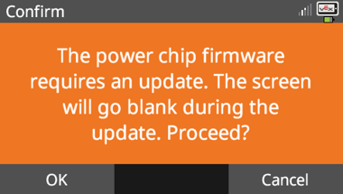
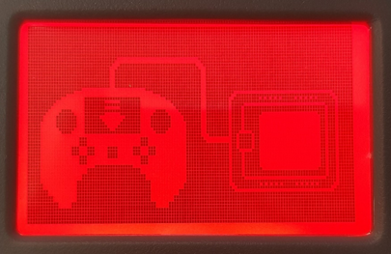
After updating the Robot Brain, it is normal to see a series of on-screen prompts, asking to update other parts of the system.
This is expected behavior, which can also occur when you connect out-of-date components later to the Robot Brain.
Press the OK button and allow them to run.
When updating the firmware on the Wireless Controller, the screen turns a deep red.
This is normal, expected behavior
Robot Brain Update Prompt
Wireless Controller Update Screen

Slide 12
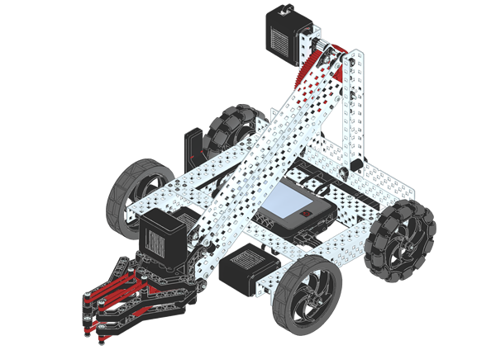
Building Clawbot
Many of the lessons in this course are designed around the VEX EDR V5 Clawbot.
The VEX EDR V5 Clawbot can be built with most VEX EDR V5 Bundles.
Other robot configurations may be used with this course, but you may need to account for those differences in your programs.
Action: If you do not already have a built robot, follow along with these instructions to build the VEX EDR V5 Clawbot:
V5-Clawbot-BuildInstructions.pdf 21.75 MB (You can safely ignore the virus warning in your browser)

Slide 13
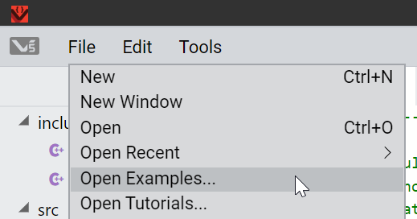
Downloading Programs
Programs in VEXcode V5 Pro can be downloaded from your computer to the V5 Robot Brain through either a wired connection over USB, or a wireless connection over the link through the Wireless Controller.
To demonstrate this, we will download an Example Project from VEXcode to the Robot Brain.
Action: First, launch VEXcode V5 Pro and go to:
File > Open Examples...

Slide 14
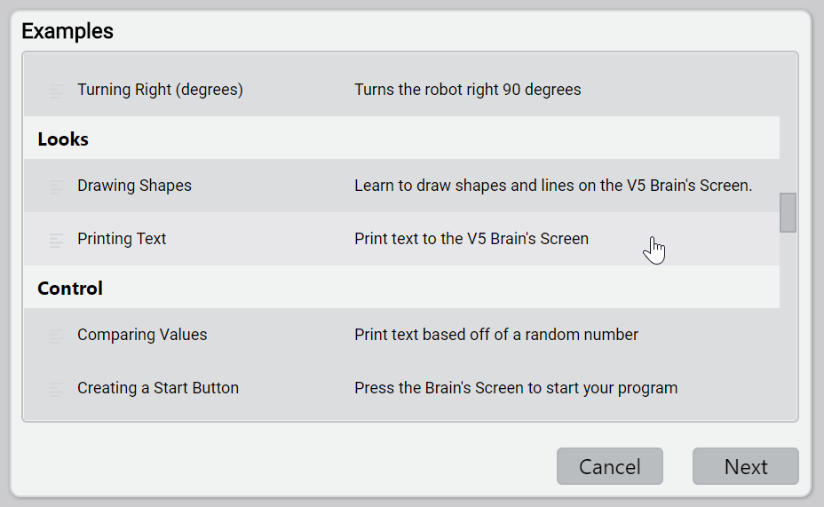
Scroll through the available examples until you reach:
Printing Text and select Next.

Slide 15
When prompted, provide a name for the Example Project
Then select Create.

Slide 16
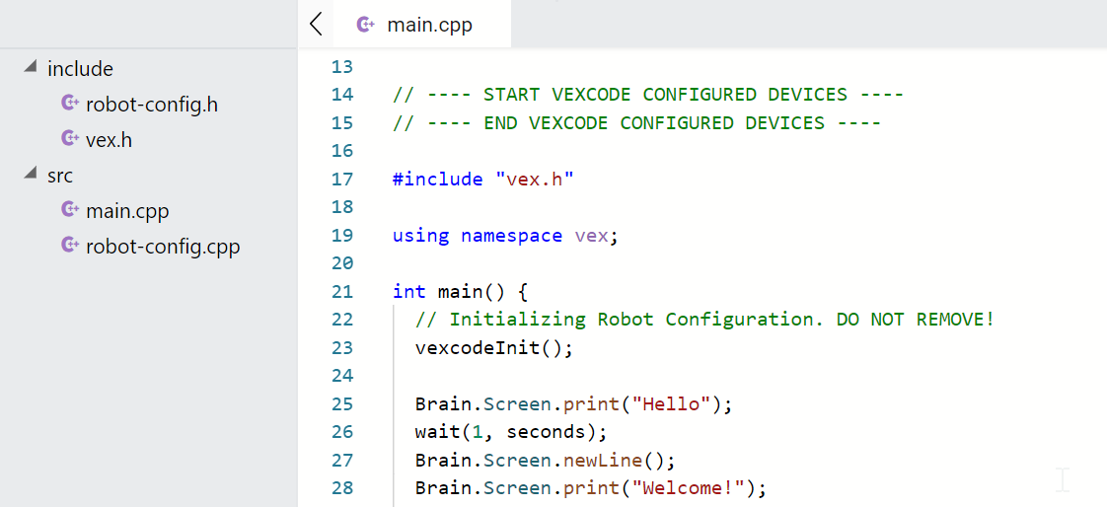
The code for the Printing Text Example Project should now be displayed in VEXcode V5 Pro.

Slide 17
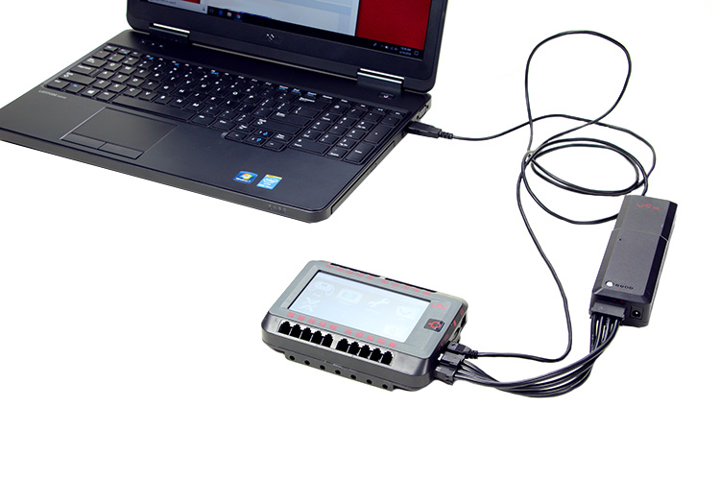
Action: Turn your VEX EDR V5 Robot Brain on and connect it to your computer through either a wired or wireless connection. (Choose one method!)
Method 1: To create a wired connection, use the Micro-USB cable to connect a USB port on the computer to the VEX EDR V5 Robot Brain.
Method 2: To create a wireless connection, you can follow along with this tutorial from the VEX Knowledge Base.
(Please copy and paste these links into a browser – PowerPoint doesn’t open them automatically)
Action: Follow along with this guide from the VEX Knowledge Base to download and run the Example Program on the VEX EDR V5 Robot Brain.
Action: Observe the program running on your VEX EDR V5 Robot Brain!

Slide 18
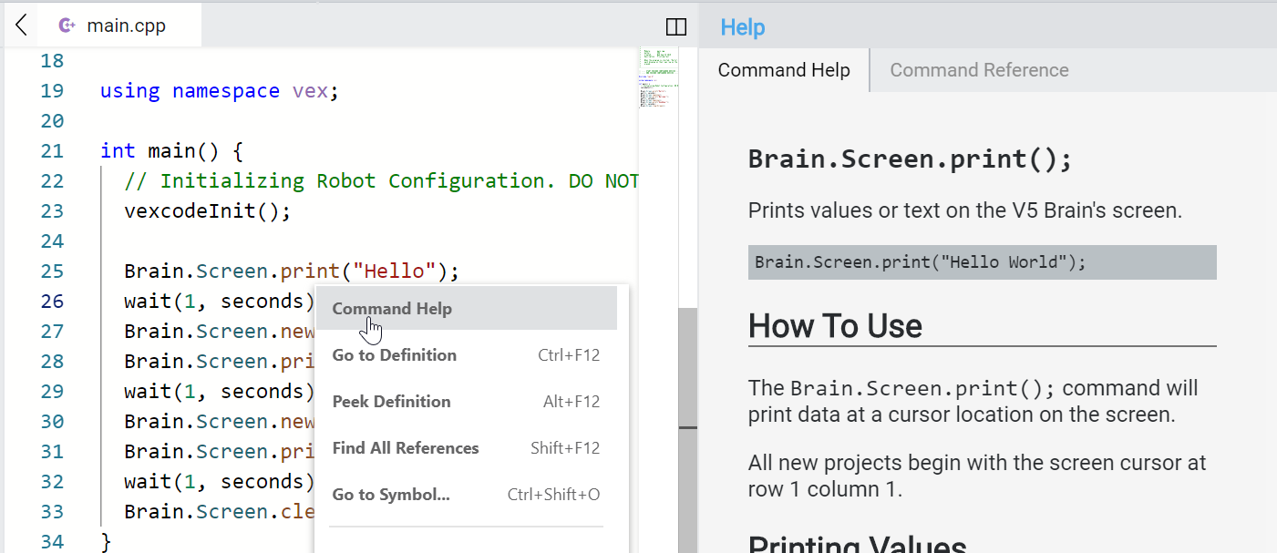
Helpful VEXcode V5 Pro Features
VEXcode V5 Pro contains many features designed to help you write and troubleshoot your programs. Command Help If you are unsure about a command in VEXcode V5 Pro, you can right-click on it and select Command Help. Doing so will open documentation specific to that command directly within VEXcode V5 Pro.

Slide 19
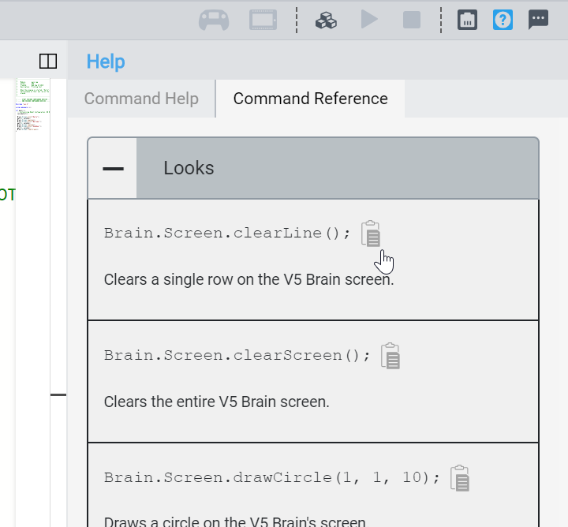
Command Reference
Available through the Help Menu, the Command reference provides a listing of currently available commands, along with brief descriptions. Additional commands are dynamically added as you configure motors, sensors, and other devices in your project. You can copy these commands directly into your code.
You can learn about additional helpful features within VEXcode V5 Pro in these tutorials from the VEX Knowledge Base:
VEXcode V5 Pro User Interface Overview
Opening Example Projects
Creating New Files
(Please copy and paste these links into a browser – PowerPoint doesn’t open them automatically)

