Slide 1
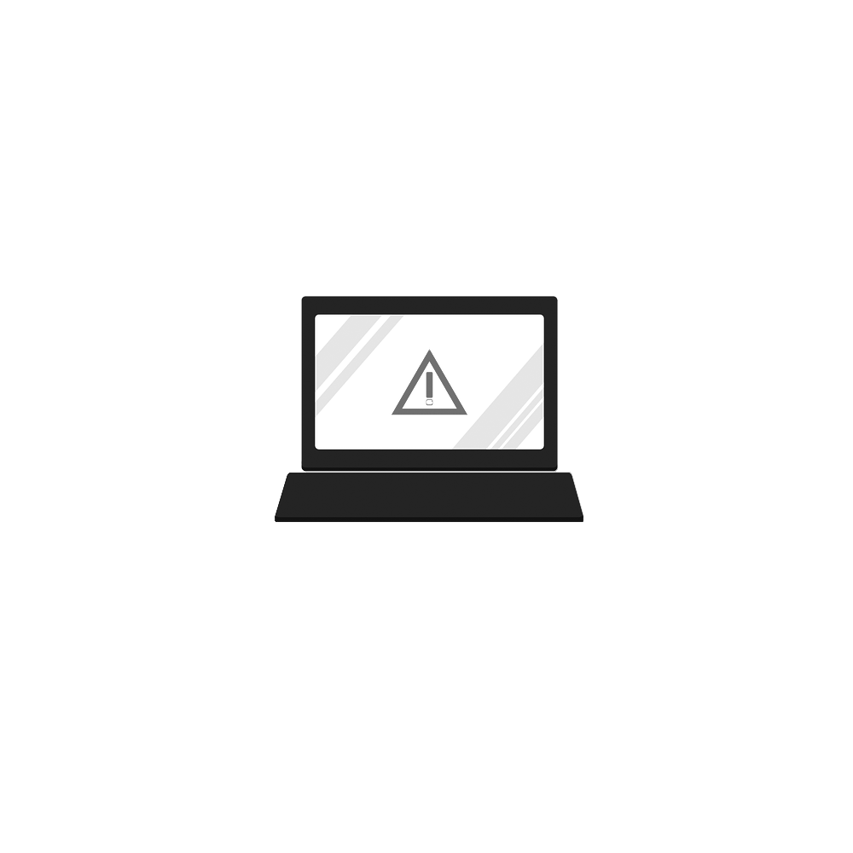
Blue Team: Defending Against Hackers
Risk Analysis & Threat Intelligence

Slide 2
Risk Analysis
Qualitative vs. Quantitative
Risk is best defined as the potential for loss and damage associated with an asset. Not to be confused with the definition of a threat or vulnerability.
Risk analysis is the process of calculating and documenting potential problems that can have negative impact allowing decision makers to prioritize these issues.
Qualitative – The process of analyzing risk by assessing the probability of occurrence and potential impact. Meaning, it relies on subjective judgement from professionals by assigning an arbitrary value for prioritization.
Quantitative – The process of analyzing risk by assigning numerical values and calculating the impact by using the probability of occurrence. It is commonly used to determine financial impact of risk occurrence.

Slide 3
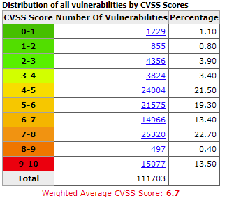
Risk Analysis
Qualitative = Experience/Feelings
Quantitative = #/$
CVE (Common Vulnerabilities and Exposure)
CVSS 0-10 (10 being the most severe)
Allows for prioritization based on severity
i.e. CVE-2017-0143

Slide 4
Risk Analysis
Quantitative
ALE = SLE * ARO
Annualized Loss Expectancy = Single Loss Expectancy * Annualized Rate of Occurrence
ALE – the potential monetary loss associated with a risk over a one-year period
SLE – the amount lost if the asset is impacted due to that risk
ARO – the likelihood of a risk occurring in a particular year

Slide 5
Risk Analysis
Single-Loss Expectancy (SLE)
ALE = SLE * ARO
Annualized Loss Expectancy = Single Loss Expectancy * Annualized Rate of Occurrence
SLE = AV * EF
Single-Loss Expectancy = Asset Value * Exposure Factor
Asset Value: Direct and indirect costs of asset (e.g., cost of replacement, labor, etc.)
Exposure Factor: The percentage of the asset that is lost if risk occurs.
SLE = $100,000 *0.66
SLE = $66,000

Slide 6
Risk Analysis
Annualized Rate of Occurrence
ALE = SLE * ARO
Annualized Loss Expectancy = Single Loss Expectancy * Annualized Rate of Occurrence
The probability this risk will be impacted in one year
Statistical data can help you determine the ARO

Slide 7
Risk Analysis
Quantitative Example
ALE = SLE * ARO
Annualized Loss Expectancy = Single Loss Expectancy * Annualized Rate of Occurrence
DDoS Attack on Webserver
Webserver = $100,000 (Direct and Indirect costs)
Exposure factor = 66%
Data suggests DDoS attacks occur on average four times a year

Slide 8
Risk Analysis
Quantitative Example
ALE = SLE * ARO
Annualized Loss Expectancy = Single Loss Expectancy * Annualized Rate of Occurrence
SLE
$66,000
ARO
4 per year
Webserver
ALE = 66,000 * 4
ALE = $264,000

Slide 9
Threat Modeling
Brief Overview
STRIDE
Spoofing
Tampering
Repudiation
Information Disclosure
Denial of Service
Elevation of Privilege
DREAD
Damage
Reproducibility
Exploitability
Affected Users
Discoverability
OCTAVE
Operationally
Critical
Threat
Asset
Vulnerability
Evaluation
Trike Threat Modeling, P.A.S.T.A. Threat Modeling, VAST Threat Modeling
OWASP Threat Dragon

Slide 10
Threat Intelligence
Understanding threats and adversaries
The act of gathering and analyzing data to better understand adversary's TTPs (tactic, techniques, and procedures), APT campaigns, threat actors, etc.
Commonly referred to as CTI (Cyber Threat Intelligence)
Data gathered…
OSINT – data collected from publically available sources
SOCMINT- identifying trends within social media
HUMINT – intelligence that is gathered from interpersonal contact (human sources)
Also used to categorized APT campaigns based on attributes about the attack
APT38 (Suspected: North Korea)
APT17 (Suspected: China)
APT32 (Suspected: Vietnam)
Sharing threat intelligence within the community is important and should be encouraged

Slide 11
Threat Intelligence
Tactical, Operational, and Strategical
Tactical
Operational
Strategical
Short-term
Security Events/Incidents
IOCs (e.g., malicious domain names, IP addresses, file hashes, emails, registry keys, file names, etc.)
Medium-term
TTPs
Malware families
Human behaviors
Long-term
Operational intelligence
Correlating data to the real world events

Slide 12
Threat Intelligence
Threat Intelligence Feeds
Many great threat intel feeds that consist of information such as suspicious IP addresses that you can use to blacklist (e.g., blocking on perimeter firewalls, DNS sink holing, etc.)
https://isc.sans.edu/threatfeed.html
https://github.com/hslatman/awesome-threat-intelligence
https://ransomwaretracker.abuse.ch/blocklist/
Do not blindly trust the data. Valid IP address can be added by accident (e.g., internal network addresses, reputable domains, etc.)
Block things that pertain to your environment
Good idea to block…
Tor exit nodes
Malicious IP addresses
C2 (aka: C&C servers)

Slide 13
Asset Management
ITAM
Defined as the documentation and organization of your assets within an inventory
Allows for stronger security and more efficient licensing
ITAM is a repetitive never ending process, and it’s very tedious and challenging
No spreadsheets, no flat files

Slide 14
Asset Management
The on-going process
Asset Management Life Cycle
Procurement
Deployment
Management
Retirement
Data to Collect
Serial Numbers/ID Number
Location
Owner/Custodian
IP address
MAC address
Product Name (Make/Model)
Firmware Number
Patch level
Licensing
OS Version
Miscellaneous

Slide 15
Asset Management
Data Gathering
Nmap
Masscan
ARP
DHCP
SNMP
PowerShell/WMI

Slide 16
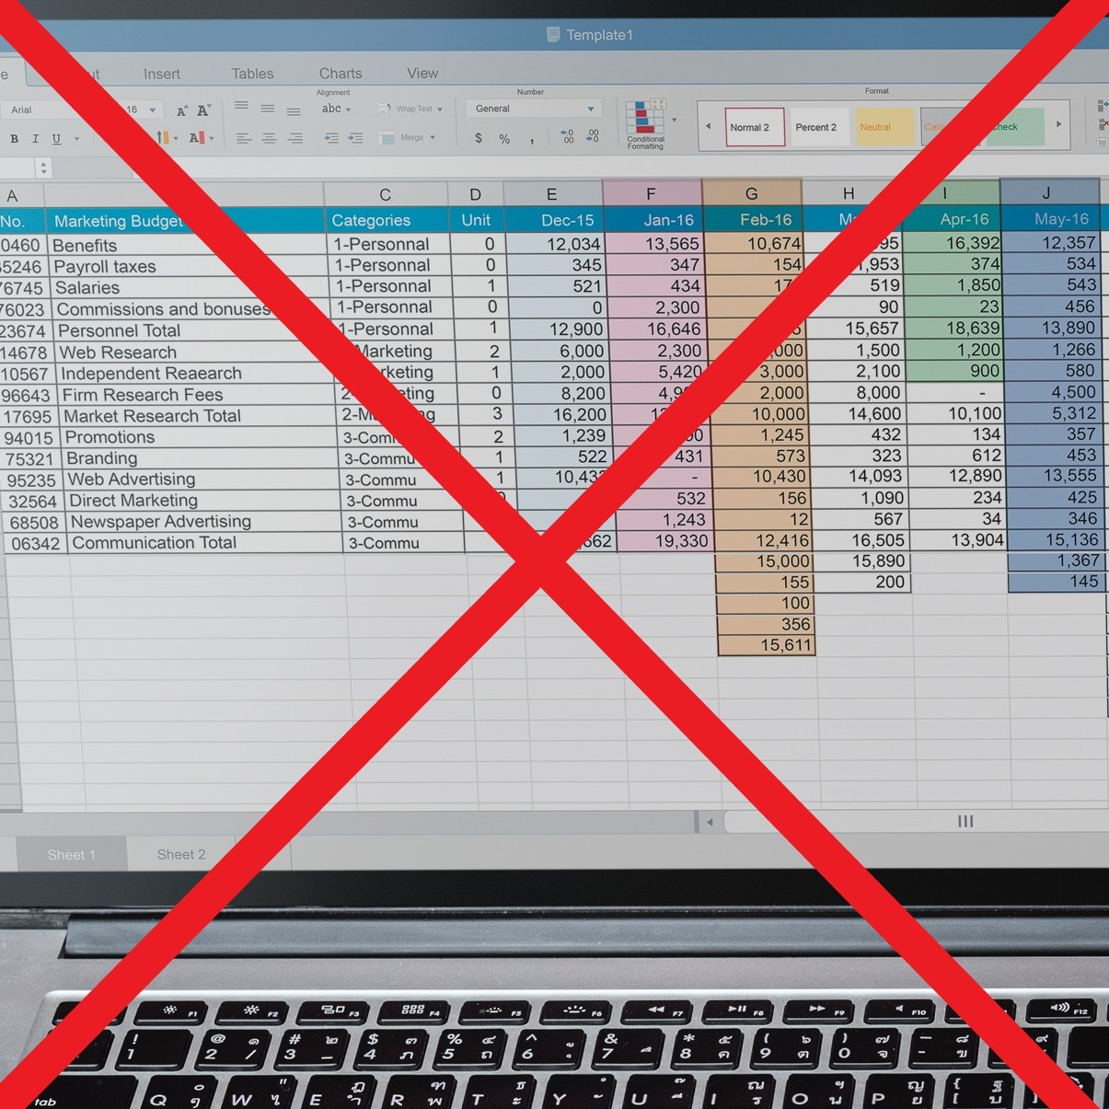
Asset Management
Solutions
SnipeIT - (free with paid cloud option)
AssetTiger – (free up to 250 assets)
Lansweeper – (free up to 100 assets)
DONT USE SPREADSHEETS FOR ITAM

Slide 17
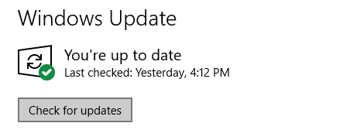
Patch Management
Stay up-to-date
Patch management is the process of downloading, testing, and deploying patches and updates to devices.
Lifecycle
Patch is released
Acquire patch
Test patch
Deploy patch
Review deployment
Windows Update via GPO
SCCM
WSUS
SolarWinds
GFI LanGuard
Red Hat Satellite

Slide 18
Security Policies
Security policies are detailed documents that set boundaries and define how an organization approach to security
Security policies need to be detailed, clear, and concise.
The language used needs to be reflective of organizational goals
Examples
Acceptable Use Policy
Clean Desk Policy
Email Policy
Password Policy
Software Installation Policy

Slide 19
Cyber Kill Chain®
1. Reconnaissance
2. Weaponization
Developed by Lockheed Martin
Methodology for understanding how cyber attacks generally take place
The more you understand attackers’ approach, the better you can thwart the attack
3. Delivery
4. Exploitation
5. Installation
6. Command & Control
7. Actions on Objective

