Slide 1
Advanced Query Tuning in SQL Server
Copyright © 2016 Madeira Ltd
All Rights Reserved
Full rights, including copyrights, belong exclusively to Madeira Ltd
No use of the materials, in any form, is allowed,
unless receiving a prior written permission from Madeira Ltd.

Slide 2
The Plan Cache

Slide 3
The Plan Cache
Query plans are cached in the plan cache in order to be reused and avoid the cost of recompiling the same queries again and again.

Slide 4
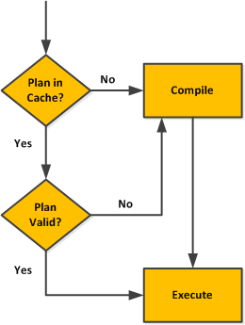
The Plan Cache

Slide 5
The Plan Cache
What Can Cause a Plan to Become Invalid?
Statistics Update
Schema Modification
Code Modification
Manual (sys.sp_recompile)

Slide 6
The Plan Cache

