Slide 1
Life Skills Scavenger Hunts

Slide 2
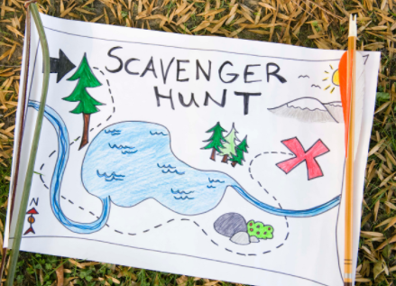
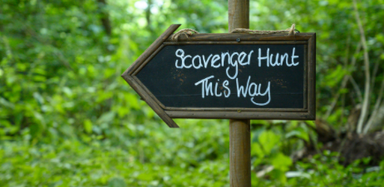
Scavenger hunts around the school and community help you to become familiar with the world around you.

Slide 3
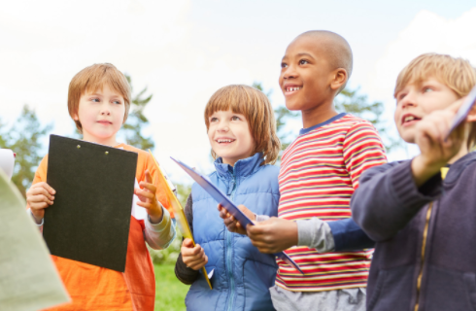
Today, we will go around the school and do a scavenger hunt.

Slide 4
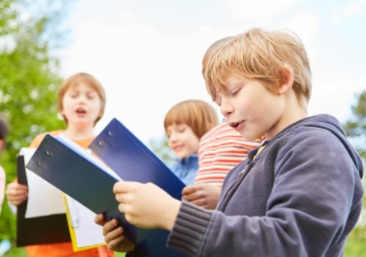
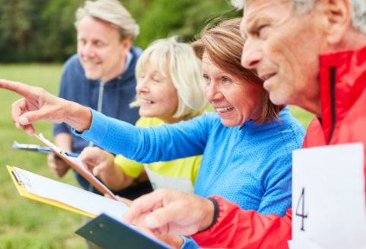
Over time, we will also do a scavenger hunt around different places in your community.

Slide 5
Some of the places you may explore are:
School
Grocery store
Convenient store
Public Library
Local Park

Slide 6
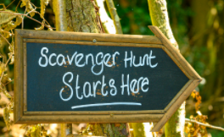
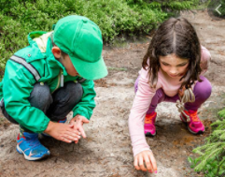
Alright, let’s get started! Have fun and good luck!

