Slide 1
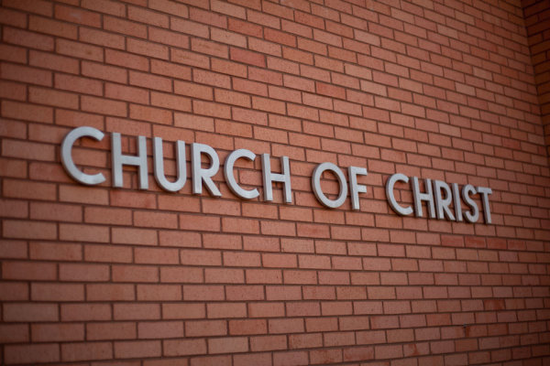
HOW WE GOT TO WHO WE ARE

Slide 2
Staying doctrinally alert
Nehemiah 9-10
1 Timothy 4:1-3
HOW WE GOT TO WHO WE ARE

Slide 3
Presbyterian Church
HOW WE GOT TO WHO WE ARE
T – total depravity
U – unconditional election
L – limited atonement
I – irresistible grace
P – perseverence of the saints

Slide 4
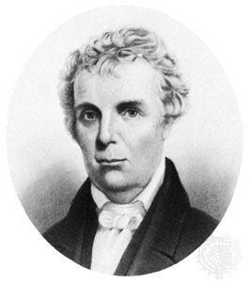
Barton W. Stone
HOW WE GOT TO WHO WE ARE
Cane Ridge Revival
Last Will & Testament of the Springfield Presbytery

Slide 6
Christians Only
James Murch

Slide 7
“Our affairs seem to lead to some crisis, some revolution; something that I cannot foresee or conjecture. I am more uneasy than during the war.”
“Your sentiment that we are drawing to a crisis accords with mine. What the event will be is beyond my foresight.”
George Washington, 1796

Slide 8
Dark period for Christianity
HOW WE GOT TO WHO WE ARE
America in 1800
Infidels
Churches

Slide 9
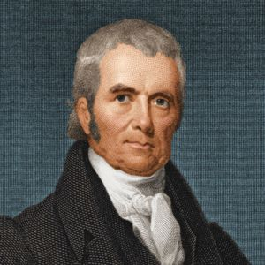
Church has gone too far to be revived.
Supreme Court Justice John Marshall

Slide 10
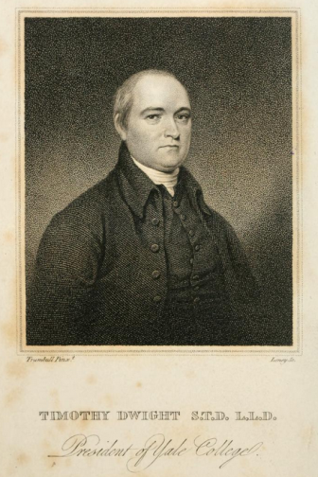
Timothy Dwight
President of Yale
1792-1810

Slide 11
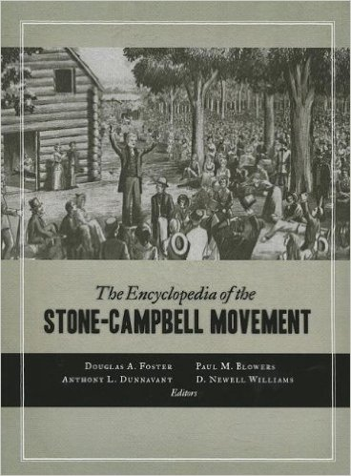
The Encyclopedia of the Stone-Campbell Movement
Douglas Foster, Paul Flowers, Anthony Dunnavant, Newell Williams

Slide 12
Barton W. Stone
HOW WE GOT TO WHO WE ARE
Cane Ridge Revival
Last Will & Testament of the Springfield Presbytery

Slide 13
Cane Ridge Revival
August 6-12, 1801

Slide 14
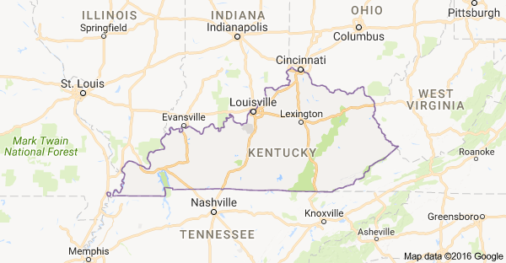

Slide 15
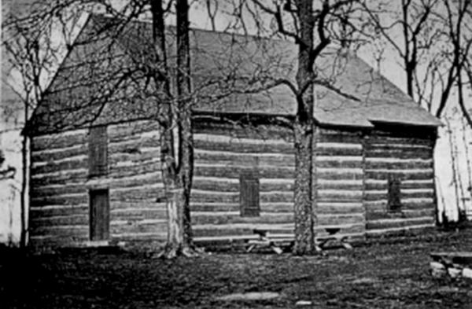

Slide 16
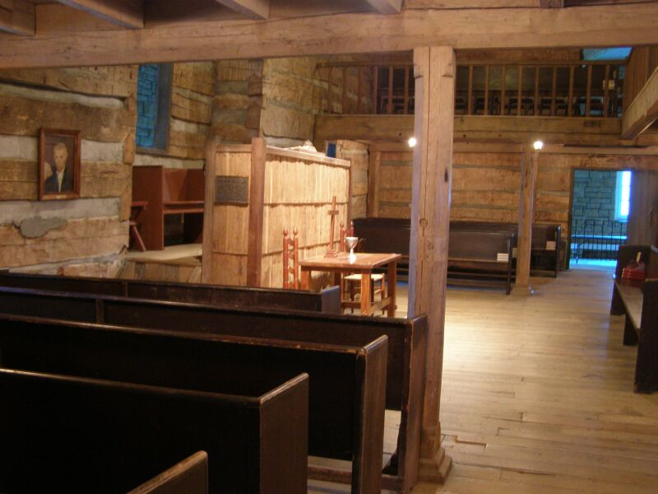
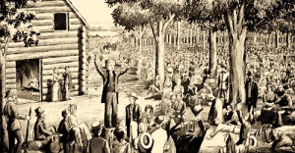

Slide 18
Last Will and Testament of the Springfield Presbytery
June 28, 1804

Slide 20
Stone’s basic beliefs
Freedom from creeds
Restoration of NT Christianity
Transforming power of HS
Sharp distinction between world and Christians
The millennium

Slide 21
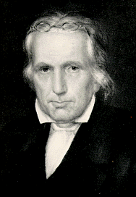
HOW WE GOT TO WHO WE ARE
Thomas Campbell 1809
Declaration and Address

Slide 22
HOW WE GOT TO WHO WE ARE

