Slide 1
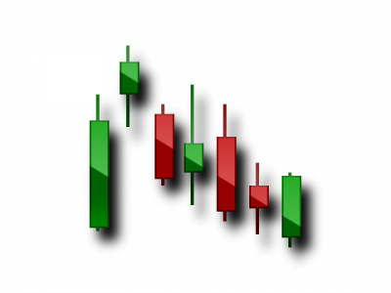
TIGER IYE
EDUCATION PART 2
INSTRUCTOR
QUENN V. GARRIS JR.

Slide 2
BEFORE WE CONTINUE… MAKE SURE TO GO BACK AND WATCH PART 1 TO REFRESH FOR THIS...

Slide 3
WHAT IS THE CORRECT UNIT FOR A MINI LOT?
WHAT TIME DOES LONDON SESSION UTC OPEN-CLOSE?
1.0
O.1
O.O1
0.001
8PM-5PM
10PM-7AM
12AM-9AM
1PM-10PM

Slide 4
WHICH ONES ARE CONSIDERED MAJOR PAIRS?
WHAT UNIT IS USED TO MEASURE PRICE DIFFERENCE?
EURGBP
AUDUSD
EURAUD
USDJPY
PIP
BUY
SELL
MOVE

Slide 5
SO HOW DO YOU KNOW WHEN TO GET IN A TRADE?

Slide 6
MY FAVORITE FORM OF ART… TECHNICAL ANALYSIS
TOOLS BASED OFF OF PREVIOUS PRICE ACTION TO HELP BUILD A STRONG & ACCURATE THESIS FOR PLACING TRADES
PERSONAL TOP 5 TIGER IYE TOOLS
TRADINGVIEW
SUPPORT & RESISTANCE
RSI & MA STRATEGY
DIVERGENCE
CANDLESTICK PATTERNS

Slide 7
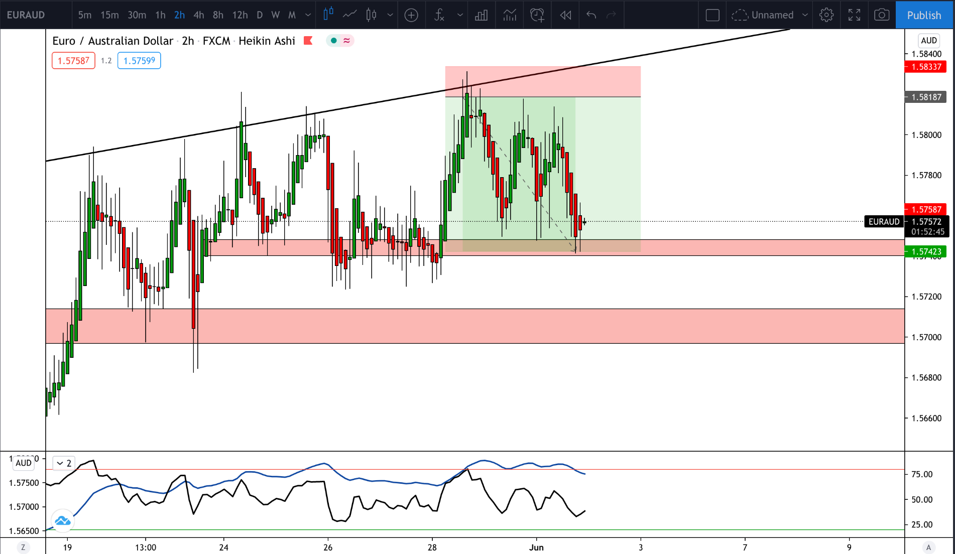
TRADINGVIEW
BEST APP \ WEBSITE TO ANALYZE ANY CHART
FREE TO USE
SET TEXT ALERTS FOR PRICE ACTION REMINDERS
ATTACH BROKER & PLACE LIVE TRADES
SHARE KNOWLEDGE WITH OTHERS BY FOLLOWING PAGE

Slide 8
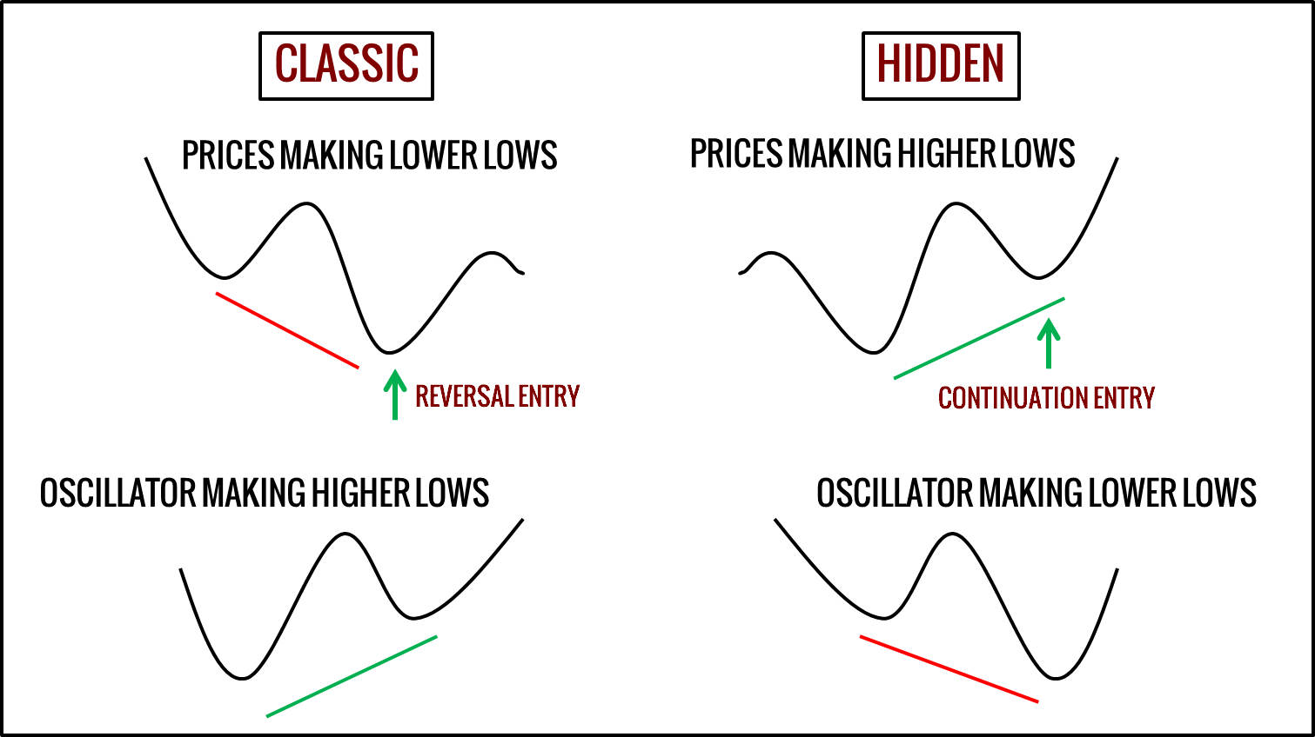
DIVERGENCE
PRICE AND RSI ARE DOING THE OPPOSITE
LOCATED IN RSI
TAKES TIME & PRACTICE TO MASTER
VERY ACCURATE IN BIGGER TIME FRAMES (1H-8H)
PATIENCE IS KEY FACTOR

Slide 9
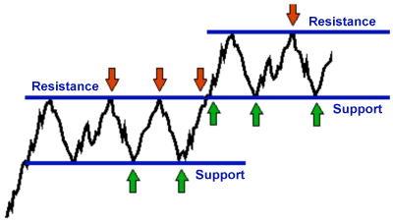
SUPPORT & RESISTANCE
DRAWN ON 2H TF MINIMUM (AVG 4H)
DRAW WITH SUPPLY & DEMAND ZONES FOR BETTER ACCURACY
LOOK FOR REVERSAL OR CONTINUATION AT ZONE
FOCUSES ON MAJOR PRICE ACTION NOT THE NOISE IN BETWEEN
NOTICE HOW ONCE THE PRICE BREAKS TO A NEW SIDE,
PREVIOUS RESISTANCE BECOMES NEW SUPPORT & VICE VERSA!!

Slide 10
NOW THESE NEXT PARTS ARE SOME OF THE MOST IMPORTANT TRADING TACTICS!
MAKE SURE TO TAKE NOTES!

Slide 11
BUT YOU’RE GONNA HAVE TO GO TO PART 3 FOR THAT!!!

