Slide 1
AIRLINES STOCKS & SECTOR ANALYSIS
By Sven Carlin

Slide 2
FACTS
Since 1980, cargo volumes have increased 14x and passenger numbers 10X
Travel cost down 60%
For INVESTORS – LITTLE MOAT – low barriers to entry, no return on investment – 0.1% of revenues returned to Investors in 40 years
However, risk equals opportunity - $500 billion invested in the sector – some good businesses waiting for M&A activity
Macro HEADWINDS – Coronavirus, economic slowdown, high competition
TICKET PRICES DOWN 2% PER YEAR OVER THE LAST 20 YERS
OPPORTUNITY OVER THE NEXT YEARS

Slide 3
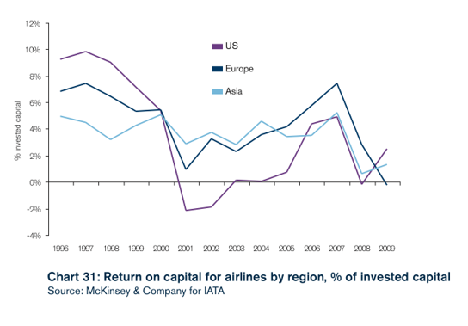
WHAT FACTORS MATTER FOR INVESTORS?
COMPETITION – MOATS – ADVANTAGES –
CYCLIAL INDUSTRY (prices down, bankruptcies and then up again)
HUBS are KEY
US & EUROPE saturation (Latin America + Asia growth)
cycles

Slide 4
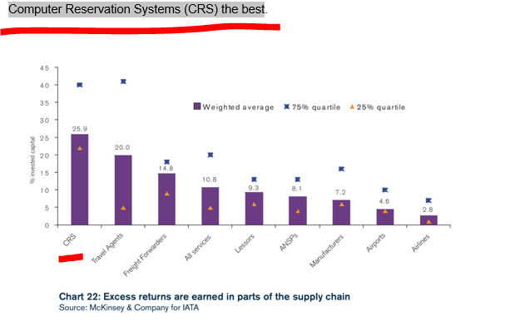
RETURN ON INVESTED CAPITAL

Slide 5
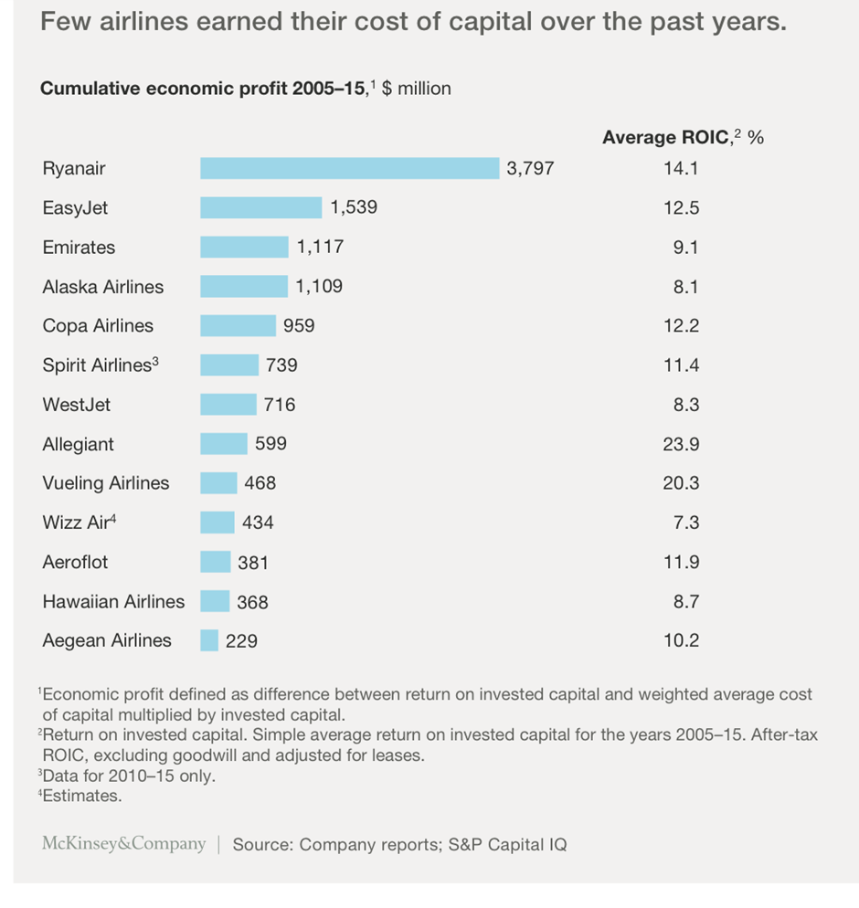
RETURN ON INVESTED CAPITAL

Slide 6
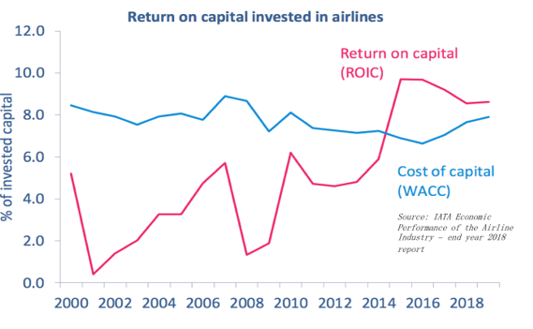
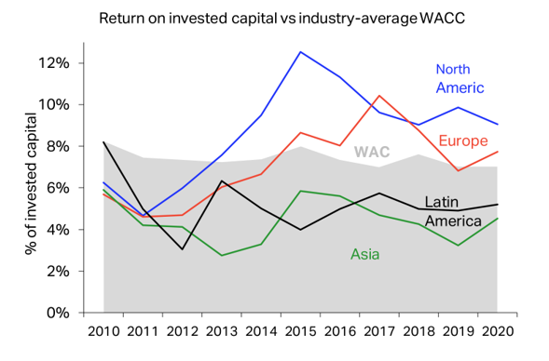
RETURN ON INVESTED CAPITAL
GOOD TIMES LATELY BUT KEEP THE CYCLE IN MIND

Slide 7
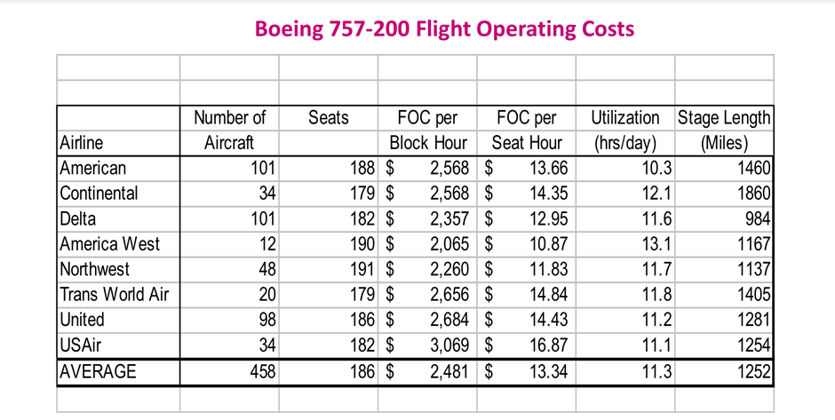
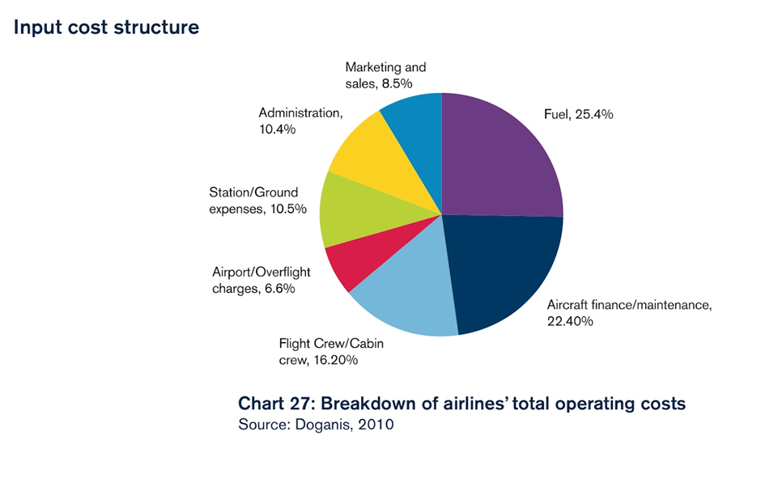
COSTS ARE KEY
FINDING THOSE WITH AN ADVANTAGE
ADVANTAGES TO LOOK FOR:
SCALE
FINANCE
COST
MARKETING
ADMIN
FUEL EFFICIENCY
LABOR COSTS
UNIONS
HUBS

Slide 8
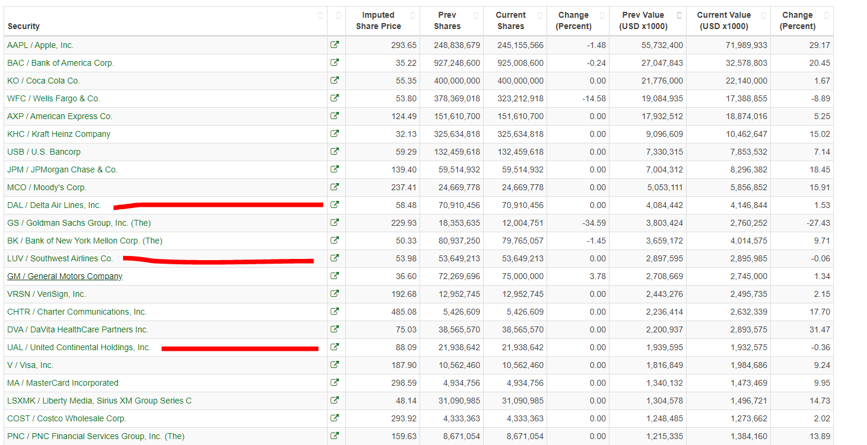
CURRENT SITUATION
COMPANIES ARE PREPARED FOR DOWNTURNS (BUFFETT IS LONG)

Slide 9
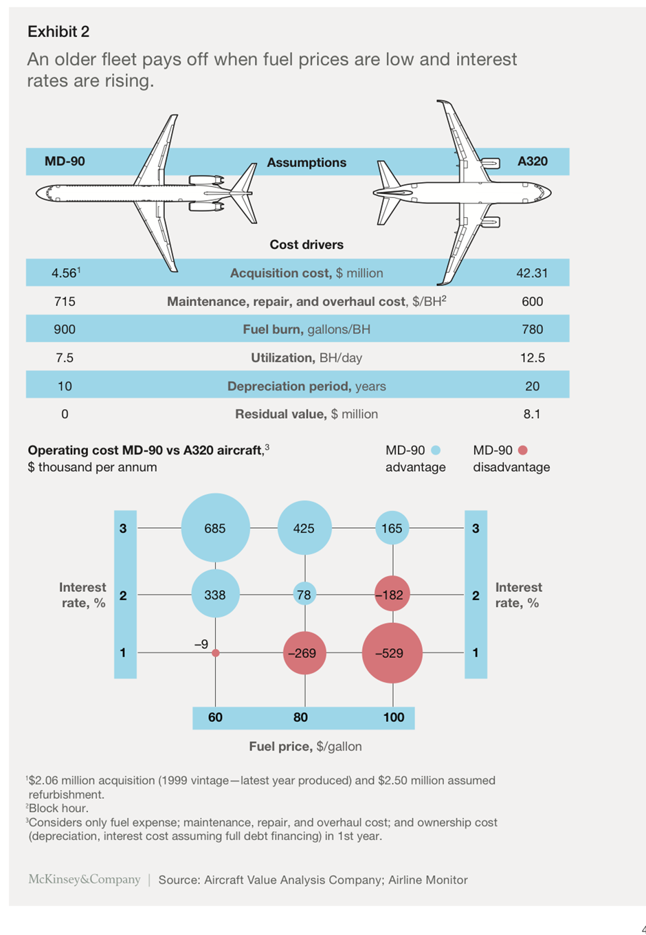
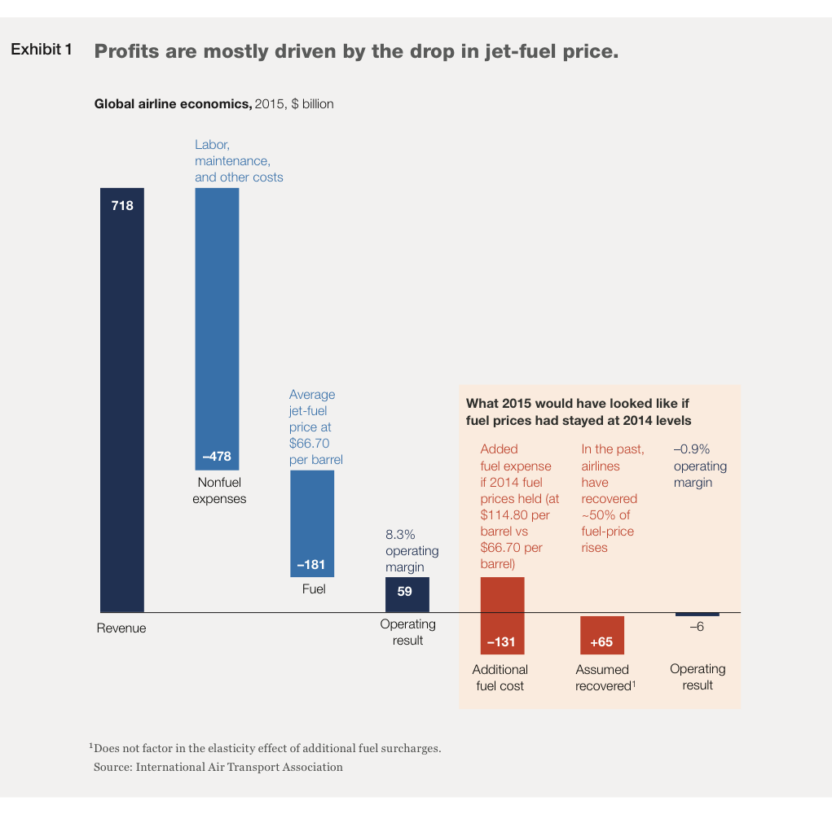
CURRENT SITUATION
HIGH PROFITS THANKS TO LOW FUEL COSTS

Slide 10
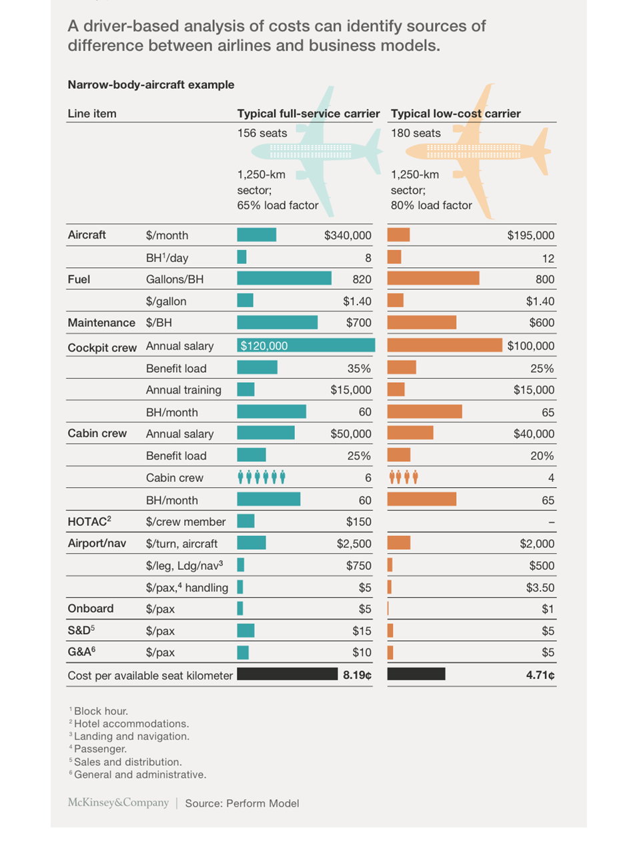
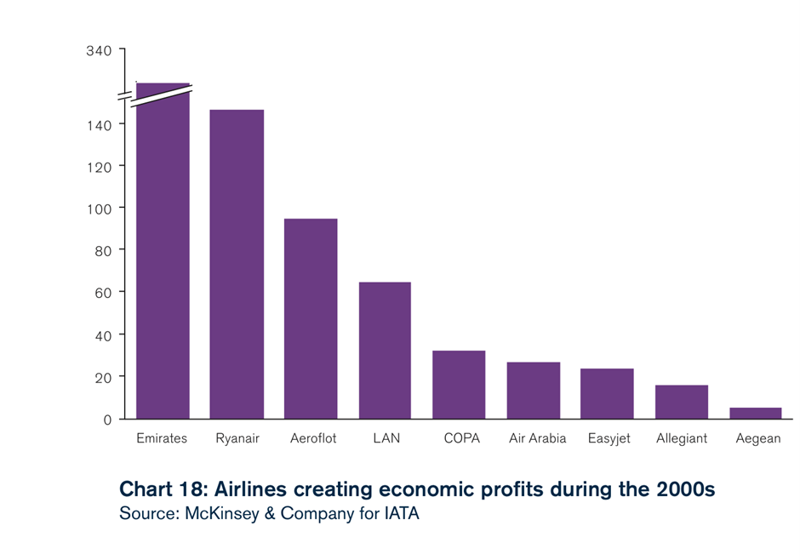
CURRENT SITUATION

Slide 11
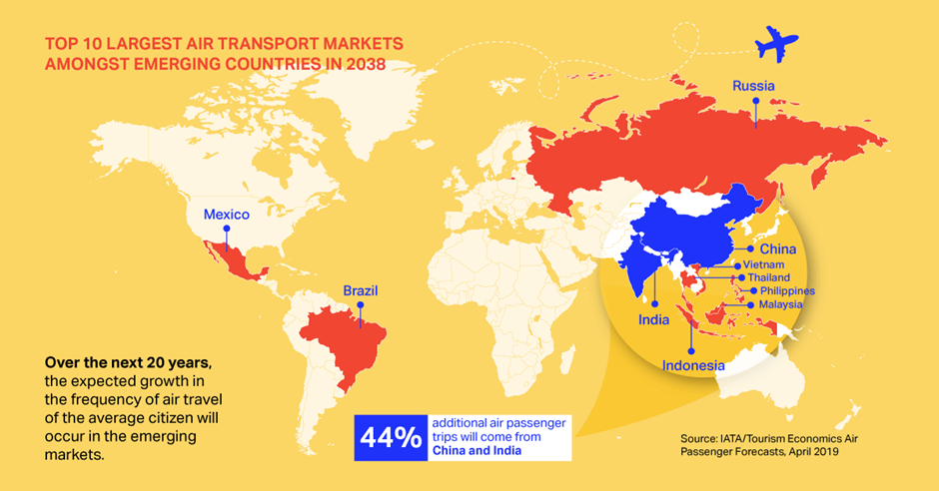
CURRENT SITUATION

Slide 12
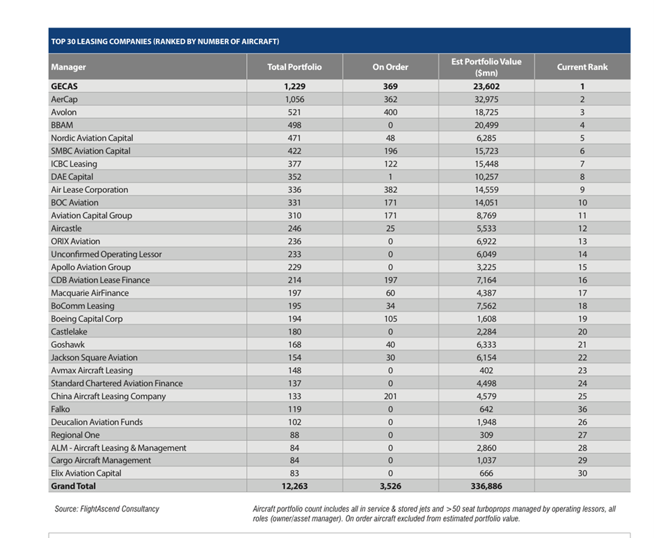
INDUSTRY TO INVEST IN
LEASING – low interest rate & huge funding + growth

Slide 13
INDUSTRY TO INVEST IN
LEASING – low interest rate & huge funding + growth
MANUFACTURING – BOEING, AIRBUS, EMBRAER
AIRPORTS

Slide 14
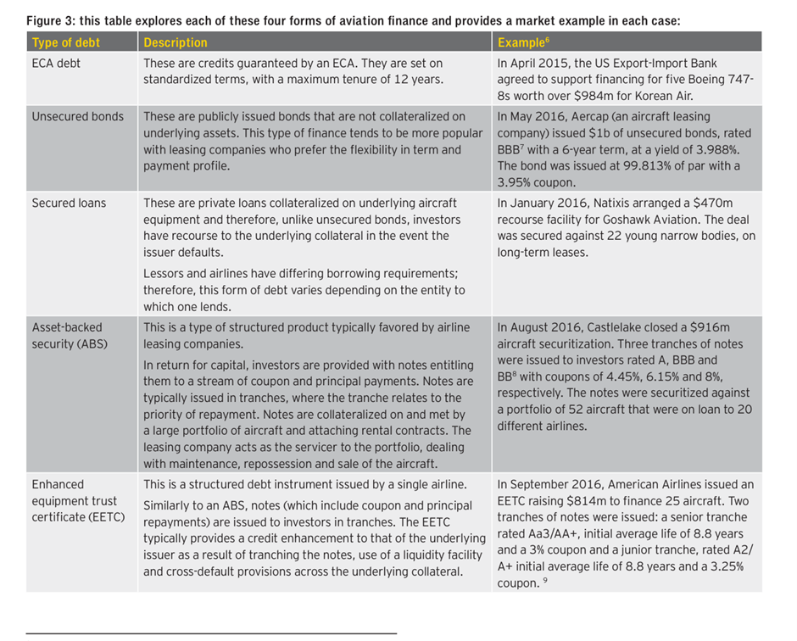
THE DEBT ISSUE

Slide 15
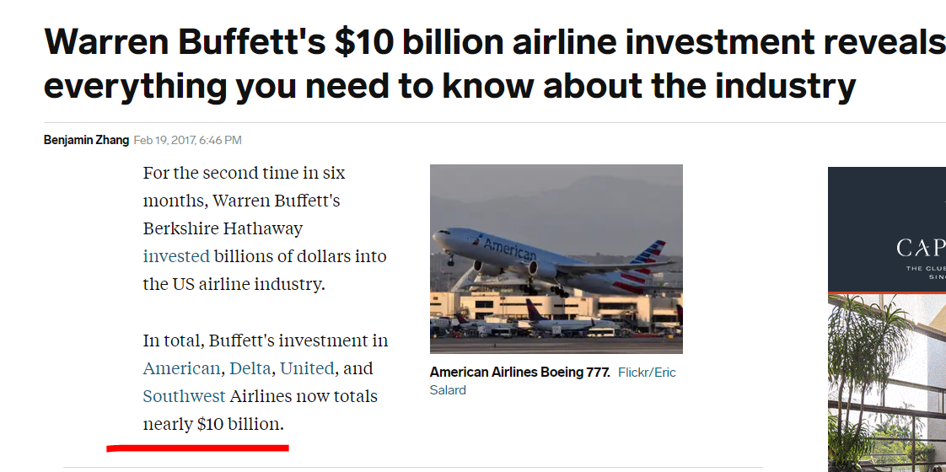
BUFFETT DIDN’T BUY AN AIRLINE – HE BOUGHT THE INDUSTRY
CONSOLIDATION LEADING TO LONG-TERM POSITIVE AND GROWING CASH FLOWS?
READY TO BUY MORE OR CAPITALIZE IF NECESSARY – the standard $10 billion convertible loan with 8% rate??

Slide 16
RISKS
RISKS
Oil price risk
Geopolitical risk
Economic fluctuations
Labor costs
EXTERNAL SHOCKS – 9/11, crises etc. SARS, CORONA
Excess capacity in weak markets
HIGH COMPETITION – LOW COST AND ULTRA LOW COST CARRIERS

Slide 17
SOUTHWEST AIRLINES – NYSE:LUV
30 Billion market cap
FINANCE

Slide 18
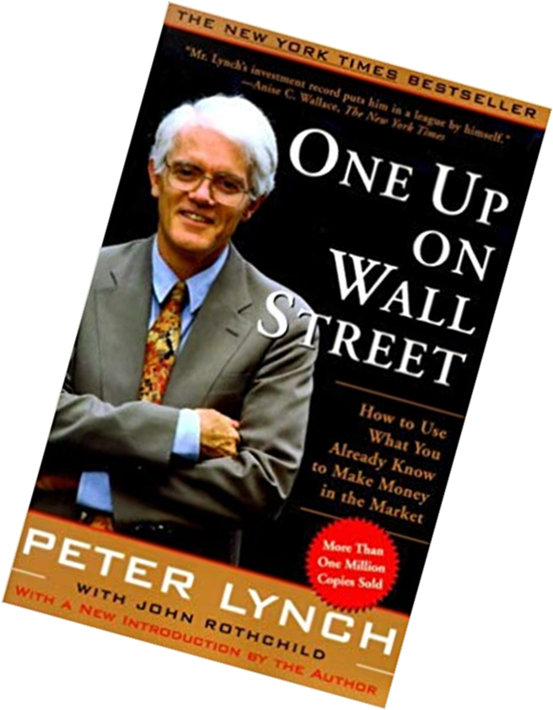
PETER LYNCH – ONE UP ON WALL STREET – PART II
THE CYCLICALS
Cyclicals expectations:
To flourish when the economy turns good again
Suffer when there is no economic growth
50% drops are normal if you buy at the wrong part of the cycle
You can wait for years before seeing another upswing (Ford down since 2013)
Large and well-known companies that make the unwary stock picker most easily part with his money
Timing is everything – watch for inventories and for new market entrants
Stock usually declines when peak earnings is reached and investors expect next recession (look at Ford)
Know your cyclical and figure out the cycles – In the car industry is 3 to 4 bad years followed by 3 to 4 good years. The worse the slump, the better the recovery.
Easier to predict an upturn than a downturn in the industry.
SIX CATEGORIES OF STOCKS TO INVEST IN:
SLOW GROWERS
STALWARTS
FAST GROWERS
CYCLICALS
ASSET PLAYS
TURNAROUNDS

