Slide 1
Rapid prototyping to build Knowledge Graph solution using TigerGraph Lecture 2 of Knowledge Graph AI Series Homework Assignment
Name:
Email:
Date:
<Enter your Full Name>:
<Enter your Email>
<Enter Test Date>

Slide 2
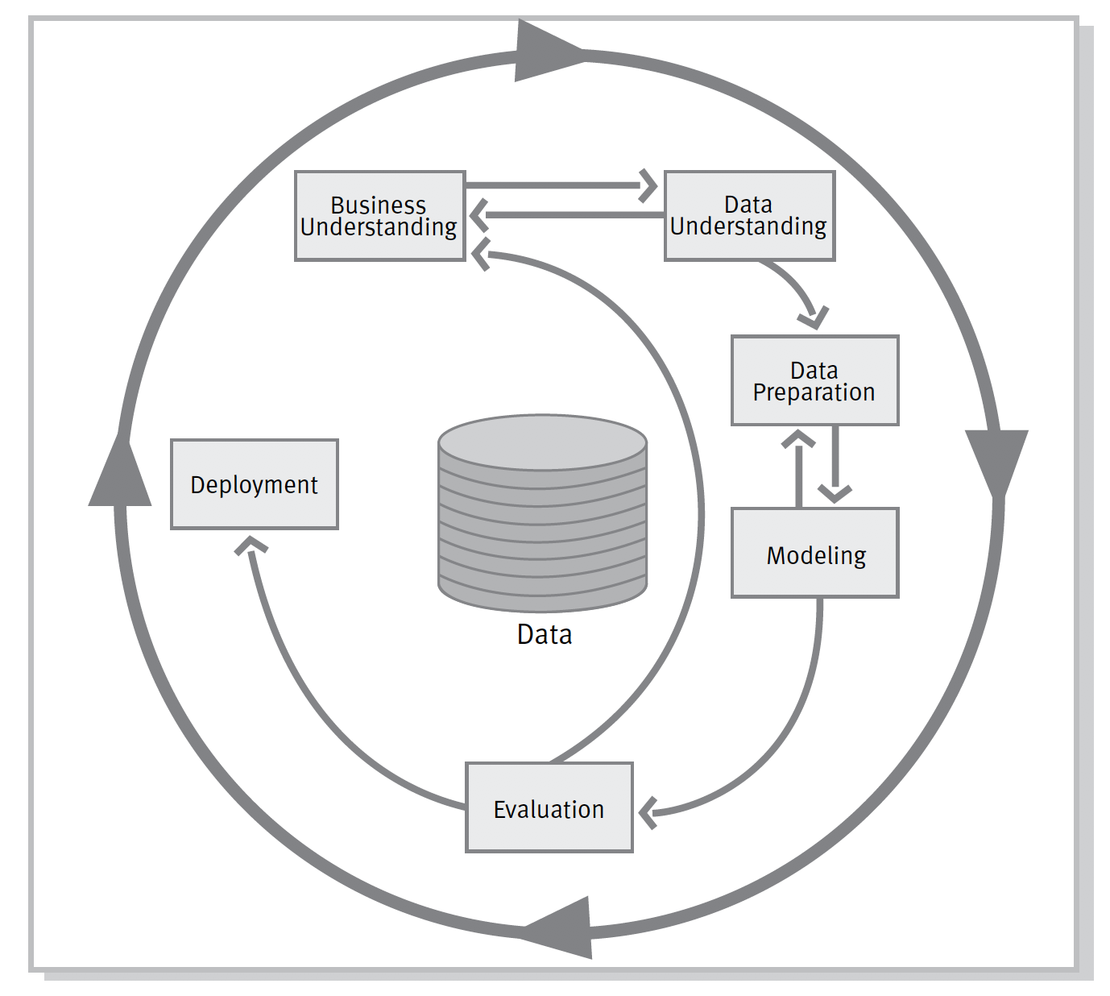
Movie Media Platform – Homework Assignment Overview
CRISP-DM¹
Students will finish the following CRISP-DM sections
Business Problem Understanding
Data Understanding
Data Preparation – Graph Development
Modeling – Graph Queries
Evaluation – Query results
Deployment (Optional)
¹CRISP-DM is a standard Data Science design methodology
https://en.wikipedia.org/wiki/Cross-industry_standard_process_for_data_mining

Slide 3
1. Business Problem Understanding
User Persona – <provide your response below>
Question | Enter your response below
Name
Title
Skill
Need
Business problem description– <provide your response below>
Question | Enter your response below
Objective
Capability
Benefit
Solution user | e.g., consumer or businessperson

Slide 4
2. Data Understanding
For each data source– <complete table below for all datasets using first row as sample>
Dataset | Description | Content (fields) | Source Data Statistics (volume, quality) | Comments
artist_attributes.csv (IMDb) | Contains artist names and ID | artist ID, artist name | 175719 entries, no missing data | Dataset connects to IMDB via artist ID
Many datasets are attached as Zip file under Use Cases section.
Please download those and utilize them to describe your Datasets

Slide 5
3. Data Preparation – Graph Development
<complete tasks listed in table below>
No | Task | Instructions
1 | Review Homework Assignment Use Case - Movie Media Platform | Review Section 1 – Use Cases and Section 8 – Summary and Homework Assignment for details
2 | Setup TigerGraph Cloud Account | Please complete as part of exercises in Section 2
3 | Provision MovieRecommendation starter kit in TigerGraph Cloud account | Please complete as part of exercises in Section 2
4 | Review and accept Starter kit schema | Please complete as part of exercises in Section 3
5 | Load MovieRecommendation Starter kit Data | Please complete as part of exercises in Section 3

Slide 6
3. Data Preparation – Graph Development (Cont.)
<Provide a screen shot of the schema>
<Provide a screen shot of data mapping>

Slide 7
4. Modeling - Graph Queries
For the homework assignment, you will be developing various queries.
See the following for assignment details:
Slide 9 – Structured Graph queries
Slide 10 – Elastic Graph queries
Slide 11 – Higher level Graph queries
Document all queries (see next slide for example template for query documentation)
Query name
Query overview
Pseudo English description
Graph traversal path
GSQL syntax
Results

Slide 8
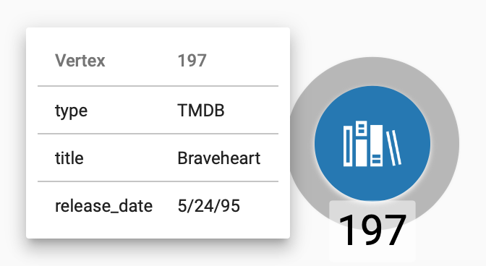
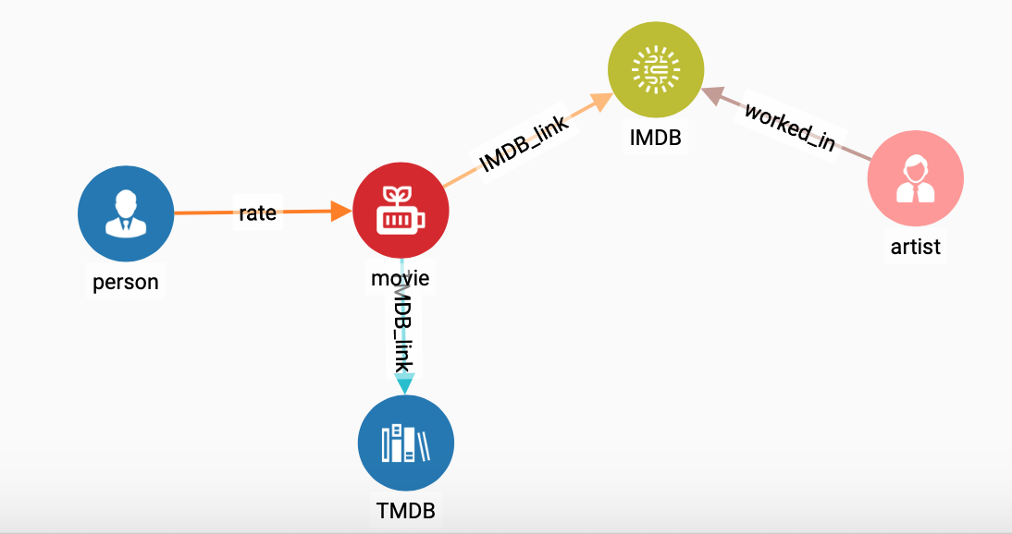
4. Modeling – Graph Query Documentation Template
1. Query Number: <query number>
2. Overview: Provide the TMDB entry for a movie title - Braveheart
3. Pseudo English description:
Find all TMDB vertices
Select TMDB vertex matching movie title
3. Provide the TMDB entry for a movie title - Braveheart
4. Graph Traversal Path:
5. GSQL syntax:
CREATE QUERY find_TMDB_attributes(String movie_name) FOR GRAPH MyGraph {
TMDB_V = {TMDB.*};
s_tmdb = SELECT c_tmdb FROM TMDB_V:c_tmdb
WHERE c_tmdb.title == movie_name;
PRINT s_tmdb;
}
6. Results:
<Screen shot>
1, 2, 3

Slide 9
4. Modeling Graph Queries – Structured Knowledge Graph
<complete tasks listed in table below and
document following structure queries using the query template defined previously >
No | Task | Instructions
1 | Update schema changes | Please complete as part of exercises in Section 4
2 | Data mapping | Please complete as part of exercises in Section 4
3 | Load data | Please complete as part of exercises in Section 4
4 | Explore Graph | Explore graph to find all movies where Julie Andrews was an artist.
5 | Structured Queries | SQ1: Write a query to find all users who rated Julie Andrews movies and gave a rating of 5. SQ2: Make a list of movies which received the rating of 5 from this group of users. SQ3: For a user, find movies he or she has not rated in this list of movies and return them as recommended movies SQ4: Write a query to find movie which are in TMDb and IMDb and not connected to each other. Can you create an edge connecting TMDb and IMDb and connect these movies

Slide 10
4. Modeling Graph Queries – Elastic Knowledge Graph
<complete tasks listed in table below and
document following elastic queries using the query template defined previously >
No | Task | Instructions
1 | Update schema changes | No change
2 | Data mapping | Load tmdb_overview_keywords data file and map them to keyword vertices and TMDb-keyword edge
3 | Load data | Delete and reload data into the updated schema and mapping
4 | Explore Graph | Explore graph to find all movies which have keyword “Penguin”
5 | Elastic Queries | EQ1: Write a query to find all movies associated with Penguin in its name EQ2: Write a query to find all movies associated with Penguin in its TMDb movie overview EQ3: Write a query to find all movies associated with Penguin or Penguins in its name or movie description

Slide 11
4. Modeling Graph Queries – Higher Level Knowledge Graph
<complete tasks listed in table below and
document following higher level queries using the query template defined previously >
No | Task | Instructions
1 | Update schema changes | Update MovieRecommendation schema to include vertices for artist and associated edge entry to connect artist to IMDb. Also add concept vertices for living being
2 | Data mapping | Load data files and map them to vertices and edges
3 | Load data | Delete and reload data into the updated schema and mapping
4 | Explore Graph | Explore graph to find all movies which are connected with concept “penguin”
5 | Higher Level Queries | HQ1: Write a query to find all movies associated with concept bird in its name or movie description HQ2: Find an action movie from 1990s which is also a Science Fiction HQ3: How similar are the genres? Can you compute the overlap across the three sets?

Slide 12
5. Evaluation
Based on your experimentation, what did you learn and how you can improve your graph schema and queries in future.
<List your response in space below>

Slide 13
6. Deployment – Movie Media Platform
<Provide Solution Overview picture using Solution Integration section as Reference>
<List solution components below>
Application Components | Data Stores | Python Interface (Optional)

Slide 14
Appendix

Slide 15
Movie Media Platform - Data Understanding
MovieLens is a research site run by GroupLens Research at the University of Minnesota and funded by National Science Foundation
The Movie Database (TMDb) is a community-built movie and TV database.
owned by Amazon, of information related to films, television programs, home videos, video games, and streaming content online.¹
¹ IMDb is a registered trademark. Information courtesy of IMDb (http://www.imdb.com). Used with permission

Slide 16
Data Understanding - movielens
Datasets:
https://grouplens.org/datasets/movielens/
Documentation is available at https://www.kaggle.com/tmdb/tmdb-movie-metadata
Please note this data should only be used for class assignment. For any other use, please see https://www.themoviedb.org/apps
¹ F. Maxwell Harper and Joseph A. Konstan. 2015. The MovieLens Datasets: History and Context. ACM Transactions on Interactive Intelligent Systems (TiiS) 5, 4: 19:1–19:19. https://doi.org/10.1145/2827872

Slide 17
Data Understanding - IMDb
Datasets:
name.basics.tsv.gz
title.akas.tsv.gz
title.basics.tsv.gz
title.crew.tsv.gz
title.episode.tsv.gz
title.principals.tsv.gz
title.ratings.tsv.gz
Documentation is available at http://www.imdb.com/interfaces/
Please note this data should only be used for class assignment. For any other use, you should seek permission from IMDb (imdb-licensing@imdb.com)
¹ IMDb is a registered trademark. Information courtesy of IMDb (http://www.imdb.com). Used with permission.

Slide 18
Data Understanding - TMDb
Datasets:
tmdb_5000_credits.csv
tmdb_5000_movies.csv
Documentation is available at https://www.kaggle.com/tmdb/tmdb-movie-metadata
Please note this data should only be used for class assignment. For any other use, please see https://www.themoviedb.org/apps

Slide 19
Class Exercises / Homework Assignment – Dataset Attachments
The following files are attached:
KG-Rapid-Prototyping-Homework Assignment – provides detailed instructions for Homework Assignment
movies.csv – movielens extract on Movie IDs, title and genres as assigned by movielens.
ratings.csv – movie ratings given by movielens users
tmdb_attributes.csv – movie attribute information as stored in the TMDb database.
tmdb_keywords.csv - movie keywords given to the movies by TMDb users
tmdb_overview_keywords.csv – movie keywords extracted by analyzing movie overviews using Watson Natural Language Understanding
imdb_attribute.csv - movie attribute information as stored in the IMDb database.
artist_attributes.csv – artist names and IDs in the IMDb database
artist_to_imdb.csv – link from artist to IMDb data connecting a movie to the artists who worked in a movie
tmdb_genres.csv – Genre information on TMDb movies
Imdb_genres.csv – Genre information on IMDb movies
links.csv – links connecting IMDb, TMDb and movielens movies

