Slide 1
PREVENTING AND HEALING INJURIES with YOGA
RACHEL KRENTZMAN PT, C-IAYT

Slide 2
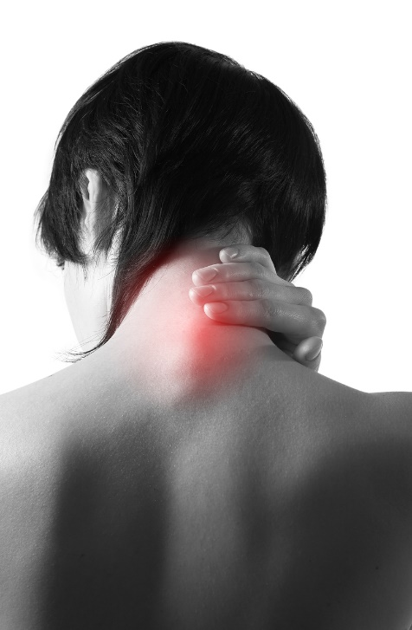
MOST COMMON YOGA INJURIES
Rotator Cuff (supraspinatus) Tendonitis
Neck Pain – Arthritis/Compression, Disc bulge
Hamstring Tendonitis – Pain in the Butt
Sacroiliac Joint Pain & Dysfunction
Lower Back Pain – Disc bulge or Herniation
Knee Pain – Meniscus Tear and/or Patellofemoral Syndrome
This Photo by Unknown Author is licensed under CC BY-ND
This Photo by Unknown Author is licensed under CC BY

Slide 3
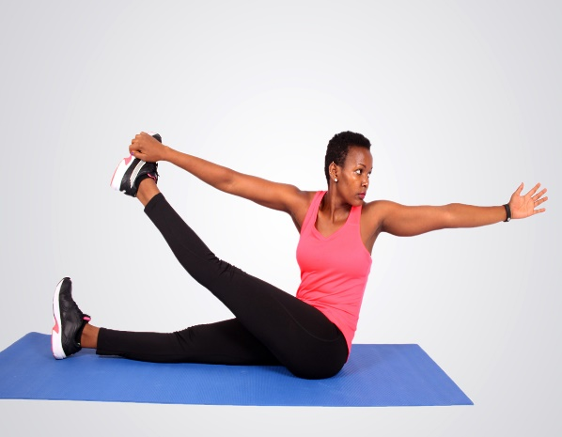
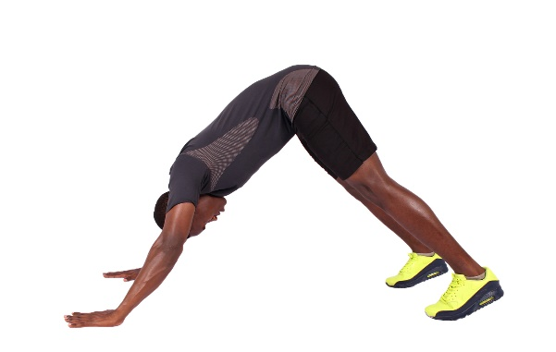
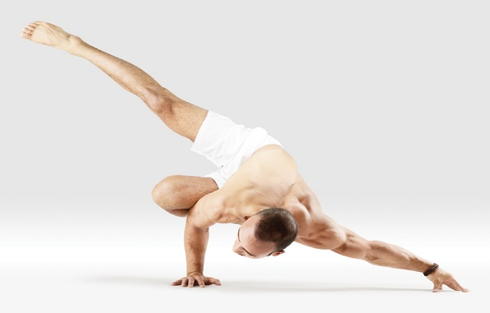
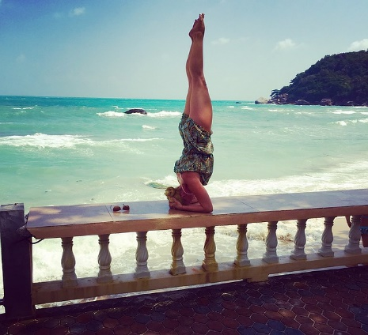
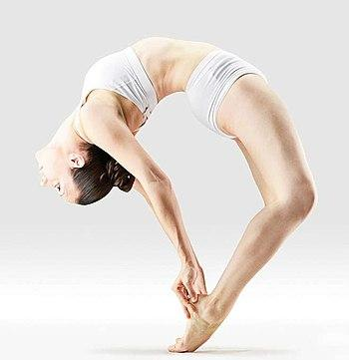
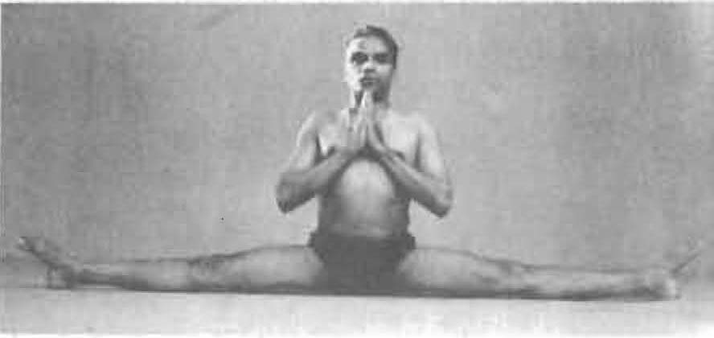
WHAT WENT WRONG?
Avidya
Ego
Attachment
This Photo by Unknown Author is licensed under CC BY-ND
This Photo by Unknown Author is licensed under CC BY-SA
This Photo by Unknown Author is licensed under CC BY-SA

Slide 4
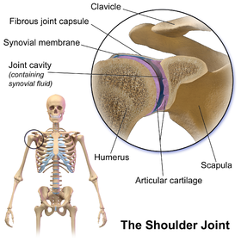
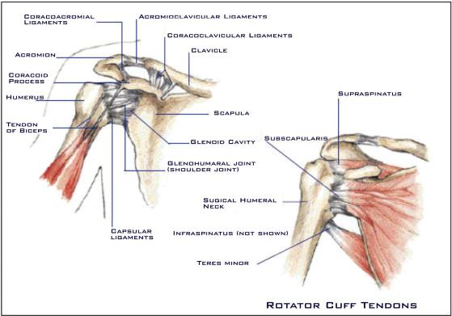
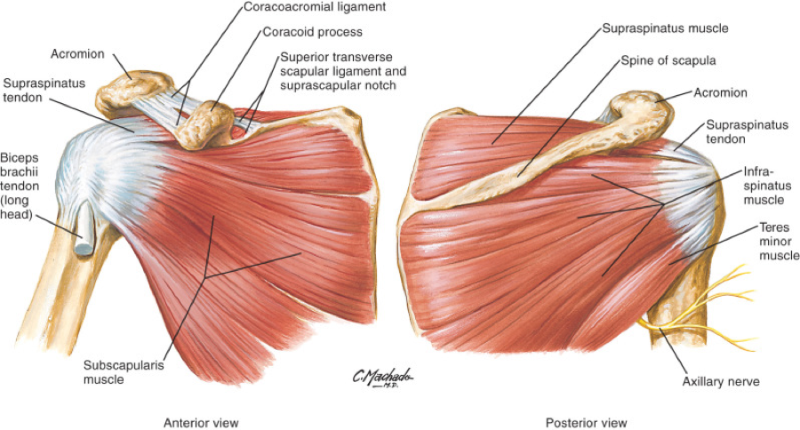
SHOULDER JOINT ANATOMY
First bullet point here
Second bullet point here
Third bullet point here
Class | Group 1 | Group 2
Class 1 | 82 | 95
Class 2 | 76 | 88
Class 3 | 84 | 90
This Photo by Unknown Author is licensed under CC BY-SA
This Photo by Unknown Author is licensed under CC BY-SA-NC

Slide 5
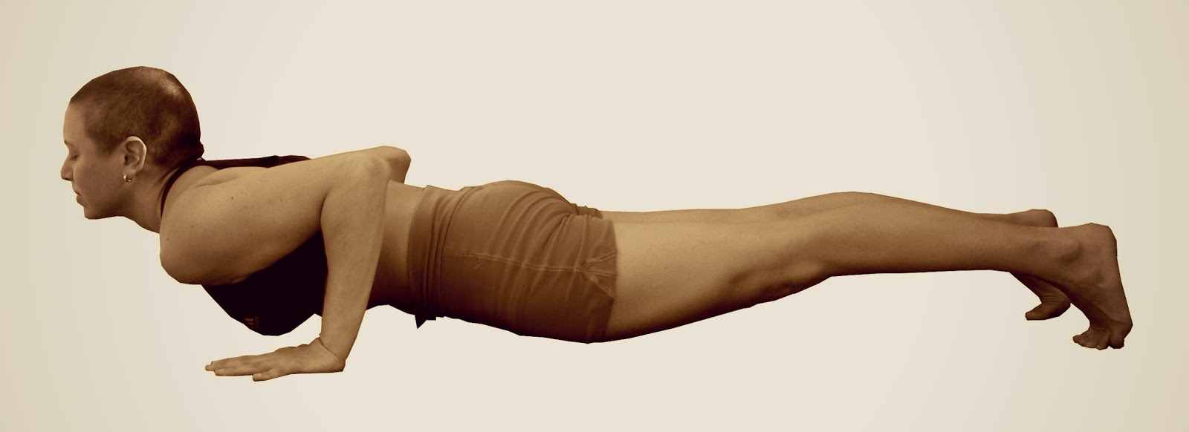
COMMON MISTAKES IN ASANA
Second bullet point here
Third bullet point here
This Photo by Unknown Author is licensed under CC BY-NC-ND

Slide 6
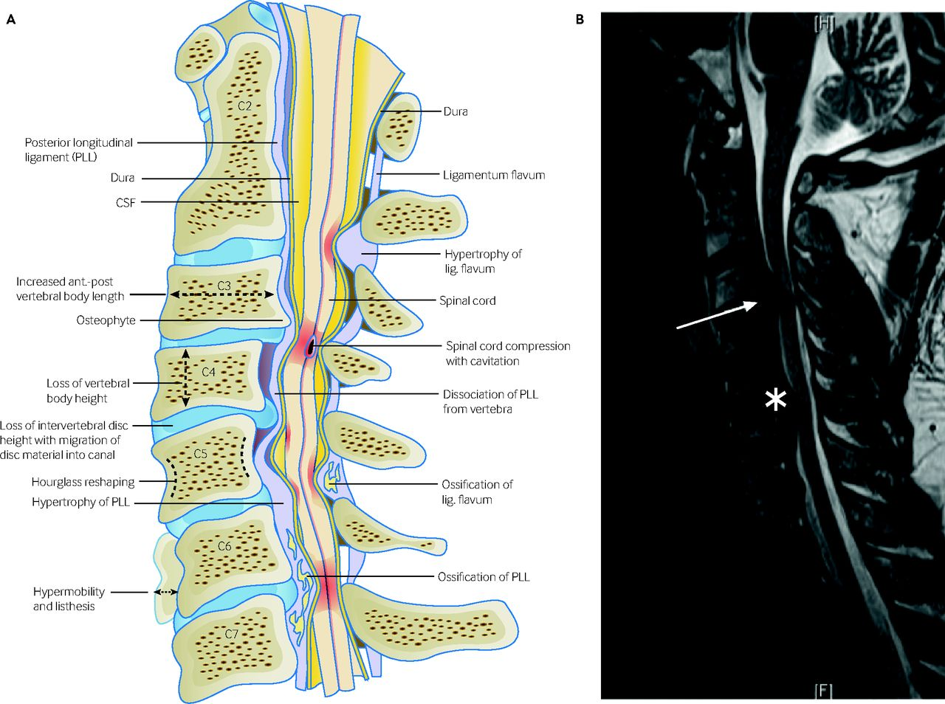
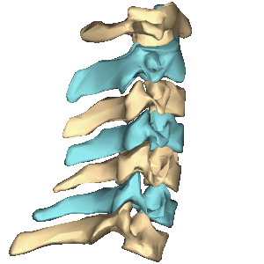
NECK ANATOMY
This Photo by Unknown Author is licensed under CC BY-SA
This Photo by Unknown Author is licensed under CC BY

Slide 7
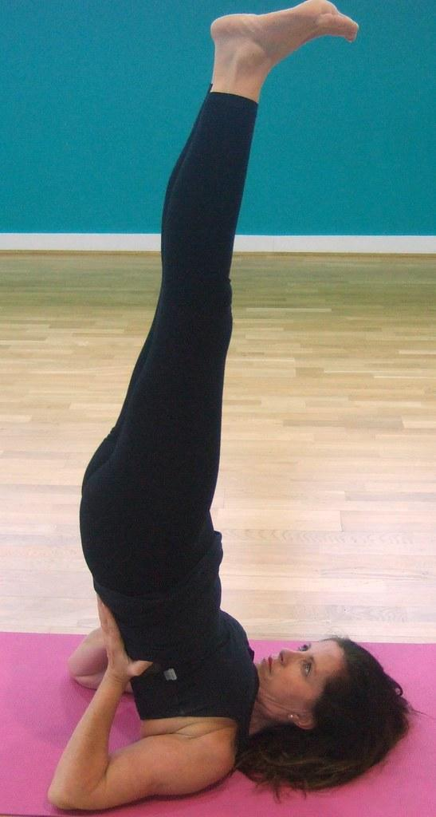
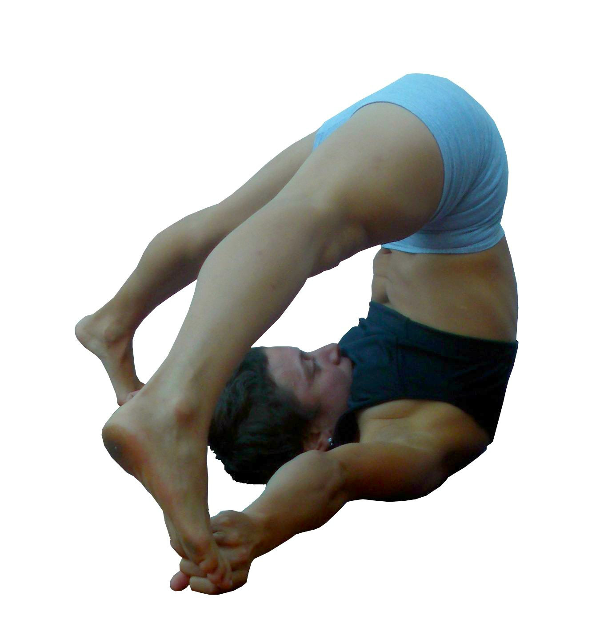
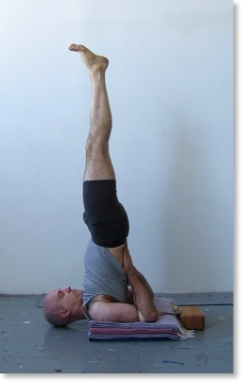
COMMON MISTAKES IN ASANA
VS.
This Photo by Unknown Author is licensed under CC BY-SA-NC

Slide 8
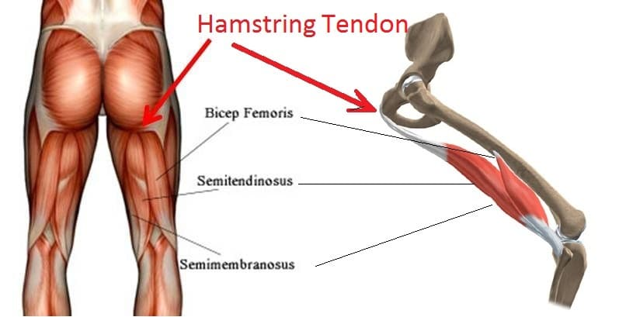
HAMSTRINGS ANATOMY
ANATOMY
INJURY
This Photo by Unknown Author is licensed under CC BY-SA

Slide 9
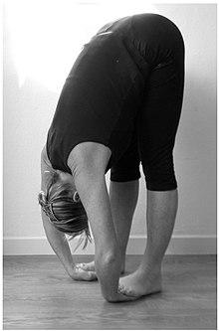
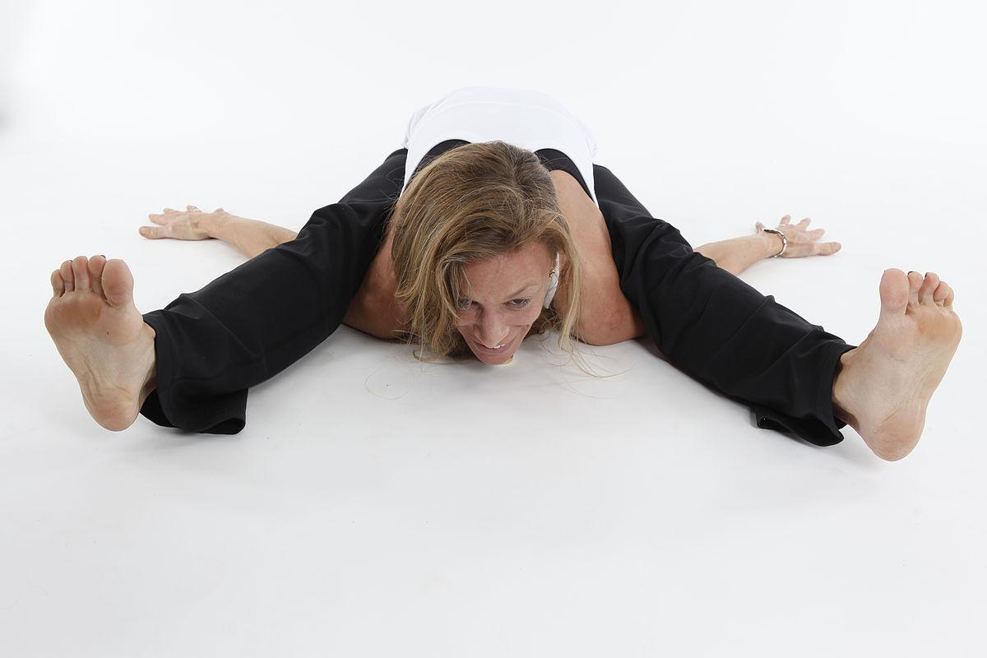
WHAT WENT WRONG?

Slide 10
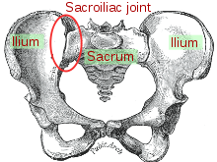
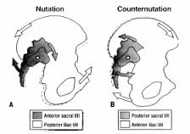
SACROILIAC JOINT ANATOMY

Slide 11
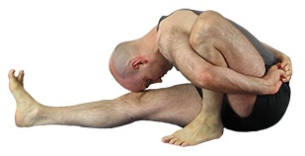
WHAT WENT WRONG?
Hyper flexibility can lead to injury
Trauma
Repetitive stress – forward bends and twists, trying to square hips

Slide 12
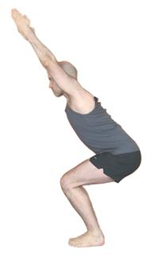
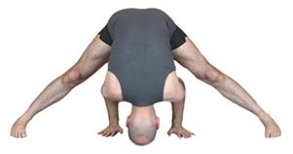
FOCUS ON STABILITY IN ASANA FOR SI JOINT

Slide 13
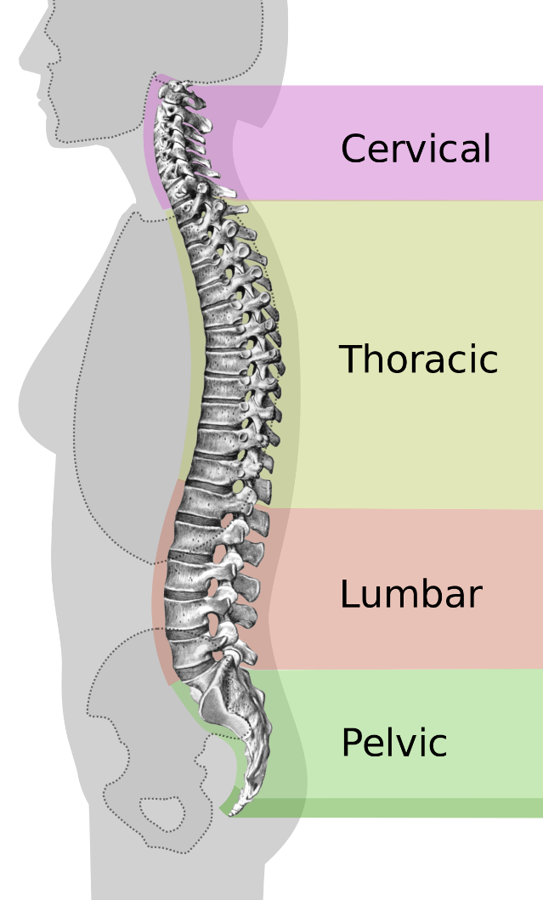
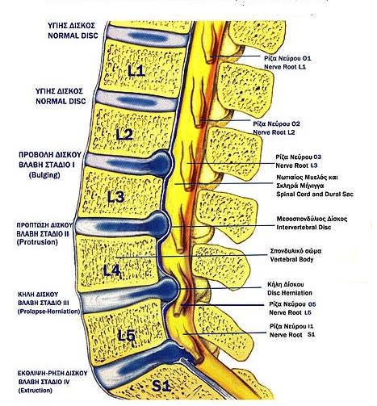
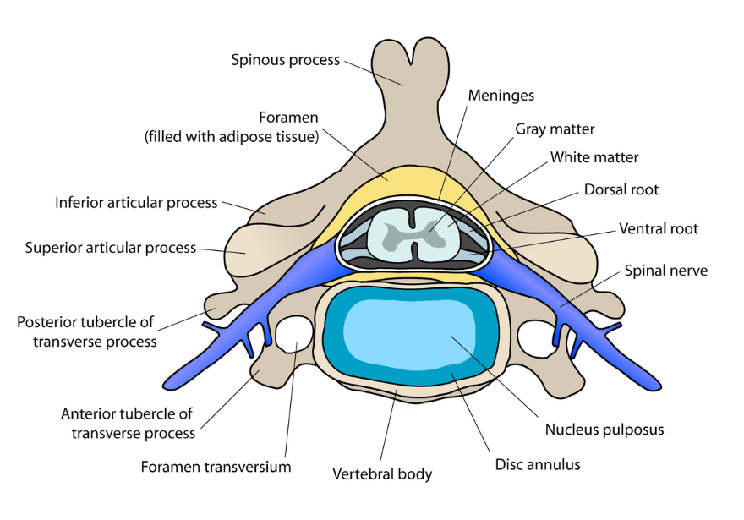
LOWER BACK PAIN – LUMBAR SPINE ANATOMY
This Photo by Unknown Author is licensed under CC BY-SA
This Photo by Unknown Author is licensed under CC BY-SA
This Photo by Unknown Author is licensed under CC BY-SA

Slide 14
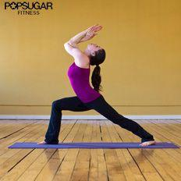
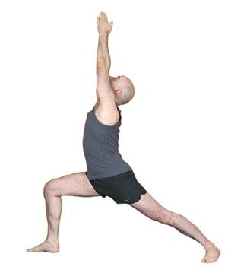
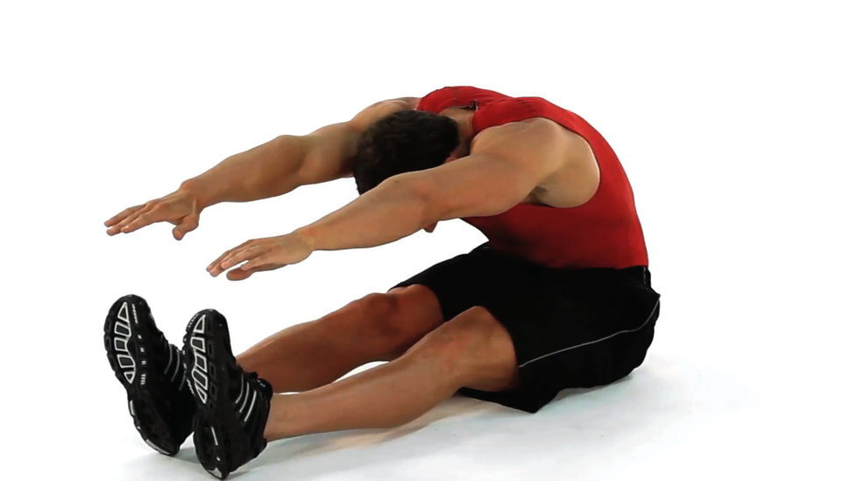
WHAT WENT WRONG?
Tightness in surrounding muscles of the hip
Decreased mobility in thoracic spine
Hypermobility in lower back
Decreased abdominal strength & pelvic floor support
Decreased leg strength
Decreased ability to move at the level of each vertebra
= Spinal Compression

Slide 15
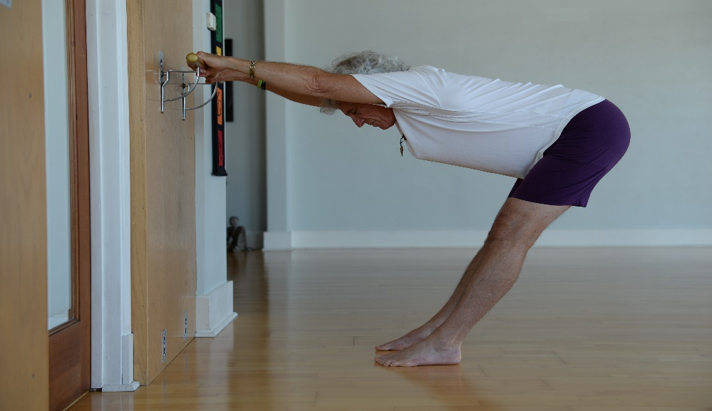
THINGS YOU CAN DO:
Create Space – awareness & traction
Open surrounding muscles
Relax tight muscles
Stabilize and strengthen the core

Slide 16
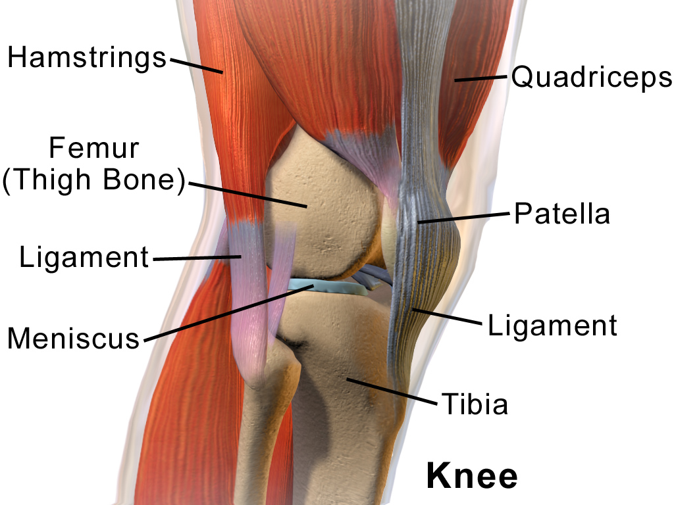
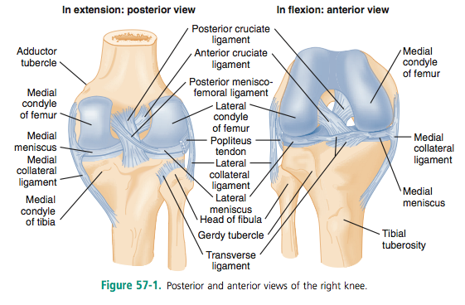
KNEE ANATOMY
This Photo by Unknown Author is licensed under CC BY-SA-NC
This Photo by Unknown Author is licensed under CC BY-SA

Slide 17
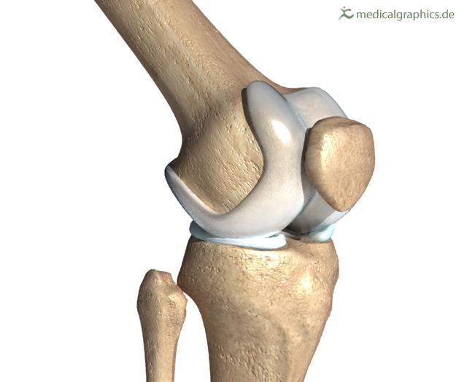
KNEE PAIN IN YOGA - CAUSES
Poor tracking of kneecap
Not enough support of muscles – quadriceps (medial > lateral)
Too much flexion – overuse & strain
Tight muscles – IT Band, external hip rotators, quads
Other factors: previous injuries, hyperextension, trauma

Slide 18
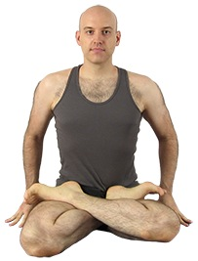
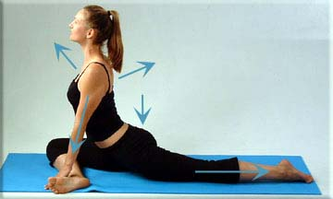
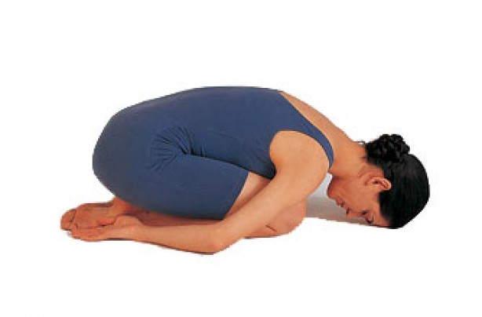
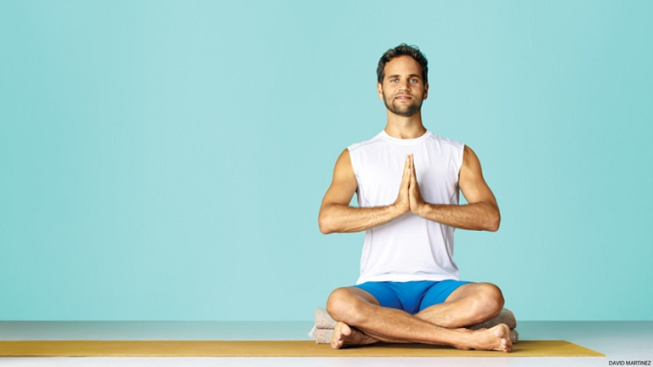
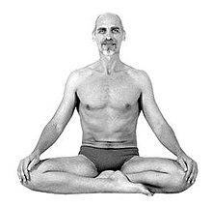
POSES THAT CAN AGGRAVATE MENISCUS

Slide 19
THINGS YOU CAN DO:
Stretch the iliotibial band
Stretch external rotators of the hip
Strengthen the medial quadriceps and adductors
Strengthen the gluteus medius
Make sure knees stay in line with the toes
Avoid hyperextension

