Slide 1
Prescribers & Insurance

Slide 2
Where to buy products
ELITE AESTHETICS WHOLESALE –cellulite/
FOX PHARMACY –revolax/everything/botox
ACRE PHARMACY – good for everything
MEDISAVE – needles/gloves/insulin syringes
www.la-beautydolls.com – deep filler & numbing cream

Slide 3
Stock Check List
Gloves
Masks
Scrubs
Fridge amazon
TROLLEY AMAZON
WIPES
Lanolin for lip filler
Stress balls
White eyeliner marker pen
Bed
Disinfectant wipes
Ring lights
Bed roll

Slide 4
CLINIC WASTE
1x normal waste bin
1x yellow clinic waste bin
Yellow clinic waste 1 litre bags
Sharps bin
Any pharmacy can dispose of this for you
INITIAL WASTE – www.initial.co.uk
Initial Waste will replace your sharps and yellow bags on a monthly subscription.

Slide 5
INSURANCE
-Once you receive your certificates you will need to call INSYNC insurance to get your insurance before you start injecting.
-You will need 6 months of injecting experience in order to gain your insurance which you need to let INSYNC know. This date will be on your certificate.
-INSYNC will ask you for our CPD number which is clearly shown on your certificate #779378
-INSYNC insurance can either be paid monthly or yearly.

Slide 6
Ordering Prescription Products
Prescription products can include Torbac, Lidocaine and Botox. These are a few of the prescription products of others.
STEP 1- MAKE YOUR PRESCRIPTION ORDER ON ANY PHARMACY WEBSITE
STEP 2- SEND THE ORDER NUMBER TO YOUR PRESCRIBER
STEP 3- YOUR PRESCRIBER WILL WRITE YOUR PRESCRIPTION TO THE PHARMACY
STEP 4-ONCE THE PHARMACY RECEIVE YOUR ORDER- THE ORDER WILL BE SHIPPED
***Please note that with prescription orders you do not pay any VAT

Slide 7
ACRE Prescribing Partner
Once you create your account on ACRE PHARMACY- you will need to click on ERX MANAGER on the top of the homepage to be able to add your prescriber.

Slide 8
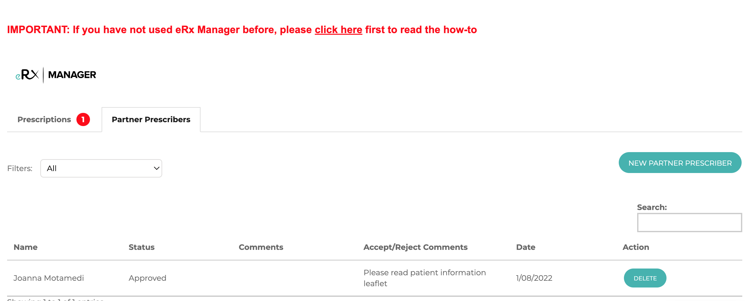
ACRE Prescribing Partner
Add your prescriber onto the partner prescriber
Create your prescription order before making your normal order and then wait for your prescriber to approve it.
Once approved the order will be shipped.

Slide 9
Thank you Dolls! XO

