Slide 1
On Academic Paper
Yas Suttakulpiboon
Alternative Risk Transfer and Securitization

Slide 3
What is an Academic Paper?
Yas Suttakulpiboon

Slide 4
“ Why do/should we care about a research paper? ”

Slide 5
What is an Academic Paper
Academic writing is writing done by scholars for other scholars.
Academic writing is devoted to topics and questions that are of interest to the academic community.
Academic writing should present the reader with an informed argument.

Slide 6
Journals and Publication
American Economic Review
Journal of Finance
Journal of Financial Economics
Review of Financial Studies
Journal of Accounting and Economics
Journal of Accounting Research
The Accounting Review
Journal of Management

Slide 7
In our field…
JRI: Journal of Risk and Insurance
IME: Insurance Mathematics and Economics
GPRI: The Geneva Papers of Risk and Insurance
JRU: Journal of Risk and Uncertainty
APJRI: Asia-Pacific Journal of Risk and Insurance
NAAJ: Northern American Actuary Journal
JIR: Journal of Insurance Regulation
JII: Journal of Insurance Issues

Slide 8
Types
Theoretical Work
Empirical Work
Survey
Literature Review
Others

Slide 9
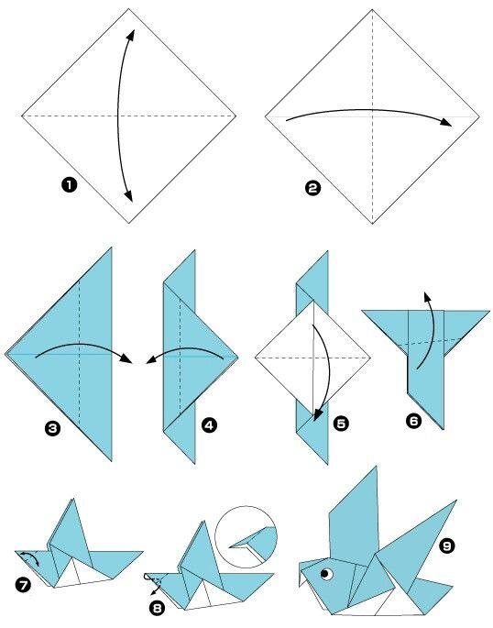
The Anatomy of an Academic Paper
Abstract
Introduction
Literature Review
Methodology / Model / Identification
Data and Summary Statistics
Results
Robustness Testing
Summary

Slide 10
Want to Write a New Paper?
Do people care about your work?
Can you significantly improve the current body of knowledge?
Deductive vs Inductive Approach
Spot the (Literature) Gap!
Interdisciplinary Approach
Regulation Change
Things that matter in the real world
When you get new sets of data

Slide 11
Where Can We Find the Papers?
scholar.google.com
papers.ssrn.com
Literature Review Papers
Handbooks of …
Chula Library
Textbook

Slide 12
How to Write an Effective Referee Report
Yas Suttakulpiboon

Slide 13
“ What makes a bad research paper? ”

Slide 14
Two people you’ll ever meet when publishing an academic paper
A Journal Editor
Significant
Accurate
Clear
Timely
(A) Referee(s)
Reject / Suggest Another Journal
Conditionally Accept (Revise and Resubmit)
Unconditionally Accept

Slide 15
Anatomy of A Referee Report
Name, Title, Date
A brief discussion, its importance, and its relation to other’s work in the field
A decision: Reject, Accept, Conditionally Accept
Originality / Clarity
Recommend where the paper should be sent to
Supporting argument
Constructive criticism
How can the work be improved?
Why it is not publishable?
What errors should be corrected?
What relevant work should be compared to / referenced?
Organization? English?
General comments vs specific comments

Slide 16
A Referee Should…
Return the report quickly
Assure quality control
Read, think about it, write the report, revise
Remember that you don’t have the final say in the work
Remember that you may have to review what you don’t know
Remember that it is like paying tax to the academic community

Slide 17
How to Give a Great Academic Presentation
Yas Suttakulpiboon

Slide 18
“ What makes a bad presentation? ”

Slide 19
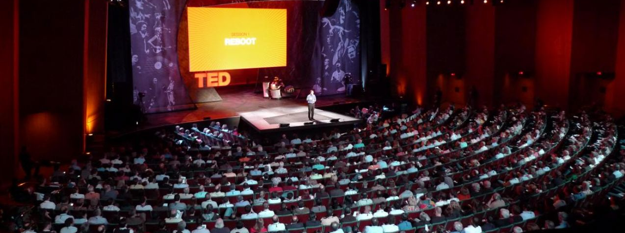
A Great Presentation
Content
Visuals
Speakers
Audience Engagement

Slide 20
A Great Academic Presentation
Content
Visuals
Speaker
Audience Engagement

Slide 21
Content
Structured
Logical
Punch line to the front!

Slide 22
Visuals
LaTeX & Beamer
PowerPoint? Not so much…
Clear text with minimal effect, or color. Picture tells a thousand words!
1 minute per slide, 30-point font

Slide 23
Speaker
Maintain composure and don’t panic!
Speak loud and clear. Give a sense of command.
Don’t speak too fast or too slow.

Slide 24
Audience Engagement
Audience may interrupt you at anytime.
Listen, say thank you, then answer the questions.
Eye contact, eye contact, and eye contact.

Slide 25
Dos
Check what is expected of you when invited to speak
Prepare in plenty of time
Establish a clear structure
Prepare good, summarized notes
Realize and accept that all good speakers experience nervous tension before speaking

Slide 26
Dos
Plan and rehearse the start with care
Put pace and enthusiasm into your delivery
Ensure you are clearly audible to everyone
Maintain good, evenly distributed eye contact with your audience
Plan and rehearse the conclusion with care

Slide 27
Don’ts
Prepare too much material: check your timing
Try to do without speaker's notes
Read the script verbatim
Start with an apology
Risk weak or dodgy jokes

Slide 28
Don’ts
Split your audience's attention by misuse of aids or handouts
Rock, sway or use repetitive gestures
Clutter your visual aids
Gabble or rush
Assume hostility

Slide 29
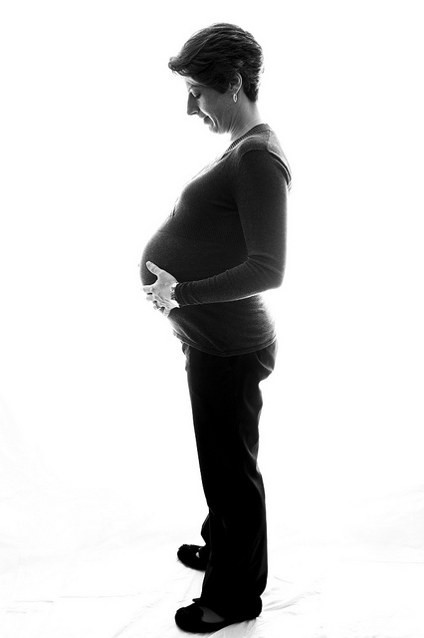
Our Expectation

Slide 30
Give a Great Presentation Write an Effective Referee Report Provide a Constructive Feedback Be Punctual & Attentive

