Slide 1
If
Rudyard Kipling
Narrator: Barbara Njau

Slide 2
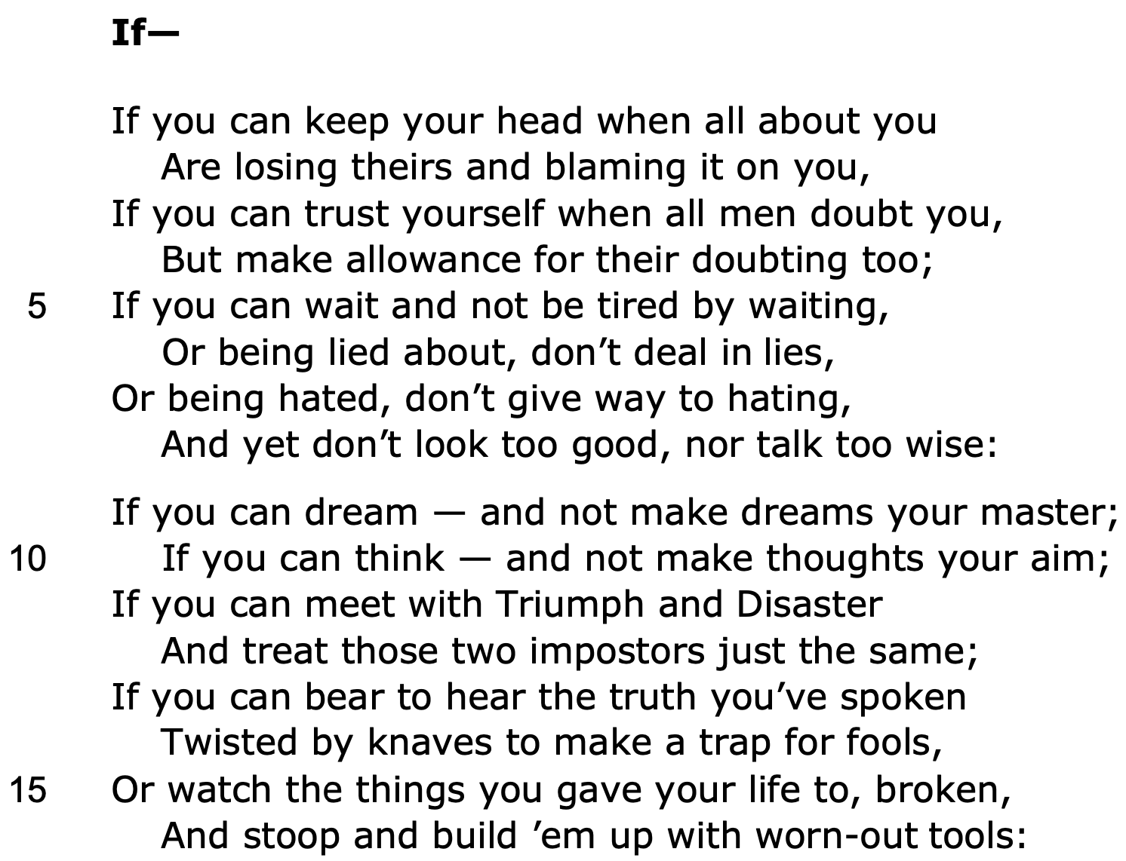
Very brief and mysterious title - suggest uncertainty
Second person pronoun shows this is advice
Colloquial
Conditional clause consistently repeated
Enjambment
People are acting irrationally
Repetition of second person pronoun
Oxymoron - self belief
Repetition of verb emphasises patience and resilience
Repetition of conjunction emphasises scenarios
Caesura
Imperative sentences
Intensifier
Importance of contemplation and action
Metaphor - advising against being too obsessively ambitious
Caesura
Oxymoron emphasises unpredictability of life
Personification shows both are deceptive
Enjambment
Alliteration - people will use your words against you
Colloquialism - reinvention after huge setbacks
Hyperbole reveals the shock of loss

Slide 3
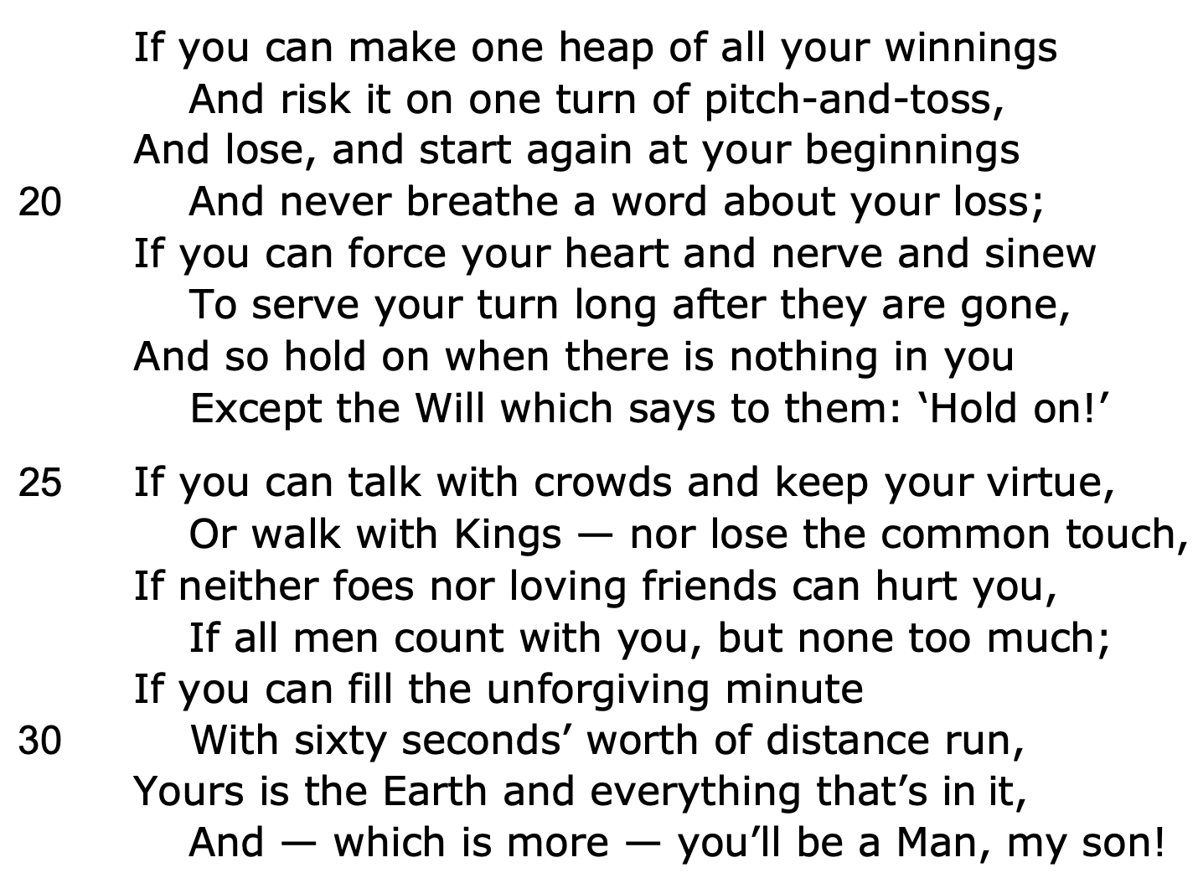
Language related to betting - semantic field of betting shows the action of gambling - life is a big gamble
Imperative sentence shows one should not openly bemoan their loss
Rule of three- symbolises will power
Focus and determination - metaphorical language
Pronoun - reference to most people in society that give up
Enjambment
Abstract noun - inner voice
Abstract noun - the importance of good morals
Contrast between royalty and commoners - the speaker says they should be treated similarly
Alliteration
Caesura
Oxymoron shows both can harm us
Metaphor for
a brief life
Personification - time is relentless
Exclamatory sentence reveals speaker is advising his son on the importance of self-belief
Hyperbole

Slide 4
THANK YOU!
WWW.FIRSTRATETUTORS.COM

