Slide 1
Market Risks for Insurance Business
Yas Suttakulpiboon

Slide 2
Agenda
Market Risks for Insurance Business
Market Valuation Approach to Insurance Contract
Solvency 2 & Market Risk (2015 Version)
Paper: Introduction to Solvency II SCR Standard Formula for Market Risk by Braun et al (JII, 2015)

Slide 3
Purposes
How to measure them?
How adequate economic capital can be defined for them?

Slide 4
Market Risks is Broadly Defined
Market risk relates to
the volatility of the market price of assets.
It involves exposure to movements in the level of financial variables, such as stock prices, interest rates, exchange rates or commodity prices.
It also includes the exposure of options to movements in the underlying asset price.
Market risk also involves exposure to other unanticipated movements in financial variables or to movements in the actual or implied volatility of asset prices and options.

Slide 5
Market Risks is Broadly Defined
Secondly, a change in asset returns/yields will affect future liability cash flows, if the policyholders are entitled to some form of profit sharing which is related, for instance, to actual and/or historical returns on assets.
A. profit sharing that is fully based on objective indicators of the performance of the capital market, for instance, an indicator of the actual interest rate level that is calculated and published periodically by a government agency, or a stock market index;
B. profit sharing that is somehow related to the actual performance of the company (‘performance linked’), particularly with respect to the company’s investments (Note: This type includes systems where the management is entitled to ‘declare the bonus rate’); and
C. profit sharing that is related to the actual performance of the assets that are ‘locked-in’ at the policyholders discretion, that is policyholders themselves are at least partially responsible for the way their premiums are invested (Note: The typical example of this type of profit sharing in life insurance is profit sharing that is implicitly offered with unit-linked/universal life (UL) products).

Slide 6
Types of Market Risks
Interest Rate Risk: the risk of exposure to losses resulting from fluctuations in interest rates
Equity and Property Risk: the risk of exposure to losses resulting from fluctuations in the market value of equities and other assets
Currency Risk: the risk that relative changes in currency values will result in the depreciation of assets denominated in foreign currencies
Basis Risk: the risk that yields on instruments of varying credit quality, liquidity, and maturity do not move together, thus exposing the company to market value variance that is independent of liability values
Reinvestment Risk: the risk that the returns on funds to be reinvested will fall below anticipated levels;

Slide 7
Types of Market Risks
Concentration Risk: the risk of increased exposure to losses due to the concentration of investments in a geographical area or another economic sector.
ALM Risk: the risk that fluctuations in interest and inflation rates will have different impacts on the values of assets and liabilities
Off-Balance-Sheet Risk: the risk of changes in the values of contingent assets and liabilities, such as swaps, which are not otherwise reflected on the balance sheet.

Slide 8
Market Value Approach in Insurance Contract Valuation

Slide 9
Question: How do you price stuff?

Slide 10
Question: How do you price financial contracts?

Slide 11
Challenges in Insurance Market Risks Management
We don’t have enough tradable asset
Some assets are highly illiquid
Complete market = Perfect Hedging
Incomplete market = Imperfect Hedging
Question: How to price insurance liabilities since they are not tradable?

Slide 12
Market Valuation & Risk Management
Two Approaches in Asset Evaluation
Law of Large Number (Actuarial Approach)
Law of One Price (Economic / Financial Engineering Approach)
Pricing Formula + Existence of Asset in the Market -> AWESOME!!!

Slide 13
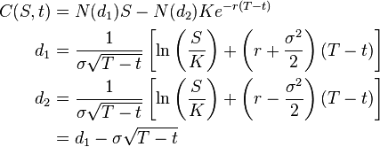
Example: Option Pricing and Risk Management
Option Pricing Formula

Slide 14
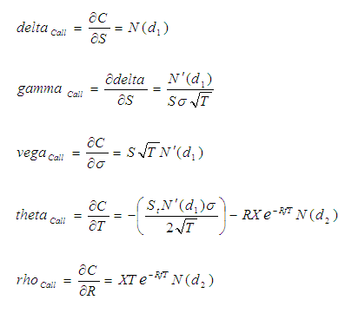
Example: Option Pricing and Risk Management
Option Greeks

Slide 15
Example: Option Pricing and Risk Management
Option Greeks & Risk Management Application
http://www.option-price.com/

Slide 16
It’s Financial Engineering!
Financial engineering is a multidisciplinary field involving financial theory, methods of engineering, tools of mathematics and the practice of programming.
It has also been defined as the application of technical methods, especially from mathematical finance and computational finance, in the practice of finance

Slide 17
Market Value Approach in Insurance Contract Valuation
PIETER BOUWKNEGT AND ANTOON PELSSER

Slide 18
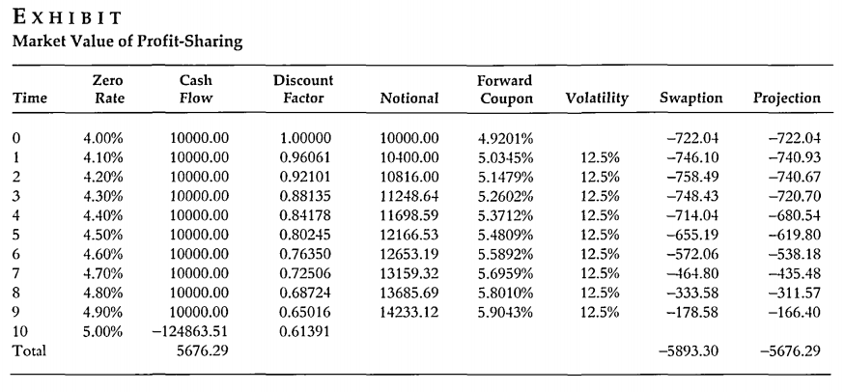

Slide 19
Introduction to Solvency II SCR Standard Formula for Market Risk
Yas Suttakulpiboon

Slide 20
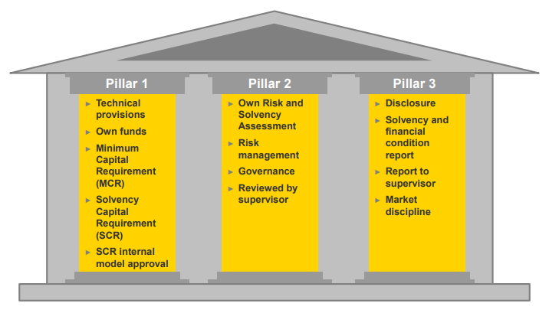

Slide 25
Interest rate

Slide 26
Equity

Slide 27
Property

Slide 28
Spread

Slide 29
Currency

Slide 30
Concentration

Slide 32
Paper: Solvency II’s Market Risk Standard Formula: How Credible Is the Proclaimed Ruin Probability?
Yas Suttakulpiboon

Slide 33
Motivation
The new regulatory regime for insurance companies, Solvency II, will come into force at the beginning of 2016.
The main goal of the first pillar is to introduce capital requirements for several risk categories.
In order to calculate these charges, the regulator provides a standard formula that is separated into distinct submodules, each of which has been calibrated to a target safety level of 99.5 percent per year, thus implying a default or ruin probability of 0.5 percent.

Slide 34
Research Question
ถ้าบริษัทประกันภัยใช้ Standard Formula ตามหลักการของ Solvency 2 ในส่วนที่เป็น Market Risk Module แล้ว ความน่าจะเป็นที่บริษัทจะล้ม (Ruin Probability) จะเป็นอย่างไร?

Slide 35
Literature Review
There is little research on the accuracy of the standard formula.
Sandstroem (2007), it is shown that the capital charges of the Solvency II submodules have to be corrected if the underlying probability distributions are skewed. Otherwise, the model is no longer consistent.
Pfeifer and Strassburger (2008), who analyze the stability of the standard formula in detail.

Slide 36
Literature Review
Dhaene et al. (2008) consider the suitability of different risk measures for the calculation of the solvency capital requirements of financial institutions. They demonstrate that the subadditivity property which is often demanded can lead to undesirable outcomes in the context of mergers
Fuchs et al. (2012) mathemat‐ ically derive a condition that has to be satisfied by the joint distribution of an insurer’s risks such that the aggregation under the Solvency II standard formula is accurate.

Slide 37
Methodology
Based on the empiricalrisk‐return profiles ofthe main asset classes held by European insurance companies, the authors derive mean‐variance efficient portfolios, taking into account both short‐sale constraints and the prevailing legal investment limits in Germany
the capital requirements under the Solvency II standard formula are calculated for each asset allocation.
Employing the respective results, we then invert the internal model to estimate the actual ruin probabilities associated with the efficient portfolios when the insurer relies on the standard formula

Slide 38
Solvency II Standard Formula—Market Risk Module
The standard formula consists of the six modules market risk, health risk, default risk, life risk, non‐life risk, and intangible asset risk.
Their analysis is centered on the market risk module, since it accounts for the largest fraction of the overall SCR for European insurance companies
The market risk module itself comprises seven submodules. We focus on those for interest rate risk, equity risk, property risk, and spread risk.
For each type of market risk, stress factors determine a change in the basic own funds (Change in BOF) that needs to be covered by the firm’s solvency capital.

Slide 39
Asset‐liability approach based on structural credit modeling (see Merton, 1974) and portfolio theory (see Markowitz, 1952)

Slide 53
Agenda
Market Risks for Insurance Business
ซับซ้อน เพราะมีการการันตีผลตอบแทนให้ผู้เอาประกัน การจะหามูลค่าที่แท้จริงทำยาก
Market Valuation Approach to Insurance Contract
ต้องใช้หลักการ Fair valuation approach… หลักการเดียวกับ Financial Engineering
Solvency 2 & Market Risk (2015 Version)
Paper: Introduction to Solvency II SCR Standard Formula for Market Risk by Braun et al (JII, 2015)
ถ้าบริษัทประกันภัยใช้ Standard Formula ตามหลักการของ Solvency 2 ในส่วนที่เป็น Market Risk Module แล้ว ความน่าจะเป็นที่บริษัทจะล้ม (Ruin Probability) จะเป็นอย่างไร?
ผลต่อความน่าจะเป็นที่บริษัทจะล้มโดยเฉพาะสำหรับบริษัทขนาดเล็กและขนาดกลางยังมีความคลุมเครือ

