Slide 1
The Hidden Fortune in Community Based Elder Care
By Stella Nsong, RN, CMC, CDP, LTCP
State Director: Ohio Elder Care Planning Council
President: Six Figures Nurse Academy
National Nurses in Business Association
Advancing Nurses through Entrepreneurship
October 12th -14th , 2018

Slide 2
Where Are You Today?
How many hours do you work now and what will be your annual income at the end of this year?
Why did you come to this conference?
What is your intention today?

Slide 3
2019…
Your gross income
$175,000
60 hours work week

Slide 4
2020…
Your gross income
$394,200
40 hours work week

Slide 5
2021…
Your gross income
$657,000
20 hours work week

Slide 6
Preparing to Learn
Shaping your ultimate goal and ultimate vision
***************************************”If you can not see it in your mind it will not show up in your life.” –Stella Nsong
Notes:
Participants will begin with relaxation, mind calming, visioning and mental preparation to identify their goals for attending the seminar so that the knowledge and tools they acquire during the seminar can be turned into short term goals and action plans they can begin to use this weekend.

Slide 7
Goals & Visions
What are the top 3 things you want to learn from this seminar?
If a miracle happened today in your life as it relates to a business, what would it look like?
How will your business look when it is completely finished (a masterpiece)?
What would ultimate success look like in your business?

Slide 8
…..Goals & Visions (cont)
If you could wave a magic wand, where will you business be in 2019? …2020 or 2021?
How much revenue would you earn?
How many hours would you work?
What would you do if you had complete freedom?
What 3 actions can you take this weekend that would help you move towards that vision?

Slide 9
Eldercare Industry Facts
These facts are infused with opportunities for nurse entrepreneurship
80% of all elder care services are provided in the community
The government only pays for 16% of all long term care.
Everyday approximately 10,000 baby boomers turn 65 years old. Meaning that your opportunity to create a million dollar business renews its self every 24 hours.
The suicide rate has sky rocketed since 2013 among people 65-75 due to the stress associated with care giving.
Family caregivers provide 650 billion dollars of unpaid care each year. America is facing an eldercare cliff. Caregiving is a personal, local, state & national crisis. The government needs strategies and initiatives to bridge the eldercare cliff… that where we nurses can make a difference.

Slide 10
5 Ways Elder Care Services Are Provided
The Elderly in their homes
The Elderly living with family
Retirement Communities
Nursing Home
VA Health Care
Service Gaps
Transportation
Personal Care
Concierge Services
Meal Preparation
Homemaking
Long-term Care Planning
Care Management
Home Safety
Home Adaptation
Service Gaps
Daytime Care
Wellness
Stress Management
Work Life Balance for blended families
Multi-generational Family Needs
Service Gaps
Care navigation
Aging in Place Support Services
Care Management
Service Gaps
Resident Advocacy
Case Management
Transition Care
Relocation Services
Service Gaps
Provider Contracts

Slide 11
Opportunities for Nurses
State Licensed Home Health Agencies
Private Pay (non-medical)
Employee Assistance Programs
Back-up Care
Medicaid Waiver Services
Area of Aging Family Caregiver Program
VA Contracts

Slide 12
Critical success factors are a number of key variables or conditions that have a tremendous impact on how successfully and effectively an organization meets its mission.
Businesses must perform the activities associated with these critical success factors at the highest possible level in order to achieve their mission and business objectives and to achieve and maintain a competitive market edge in the communities they serve.
The nursing process (a scientific method used by nurses to carry out their daily duties) has primed nurses for entrepreneurship.

Slide 13
Critical Success Factors & The Nursing Process
Critical success factors for business management are closely identical to the nursing process that nurses use everyday. During our round table discussion we will match your core skills and strengths to the available business opportunities.
Business Management
Planning
Organizing
Staffing
Delegating
Supervising
Measuring
Reporting
The Nursing Process
Assessment
Diagnosing
Planning
Implementation
Evaluation

Slide 14
Part-time Opportunities
Simple, fun, creative part time opportunities you can start with less than $1,000 investment
Companionship & Home Making
Concierge Services
Care Management/Care coordination/Care Navigation
Bridge or card or art club
Virtual Retirement Community
ERS Services
Non-Medical in Home Care

Slide 15
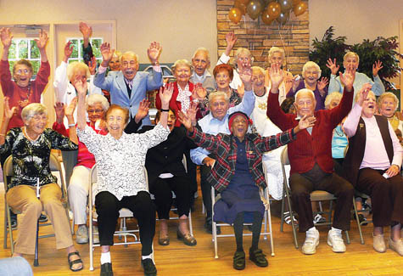
Full-time Opportunities
Require large start ups, investments, and regulations
Adult Day Centers
State Certified (skilled home care) Agencies
Mobile Medical Care
Durable Medical Equipment and Supplies
Independent Living
Group homes
Assisted Living Communities

Slide 16
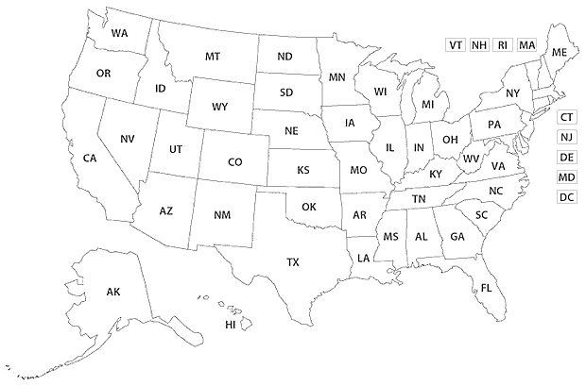

Slide 17
Thank You for Your Time Today and for your support of NNBA
May the time we spend this weekend serve as a powerful seed for your future enterprise. *Stella Nsong

