Slide 1
Cognitive Acceleration TheoryTM
...with your host, Mr. Ashkinos

Slide 2
Why are we here?
Cognitive Processing
Analytical Reasoning
Organized Writing
Build Leadership Skills

Slide 3
How will we achieve this?
Vocabulary Acquisition
Story Comprehension
Critical Thinking Skills
The Levels of Thought

Slide 4
What Materials do I Need?
Acquire a copy of the book
Laptop/Desktop computer
A countdown timing device
ACADEMIC INTEGRITY!

Slide 5
What’s the routine?
Access Great Literature
Mental Warm-ups
Excellence Quickly Quiz
Analytical Breakdown

Slide 6
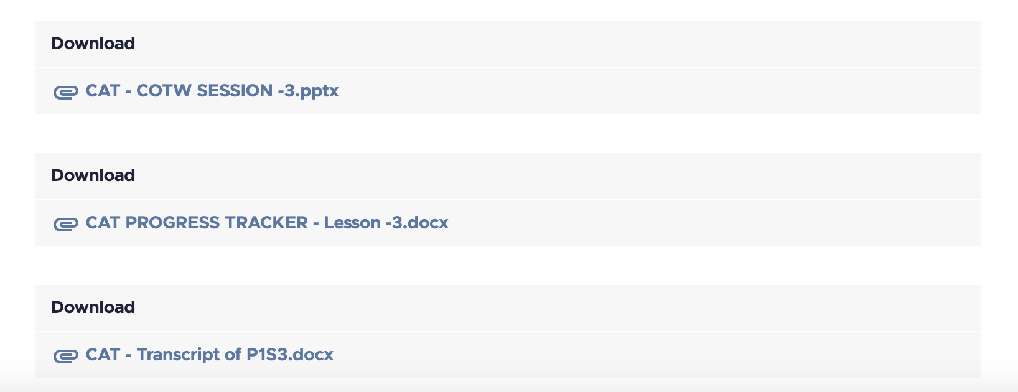
What’s the routine?
Video Lesson
Progress Tracker
Review Slides
Video Transcript

Slide 7
It Begins With Great Literature!
You will be asked to access great literature as a vehicle by which we will engage in CAT learning processes.
Courses should be taken in the prescribed order.
New programs will show an increase in expectations.
Read pages assigned before each class.
Don’t read ahead! (Even if you already read the book.)

Slide 8
Agenda Item #1 - I found a word!
As you read, look for words that impress upon you. Write these words down and define them.
Didn’t know it?
Used in a different way?
Provoked you?
Made you think?
Interesting?
Great Author
Classic Literature

Slide 9
Agenda Item #2 - What just happened?
You read the pages, right? Compare my summary to your experience. Are we on the same “page”?
Exposition
Call to Action
Rising Action
Climax
Falling Action
Resolution
Great Author
Classic Literature
After we summarize, we will showcase a valuable excerpt from the reading.
Well written
Telling
Provoking
Confusing

Slide 10
Agenda Item #3 - Excellence Quickly Quiz
Introducing…The Levels of Thought!
FACE VALUE
TEXT VALUE
METAPHORICAL V
CONNECT TO MV
JUDGE THE MV
ACTIVATE THE MV

Slide 11
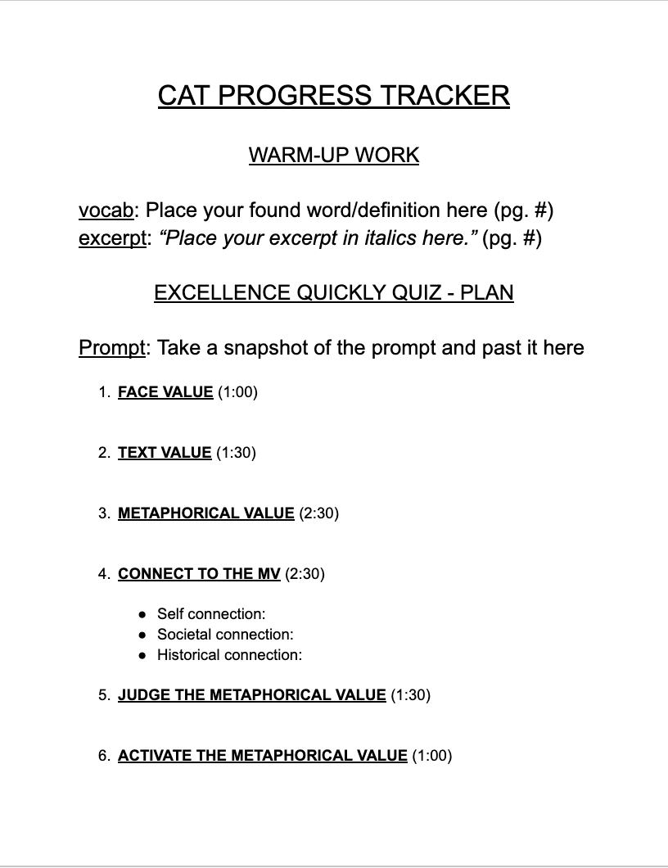
Introducing…The Progress Tracker!

Slide 12
Introducing…The Progress Tracker!

Slide 13
Agenda Item #4 - Break it down!
Okay, how did you do?
Your guide will break it down.
Calibrate your cognition.
Pinpoint misfires.
Rewire thinking.
Grow at your own pace…but you will GROW!

Slide 14
Cognitive Acceleration TheoryTM
See you for SESSION #1!

