Slide 1
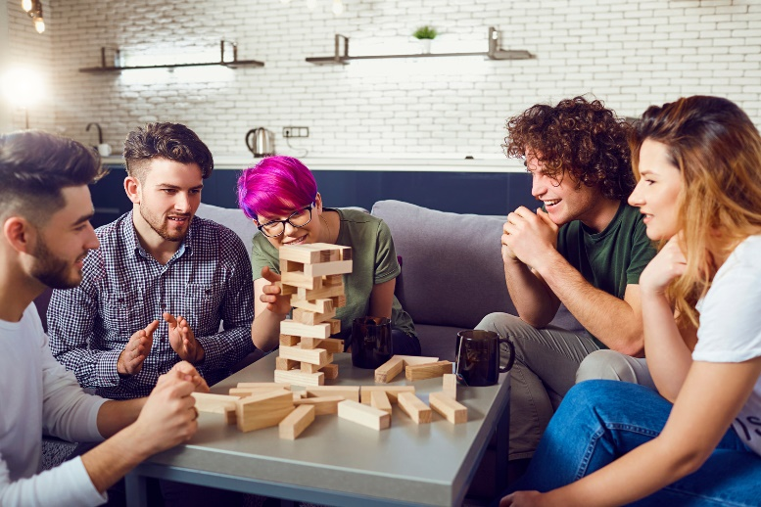
Playing Games/Leisure

Slide 2
Playing games is a fun leisure activity.

Slide 3
You can play games by yourself.

Slide 4
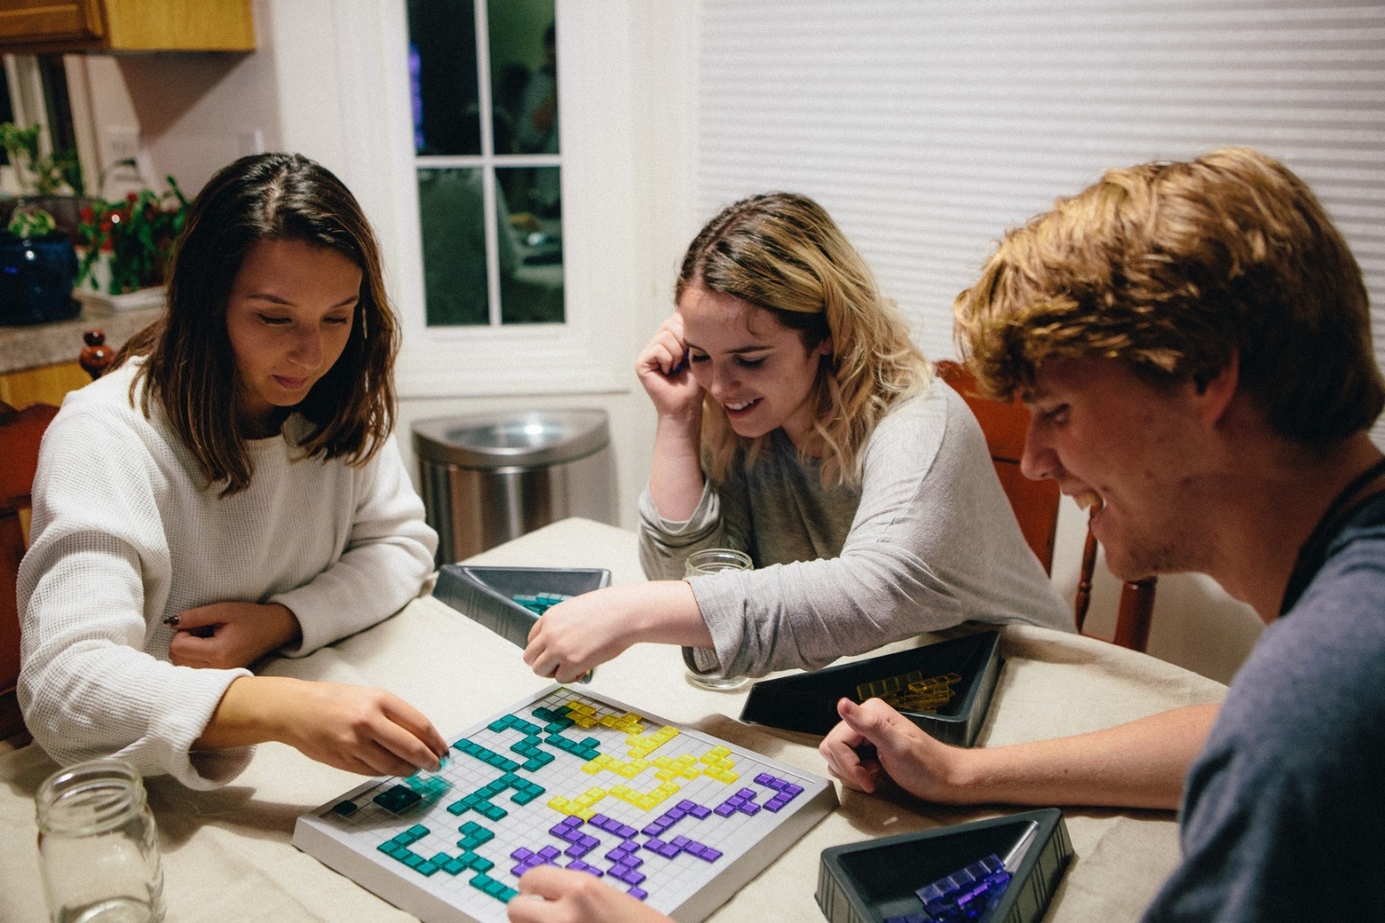
You can play games with other people.

Slide 5
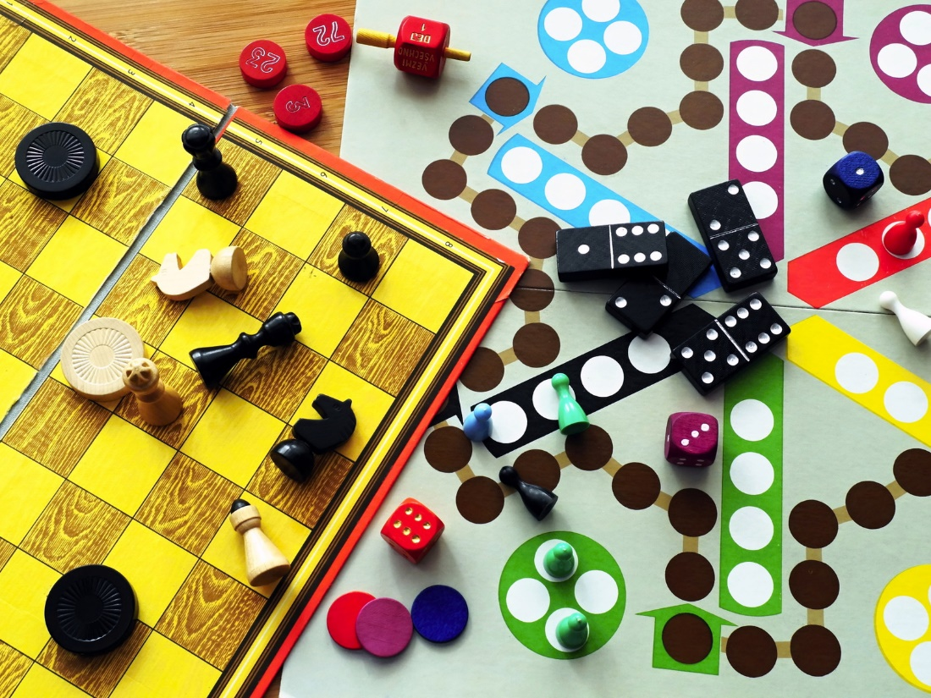
Make sure you understand the rules of the game. If you don’t, ask for help.

Slide 6
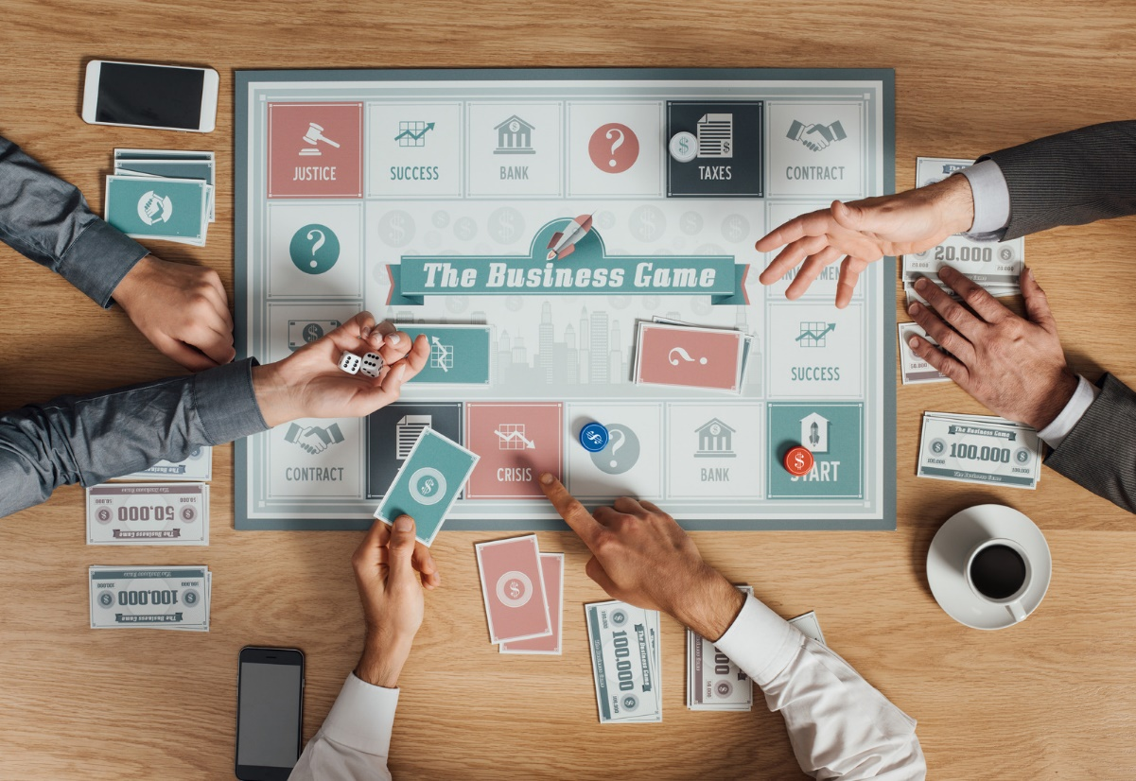
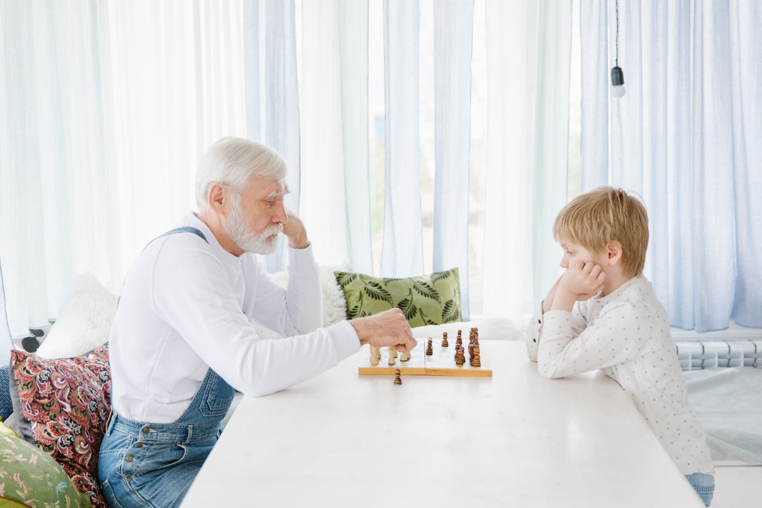
When playing with others, you must take turns.

Slide 7
Remember, it’s all for fun.

Slide 8
Someone will win and someone will lose.

Slide 9
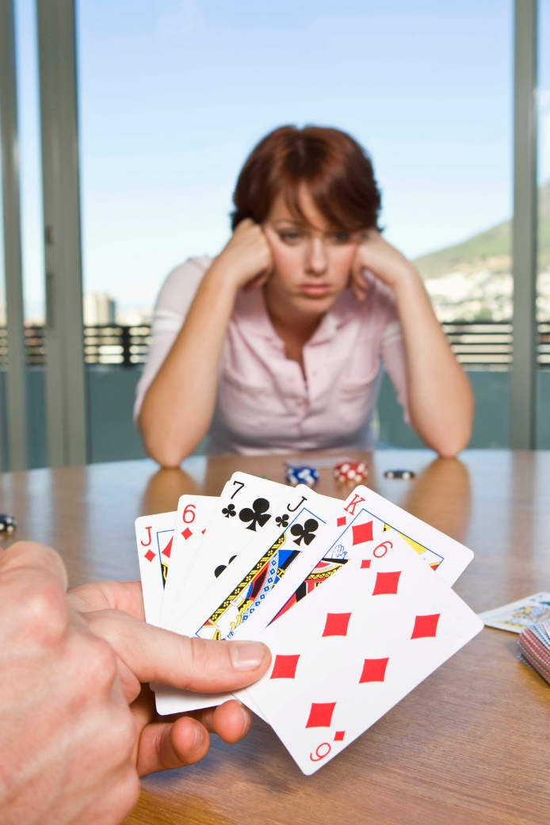
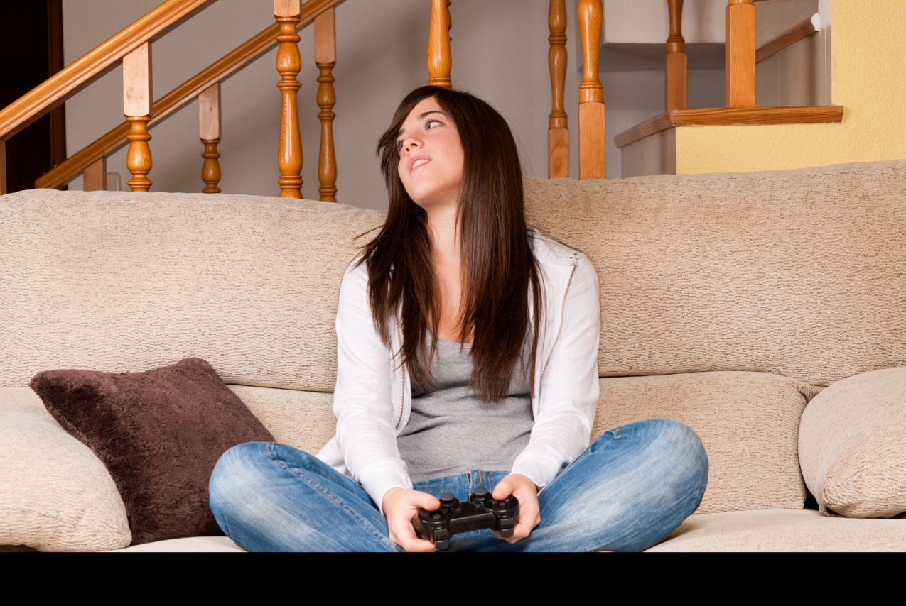
It is okay to lose. Try to have a good attitude about it.

Slide 10
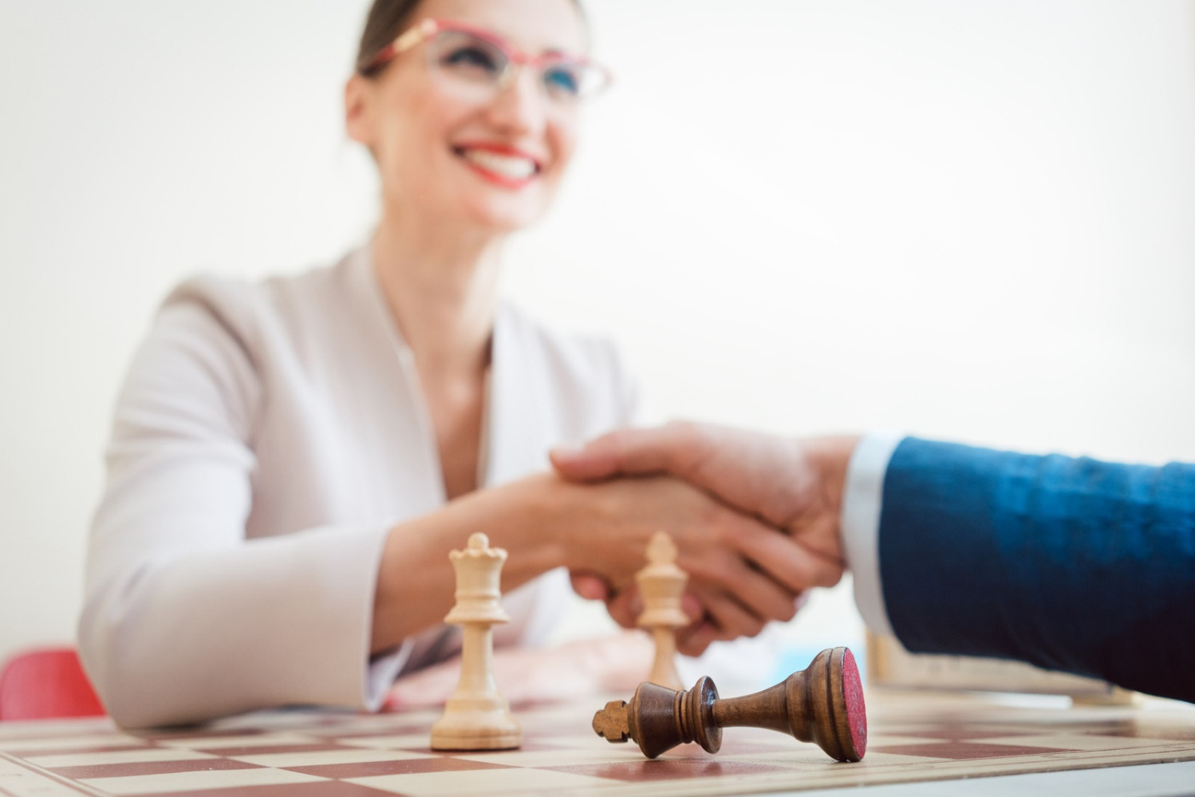
If you win, you should also have a good attitude about it.

Slide 11
Games are fun ways to spend time with friends.

Slide 12
What are some games that you like? Here are some great ones! Now let’s play!!
Uno
Card Games (Go Fish, War, Speed)
Connect 4
Guess Who?
Sorry!
Don’t Break the Ice
Hedbanz
Zingo
Jenga
Solitaire
Checkers
Trouble!
Dominoes
Tic Tac Toe
Bingo
Twister

