Slide 1
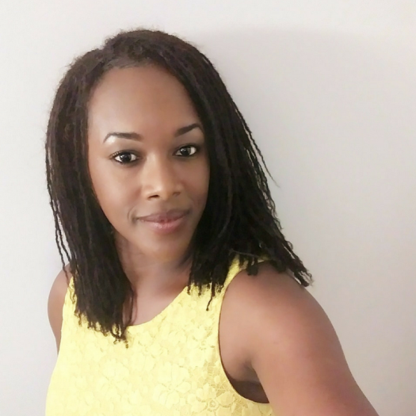
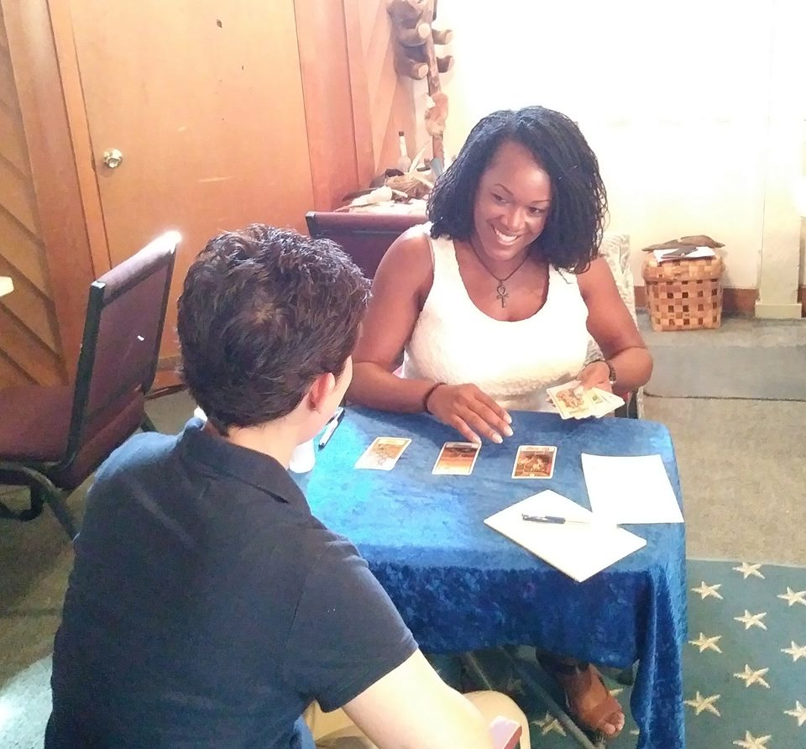
About Bernette Sherman
Bernette is a certified coach and an intuitive, medium, and channel.

Slide 2
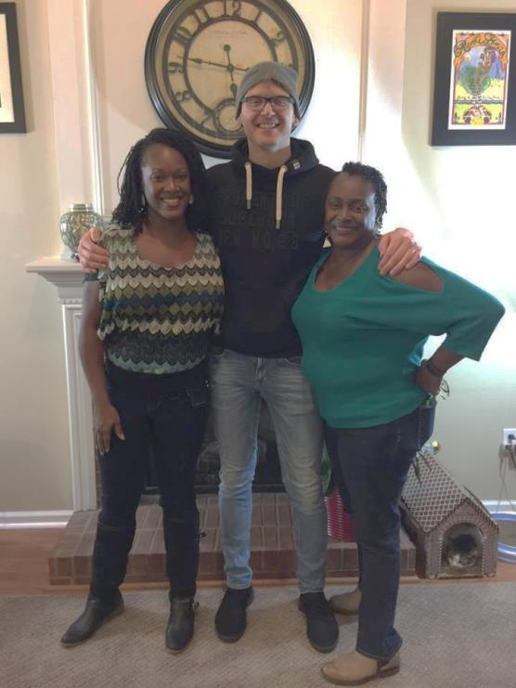
About Bernette Sherman
She’s appeared on the Psychic Inside Show and in the documentary They Call Us Channelers.

Slide 3
About Bernette Sherman
She’s also been a guest twice on The Lighter Side Show on The Lighter Side Network.
Learn More and Follow: SpiritSpeaksChannel.com
Follow Spirit Speaks on IG at SpiritSpeaksChannel and on FB at www.fb.com/SpiritSpeaksChannel

Slide 4
Contact Me & Stay Connected
Website: www.BernetteSherman.com and www.SpiritSpeaksChannel.com
Email: Bernette@BernetteSherman.com
Instagram: IAmBernette
Twitter: BernetteSherman
Facebook: IAmBernetteSherman
YouTube: www.youtube.com/c/spiritspeaks and www.youtube.com/bernstube3003

