Slide 1
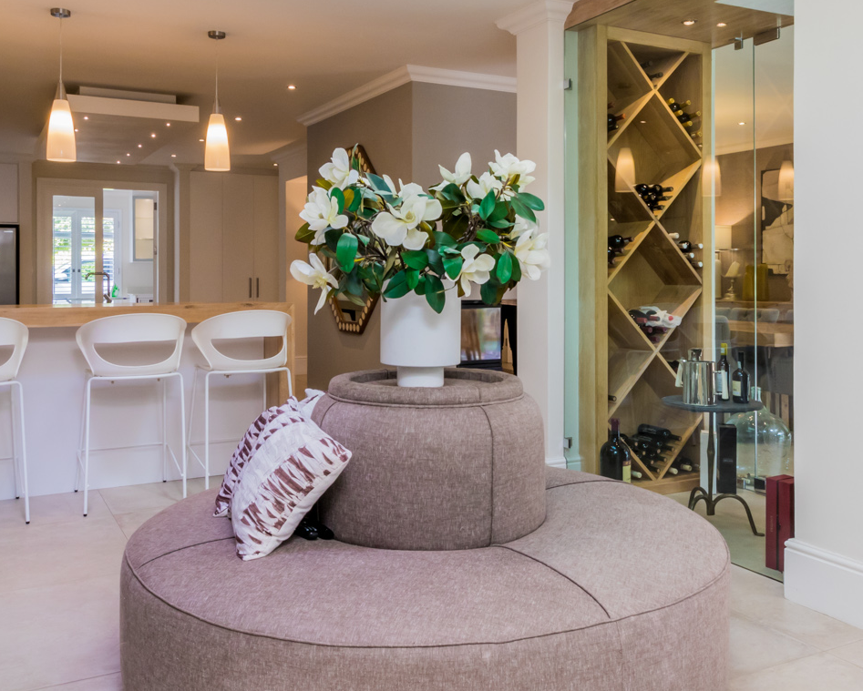
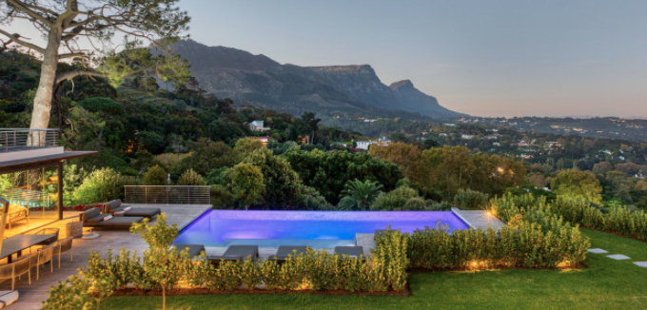
Recently Sold
NOTHING COMPARES.
Johannesburg

Slide 2
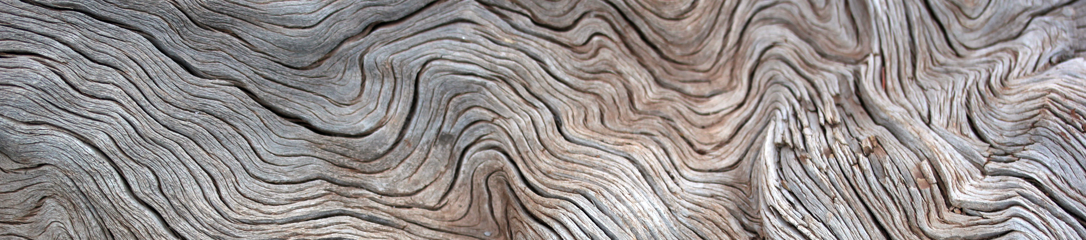

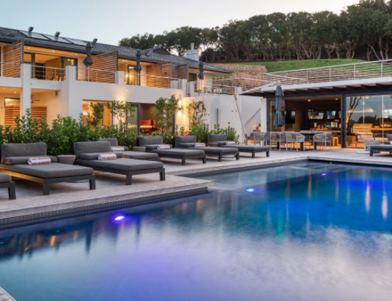
Recently Sold
NOTHING COMPARES.
JOHANNESBURG

