Slide 1
Dana LaRue
VP of NLSuite

Slide 2
History of FICO
Started off as a business opportunity between William Fair and Earl Issaac. One a mathematician, the other an engineer. They built the scoring system and began to market it to banks and other lending institutions in the 1950’s
This scoring formula has become widely accepted by lenders as a reliable means of credit evaluation. Prior to that, banks and lending institutions tended to be locally based and decisions were likely to be made on a personal basis. Unfortunately, this lead to discrimination based on age, sex, marital status and ethnicity.
Making credit unavailable to many.

Slide 3
Your credit score can COST (or SAVE) you Money!
Where you live in a rental home
Purchase a Car
Insurance Rates
Purchase a Home
Career
Promotion
Security Clearance
Romance

Slide 4
Why ARE credit Scores so confusing ....
Credit Score | Credit Score Range
FICO | 300-850
Equifax (Beacon) | 300-850
Experian (Plus) | 330-830
Transunion (Empirica) | 150-934
Vantage Score – ALL CRAS | 500-990

Slide 5
WHY IS MY SCORE SO MUCH LOWER when I apply for a HOME loan??
The credit score you pull on YOURSELF, is called a “Consumer Pull”, it is a soft pull (meaning it does not count against you) and the score is meant for educational purposes.
.

Slide 6
If a creditor reports to the bureaus, all data is entered in:
E-OSCAR

Slide 7
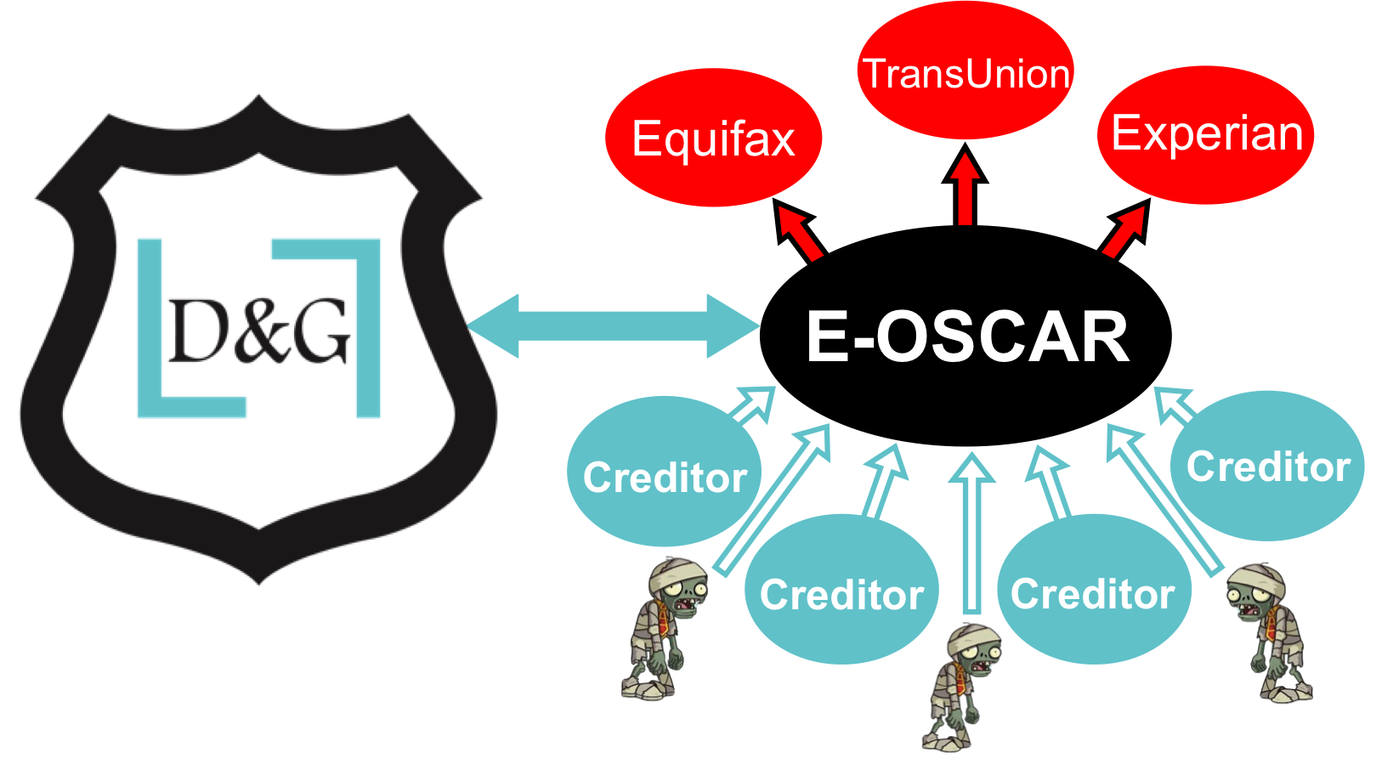

Slide 8
Did you know?
Lender Algorithm requires a minimum of 3 Active Positive trade lines that report to all 3 bureaus IN YOUR NAME – 1 installment and 2 revolving accounts is a great mix
Of the 850 points available, 255 come from credit utilization. Credit utilization is how the client balances their finances. For maximum points get and keep the balance to 20% of the card limit and never have a ‘0’ balance.
All things being equal on 2 credit files – The file with the ‘0’ balance reporting will have a lower score than the same account with a $10 balance.

Slide 9
How can I help my score increase?
Lender Algorithm needs AT MINIMUM – 3 OPEN , ACTIVE, POSITIVE tradelines that report to ALL 3 bureaus IN YOUR NAME.
Best mix is 2 revolving accounts and 1 installment
Do NOT close ANY credit cards.
Keep all revolving debt to 20% of the cards limit and never 0.
Authorized User – SLIPPERY SLOPE
If you owe more on your student loans than you borrowed…
Optoutprescreen.com – Pick 5 years, it’s FREE

Slide 10
We aren’t attorney’s, so don’t take this as legal advice... We have abbreviated the FCRA , an over 1600 page document, to 3 bullet points
Whatever is on your credit report, must be 100% accurate, regardless if the debt is owed.
Under Federal law any person who knowingly and willfully obtains information from a CRA under false pretenses (ie: getting a credit report on an individual without his or her permission) shall be fined under title 18 United States Code, or imprisoned for not more than 2 years or both. (Permissible purpose)
It is against the law to knowingly dispute accurate information on a credit report.

Slide 11
Bad Debt Happens to Good People
Catastrophe Struck
Job Loss
Reduction in Income
Divorce
Medical Issues
Death
After 180 days of no payments creditors must stop charging you interest, penalties and late fees BY LAW

Slide 12
Debt can go 3 ways:
1) Legal – take you to court and typically get a judgement
2) Creditor can hold on to their full color file and farm out collection attempts
3) Creditor can charge off the debt –because they get a tax break and make a “black and white” copy of their “full color” file and sell the file.

Slide 14
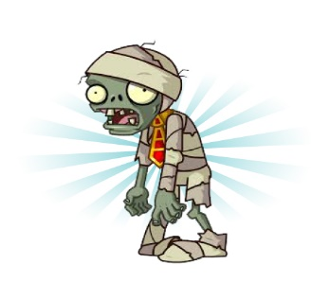
Zombie Debt
Debt that is old but keeps reappearing as new on a credit report.
The newer a collection appears the more “weight” it has on a credit report. And the higher likely hood of payment.
Junk debt buyers tend to change the date on old collections to make them appear as new – artificially lowering a credit score – this is the most common violation….

Slide 15
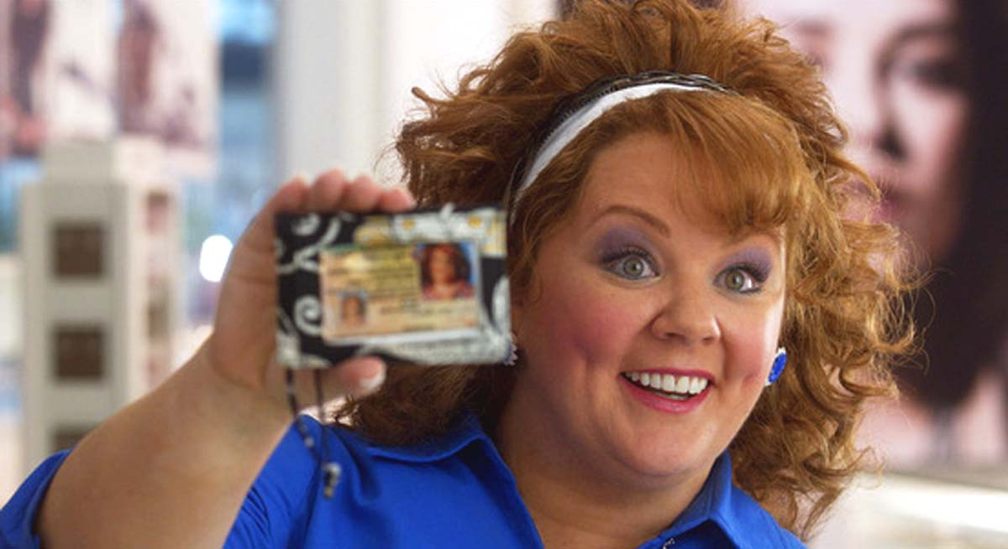
We don’t have to assume your identity
Our system works with myFICO – No hard pull or inquiry – Using their pull, we run the credit file through our system which detects the violations and inaccurate remarks.

Slide 17
We work NATIONWIDE
We aren’t considered “Credit Repair” – we offer education, information, use of a proprietary computer system written for attorney’s working with Federal Statutes holding creditors accountable to the law. We been IAPDA certified and can guide clients through settlement services if needed.

Slide 18
Real Clients / Real Results Individual Results Will Vary
Report Details | Initial Pull | After 90 day process
Experian | 570 | 636 (+66)
Trans Union | 606 | 697 (+91)
Equifax | 566 | 680 (+114)
Items Deleted |  | 6 items

Slide 19
Real Clients / Real Results Individual Results Will Vary
Report Details | Initial Pull | After 90 day process
Experian | 640 | 710 (+70)
Trans Union | 543 | 685 (+142)
Equifax | 585 | 660 (+75)
Items Deleted |  | 12 items

Slide 20
Real Clients / Real Results Individual Results Will Vary
Report Details | Initial Pull | After 90 day process
Experian | 574 | 664 (+90)
Trans Union | 542 | 663 (+121)
Equifax | 514 | 652 (+138)
Items Deleted |  | 12 items

Slide 21
Real Clients / Real Results Individual Results Will Vary
Report Details | Initial Pull | After 90 day process
Experian | 524 | 602 (+78)
Trans Union | 592 | 659 (+67)
Equifax | 563 | 650 (+87)
Items Deleted |  | 10 items

Slide 22
What our clients are saying….
…”We’d been with a credit repair company before and we were extremely skeptical when our lender told us about D&G. However after visiting the website, we could see this was something different! ….
…The action plan alone was worth the price! No one ever gave us this much information! Thank you!”
Notes:
I will talk about this first.
What is the one thing you would say to folks who want to start being one of the many that share in Affiliate Rewards?

Slide 23
The “OTHER GUYS”
1-Require a copy of your clients Drivers License
2-Require a copy of your clients Social Security Card
3-Require a copy of your clients utility bills
4-Sometimes require a copy of your clients Bank statements
5- Require your client to mail documents from their creditors
6-Typically charge a monthly maintenance fee
7-Some programs can last a year or more.
8-Require a limited power of attorney
9-Pretending to be your client to the creditors and credit bureau.
10- Write hundreds of letters to the bureaus disputing accounts.

Slide 24
FAST – First 45 days
Our computer communicates DIRECTLY into the bureaus computer - Basically asking them to PROVE the debt to the letter of the law.
We do get quite a few deletions this first round –
but what our system is really doing is laying the groundwork to pursue the violations found in our initial pull and run thru.
NO HUMAN HANDS TOUCH THE FILE

Slide 25
Second 45 day cycle
…when our guns come out!
First you have to give the creditors a chance to correct their errors.
Then you can show the section and paragraph of the FCRA or FDCPA violation they have committed with PROOF of the date , time and paragraph of the act violated.
NOT credit repair…..
CREDIT JUSTICE!

Slide 26
Remaining Collection Accounts are legitimate debt… I.A.P.D.A. Settlement Guidance is included with our flat fee. We also offer an Attorney Settlement service over 20K – for an additional charge.

Slide 27
Is it worth the price? How much does credit really cost?
The example you are about to see is a REAL CLIENT – this is for a FAKE LOAN – we got our information from CBSnews.com – it came from their show.
We are not lenders – ILLUSTRATIVE purposes only.
Example used
$250,000 LOAN – 37 yr. old male – 30 yr fixed rate.

Slide 28
Real Clients / Real Results Individual Results Will Vary
 | Initial Pull – POOR ( 550-619) | Round 1 - FAIR (620-679) | Round 2- GOOD (680-739)
Experian | 636 | 652 (+16) | 683 (+31)
Trans Union | 593 | 592 (-1) | 689 (+97)
Equifax | 592 | 693 (+101) | 694 (+1)
INTEREST PAID | $253,976 | $206,018 | $179,674

Slide 29
Dana LaRue 972-971-3175
www.DandGcredit.com
Home Buyers Seminar Special
HALF PRICE FOR THOSE IN ATTENDANCE
MUST PUT: HBS
in referred by box

Slide 31
Types of Credit:
Long Term – Mortgage, Auto loans or other installment loans which are typically repaid over months or years
Short Term – by definition a shorter period of time usually used to purchase items or services that are to be paid in a single payment within a given period of time, usually with no interest (utility bills)
Secured – requires something of value pledged to the lender if the debt is to be repaid. Also known as, closed end credit. Interest rate could be fixed or variable. (Mortgage or Auto loans)
Unsecured – based solely on the trustworthiness of the borrower. In other words, there is nothing of value pledged as collateral. Usually the lenders risk is greater, therefor it carries a higher interest rate (credit cards)

Slide 32
Reporting Time Frames
Delinquencies ( Accounts 30-180 days late) can remain 7 years plus 180 days from the date of the initial missed payment.
Charged off accounts remain 7 years plus 180 days from the date of the initial missed payment that lead to the charge off. (original delinquency date) even if payments are later made on the charged off account.
Collection accounts remain 7 years plus 180 days from the date of the initial missed payment that lead to the collection. (original delinquency date). When a collection account is paid in full, it should be marked Paid in Full on the credit report.
Closed accounts are no longer available for use, if they have delinquencies, they will stay 7 years and 180 days from the date they are reported closed.
Positive open credit remains indefinitely and paid positive accounts remain 10 years and 180 days.

Slide 33
Reporting Time Frames
Bankruptcy Chapters 7,11 & 12 remain 10 years from the filing date.
Bankruptcy Chapter 13 remain 7 years from the filing date
Child Support Judgments: 7 years from the date the judgment is filed.
Civil and Small Claim Judgments: 7 years from the date the judgment is filed.
City, County, State and Federal Tax Liens: Unpaid tax liens remain 15 years from the filing date.
Paid Tax Liens : remain 7 years from the paid date.
Lost Credit Card: continue to report for2 years from the date the card was lost. Delinquent payments will report for 7 years plus 180 days.
Inquiries: will remain for a minimum of 12 months from the date the inquiry was made – and a maximum of 24 months.

Slide 35
1-Using myFICO we get the lender algorithm 2-No hard pull or inquiry on a credit report 3-Just follow the tailor made Action Plan 4-No mailing of correspondence required 5-Secure portal with access to a Credit Expert 6-Flat Fee – no monthly fee. 7- Programs are typically 90 days 8-Our computer communicates directly to E-Oscar 9-We offer a Public Service Discount 10-We offer a Satisfaction Guarantee

