Slide 1
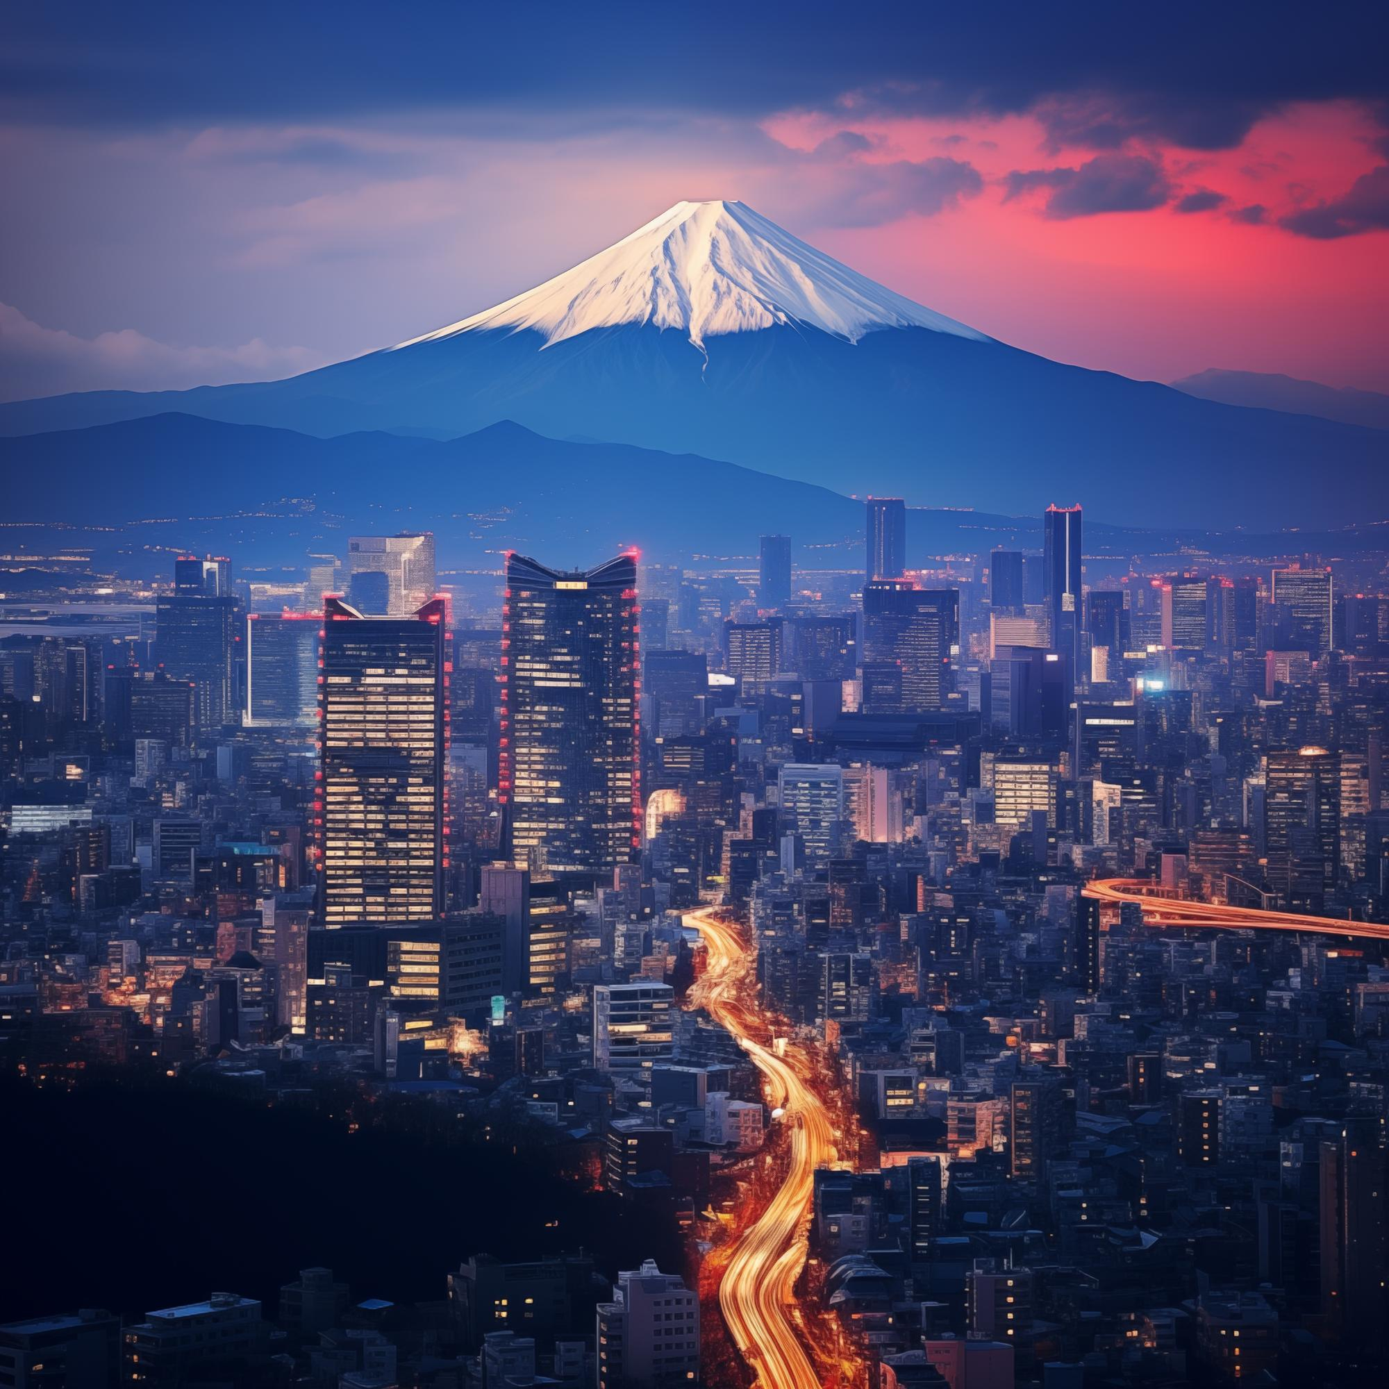
Tokyo
EXPLORE
Tokyo is the world's largest and most dynamic metropolis.

Slide 2
Tokyo
EXPLORE
Tokyo is the world's largest and most dynamic metropolis.
37.4 million
634 meters
The population of the Greater Tokyo Area, the largest in the world.
Height of Tokyo Skytree, one of the tallest towers globally.

Slide 3
Tokyo
EXPLORE
Tokyo is the world's largest and most dynamic metropolis.
37.4 million
The population of the Greater Tokyo Area, the largest in the world.
634 meters
Height of Tokyo Skytree, one of the tallest towers globally.

