Slide 1
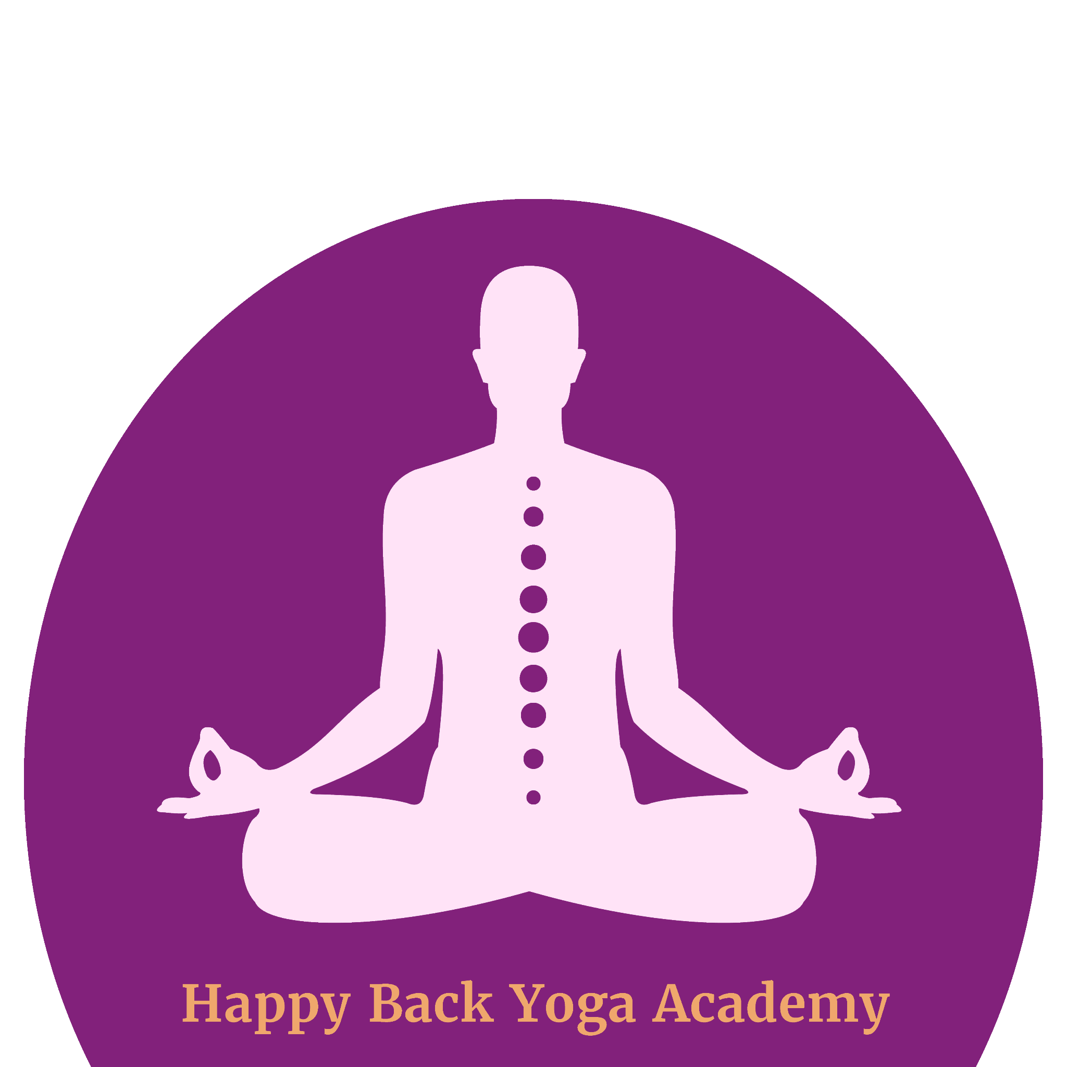
CERVICAL SPINE MASTERY
PART 1: Anatomy
BY RACHEL KRENTZMAN PT, C-IAYT
happybackyoga.com

Slide 2
NEED I SAY MORE?

Slide 3
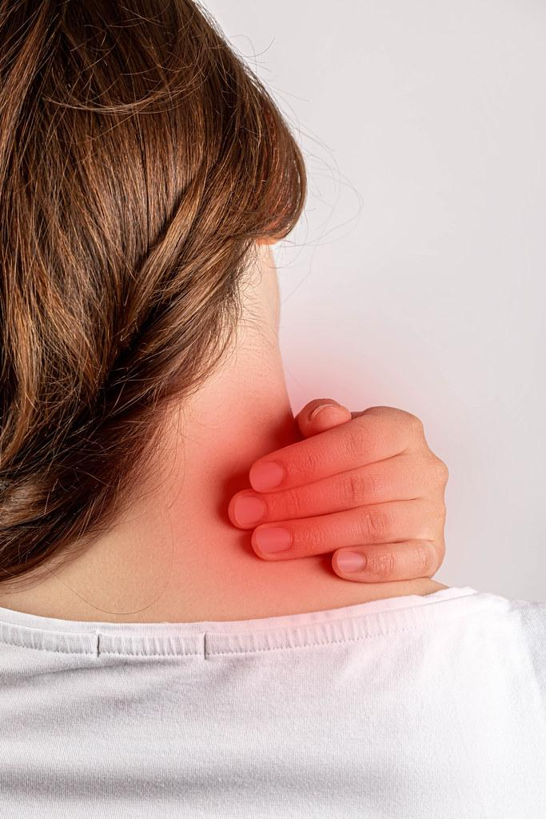
WHO GETS NECK PAIN?
Women, ages 35-49 (risk declines after 49)
Higher income areas
Urban vs. rural areas
Office and computer workers
Women are more likely than men to experience persistent neck problems, and less likely to experience resolution

Slide 4
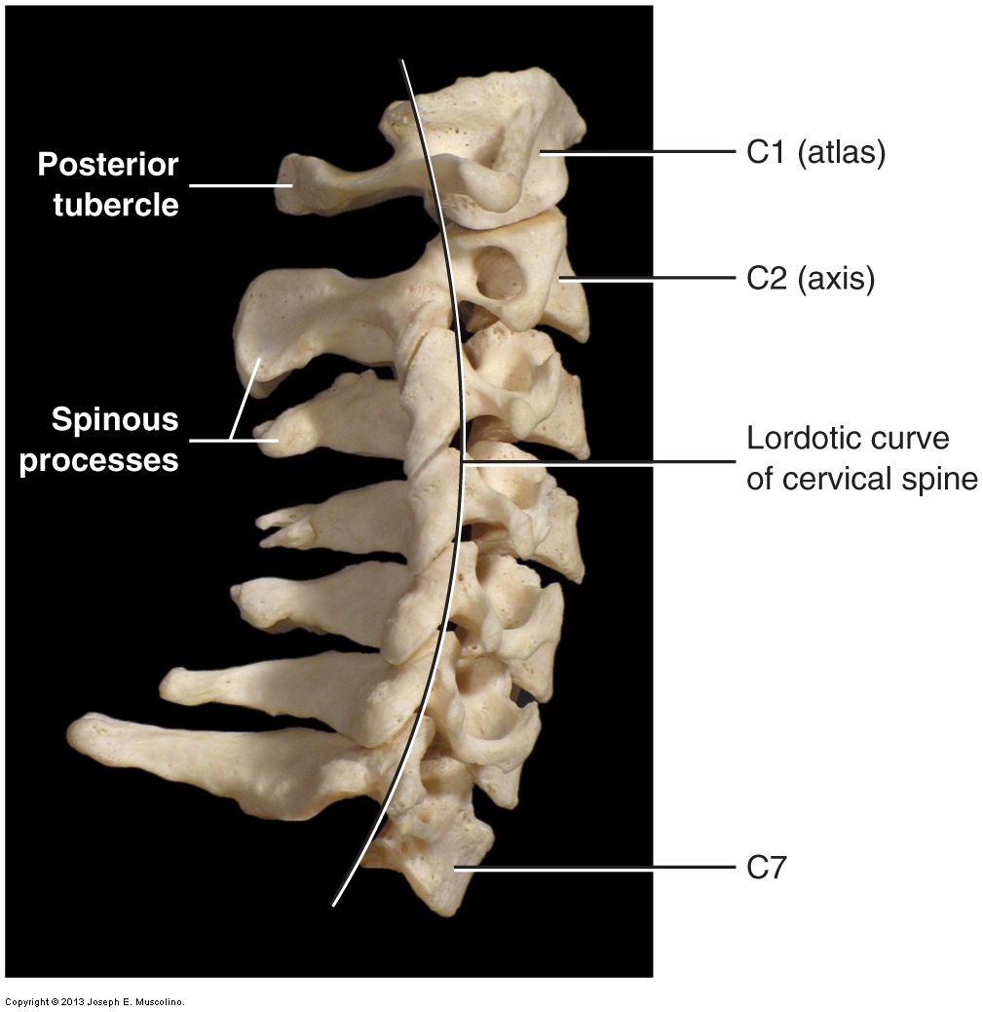
Anatomy of the Cervical Spine
The importance of the curve

Slide 5
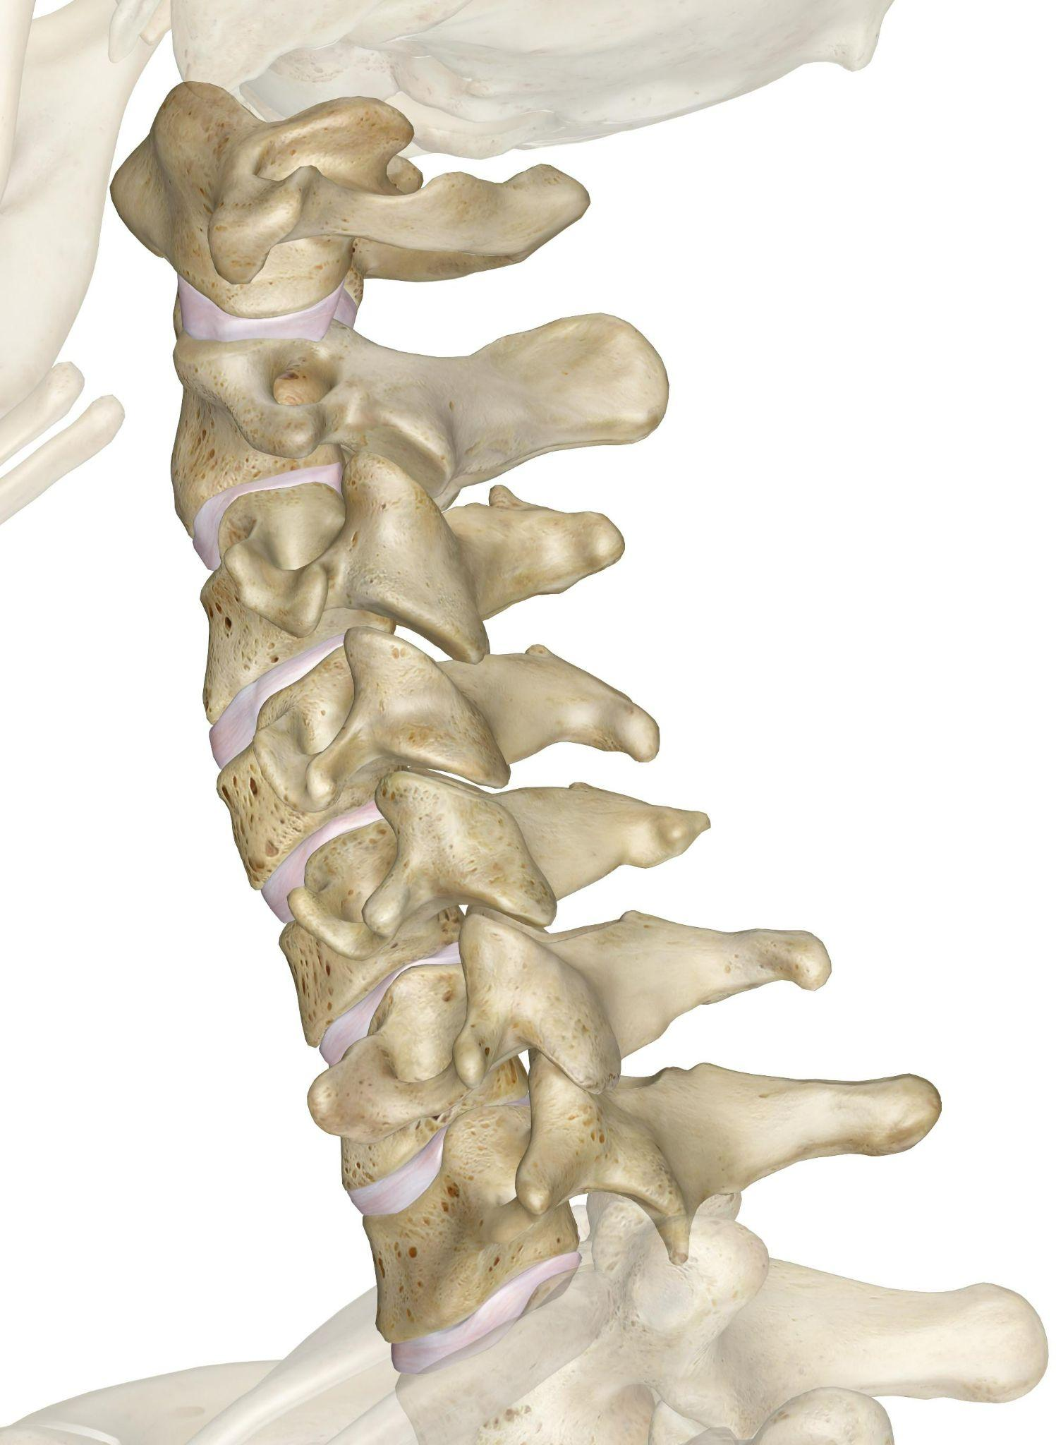
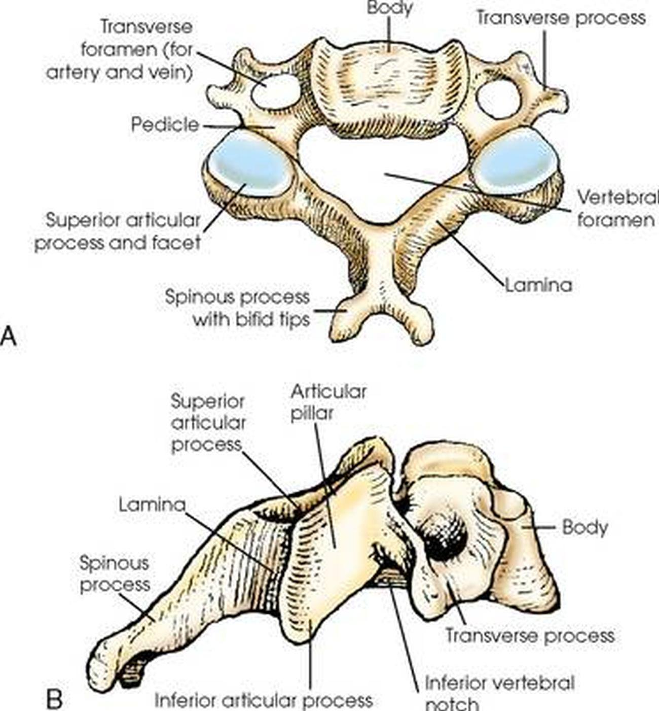
The Vertebrae, Discs & Facet Joints

Slide 6
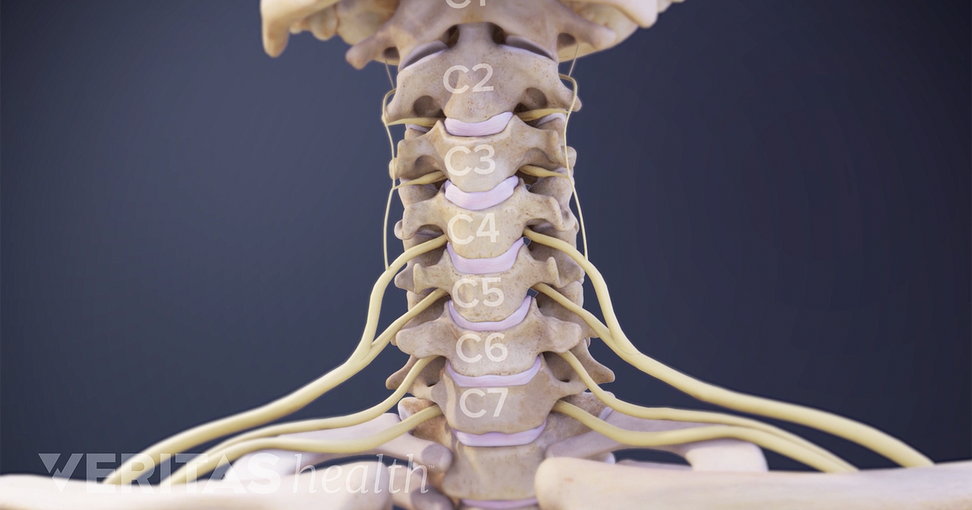
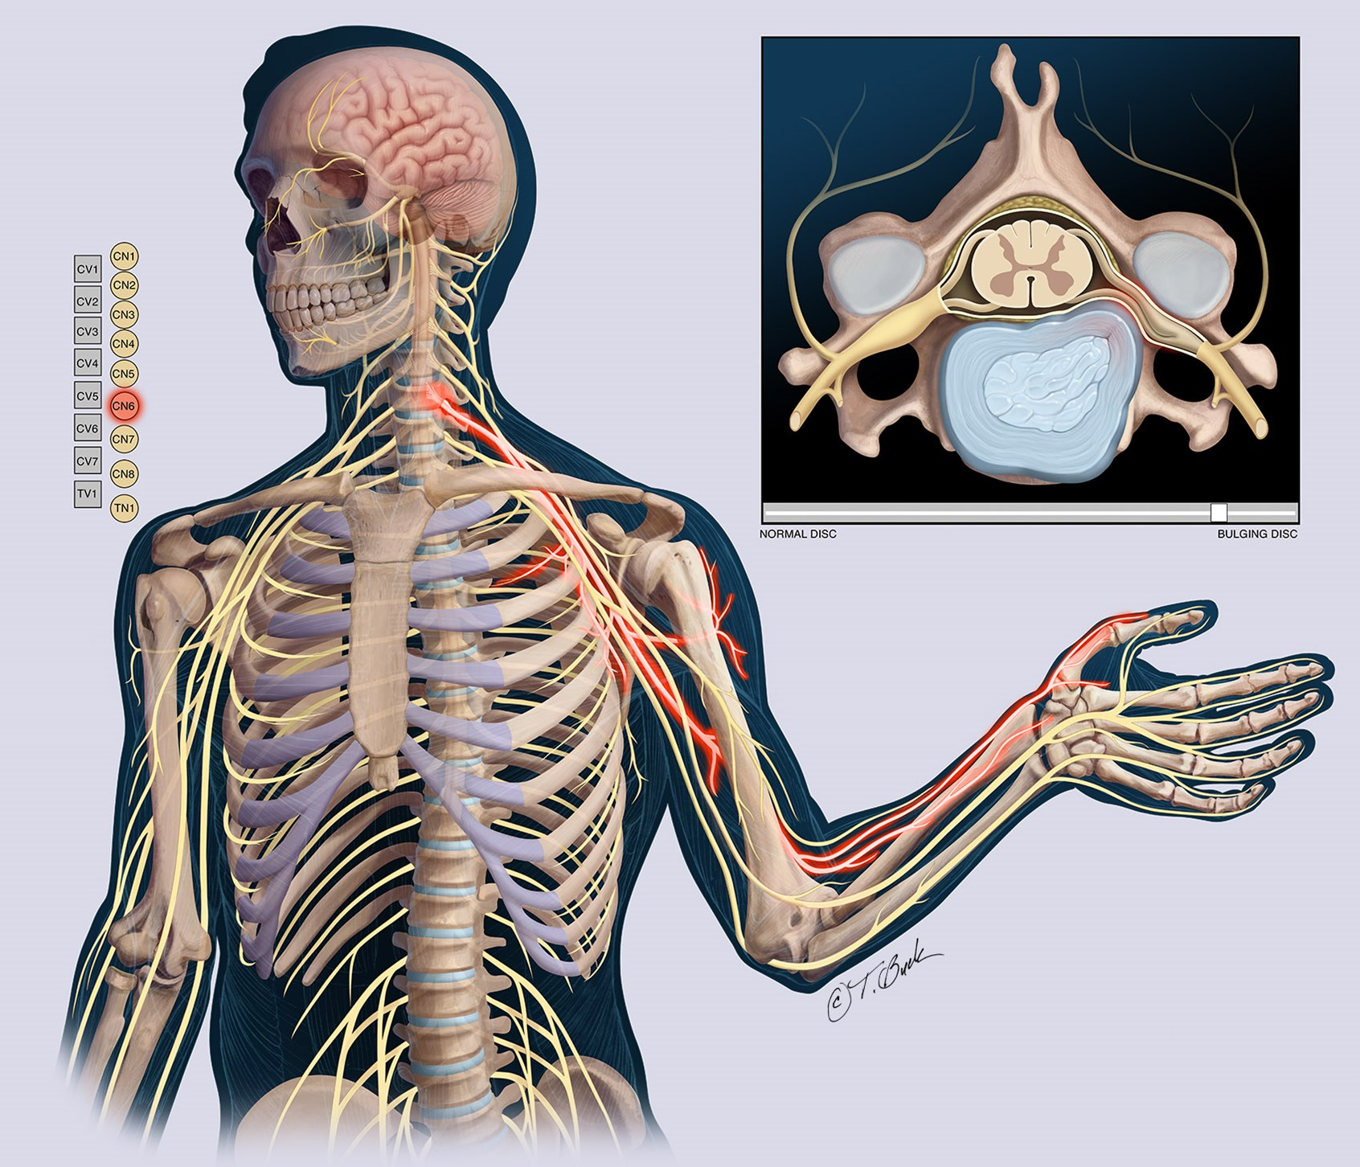
The Spinal Nerves

Slide 7
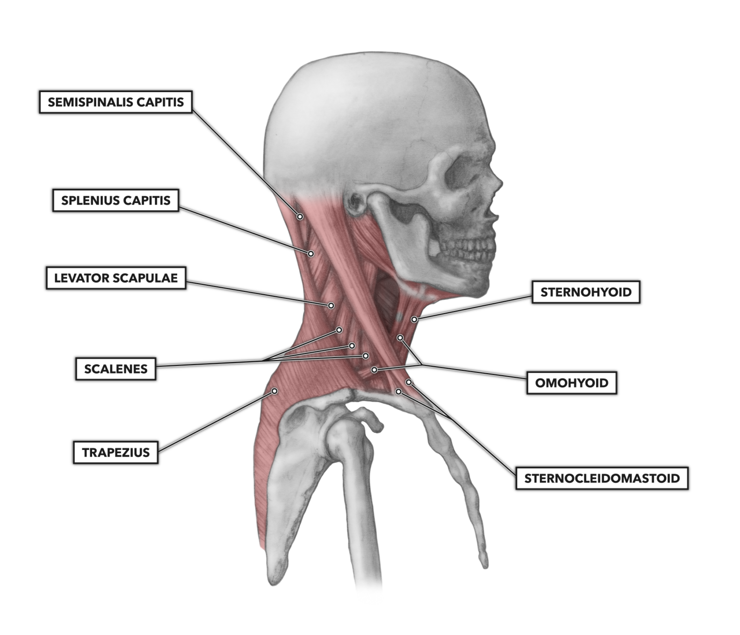
Cervical Spine Musculature

Slide 8
The Stress Cycle
Increased Respiratory Rate
Stress
Increase tightness in Scalenes, SCM, anterior chest musculature
Activation of Sympathetic NS

Slide 9
DIFFERENTIAL DIAGNOSIS: WHAT CAN GO WRONG?
osteoarthritis
facet joint syndrome
cervical strain
disc bulge, herniation, radiculopathy
shoulder impingement
rotator cuff tear/tendonitis
thoracic outlet syndrome
tennis elbow
carpal tunnel syndrome
…but they all respond to one of two courses of treatment.

Slide 10
TWO MAIN NECK POSTURES
FORWARD HEAD POSTURE
REVERSED CERVICAL CURVE

Slide 11
PHILOSOPHY OF TREATMENT – FORWARD HEAD POSTURE
Chest Opening- anterior chest and shoulder musculature
Upper Back Strengthening – lower Trapezius, serratus Anterior
Mobilization of the Upper Thoracic Spine – T4-T6, mindful twists, moving the vertebrae into the body
Normalizing the Cervical Curve – maintaining lordosis
Correct Breathing Pattern – using the diaphragm instead of accessory muscles
Work on Core Beliefs – carrying the weight of the world, lack of trust, need for control, feeling emotionally unsupported (Vijnanamyakosha)

Slide 12
PHILOSOPHY OF TREATMENT- REVERSED CERVICAL CURVE
Increase Cervical Lordosis - supported positions, back bends
Maintain curve in Set Bandha Sarvangasana (Bridge), Sarvangasana (Shoulder Stand) and Halasana (Plough) – MUST USE BLANKETS!!
Soften Thoracic Kyphosis – Garudasana, supported forward folds
Serratus Anterior Strengthening – avoid “squeezing shoulder blades together”
Normalize Breathing Pattern – focus on exhalation, breathing into the upper back, sense of surrender in asana and pranayama
Focus on Core Beliefs – Need to stay in control, rigidity, difficulty trusting, hard to open heart, holding back love

Slide 13
BOOKS:
Email: rkrentzman@gmail.com
Web: happybackyoga.com

