Slide 1
Baptism
Date: 6 Jan 2019
Theme: Understanding the significance of Baptism
Key verse: Matthew 28:19, 20

Slide 2
Therefore go and make disciples of all nations, baptizing them in the name of the Father and of the Son and of the Holy Spirit, and teaching them to obey everything I have commanded you. And surely I am with you always, to the very end of the age. Matthew 28:19, 20

Slide 3
Why is this command so important?
Baptism is the believers’ first act of obedience to follow Jesus
A step to say I am sure about following Jesus.
Romans 10:9-10 commands not just believing in the heart but confessing with our mouth.

Slide 4
Why is this command so important?
b. It is a conscious shift in allegiance to follow Jesus alone.
A step to obey the1st commandment I will have no other gods beside Jesus

Slide 5
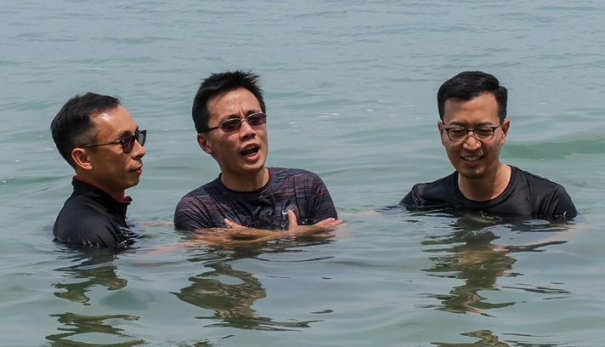
Why is this command so important?
c. It reduces the danger of syncretism
A step to be set free from bondages I renounce all allegiance to spirits of my past

Slide 6
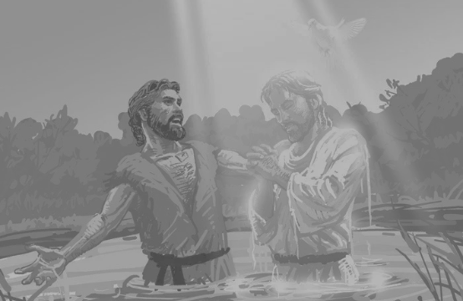
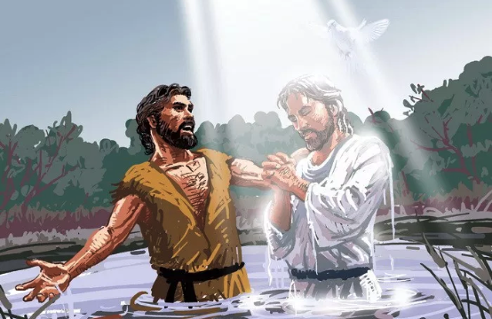
2. What are the benefits of baptism?
Boldness to speak the Word of God
… repent and be baptised every one of you … and you will receive the gift of the Holy Spirit … Acts 2:38
… they were all filled with the Holy Spirit and spoke the Word of God boldly … Acts 4:31
God the Father was pleased when Jesus was baptised

Slide 7
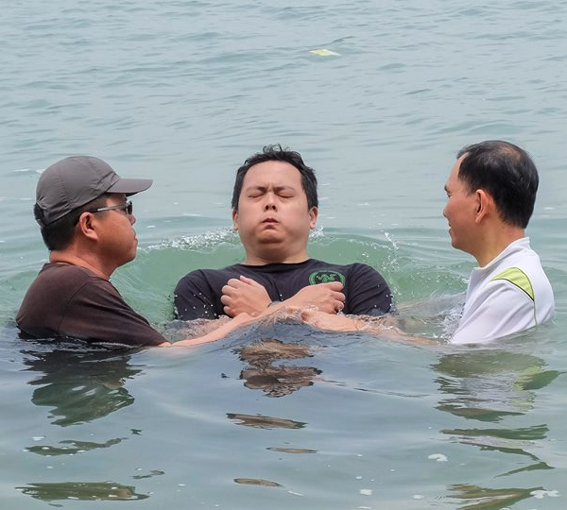
3. Who / When / Where /
How of baptism (Book of Acts)
Who were baptised? New believers who professed faith in Christ
Who baptised them?
The person who led the new believers to faith and discipleship.

Slide 8
3. Who / When / Where / How of baptism (Book of Acts)
When were they baptised? Soon after their confession of faith
How were they baptised? By immersion. Acts 8:38

Slide 9
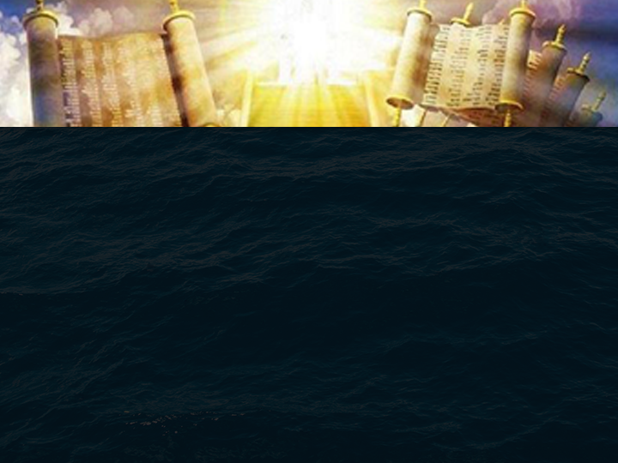
Application
(those who face challenges with family members)
Understand the great value of the Kingdom of God
- we reap the great benefits for ourselves and family from this act of honouring God. (1 Samuel 2:30)
Pray for teachable moments to discuss the reasons for your hope in Christ with your loved ones. - To surface why there is no other Savior

