Slide 1
中文
HanZi MasterClass
Lesson 1
SMART Mandarin - Read Chinese with Confidence & Joy

Slide 2
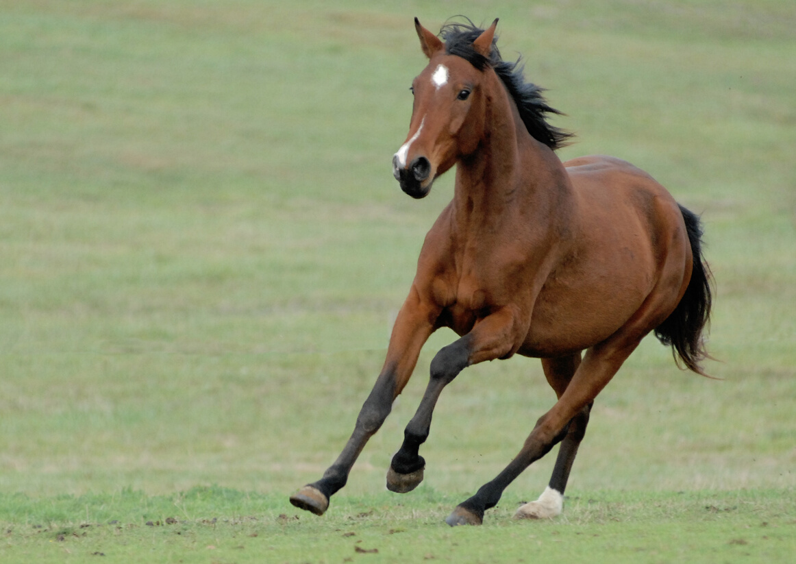
Traditional Hanzi
Simplified Hanzi
馬
马
mǎ
horse
by SMART Mandarin

Slide 3
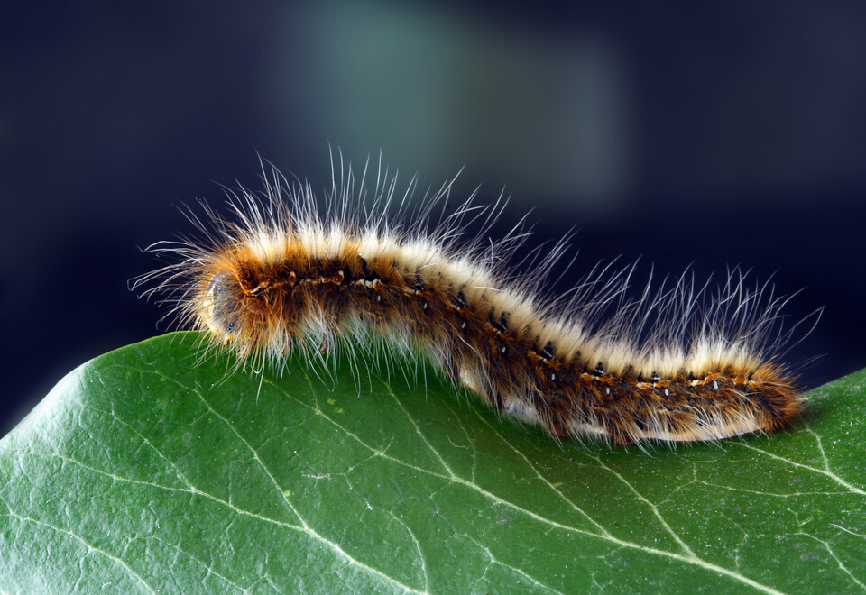
Traditional Hanzi
Simplified Hanzi
蟲
虫
Chóng
bug; worm
by SMART Mandarin

Slide 4
Traditional Hanzi
Simplified Hanzi
見
见
jiàn
to see; to meet
by SMART Mandarin

Slide 5
Traditional Hanzi
Simplified Hanzi
書
书
Shū
book
by SMART Mandarin

Slide 6
書
Traditional Hanzi
Shū
book
by SMART Mandarin

