Slide 1
Introduction to Captive Feasibility Study
Yas Suttakulpiboon

Slide 2
Why captives are formed?
To improve control over access to insurance market capacity
Consolidate (re)insurance programs across operations and countries
Consistent, efficient access to capacity
Centralize risk finance
Develop elements of coverage specific to your needs
Direct contractual role in claims resolution

Slide 3
Why captives are formed?
To reduce total cost of risk
Direct access to reinsurance
Captive profit to invest in risk management initiatives
To provide cover for emerging risk
Non-damage BI; Cyber; climate extremes
Access ‘Alternative Risk Transfer’ reinsurance
To generate income
Enhance offering to customers, suppliers, business partners …..

Slide 4
Captive is all about…
Risk Retention – Risk Transfer Optimality
Know your risk appetite
Lower the overall cost of risk management
Access to Reinsurance
It is not about investment!

Slide 5
First – Assess your current business and risk
Look at your business and risks
Look at how you manage your risks
Then – Shop Around
Pick a domicile
Pick a structure
Last - Implementation
Pick a manager
Pick an actuary
Is it more cost effective to form a captive?
Tax
Investment Policy
Capitalization
Other Legal Stuff
Filing and Execute

Slide 6
First – Assess your current business and risk
The First Impression
your (group) last audited financial
your current insurance schedule - noting deductibles, limits, premiums, key underwriters
5-10 years of incurred claim history in key lines
First – Assess your current business and risk
Look at your business and risks
Look at how you manage your risks
Then – Shop Around
Pick a domicile
Pick a structure
Last - Implementation
Pick a manager
Pick an actuary
Is it more cost effective to form a captive?
Tax
Investment Policy
Capitalization
Other Legal Stuff
Filing and Execute

Slide 7
What Lines of Coverage Belong in a Captive?
Yes | Not Really
Liability Lines Professional Liability, General Liability, Auto/Fleet Liability, D&O Liability, Worker’s Compensation and Employer’s Liability | Property, Employee Benefit
First – Assess your current business and risk
Look at your business and risks
Look at how you manage your risks
Then – Shop Around
Pick a domicile
Pick a structure
Last - Implementation
Pick a manager
Pick an actuary
Is it more cost effective to form a captive?
Tax
Investment Policy
Capitalization
Other Legal Stuff
Filing and Execute

Slide 8
First – Assess your current business and risk
Look at your business and risks
Look at how you manage your risks
Then – Shop Around
Pick a domicile
Pick a structure
Last - Implementation
Pick a manager
Pick an actuary
Is it more cost effective to form a captive?
Tax
Investment Policy
Capitalization
Other Legal Stuff
Filing and Execute

Slide 9
Domicile Considerations
This is more than just where your boss wants to spend his vacation…domicile considerations are all about:
Capitalization and solvency requirements
Receptiveness of regulatory environment
Quality of local infrastructure
Availability of expertise
Stability of regulatory environment
Flexibility as respects investment portfolio
Ease of doing business – in a suitably regulated environment
Experience in business under consideration
Efficient financial outcomes: tax, wealth, investment etc.
Accessibility
First – Assess your current business and risk
Look at your business and risks
Look at how you manage your risks
Then – Shop Around
Pick a domicile
Pick a structure
Last - Implementation
Pick a manager
Pick an actuary
Is it more cost effective to form a captive?
Tax
Investment Policy
Capitalization
Other Legal Stuff
Filing and Execute

Slide 10
Domicile Comparison

Slide 11
First – Assess your current business and risk
Look at your business and risks
Look at how you manage your risks
Then – Shop Around
Pick a domicile
Pick a structure
Last - Implementation
Pick a manager
Pick an actuary
Is it more cost effective to form a captive?
Tax
Investment Policy
Capitalization
Other Legal Stuff
Filing and Execute

Slide 12
Hiring Management and Actuaries
A good captive consultant will bring the following wisdom to the feasibility process:
A sense of which domicile will accept your business plan and overall risk financing program based on the facts as presented.
An understanding of how the claims management process will be handled for the lines of coverage selected.
An awareness of the legal, tax, administrative, and structural implications of the captive formation.
How the value of the captive program can be explained (quantified) to your finance committee, CFO, board of directors, etc.
First – Assess your current business and risk
Look at your business and risks
Look at how you manage your risks
Then – Shop Around
Pick a domicile
Pick a structure
Last - Implementation
Pick a manager
Pick an actuary
Is it more cost effective to form a captive?
Tax
Investment Policy
Capitalization
Other Legal Stuff
Filing and Execute

Slide 13
Hiring Management and Actuaries
First, a good actuary is important.
You will need to provide your actuary with 8 to 10 years of credible claims data in the lines that look like candidates for captive treatment.
Arm’s length decision making & transfer pricing
First – Assess your current business and risk
Look at your business and risks
Look at how you manage your risks
Then – Shop Around
Pick a domicile
Pick a structure
Last - Implementation
Pick a manager
Pick an actuary
Is it more cost effective to form a captive?
Tax
Investment Policy
Capitalization
Other Legal Stuff
Filing and Execute

Slide 14
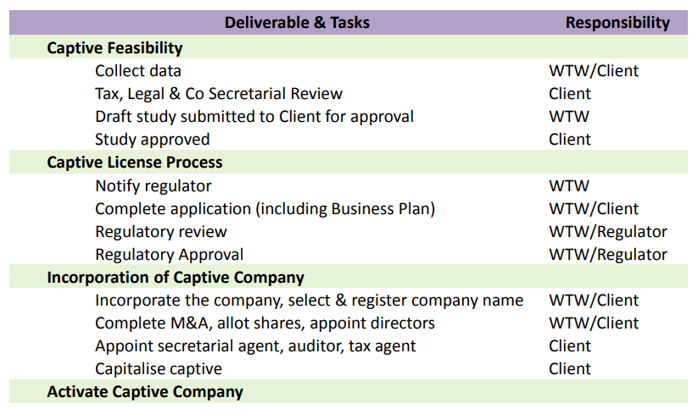
Typical Implementation Timeline

Slide 15
What would happen if Thailand’s OIC allow for captive formation?

Slide 18
Utah Captive Insurance Division
What Types of Captives are available in Utah?
Generally there are two types of captives in Utah:
Pure Captives
Group Captives

Slide 19
Utah Captive Insurance Division
Startup Activity: | Estimated Cost:
Prepare business plan and complete application | Varies, but should not be significant once feasibility study completed.
Filing of application | $200 per application
Review of application | $3,600 est. (only if Contractor reviewed)
Initial license fee | $5,000 without proration ($1,000 for a Cell without proration)
Initial e-Commerce fee | $250 without proration
Incorporation | Nominal fee with annual renewal of same. Paid to Dept. of Commerce
Initial Capital:
Pure Captive | $250,000
Association | $750,000
Industrial Insured | $700,000
Sponsored | $1,000,000 (minimum of $350,000 provided by the Sponsor)
Ongoing Maintenance: | Estimated Cost:
Annual renewal fee | $5,000 due June 1st ($1,000 for a Cell)
Annual e-Commerce fee | $250 due June 1st
State Taxes | None (captive is subject to real & personal property taxes)
Independent Actuary – Reserve Opinion | $5,000 – $8,000+
Independent CPA – Annual Audit | $8,000 – $12,000+
Management Firm | $24,000 – $36,000+

Slide 20
Utah Captive Insurance Division
Captive Type | Total Capital Requirement
Pure Captive | $250,000
Association Captive | $750,000
Association Captive (Mutual) | $750,000
Industrial Insured Captive | $700,000
Industrial Insured Captive (Mutual) | $700,000
Sponsored Captive | $1,000,000

Slide 21
Case Study: CSAC-EIA Domicile Shopping *** Extra 2% on top of the midterm exam

Slide 22
Packet Include:
CSAC-EIA 2016/2017 Annual Report
Excess Insurance Organization (EIO) 2016/2017 Financial Statement
CAPTIVE FEASIBILITY STUDY AND BUSINESS PLAN
Captive Investment Guidelines October 16, 2017

Slide 23
Background
CSAC Excess Insurance Authority (EIA) provides outstanding risk coverage programs and risk management services to California’s public agencies
EIA will continue to be internationally recognized as a leading risk sharing pool for its member-directed operating philosophy and commitment to member fiscal sustainability. The EIA will continue to influence and shape the future of the risk management profession.

Slide 24
Background
In 2016, The Executive Committee has spent much time this past year on strategic initiatives, including the promotion of the EIO captive to transfer corridor risk, succession planning, as well as updating the EIA’s Mission and Vision statements, and statement of Core Values.
Benefits of EIO include:
There is a short-term savings on cost of funds
Flexible investment schemes
Superior risk transfer mechanism

Slide 25
An Email from The President…
Good morning,
As we have established our first captive reinsurance – EIO - for our company last year, it has been a success thus far. However, we would like to re-evaluate whether Utah it is the right domicile for our captive reinsurance. Please consider the following domicile states and countries and see whether they might be a better fit for us:
Arizona
Nevada
British Columbia
Bermuda
Singapore
Hong Kong
Malaysia
By next week, please provide a 1-2 page analysis which states or countries might be a better candidate domicile for us next year. Please consider the taxation rules, capitalization, capital requirement, investment restrictions and overall captive environment within the state/country.
Best regards,
James Brown
EIA President

Slide 26
References
https://www.csac-eia.org
https://www.eiocaptive.org/
http://www.cicaworld.com/Resources/World-Map.aspx
https://www.labuanibfc.com
https://www.michaelmaglaras.com/121-2

