Slide 1
DEPRESSION: ITS TRUE NATURE
(Section Three)
DEFENSE MECHANISMS & COPING STRATEGIES
Dr. Terry Lynch,
physician, psychotherapist, author
www.doctorterrylynch.com
info@doctorterrylynch.com

Slide 2
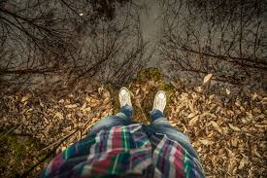
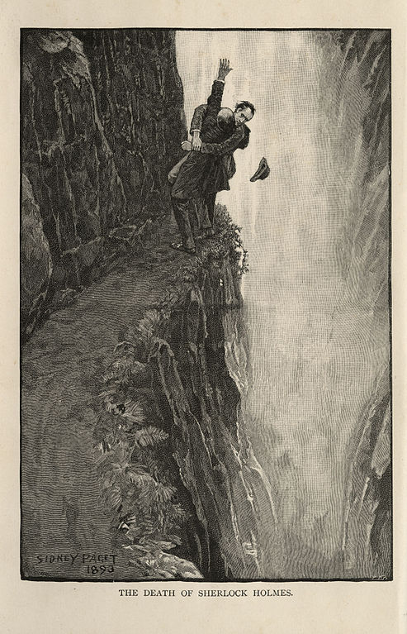
People considered to have “depression”
Fear
Anxiety
Close to the edge
Easily fall off the edge

Slide 3
Many features of “depression”
Defense mechanisms
Coping strategies

Slide 4
Purpose of defense mechanisms & coping strategies
1.
Minimise contact with wounding & distress experienced to date
2.
Minimise further wounding & subsequent distress
Many cause secondary wounding and distress

Slide 5
Range of defense mechanisms & coping responses
Very considerable
Testament to the creative ability of us human beings
Always serve a purpose

Slide 6
Defense mechanisms & coping strategies
“Depression”

Slide 7
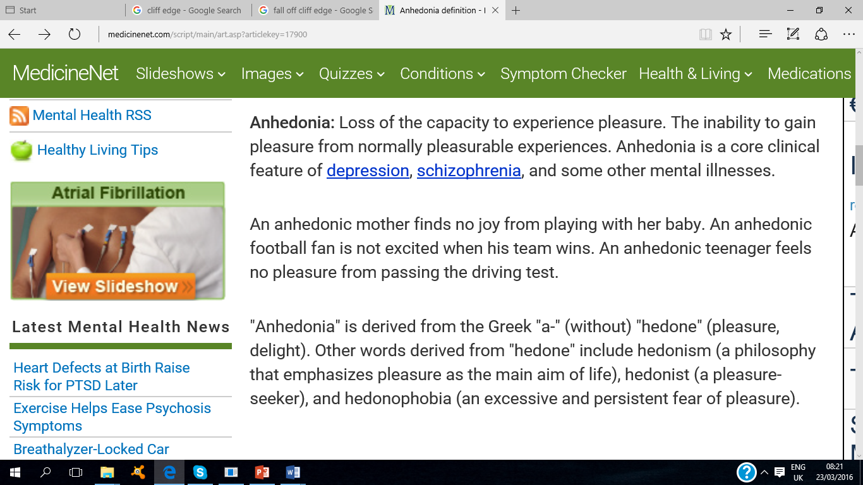
http://www.medicinenet.com/script/main/art.asp?articlekey=17900 , accessed 23rd March 2016

Slide 8
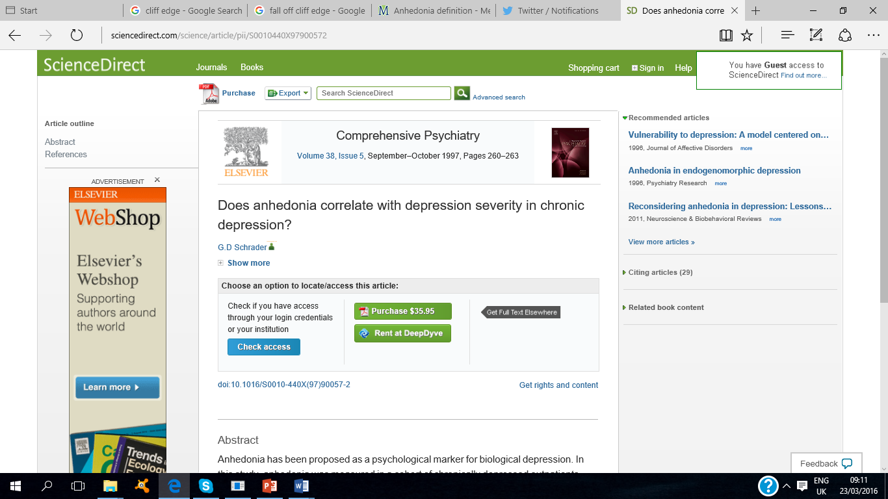
http://www.sciencedirect.com/science/article/pii/S0010440X97900572 , accessed 23rd March 2016.

Slide 9
Anhedonia
(Not feeling pleasure)
Inability to experience pleasure
Unwillingness to experience pleasure

Slide 10
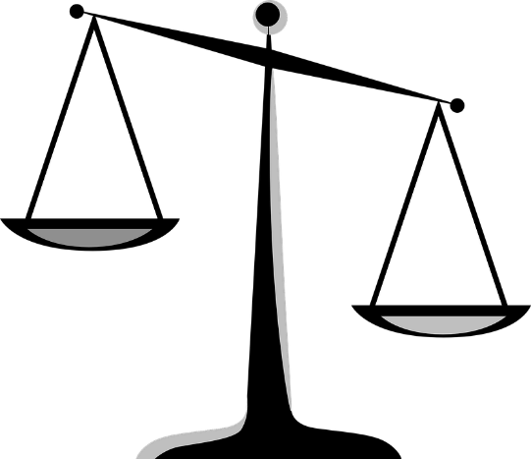
Why might one choose
to not feel pleasure?
Question:
Answer:
BENEFITS
RISKS

Slide 11
Psychic wounding
Distress in its many forms
Excruciating
Disconnect
Resolution
STOP!!
Detach

Slide 12
Disconnecting from our distress
Disconnecting from our feeling, sentient aspect
Difficult
Big price to pay
Guard up constantly
100% “success” impossible

Slide 13
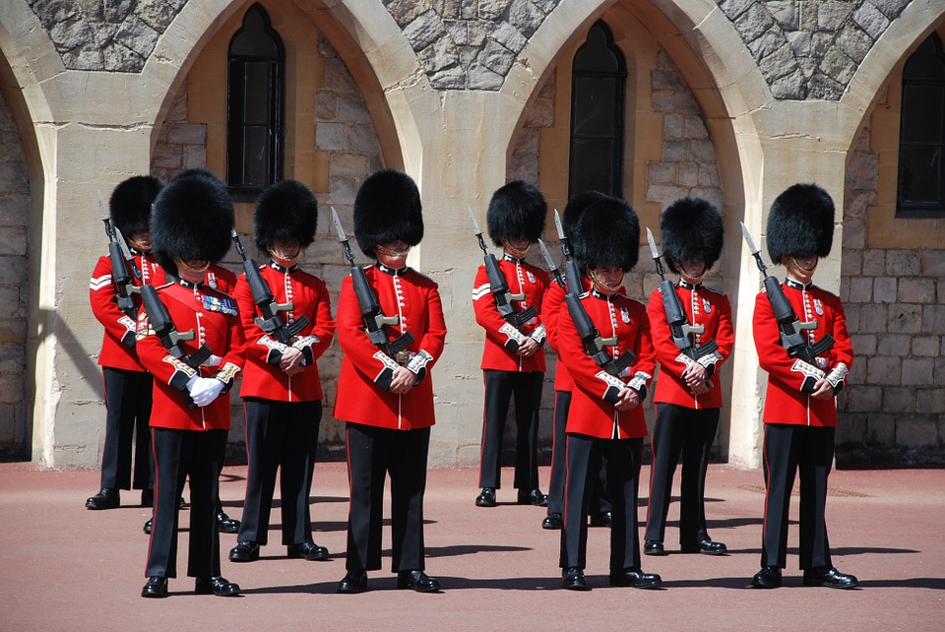
Reinforce defenses
On guard

Slide 14
Maintaining these defenses
No. 1 priority

Slide 15
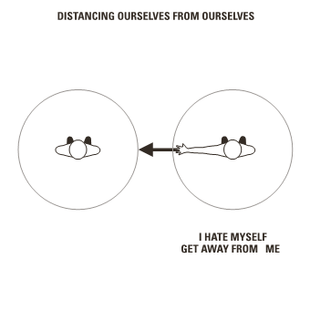

Slide 16
To maintain this defense
Love
Affection
Warmth
Compliments
Caring

Slide 17
Ideal way of being
Ideal solution
Ideal way of living
Relying on
Defense mechanisms and coping strategies
Least difficult way to live

Slide 18
Experiences and behaviours
INTERPRETED
“Depression”
Best solutions

Slide 19
Defense mechanisms/coping strategies
Regularly seen as evidence of “depression”
Withdrawal
Cut-off
Shutdown
Minimise risk of experiencing
Further wounding
Peak contact with one’s painful emotional unfinished business
Further distress
AVOID
Overwhelm

Slide 20
Self-protection

Slide 21
Defense mechanisms and coping strategies
MAY INFLUENCE
How we choose to process and express emotions
EXPERIENCES & BEHAVIOURS
“Depression”

Slide 22
Many people considered to have a “mental illness” - “depression”
“Private”
“Deep”
Hold back
much of who they really are
and how they really feel
from others,
locking away key aspects of themselves
very deeply within them.
They rarely express their true self,
their vulnerability,
their deeply held emotions.
Defense mechanism
DESIGNED TO MINIMISE RISK OF
Further wounding
Peak contact with one’s painful
emotional unfinished business

Slide 23
Anxiety
“Depression”
(P: 3.12)
THIS PRESENTATION
Defense mechanisms and coping strategies
Comprehensive course on anxiety for mental health therapists

Slide 24
Anxiety
OFTEN FOLLOWED BY
“Depression”

Slide 25
http://www.mayoclinic.org/diseases-conditions/depression/expert-answers/depression-and-anxiety/FAQ-20057989, accessed 14th June 2016.

Slide 26
Anxiety
OFTEN FOLLOWED BY
“Depression”
Shutting down
Cutting off
“Depression”
Avoidance

Slide 27
Many experiences and behaviours
ERRONEOUSLY
“Mental illness”
“Depression”

Slide 28
Avoidance
REFLECTED
IN
Adopted defense mechanisms and coping strategies
ESTABLISHED
Childhood
Adolescence
REFLECT
Unhealed
+
Unhealed
Avoidance
wounding
distress

Slide 29
All defense mechanisms and coping strategies
EMPLOYED HABITUALLY
Short-term
Long-term
gain
pain
Avoidance
Relief
Failure
Anxiety
Sense of self

Slide 30
Other defense mechanisms/coping strategies
Apathy
Disappear
Autopilot
Numbing
Indecisiveness
Mindreading
Daydreaming
Fantasy creation
“What if”
Extroversion

Slide 31
http://www.dictionary.com/browse/extroversion, accessed 17th June 2016.

Slide 32
Other defense mechanisms/coping strategies
Apathy
Disappear
Autopilot
Numbing
Indecisiveness
Mindreading
Daydreaming
Fantasy creation
“What if”
Extraversion
People-pleasing
Blaming
“Negative” thinking
“Forewarned is forewarned”
Protective thinking
For further examples, see text that accompanies this presentation

Slide 33
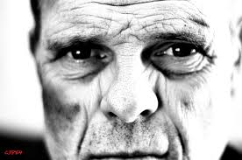
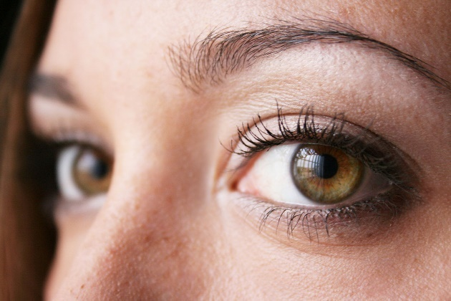
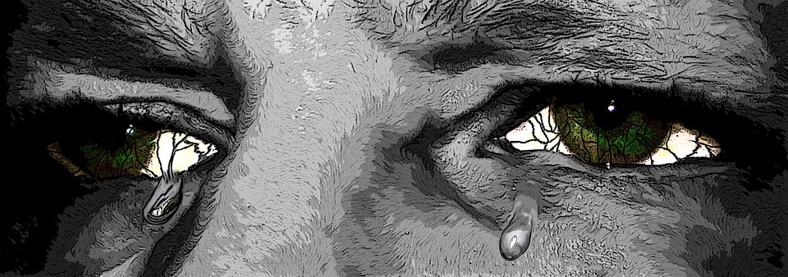
Eye contact

