Slide 1

We are a national alliance of agents working together to provide mortgage, final expense, Life Insurance and retirement protection to our clients.
Our company is hiring, do you know anyone that could help us out?

Slide 2
About Me

Slide 3
About Me
Insert Photo 1 Here
Insert Insurance License Here
Insert Photo 2 Here

Slide 4















Companies I Represent

Slide 5
Your Financial Picture
Name & Age
Height & Weight
Tobacco Use
Medications
Operations
How Long with Company
Income
Name & Age
Height & Weight
Tobacco Use
Medications
Operations
How Long with Company
Income
Mortgage & Monthly Payment
401K, CDs, IRAs, Stocks, Retirement Accounts
Current Policies (Type & Face Amounts)
Criminal or Driving Record
Military Member (orders for deployment overseas)
Children? Names & Ages

Slide 6
Why Is This Important?
Most people request information for 1 of 4 reasons:
  Help pay off a mortgage.
  Replace lost income.
  To pay off final expenses, cover children’s expenses, or debt.
  To leave a Financial Legacy for their loved ones.
Why did you send this in?
  Who do you want to protect?
  To ease financial burden?
  To replace loss of income?

Slide 7
What is Mortgage Protection?
Helps pay off your mortgage when you die
  You choose the beneficiary
  Portable – follows YOU, not your mortgage
  Coverage and Payment Amounts stay the same
The Split Plan
  Covering ½ of the Balance with Full Coverage & the other ½ with Accidental Death Coverage
Mortgage Payment Protection
  Can cover 6, 12, or 24 months or more of mortgage payments
  Provides time and could earn more equity in the home
Disability
  Unable to work – helps pay some of your mortgage payment
Return of Premium
  Pays all your premiums back, tax free, if you are alive at the end of the term.

Slide 8
What Is Final Expense?
A funeral and all it’s expenses can easily total over $12,000.
Final expense coverage eases the financial burden placed on loved ones after the death of a family member.
The coverage is permanent.
If you qualify, your rate never increases and your benefits never decrease.
A lot of families use Final Expense for social security income replacement.
It has a cash accumulating account that can temporarily cover missed payments.

Slide 9
What Happens Next
We will show you some options that will give you peace of mind and fit into your budget.
We will fill out the paperwork, sign and send in to the carrier that best fits your family’s needs.
I will do everything I can to get you qualified. Sound good?

Slide 10
Your Quote
Let’s shop around and try to find you the best deal.
Option 1
Option 2
Option 3
Benefits
Monthly Payment
Which one of these fits your family’s needs and your budget the best?
All we need to get this started is your drivers license.

Slide 11
Emergency Response System
Currently there is OVER One Billion dollars in unclaimed life insurance money in America.
Most unclaimed life insurance is from beneficiaries not knowing that they were a beneficiary on a policy.
Emergency Response System is our way of making sure your death claim will be paid immediately to your beneficiaries.

Slide 12

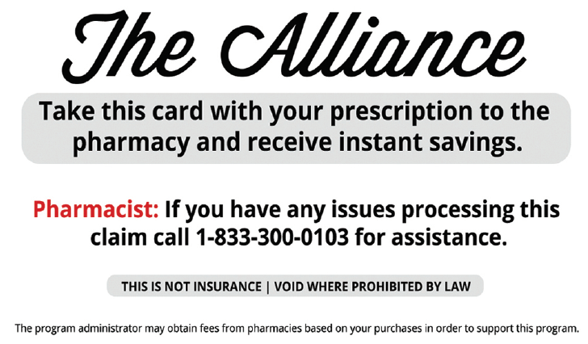
Prescription Discount Card
This card makes sure you get the lowest price on all of your prescriptions.
When you take this card to your pharmacy the Rx Card Price could be cheaper than your insurance copay.
Free to use, there is no signing up for anything or an enrollment process.
It even works on pet medications!
The Alliance allows you to sponsor a few local friends or family members so you can help them save money on their prescriptions too!

Slide 13
Safe Money
Are you willing to lose all of your money, some of your money, or none of your money?
Do you want a plan for living or for death?
What type of Longevity Insurance do you have?
What insurance do you have that protects you from market downturns?
Do you know there is a way to participate in market gains without any market losses?
I have an EXPERT that can likely improve your situation.
What I would like do is schedule a time for us to talk with them. Is morning or afternoon better?

Slide 14
Final Questions
Do you feel good about taking care of your family today for ________ per month?
Anything you can think of that would prevent you from keeping this payment going?
I will call you in a couple of days to give you an update on your case.
If you have any questions after you receive your policy in the mail please let me know.

Slide 15
Final Questions
Do you know someone who may be interested in making an extra $500 a week helping families do what I just did for you?
My manager is hiring motivated, intelligent, people in this area, how can we contact them?

Slide 16
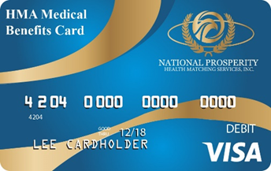
Health Matching Account (HMA)
What are your estimated out of pocket health/medical 213(d) expenses?
  Co-pays and deductibles, ambulance, lab services, doctors not classified on your health insurance, dentists, orthodontists, osteopaths, chiropractors, optometrists, ophthalmologists, opticians, optical goods, eyeglasses, podiatrists, nursing and personal care facilities, hospitals, home health care, long term care, fertility procedures, Lasik surgery, drug stores, pharmacies, hearing aids, orthopedic goods/prosthetics, counseling services – debt/marriage/personal and more . . .
The HMA VISA card will match you about dollar for dollar for 213(d) medical benefits (depending on what plan you select).
Better than a Health Savings Account (HSA).
Can allow you to decrease your health insurance premiums by raising your deductible which would be covered under this HMA account.
Covered in Forbes, May 17, 2017, “A New Approach to High Deductibles”. John Goodman: https://www.forbes.com/sites/johngoodman/2017/05/17/a-new-approach-to-high-deductibles/#6621ba6f72cc

Slide 17
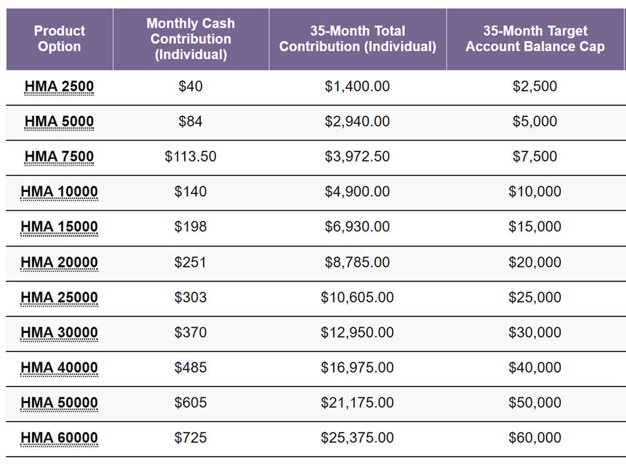
Health Matching Account (HMA)

