Slide 1
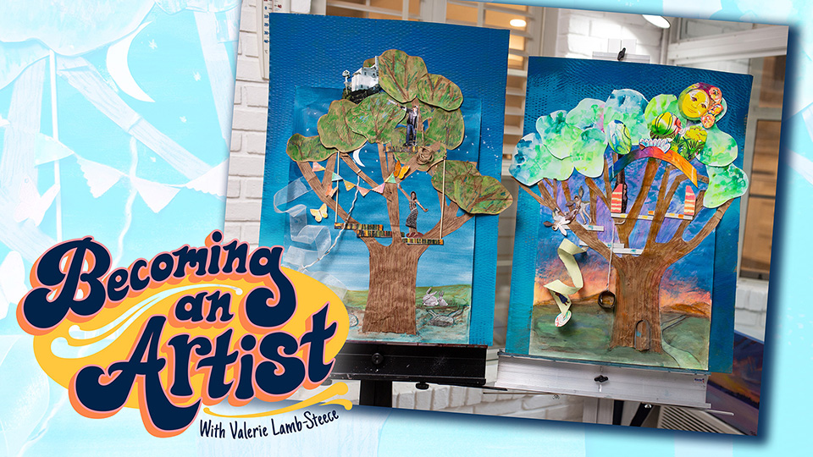

Slide 2
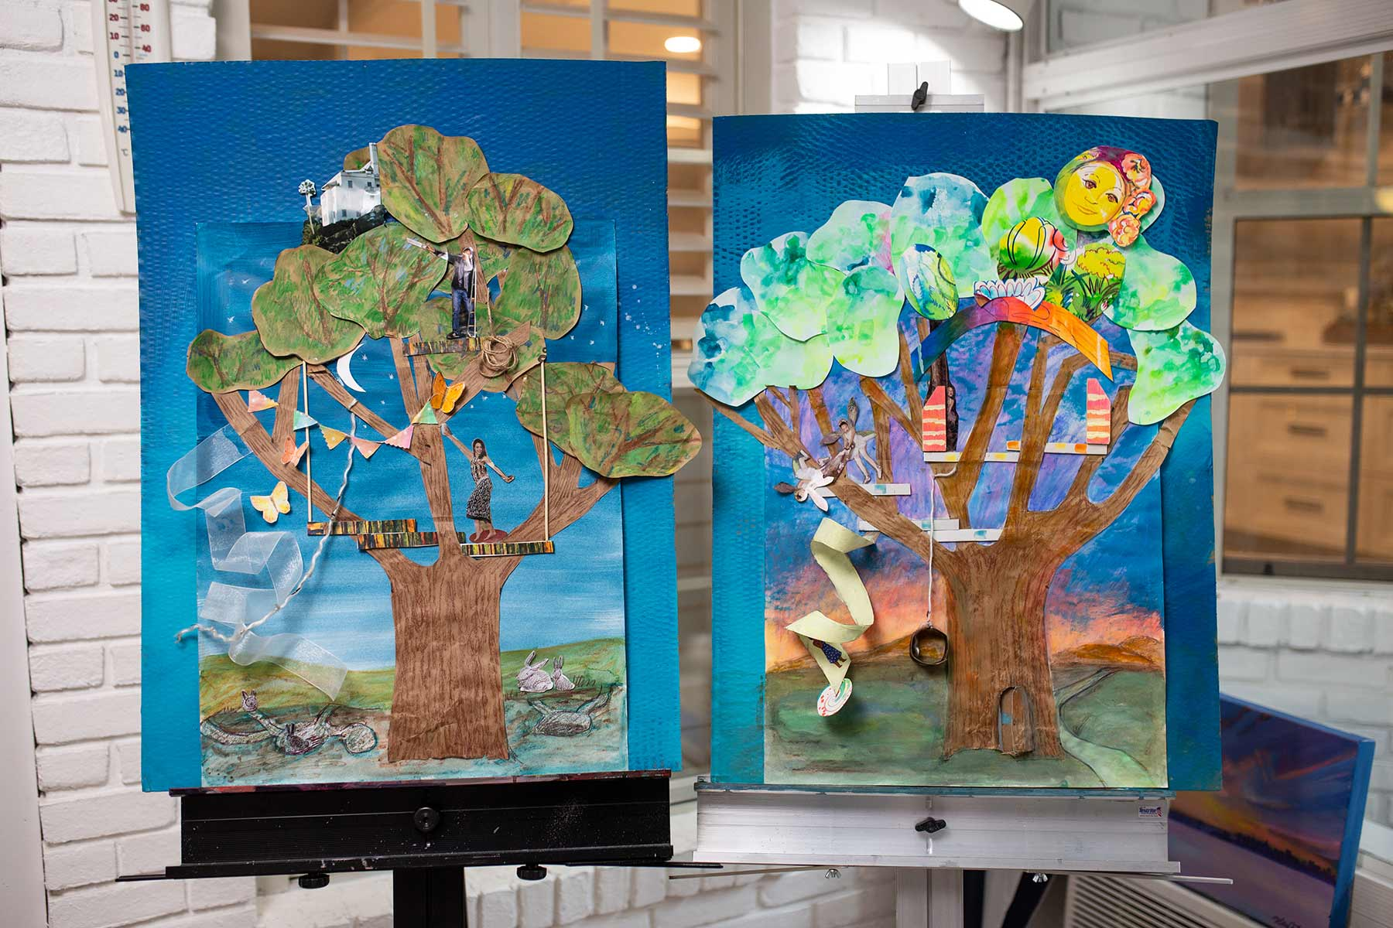
Ultimate Treehouse
Dream it -Make it
Let’s make a treehouse!
First we need to plan it- print out the dream sheet and imagine what you’d like yours to look and feel like if you were there.

Slide 3
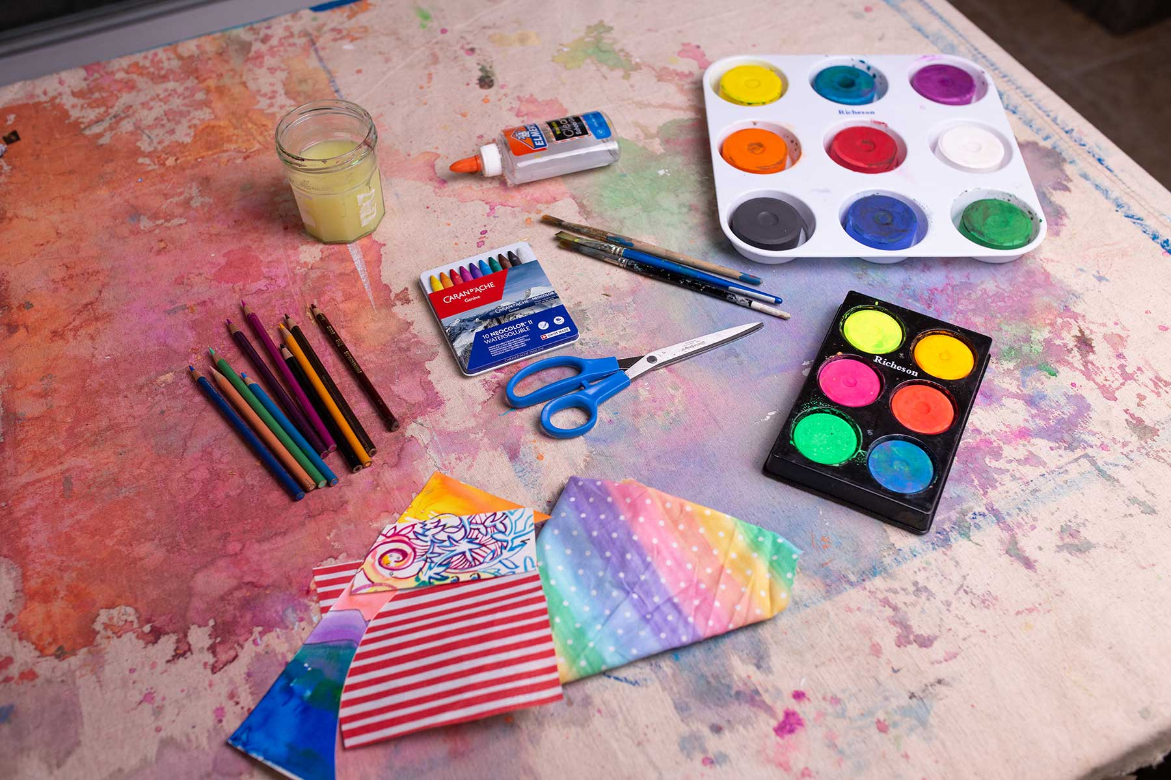
gather all your supplies
Glue & Scissors
Paints and brushes
Colored pencil and pencil
Watercolor crayons
Recycled items, magazines, fabric scrap
Craft box items- any you think work for your vision
Brown paper sack or brown paper -for tree
A blue poster board or large cardboard to be painted with house paint
*make sure to use a tarp or shower curtain to cover your work area

Slide 4
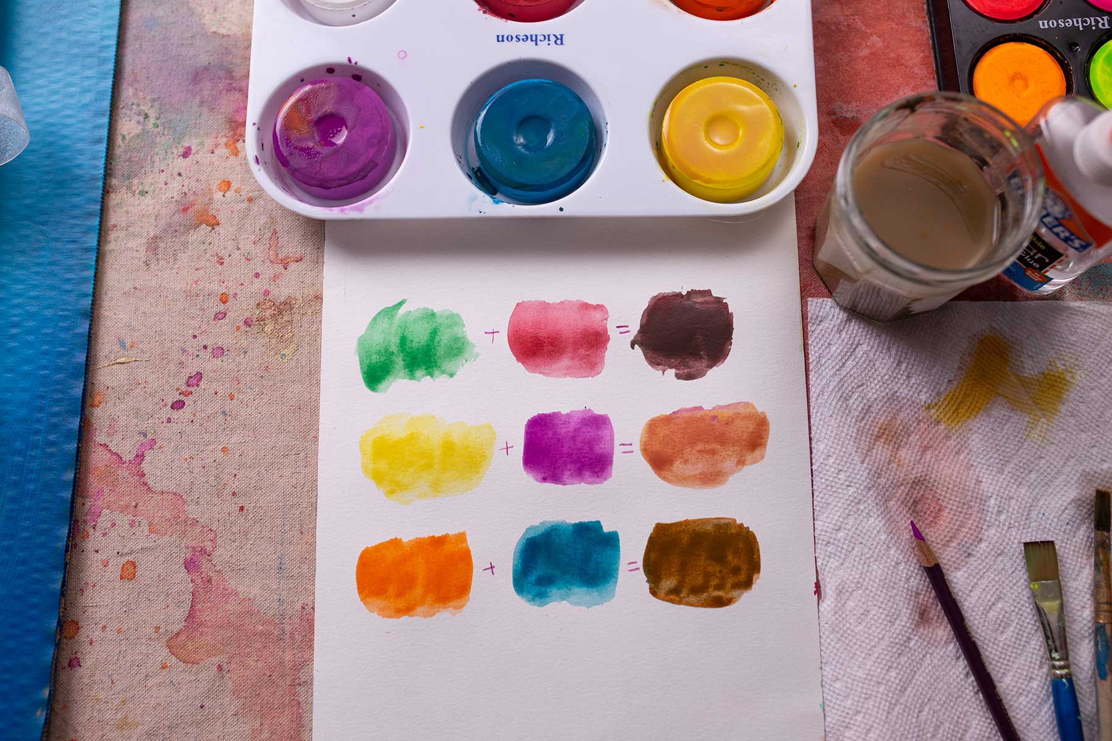
creating colors
Here my goal was to create browns for soil or animals. I like to keep sketchpads with my color mixing experiments, so that next time I’d like to make the same color I can look at my sheet.
tip-these colors above mixed will always make a brown tone
these color combos are color compliments across the color wheel from each other

Slide 5
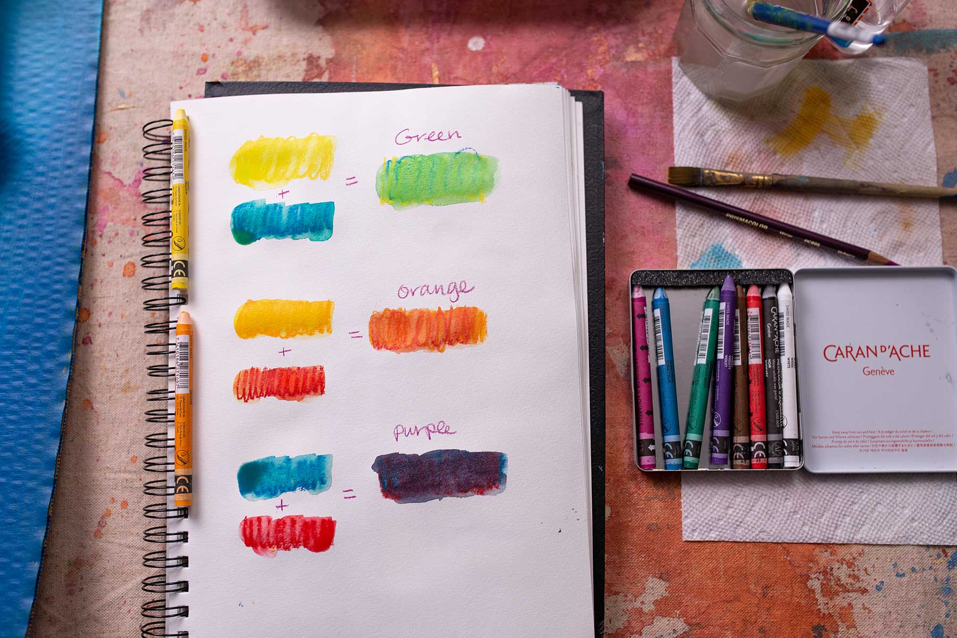
take your time
do one task at a time

Slide 6
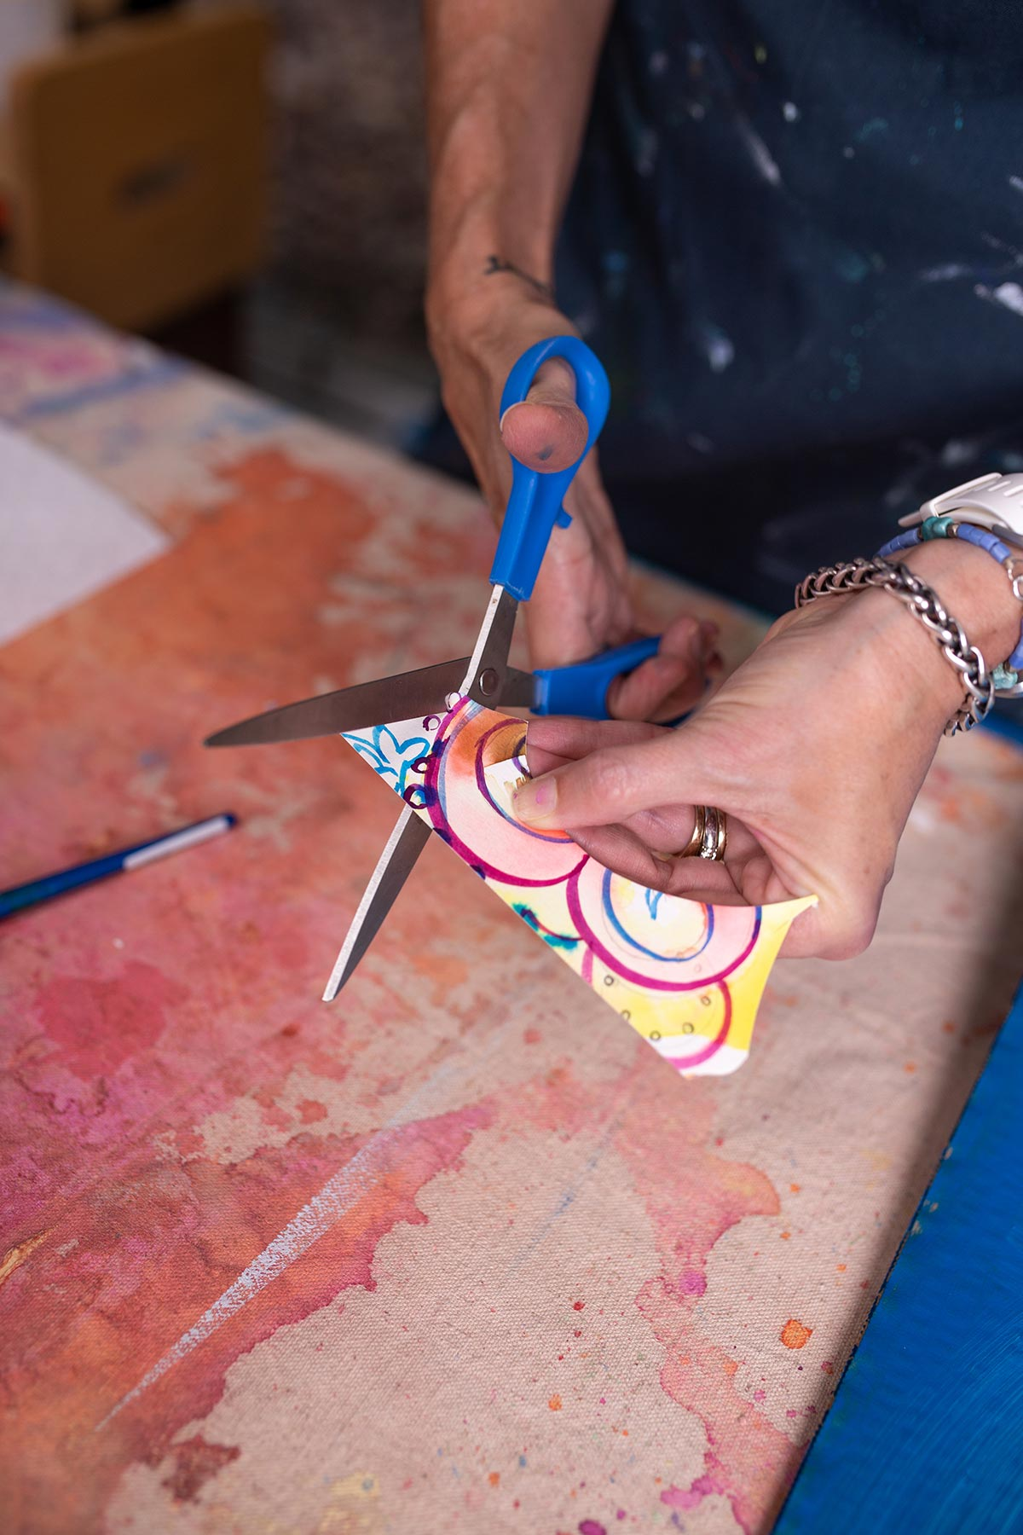
layout pieces as you go along- its ok to
change your mind or move things around

Slide 7
adding on -
each area
artists- if your treehouse is in the fall or winter the leaves will be warm colors or no leaves at all. Be sure to stay true to your vision.
I did rainbow type leaves on one so, it whatever your idea is !

Slide 8
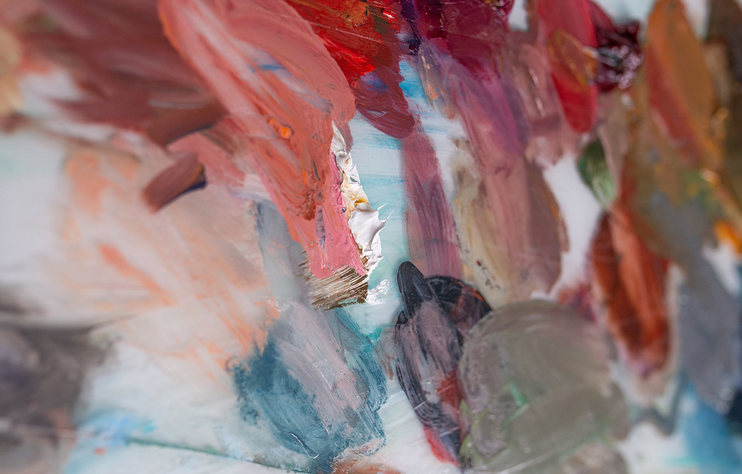
wash out your paintbrushes- do not let them soak in water, it makes them sad
Leave no art supply behind, they like to all be together
Glue- dot dot not a lot
Colored pencils break inside when you drop them ( no really)
I like to make a box with everything for one project in it,
then I can just grab that box
I love washed out food jars, mustard, pickle or jam jars are my favorite

Slide 9
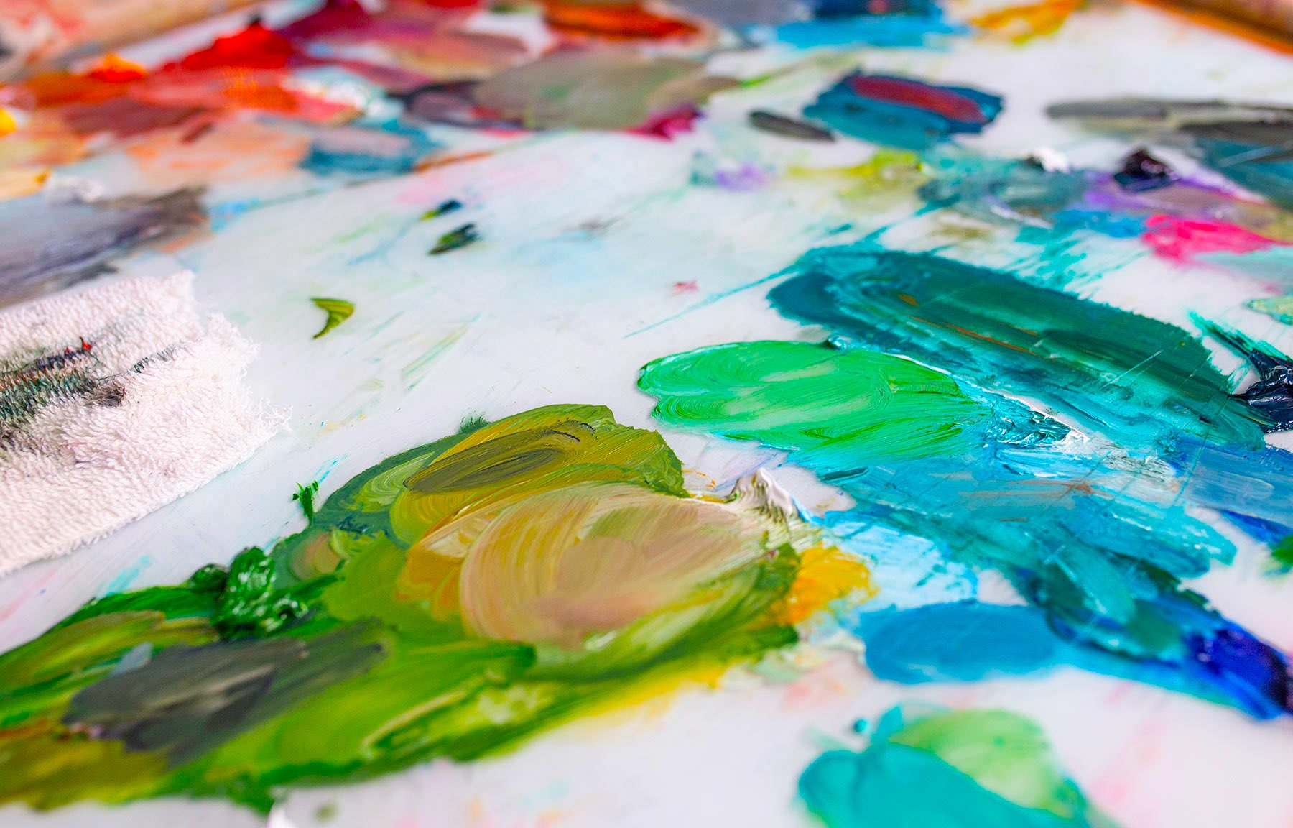
take good care of your supplies & make sure to clean up as you go along and have Fun!

