Slide 1
Global Social Work Issues
and the need for collaboration
Notes:
https://www.weforum.org/agenda/2016/01/what-are-the-10-biggest-global-challenges/

Slide 2
Some challenges facing every social worker around the world
Notes:
Income Inequality –
The push for economic growth in recent decades has led to substantial increases in wealth for large numbers of people across the globe. But despite huge gains in global economic output, there is evidence that our current social, political and economic systems are exacerbating inequalities, rather than reducing them.
A growing body of research also suggests that rising income inequality is the cause of economic and social ills, ranging from low consumption to social and political unrest, and is damaging to our future economic well-being.

Slide 3
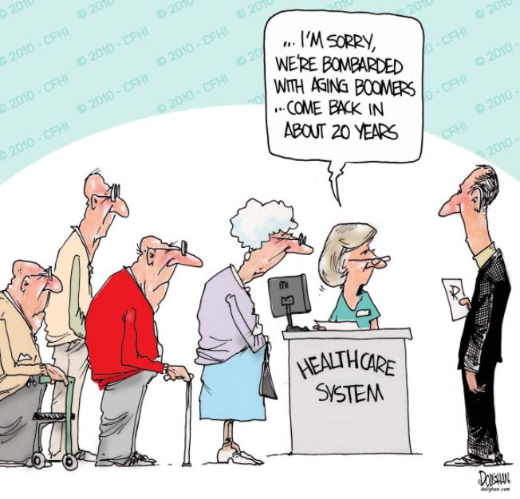
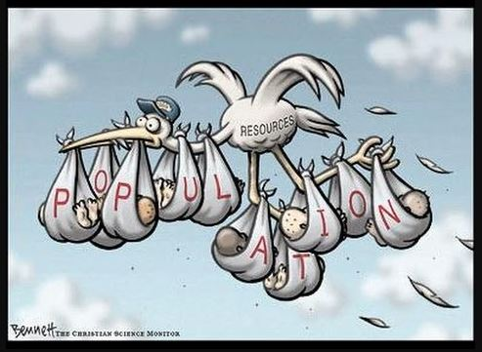
Some challenges facing every social worker around the world
Notes:
Healthcare; aging population and population booms
Over the past few decades, the world has seen major advancements in health and largely as a result, people are generally living longer, healthier lives. However, serious challenges to global health remain, ranging from dealing with pandemics to the rise of noncommunicable diseases (NCDs) to the prohibitive costs of care, particularly in developing countries.
The number of people on the planet is set to rise to 9.7 billion in 2050 with 2 billion aged over 60.
The global health system will need to adjust to this massive population growth, which will be concentrated in the poorest countries, and increasing numbers of elderly. This will mean shifting the current focus on treating sick people towards preventing illness and preserving the health of populations.

Slide 4
Some challenges facing every social worker around the world
Notes:
Food security – hunger and nutrition
The United Nations has set ending hunger, achieving food security and improved nutrition, and promoting sustainable agriculture as the second of its 17 Sustainable Development Goals (SDGs) for the year 2030.
To achieve these objectives we will need to address a host of issues, from gender parity and ageing populations to skills development and global warming.
Agriculture sectors will have to become more productive by adopting efficient business models and forging public-private partnerships. And they need to become sustainable by reducing greenhouse gas emissions, water use and waste.
The risks if we fail? Malnutrition, hunger and even conflict.

Slide 5
Some challenges facing every social worker around the world
Notes:
Migration – legal or otherwise → integration into new community, and access to aid
The International Organisation for Migration (IOM 2015) gave an estimate of 972 million migrants globally. Of these, the minority, 232 million, were international migrants reportedly living in high-income countries, while the majority 740 million, were internal migrants moving within their own countries, mostly from rural to urban settings. The reasons why people move were multiple and varied: people often moved in pursuit of better socioeconomic opportunities, though migratory patterns may also result from civil conflict, political persecution, development activities, and natural disasters.
Other commentators highlight the perceived threat to culture and tradition pointing at the rise of xenophobia in ethnically relatively homogenous communities faced by the arrival of immigrants and refugee groups dislodge by globalization.

Slide 6
On Collaboration
Notes:
Collaboration – covering holonic thinking, and the Bill Gates Foundation’s collaborative fight against malaria

Slide 7
Holonic Thinking
Notes:
Where every part is a whole, and every whole is a part of something else - holons exist simultaneously as self-contained wholes in relation to their sub-ordinate parts, and as dependent parts when considered from the inverse direction e.g. this is a plate. The plate is on a table. The table is set in the dining room. In the house – etc.
Holons are stable forms that are able to withstand disturbances… (yet) are intermediate forms, providing a context for the proper functionality for the larger whole.
Koestler defines a holarchy as a hierarchy of self-regulating holons that function first as autonomous wholes in supra-ordination to their parts, secondly as dependent parts in sub-ordination to controls on higher levels, and thirdly in coordination with their local environment.

Slide 8
What does that mean for collaboration?
Notes:
The more complex the issue facing social workers, the more factors are involved → the more collective the effort needed for an encompassing solution which adequately address the challenge

Slide 9
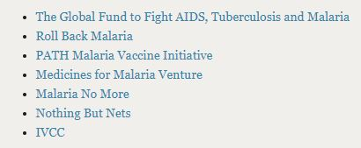
The example of Bill & Melinda Gates Foundation against malaria
Partners:
Notes:
http://www.ivcc.com, https://www.theglobalfund.org/en/, http://rollbackmalaria.com, http://www.malariavaccine.org, https://www.mmv.org, https://www.malarianomore.org, https://nothingbutnets.net

Slide 10
Collaboration in action
Malaria occurs in nearly 100 countries worldwide, exacting a huge toll on human health and imposing a heavy social and economic burden
Severe malaria can cause lifelong intellectual disabilities in children, and malaria’s economic impact is estimated to cost billions of dollars in lost productivity every year.

Slide 11
Collaboration in action – Spotlight on Tanzania
Tanzanian health authorities have launched major campaigns to distribute insecticide-treated bed nets and encourage people—especially children—to sleep under them every night. They’ve done widespread spraying of insecticides inside homes and in urban ponds, puddles, and marshes where mosquitoes breed.
Medicine used contains a drug called artemisinin, which earned its discoverer, Youyou Tu, the 2015 Nobel Prize in Medicine. Ms Tu is Chinese.
Precision malaria maps with the ability to see at a very high degree of granularity (5 km by 5 km) the burden of malaria. That’s super valuable for short-term interventions, like helping a country determine where to deploy health staff. It’s just as valuable for long-term efforts to reduce the rate of transmission and shrink the malaria map. Contributors to the map: http://www.map.ox.ac.uk/acknowledgements/
Notes:
Other collaborative actors:
Private-sector companies who have developed new, safe insecticides that will allow us to preserve the gains we have made against malaria. We have also helped bring to market simple technologies to protect families from mosquitoes, such as “eave tubes” that kill mosquitoes trying to enter homes and new traps which exploit mosquitoes’ attraction to sugar to kill them outdoors.
Scientists who are using a powerful new tool called “genome editing” to introduce genetic changes in the Anopheles gambiae species of mosquito, one of the most effective transmitters of malaria in Africa. These genetic edits cause females to produce mostly male, sterile offspring. In theory, scientists could drive this trait throughout entire populations of mosquitoes in much of Africa, dramatically reducing malaria transmission in a very short time.
More than 50 countries have joined together to mobilize billions of dollars through The Global Fund. And these resources are coming not just from wealthy countries. African countries such as Benin, Côte d’Ivoire, Kenya, Namibia, Nigeria, Senegal, South Africa, Togo, and Zimbabwe are contributing as well. In fact, African countries are now, for the first time ever, mobilizing more of their own resources for malaria than they’re receiving from donors.

Slide 12
AMKFSC Community Services Ltd. Centre for Collaborative Practice (CCP)
The Centre for Collaborative Practice (CCP) was conceived by AMKFSC Community Services Ltd in 2016 to transform social work practice in Singapore into a uniting force through collaboration
Areas of focus:
• Training
• Thought leadership
• Research
• Partnership
Notes:
Using collaboration to exchange resources and consolidate expertise, we believe we can coordinate with and partner other social service organisations to meet the diverse needs of our clients

Slide 13
Centre for Collaborative Practice - Research
Collaboration with the Family Justice Courts on Intimate Partner Violence (IPV)
Collaboration with AMKFSC and NUS Social Service Research Centre (NUS SSR) on transforming research into actions, competencies and effective services.
Notes:
1) With Family Justice Courts - Working with parents and children caught in child custody disputes after or during separation and divorce can be challenging for both legal and social service professionals. The purposes of this study are to further understanding of the profile of the families who are known to the Family Courts for child custody issues and to review the current system and processes to help these families.
A descriptive profile of custody cases compared to non-custody cases will first be generated to inform about the unique characteristics of families involved in family law proceedings. It will be followed with an in-depth study of the custody cases where allegation and incidence of violence will be identified. Where allegation and/or incidence of violence were found to be present, the magnitude and extent of the issue will be measured. Both quantitative and qualitative data will be collected to understand the current help processes, key strengths and gaps of the system.
2) Transforming Research into Actions, Competencies and Effective Services (TRACES) is a research project, jointly undertaken by AMKFSC and NUS Social Service Research Centre (NUS SSR). It follows the principles of implementation research where it involves study of methods to improve the uptake and translation of research findings and evidence are weaved into routine and common practice, and thereby, tackling the gap between research and practice.
TRACES seeks to study the relationship between organisational readiness for change and effective implementation of evidence-based intervention programmes. The central aim of TRACES is to study whether a higher organisational readiness for change would lead to a successful implementation of evidence-based intervention programmes, which lead to a greater positive clients’ outcomes.

Slide 14
Centre for Collaborative Practice – Training 2018
Cormac Russell – Asset-Based Community Development (ABCD)
Dr. Liu Ting – Emotionally Focused Couple Therapy (EFT)
Professor Karl Tomm – Family Therapy
Professor Ronald Toseland – Group Work
Notes:
As capability building is not only the role of MSF, AMKFSC also contributes by engaging eminent overseas speakers in order to build depth in social work practice. AMKFSC hopes to encourage other social service agencies to keep a sector perspective and to contribute positively towards it so as to build a professional social service with robust skill sets.
1) Cormac is Managing Director of Nurture Development and a faculty member of the Asset Based Community Development (ABCD) Institute at Northwestern University, Chicago. He has trained communities, agencies, NGOs and governments in ABCD and other strengths based approaches in Kenya, Southern Sudan, South Africa, the UK, Ireland, Canada and Australia.Cormac holds degrees in philosophy and psychology and is also an accredited civil and commercial mediator with the ADR group. He uses these and other skills and processes including World Café, Appreciative Inquiry and Open Space Technology alongside strength based thinking to support those with whom he works to move towards inclusive, actionable change.
2) Lui Ting - a skills-based training course to equip participants to work with couples who have experienced trauma and domestic violence. Dr Liu Ting will focus on key areas pertaining to childhood trauma, attachment injuries (EMA or other incidents of betrayal or abandonment) and domestic violence to address the high incidences of such cases in Singapore. She will use different modes of learning such as lectures, discussions, role-plays and case presentations to sharpen the perspective and skills of participants. At the end of the training, participants will:
1) Understand the effects of trauma and domestic violence on couples;
2) Use emotion as an effective tool for change;
3) Gain insights into the use of EFT; and
4) Acquire skills to work with couples experiencing or have experienced trauma and family violence.
3) Karl Tomm - Professor of Psychiatry, Cumming School of Medicine, University of Calgary; Director, Calgary Family Therapy Centre. Karl is deeply interested in the application of systems theory, narrative theory, social constructionism, bringforthism, and second order cybernetics to therapy. He is currently focused on clarifying the effects of social injustice on families, the influence on therapists of the distinctions they make regarding their clients, and on explicating the possible therapeutic and counter therapeutic effects of the interviewing process itself.
4) Touseland - He is the author and co-author of a number of books including Maintaining Communication with Persons with Dementia (Springer, 1998); Group Work with Older Adults and Their Family Caregivers(Springer, 1995); Effective Work with Administrative Groups (Haworth Press, 1987); Education and support programs for caregivers: Implications for practice, research, and policy, (Springer, 2011); and An Introduction to Group Work Practice, 7th edition (Allyn & Bacon, 2012). He has published more than 100 articles and book chapters, many of which address issues related to developing and leading support groups for family caregivers and interventions for frail and chronically ill older adults.

Slide 15
Centre for Collaborative Practice – Partnerships and Thought Leadership
SPARK Series – with the Ministry of Social and Family Development, Social Service Institute, and Singapore University of Social Sciences
Project Inchoate - with the Ministry of Social and Family Development
Notes:
SPARK: The SPARK Series 2017 is jointly organised by MSF, AMKFSC Community Services Ltd, Singapore University of Social Sciences, and the Social Service Institute to groom future leaders of the social work sector. AMKFSC and MSF were the main sponsors for the series, while SUSS and SSI were venue sponsors. The series consists of six workshops and a lunchtime lecture held between 30 August to 15 December 2017. The 30 participants were nominated by their ministries and VWOs, and were selected through an interview with a panel (DSW, D/PDD and an AMKFSC rep). After the series, participants will translate their learning into action by committing 12 months to work on a chosen social cause.
Inchoate: Project Inchoate 2018 is an initiative to groom influential social service professionals to transform the social service sector. The initiative aims to develop trans-disciplinary leaders who can learn and apply insights from various settings to the social service sector. There will be about 25 participants ranging from 5-8 years of work experience. The initiative will include local and overseas components. A series of local workshops will be conducted by eminent leaders in the private and public sector to study world class organisational transformations and facilitate participants to apply these insights to their areas of work.
There will also be an overseas trip to Taiwan that will expose participants to world-renowned companies to study their entrepreneurial processes and systems and network with the organisation staff. Thereafter, participants will be required to do a trans-disciplinary project of their choice.
Project Inchoate 2018 is jointly organised by the Ministry of Social and Family Development and AMKFSC Community Services Ltd.

Slide 16
Centre for Collaborative Practice – Contact Details
For more information on CCP or to explore opportunities for collaboration, please contact:
Rachel Ng – rachelng@amkfsc.org.sg
Phua Chun Yat – phuachunyat@amkfsc.org.sg

Slide 17
Thank You

