Slide 1
Appraising my Lordship Journey
Date : 11 June 2017
Key Passage : Matthew 7:13-27
Theme : Christian Living
Chapter 1 - Putting Christ First

Slide 2
Not everyone who says to me, ‘Lord, Lord,’ shall enter the kingdom of heaven, but he who does the will of My Father in heaven
Matthew 7:21

Slide 3
Introduction:
Everyone tends to overestimate themselves when they evaluate their lives.
How can we recognize our true condition? Jesus warns us against smugness and self-righteousness in our relationship with God.

Slide 4
Appraising my Lordship Journey
Do we define Lordship like Jesus did?
How do we examine the choices on this journey?
What do we do with the road blocks on our Lordship journey?

Slide 5
1. Do we define Lordship like Jesus did?
Is it about motives?
Not everyone who says to me, ‘Lord, Lord…’
Matthew 7:21

Slide 6
1. Do we define Lordship like Jesus did?
Is it about wholeheartedness in loving God? Matthew 22:37

Slide 7
1. Do we define Lordship like Jesus did?
Is it about who we serve?
…you cannot serve God and mammon… Matthew 6:24
…as for me and my house, we will serve the Lord… Joshua 24:15

Slide 8
2. How do we examine the choices on this journey?
There are 2 ways to choose Matthew 7:13-14
Broad way (popular, easy, my associations)
Narrow way (lonely, costly, hard)
Which way have I consistently lean toward?

Slide 9
2. How do we examine the choices on this journey?
There are 2 kinds of trees to grow
Matthew 7:15-20
Good tree produces good fruit
Bad tree produces bad fruit
Are there good fruits from my decision to follow Christ?

Slide 10
2. How do we examine the choices on this journey?
There are 2 kinds of houses to build
Matthew 7:24-27
Is my house (life) one of obedience?
Can my life stand against the flood of God’s judgement?

Slide 11
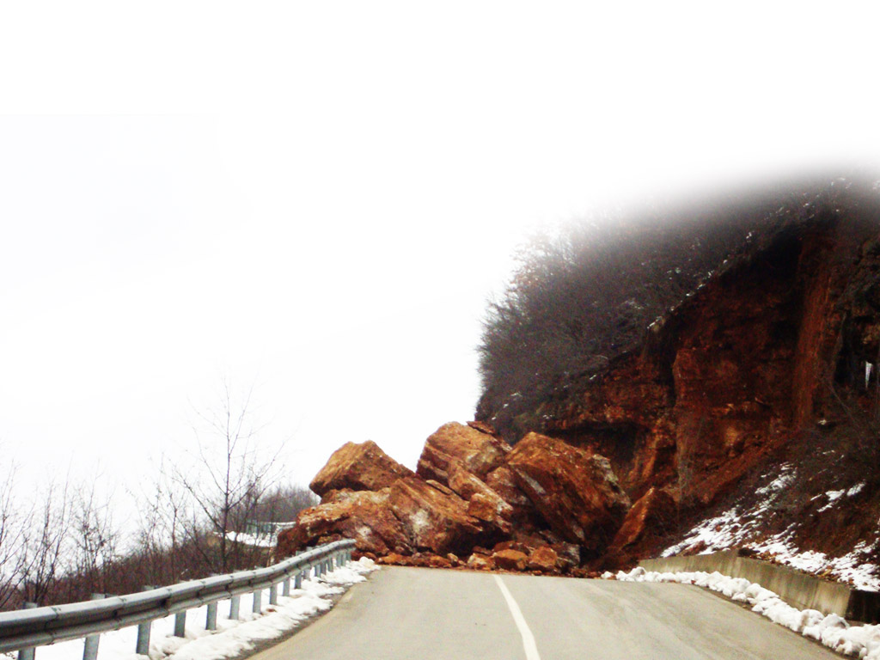
3. What do we do with the road blocks on our Lordship journey?
Problem of re-cycled faith
Distrust of God’s intentions.
Psalms 84:11. Genesis 3:1
Failure to inquire for God’s will

Slide 12
Application: Appraising 8 areas of my life
CHRIST
How much of each area is dedicated to the Lord Jesus?
What was my attitude in offering that area to the Lord?
How many of my choices were based on God’s will or just self-wisdom.

