Slide 1
Virtual LANs (VLANS)
Dr. Mohammad Adly

Slide 2
Virtual LANs VLANs
Segment physical switches into two or more virtual switches
VLANs can span multiple switches
Sometimes vendor-specific
Need some form of routing to tie VLANs together for connectivity
Router
Layer 3 Switch

Slide 3
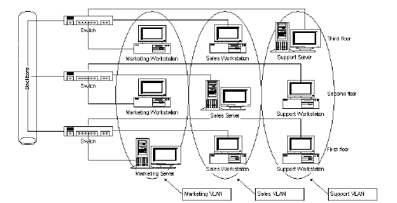
VLANS

Slide 4
Thank you

