Slide 1
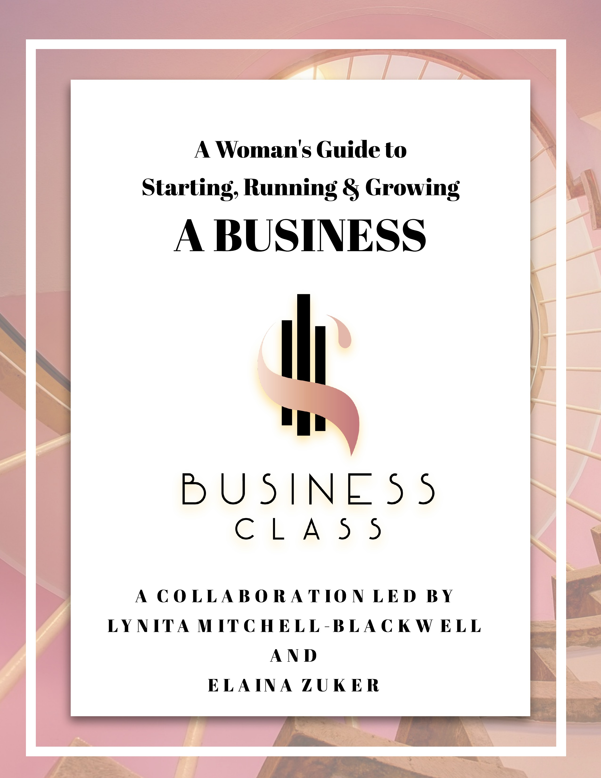
Strategic Planning is Really NOT Boring… It’s Essential!
Molly Sutherland
Sutherland & Associates
www.sutherlandww.com
February 12, 2019

Slide 2
Where do I/WE INTEND to be?
Where are we/I NOW?
Unique Value Proposition
(UVP)
What is MY/OUR WHY?
HOW do I/WE INTEND to GET THERE
WHO are MY/OUR KEY STAKEHOLDERS?
AND What do they EXPECT?

Slide 3
?
ROAD MAP

Slide 4
Business Cycle
Maturity
Decline
Growth
CHAOS
Startup
SOP
Leadership &
TRUST & RESPECT
Notes:
4
The “Rise & Fall of the Roman Empire” – it happens everywhere, in civilizations, products, organizations, communities, ourselves… almost anything you think of goes through a similar cycle.
What many people miss is the “jump – or leap” to the next cycle. This is the hardest part of the cycle. Working from a position of denial and/or lack of courage, leadership, the understanding of the power of influence, the decline occurs and continues to fall, until nothing is left, or you are operating in an extreme turn-around position.
Chaos is an opportunity – it is difficult, there are no clear crystal balls - organizations make it through this phase with confidence and trust in leadership.
Leadership and influence is critical to the success of any organization. As part of my responsibilities on long the way, I evaluated new business plans, saw many “pitches” and had to make recommendations to people regarding personally investing in the concept – organization. The #1 are of importance was not the concept, but the leadership team… why?
Anyone can have an idea – only leaders can make it happen – execute in a timely & profitable manner.

Slide 5
RESEARCH

Slide 6
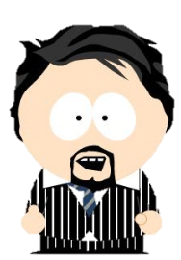
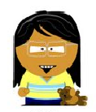
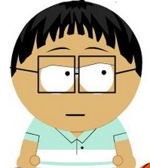
4 Quadrants of Business
C
C
C
MUDA

Slide 7
WASTE
MUDA
I WORMPIT
Intellect
Quality Questions
Worry
Communications & Accountability
Over Production
Active Listening
Re-Work
Doing it Right the 1st Time
Motion
Housekeeping
Processes
KIS
Right Inventory
Inventory
Time
Mutual Respect

Slide 8
BUDGET
INVESTMENT(S)
BREAKEVEN
ROI

Slide 9
4 Quadrants of Business
C
C
C
MUDA

Slide 10
Business Cycle
Maturity
Decline
Growth
CHAOS
Startup
CHANGE MANAGEMENT
SOP
Notes:
10
The “Rise & Fall of the Roman Empire” – it happens everywhere, in civilizations, products, organizations, communities, ourselves… almost anything you think of goes through a similar cycle.
What many people miss is the “jump – or leap” to the next cycle. This is the hardest part of the cycle. Working from a position of denial and/or lack of courage, leadership, the understanding of the power of influence, the decline occurs and continues to fall, until nothing is left, or you are operating in an extreme turn-around position.
Chaos is an opportunity – it is difficult, there are no clear crystal balls - organizations make it through this phase with confidence and trust in leadership.
Leadership and influence is critical to the success of any organization. As part of my responsibilities on long the way, I evaluated new business plans, saw many “pitches” and had to make recommendations to people regarding personally investing in the concept – organization. The #1 are of importance was not the concept, but the leadership team… why?
Anyone can have an idea – only leaders can make it happen – execute in a timely & profitable manner.

Slide 11
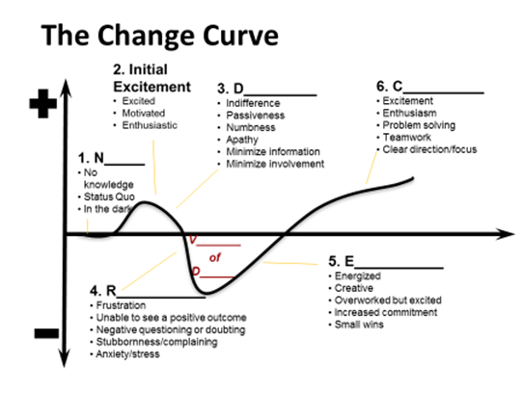

Slide 12
PURPOSE

Slide 13
&
Key Audiences or Stakeholders
Expectations

Slide 14
SWOT
STRENGTHS
WEAKNESSES
OPPORTUNITIES
THREATS

Slide 15
P
Political
E
Economic
S
Social
PEST
T
Technical
© 2019 Sutherland & Associates. All rights reserved

Slide 16
The DIKW Model
Wisdom
Information
Data
Knowledge
principles
patterns
relationships
algorithmic
Adapted from Awad & Ghazmi and Bellinger, Castro & Mills

Slide 17
P
Political
E
Economic
S
Social
PEST
(ER)
T
Technical
E
Environmental
R
Regulatory
© 2019 Sutherland & Associates. All rights reserved

Slide 18
HOW MANY?
WHAT KIND?
SMART

Slide 19
SMART Goals What are they?
Specific
Measurable
Attainable
Realistic
Timely

Slide 20
KPI
Key Performance Indicators
3
6

Slide 21
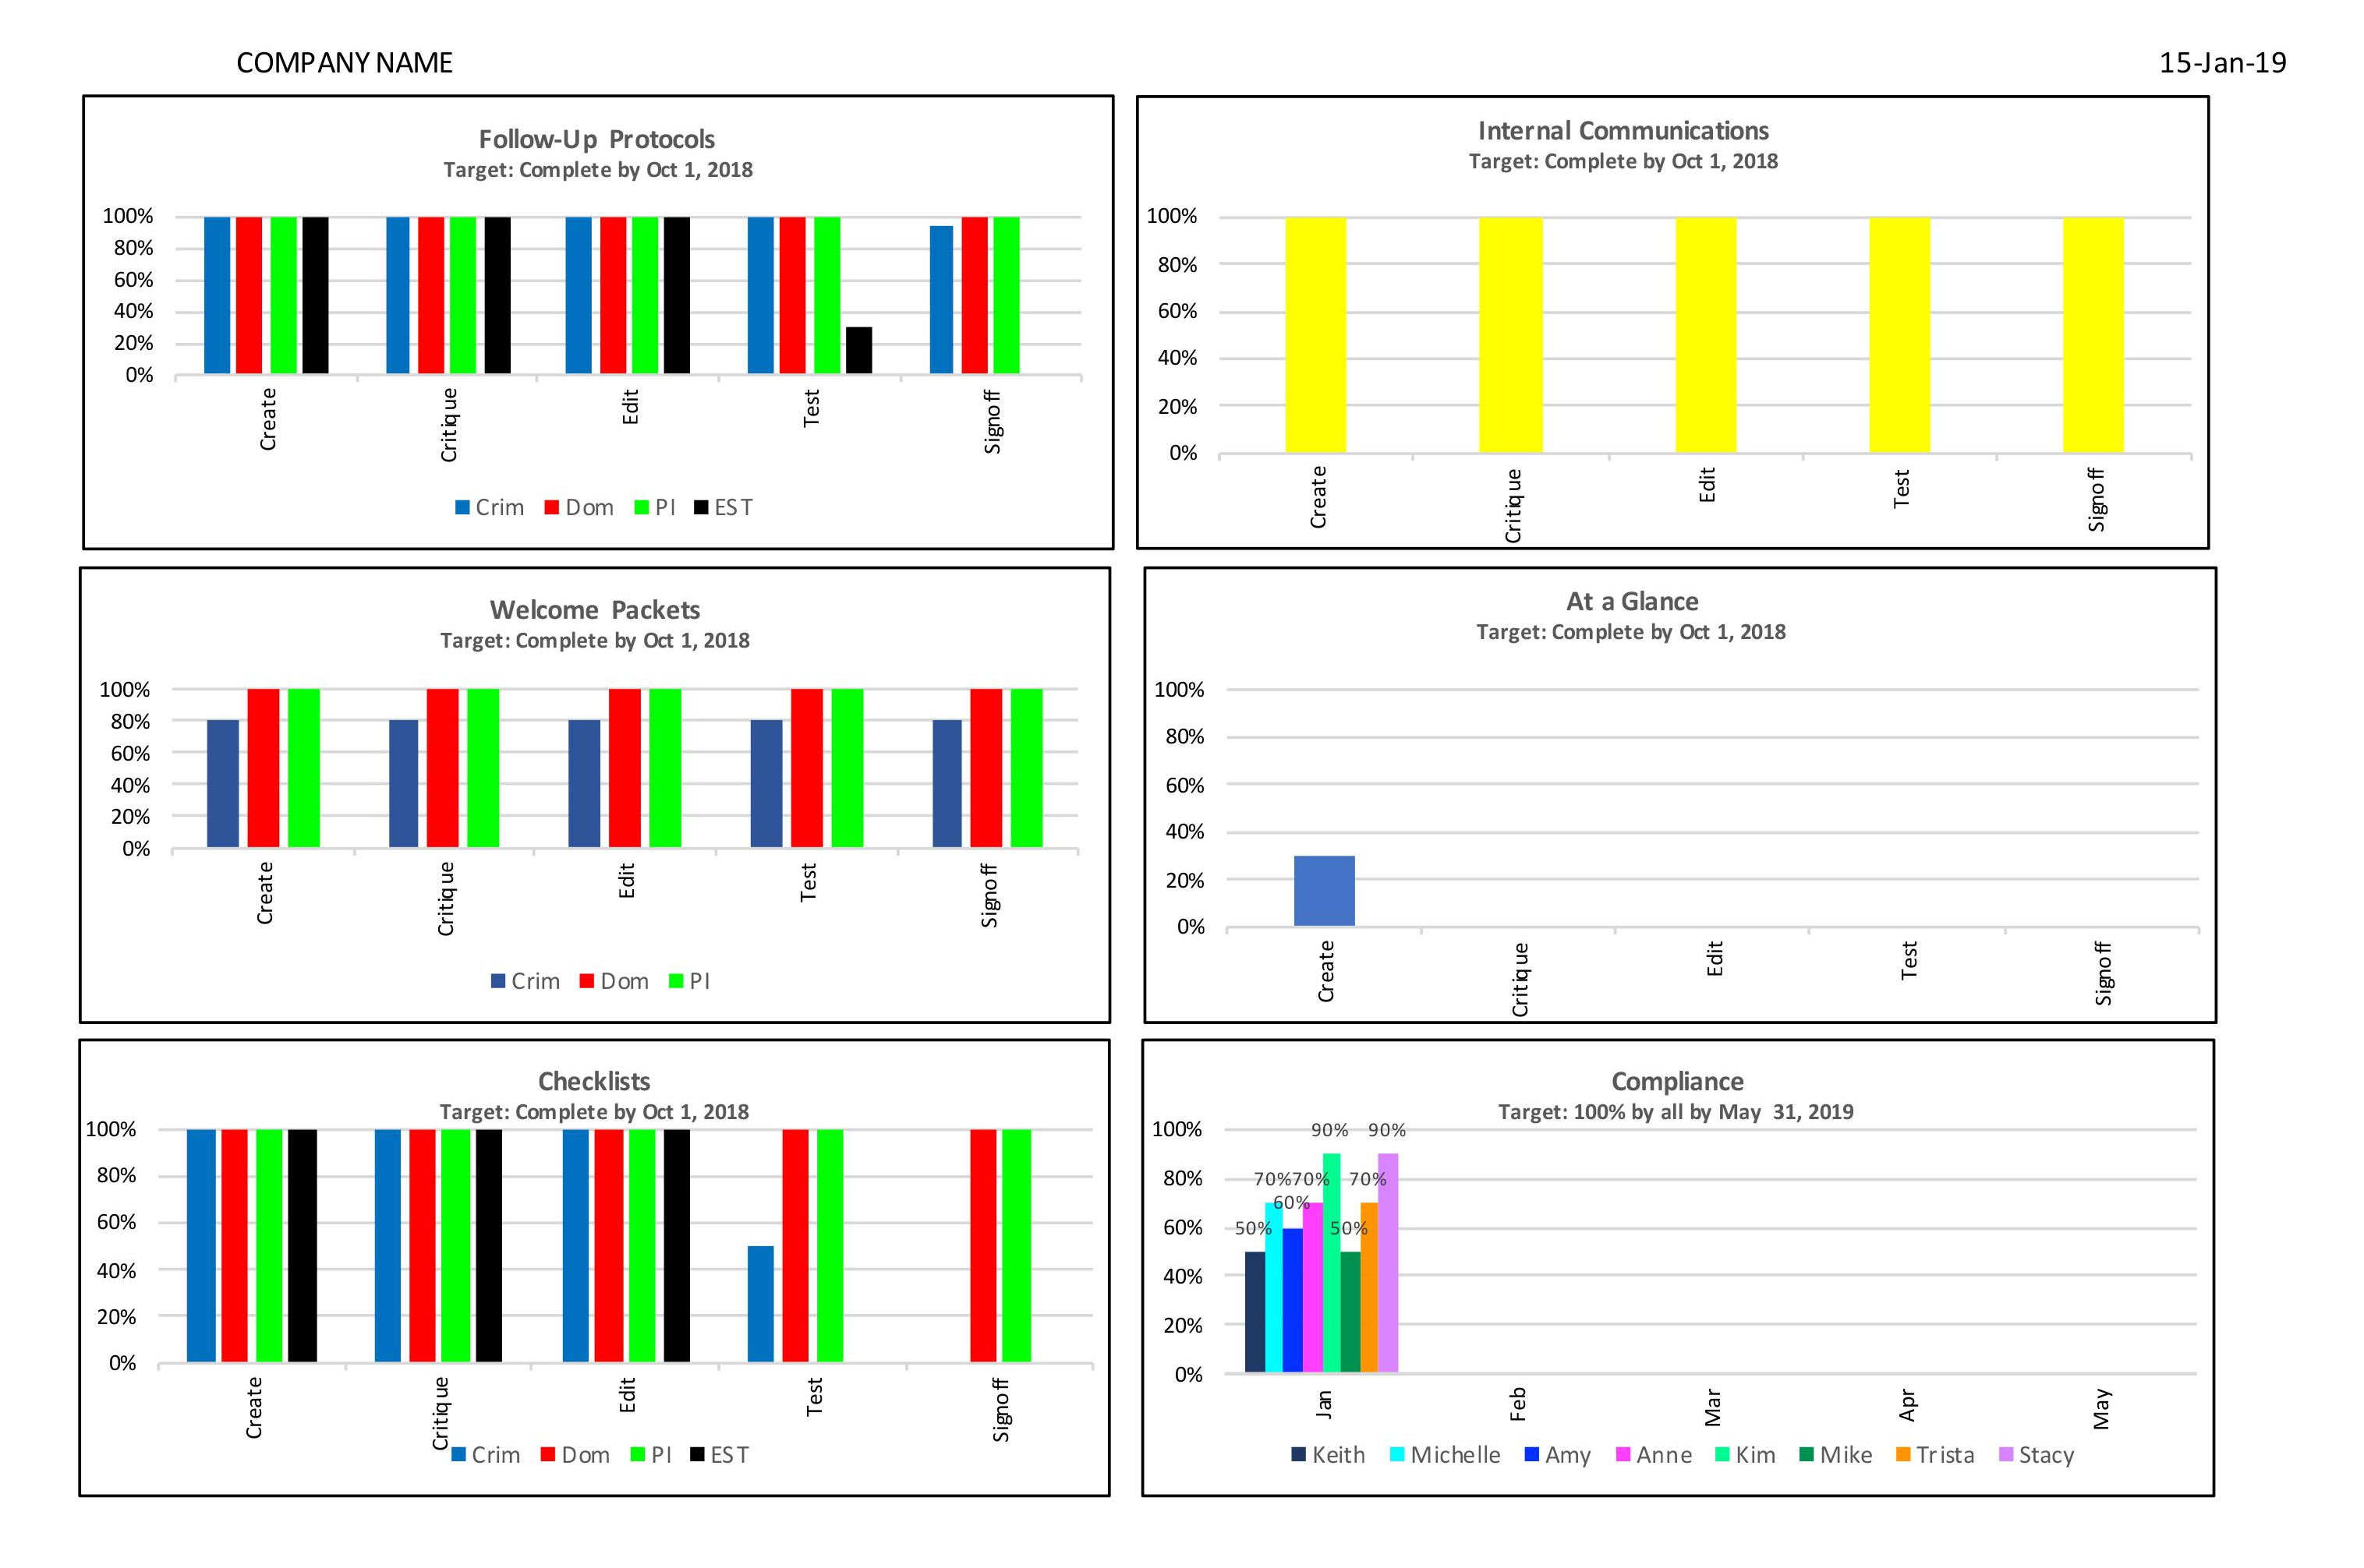
© 2019 Sutherland & Associates. All rights reserved

Slide 22
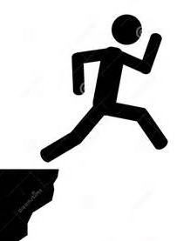
&
Balanced Approach

Slide 23
STRATEGY vs TACTICS
HIGH
LEVEL

Slide 24
ROLE OF BOARD OF DIRECTORS
CREATE/IDENTIFY STRATEGIC DIRECTION OF THE ORGANIZATION
HIRE – FIRE – COACH
PRESIDENT OR EXEC DIRECTOR
PROVIDE FISCAL & ETHICAL OVERSIGHT
FUNDRAISING

Slide 26
DRIVE

Slide 29
BE OPEN
KNOW WHERE YOU ARE GOING
BE INTENTIONAL
PEOPLE ARE PEOPLE

Slide 30
Discussion?
Dialogue?
Comments?
Questions?

Slide 31
Molly Sutherland
Lexington, KY
859-509-2249
molly@sutherlandww.com
Notes:
31

