Slide 1
Security Goals And Concepts
Dr. Mohammad Adly

Slide 2
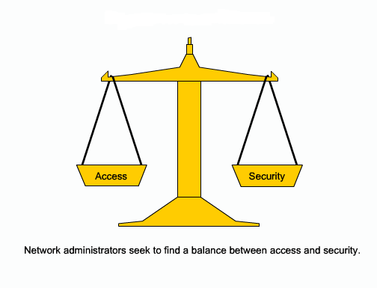
Balancing Access and Security

Slide 3
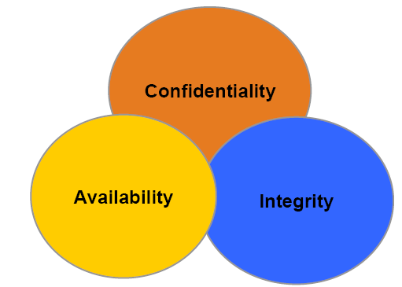
Security Goals

Slide 4
Security Goals: CIA
Confidentiality
Ensuring that information is not revealed to unauthorized persons
Data transmitted or stored should only be revealed to an intended audience
Integrity
Ensuring consistency of data
Possible to detect any modification of data
Availability
Ensuring that legitimate users are not denied access to information and resources

Slide 5
Assets
Everything that have value for an organization or impact its business continuity
This includes people, data, hardware, software, physical devices, and documents
Bank: Clients accounts
Hospital: Medical records
Software: Patents and Source Codes
University: Teaching materials and Grades
Assets should be identified to create information security system
An asset is what we are trying to protect
Security specialist must be fully aware of the assets he/she is protecting

Slide 6
Threat
A person, thing, event or idea which poses danger to an asset
A breach to the following:
Confidentiality
Integrity
Availability
Legitimate use
A possible means of breaching a security policy
Exploiting a vulnerability, intentionally or accidentally
Obtain, damage, or destroy an asset
A threat is what we are trying to protect against

Slide 7
Vulnerability AND Exploit
Vulnerability
Weakness or absence of safeguards
Holes or gaps in a security program
Can be exploited by threats to gain unauthorized access to an asset
A vulnerability is a backdoor in our protection efforts
Exploit
An exploit is a program, script, or code
Aims to perform unauthorized operations
An example is a backdoor Trojan used to grant unauthorized access to a machine
The way or tool by which an attacker uses a vulnerability to damage the target system

Slide 8
RISK
A measure of the cost of realized vulnerability
The potential for loss, damage, or destruction of an asset
Result of a threat exploiting a vulnerability
Risk exists when our systems have a vulnerability that a given threat can attack
Security deals with managing risk to your critical assets
Security is basically an exercise in loss reduction
Impossible to eliminate risk totally
Risk is the probability of a threat crossing or touching a vulnerability

Slide 9
Impact
The result of an exploited vulnerability
Deleted files
Loss of information
Loss of company image
Loss of privacy

Slide 10
RISK Assessment
Vulnerability
Password is vulnerable for dictionary or exhaustive key attacks
Threat
Intruder can exploit the password weakness to break into the system
Risk
Resources within the system are prone for illegal access/modify/damage by the intruder.
Risk = Threat x Vulnerability x Impact

Slide 11
Thank you

